Slide 1
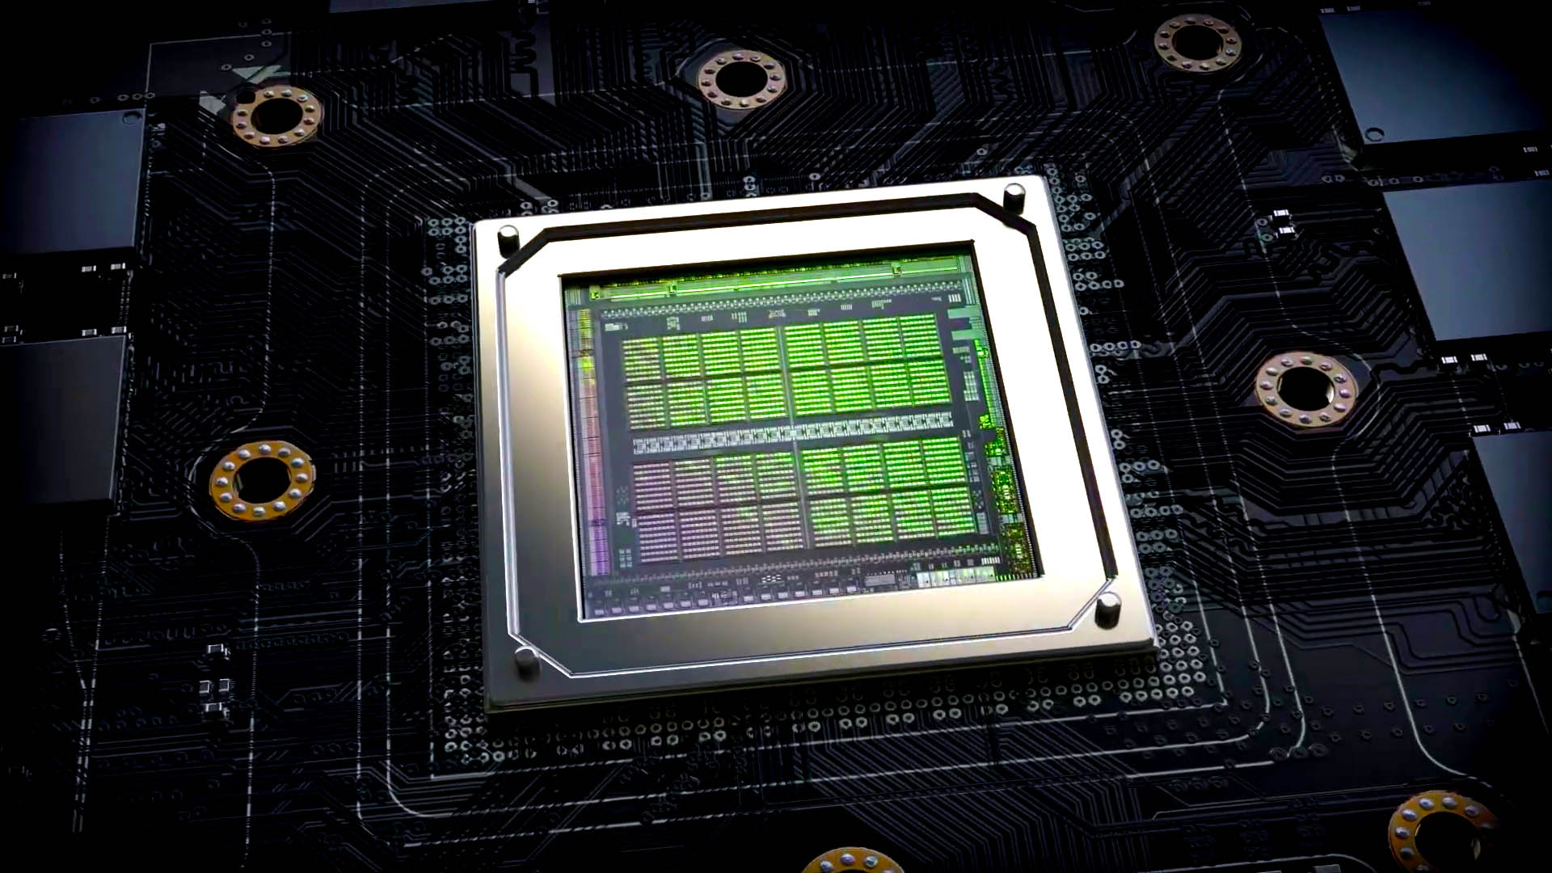
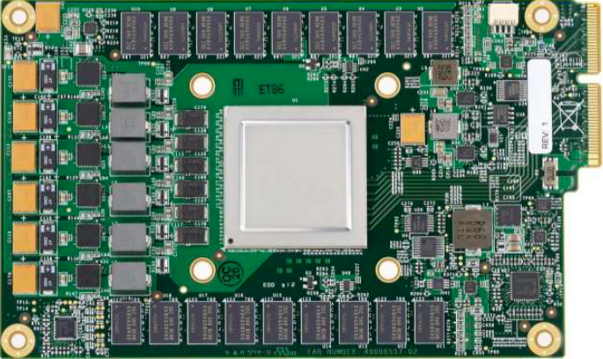
Lecture 11: DSP Review (Factoring Computations)
Topics:
Nvidia Ampere: Architecture Overview
Google Coral TPU Overview
Graphic Processing Units
SIMD Processors and GPUs
Fused Multiply Add Operations

