Slide 1
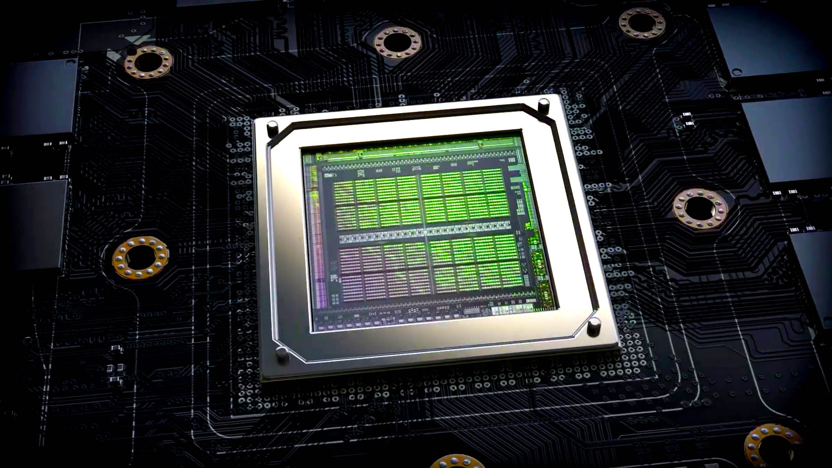
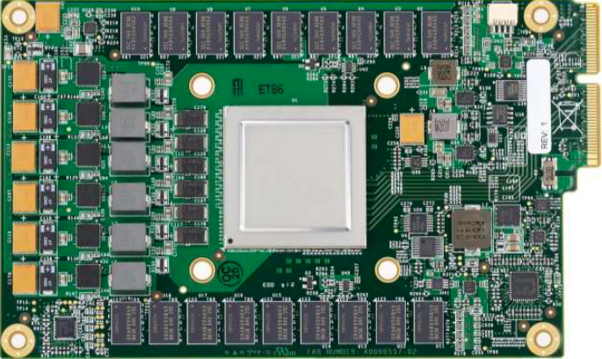
Lecture 10: Lab No. 2 – Pointer-Version of Matrix Multiplication
Topics:
Nvidia Ampere: Architecture Overview
Google Coral TPU Overview
Graphic Processing Units
SIMD Processors and GPUs
Fused Multiply Add Operations

