Slide 1




Are Mobile DNN Accelerators Accelerating DNNs?
Qingqing Cao*, Alexandru E. Irimiea‡, Mohamed Abdelfattah⋄,
Aruna Balasubramanian*, Nicholas D. Lane†⋄
‡
†
⋄
*
5th International Workshop on Embedded and Mobile Deep Learning (EMDL 2021)

Slide 2

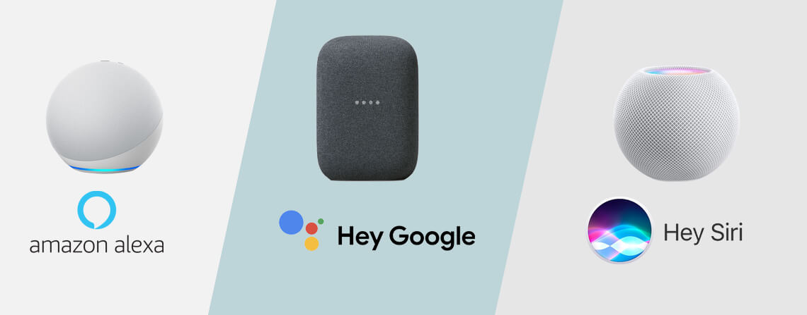


Deep Learning Applications Exploding on Mobile
Notes:
Are becoming more popular today
For example, mobile users… machine translation..
Alex, siri to help daily tasks
More deep learning application include face recognition and landmark detection

Slide 3

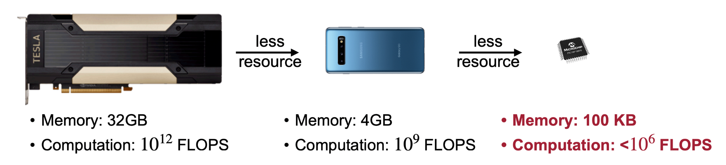
Challenges in Running DNNs on Mobile Processors
Mobile processors often run on battery-powered devices
Mobile processors often have limited processing power
Credit: OFA, ICLR 2020
Notes:
However, challenges still exist when running dnns on mobile devices
For example, deep learning workloads often consume significant energy but mobile processors ...
Moreover,
Running DNNs requires large amounts of computation resources, but mobile processors often have limited processing power.
For instance, desktop GPUs often has 3 orders of magnitude processing power than a mobile phone. Embedded devices like a microcontroller have even less computational power.

Slide 4
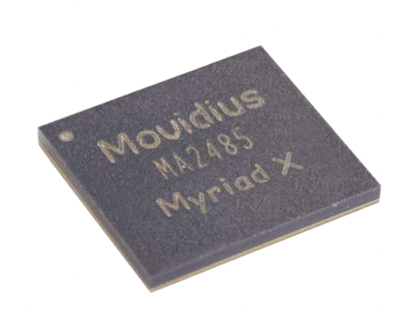
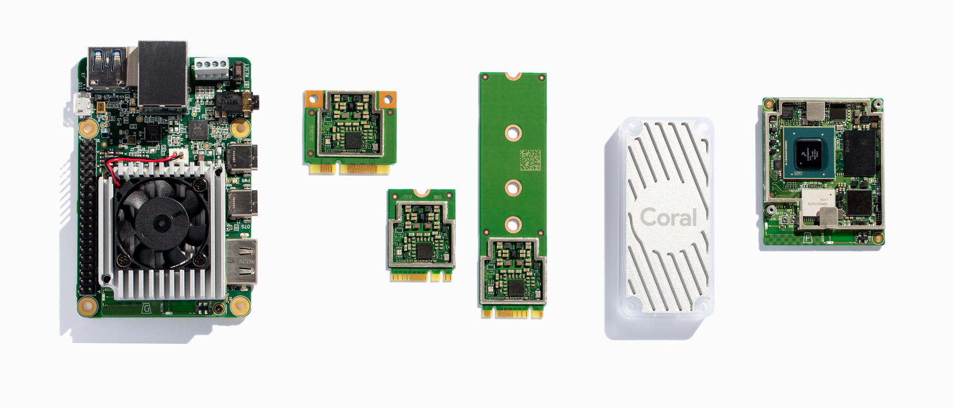
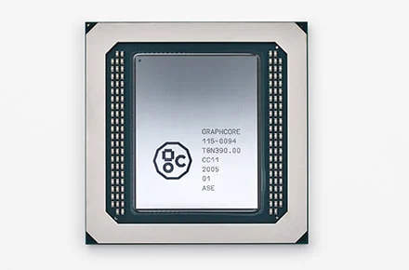
Are Mobile DNN Accelerators the Solutions?
Vision processing unit (VPU)
Tensor processing unit
(EdgeTPU)
Intelligence processing unit
(IPU)
Many customized DNN accelerators, xPUs: designed for better energy efficiency and greater DNN processing power
Notes:
To make DNNs run more efficiently on mobile platforms, many customized commercial DNN accelerators called xPU like VPU, TPU or IPU, have been developed.
These accelerators often claim to have better energy efficiency than conventional processor like mobile CPUs or GPUs.
In this work, we want to ask are mobile DNN accelerators the solutions to solve the energy and computation power challenges?
Before we talk about the answer, let me introduce a bit of the background of mobile processors in the context of DNN computation.

Slide 5
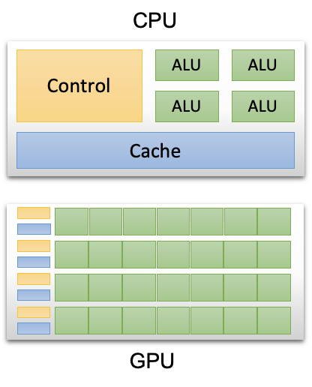
Background: Architecture of Mobile CPUs
CPU
Single instruction multiple data (SIMD) capabilities to parallelize compute intensive operations
Designed for more general tasks, complex control logic and lower compute density
Notes:
First, Mobile CPUs such as ARM processors as shown in the figure have many ALUs that perform math operations which are prevalent in DNNs.
These ALUs have single instruction multiple data (SIMD) capabilities to parallelize compute intensive operations.
However, CPUs are often designed for more general tasks and have complex control logic and lower compute density, which are mainly optimized for serial, control-heavy operations.
In contrast, DNN workloads are very computationally-intensive, but have relatively simple, coarse-grained control flow.

Slide 6
Background: Architecture of Mobile GPUs
GPU
Stronger SIMD capabilities (many GPU shader cores/more ALUs), high compute density
Mobile GPUs often share memory with CPUs, memory accesses are energy-consuming
Notes:
GPUs are designed to accelerate graphics applications thus havingstronger SIMD capabilities built for massively parallel workloads.
Deep learning execution frameworks using GPUs typically utilize many GPU shader cores (usually range from tens to hundreds) to parallelize the mathematical computations. The figure shows the high-level GPU SIMD architectures, GPUs are built to have high compute density and high computations per memory access, which are optimized for parallel operations.
But mobile GPUs often share memory with CPUs, whereas memory accesses are energy-consuming.

Slide 7
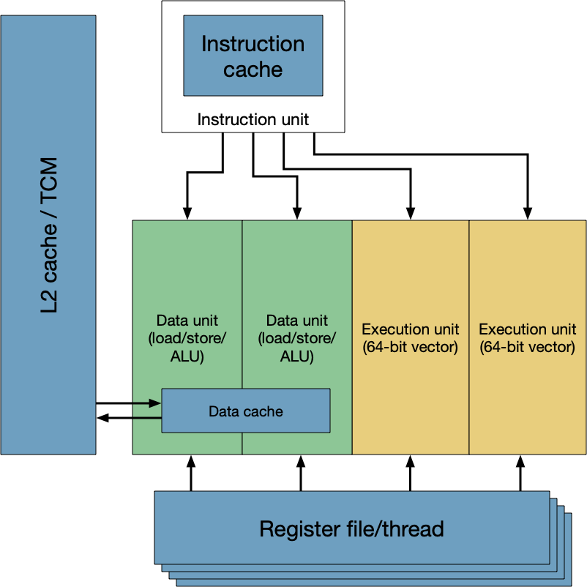
Background: Architecture of DSPs
DSP
Enhance SIMD by introducing vector execution unit in addition to ALUs
Integer based operations, hardware-assisted multithreading, more energy efficient
Notes:
Another type of mobile processor is DSP. Mobile DSPs (e.g. Hexagon DSP) use SIMD extentions, which enhance the original SIMD by introducing vector execution unit in addition to ALUs as mentioned in the CPU architecture.
Another feature of DSPs is that they usually support 8bit integer based operations instead of 32bit floating point operations to further reduce compute clock cycles and energy footprints.

Slide 8
Background: Differences between CPU, GPU and DSP
CPU: general purpose, SIMD instructions for parallel processing
GPU: originally designed for graphics processing, massive parallelism (more SIMD processing units), power hungry
DSP: originally for photo/video/audio processing, integer-only vector operations, energy efficient

Slide 9
Goal of Mobile DNN Accelerator Empirical Study
Understanding the DNN performance on mobile accelerators in comparison to conventional processors like CPU, GPU, and DSP architectures

Slide 10
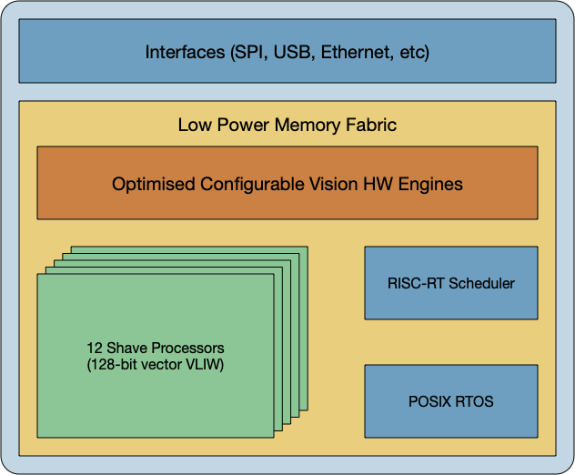
Mobile DNN Accelerators: The architecture of NCS VPU
VPU of Neural Compute Stick (NCS)
128-bit vector processing cores (SHAVE processors), SIMD support controlled via VLIW instructions
NCS1: 12 SHAVE cores, 2MB on-chip memory (SRAM)
NCS2: 16 SHAVE cores, 2.5 MB SRAM, additional neural compute engine dedicated for DNN workloads with higher efficiency
Notes:
In this work, we focus on one class of commodity mobile DNN accelerators called Intel Neural Compute Stick or NCS.
Intel Movidius Neural Compute Stick (NCS) is one of the first commercially available accelerators for mobile, wearable, and embedded systems. It is powered by a low-power, high-performance Vision Processing Unit (VPU) designed to handle DNN applications. The architecture difference between VPU and mobile CPU/GPU/DSP is that it contains twelve 128-bit vector processing cores called SHAVE which compute most of the neural network load.
NCS1 ...
NCS version 2 has a more powerful VPU and increases the number of SHAVE cores from 12 to 16. Additionally, it includes a new "neural compute engine" dedicated for DNN workloads. Both of the two NCS devices aim to accelerate DNN computations with higher efficiency.

Slide 11
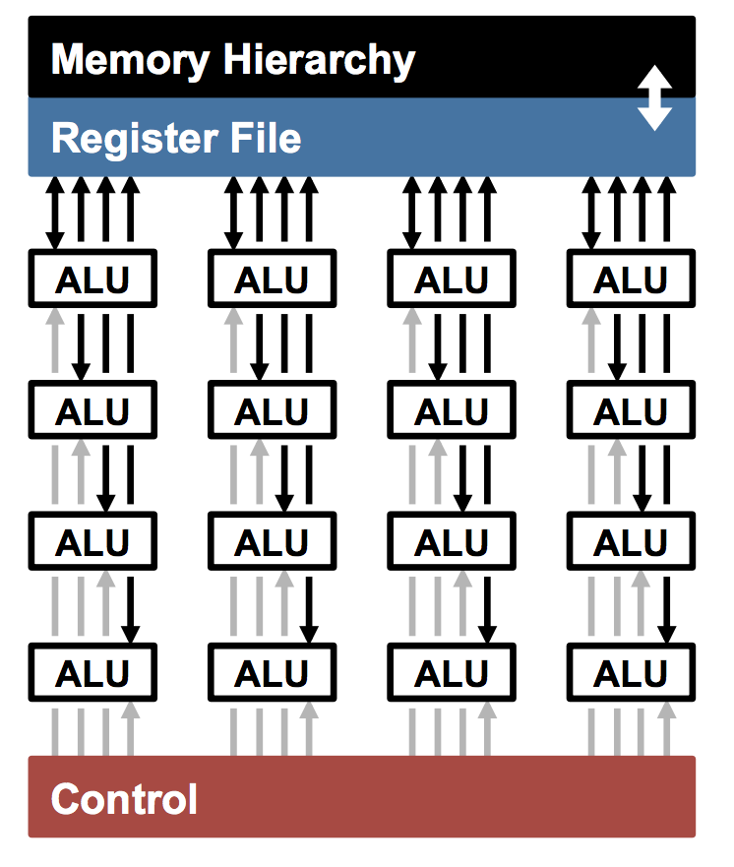
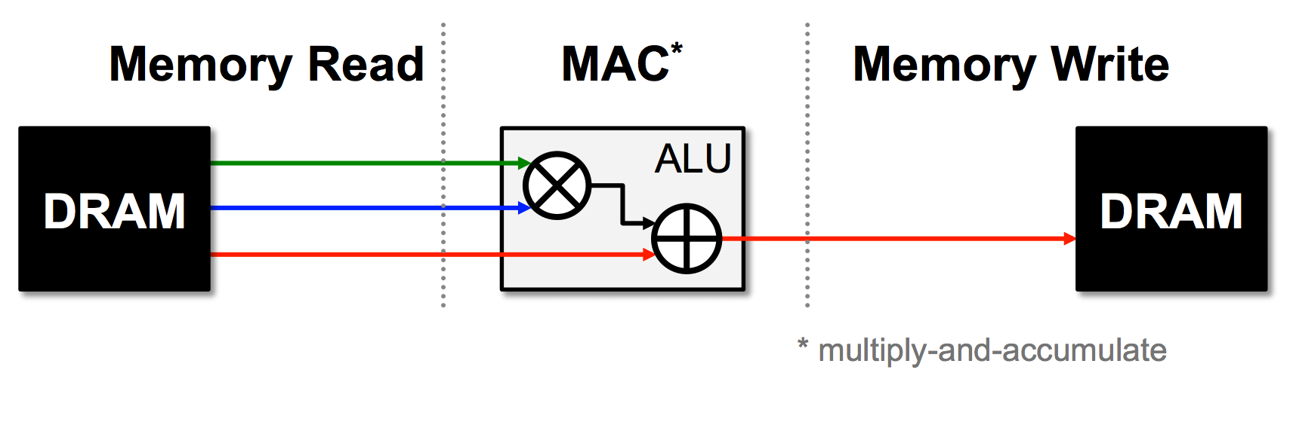
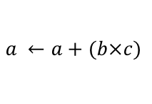
Why NCS Matters? Relationships to DNN Accelerators
CPUs and GPUs
(SIMD/SIMT)
Memory access is the bottleneck for CPUs and GPUs
Example: AlexNet has 724M MACs , but 2896M DRAM accesses required!
Credit: Eyeriss [ISCA 2016]
Notes:
So why would NCS accelerators matter? Or How these accelerators achieve better energy efficiency for DNN computation?
As you already know, CPUs and GPUs have SIMD technology and essentially the ALUs are performing the computation.
But previous research has shown that for the energy bottleneck is the memory access in CPUs and GPUs.
For example, this right figure shows a simple multiply and accumulation operation, and the ALU has to read DRAM for input data and write results back to DRAM
A DNN like AlexNet has over 700 millions of such data movement operations.

Slide 12
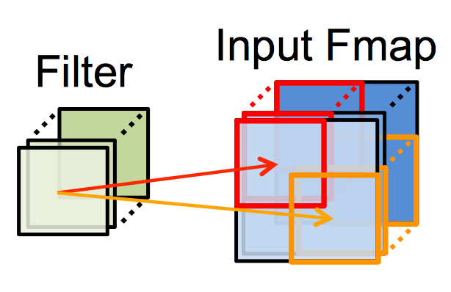
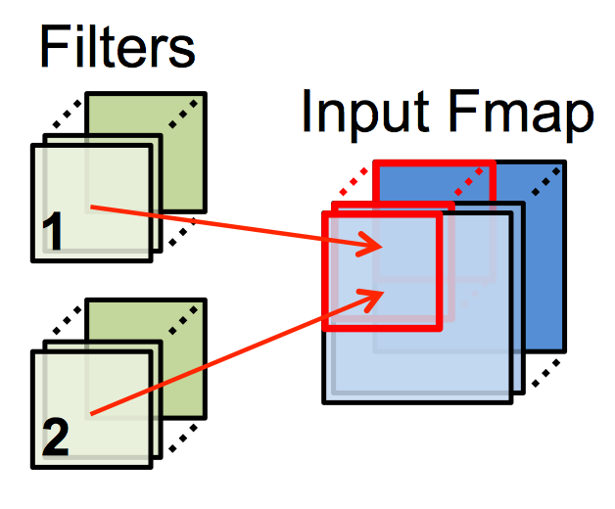
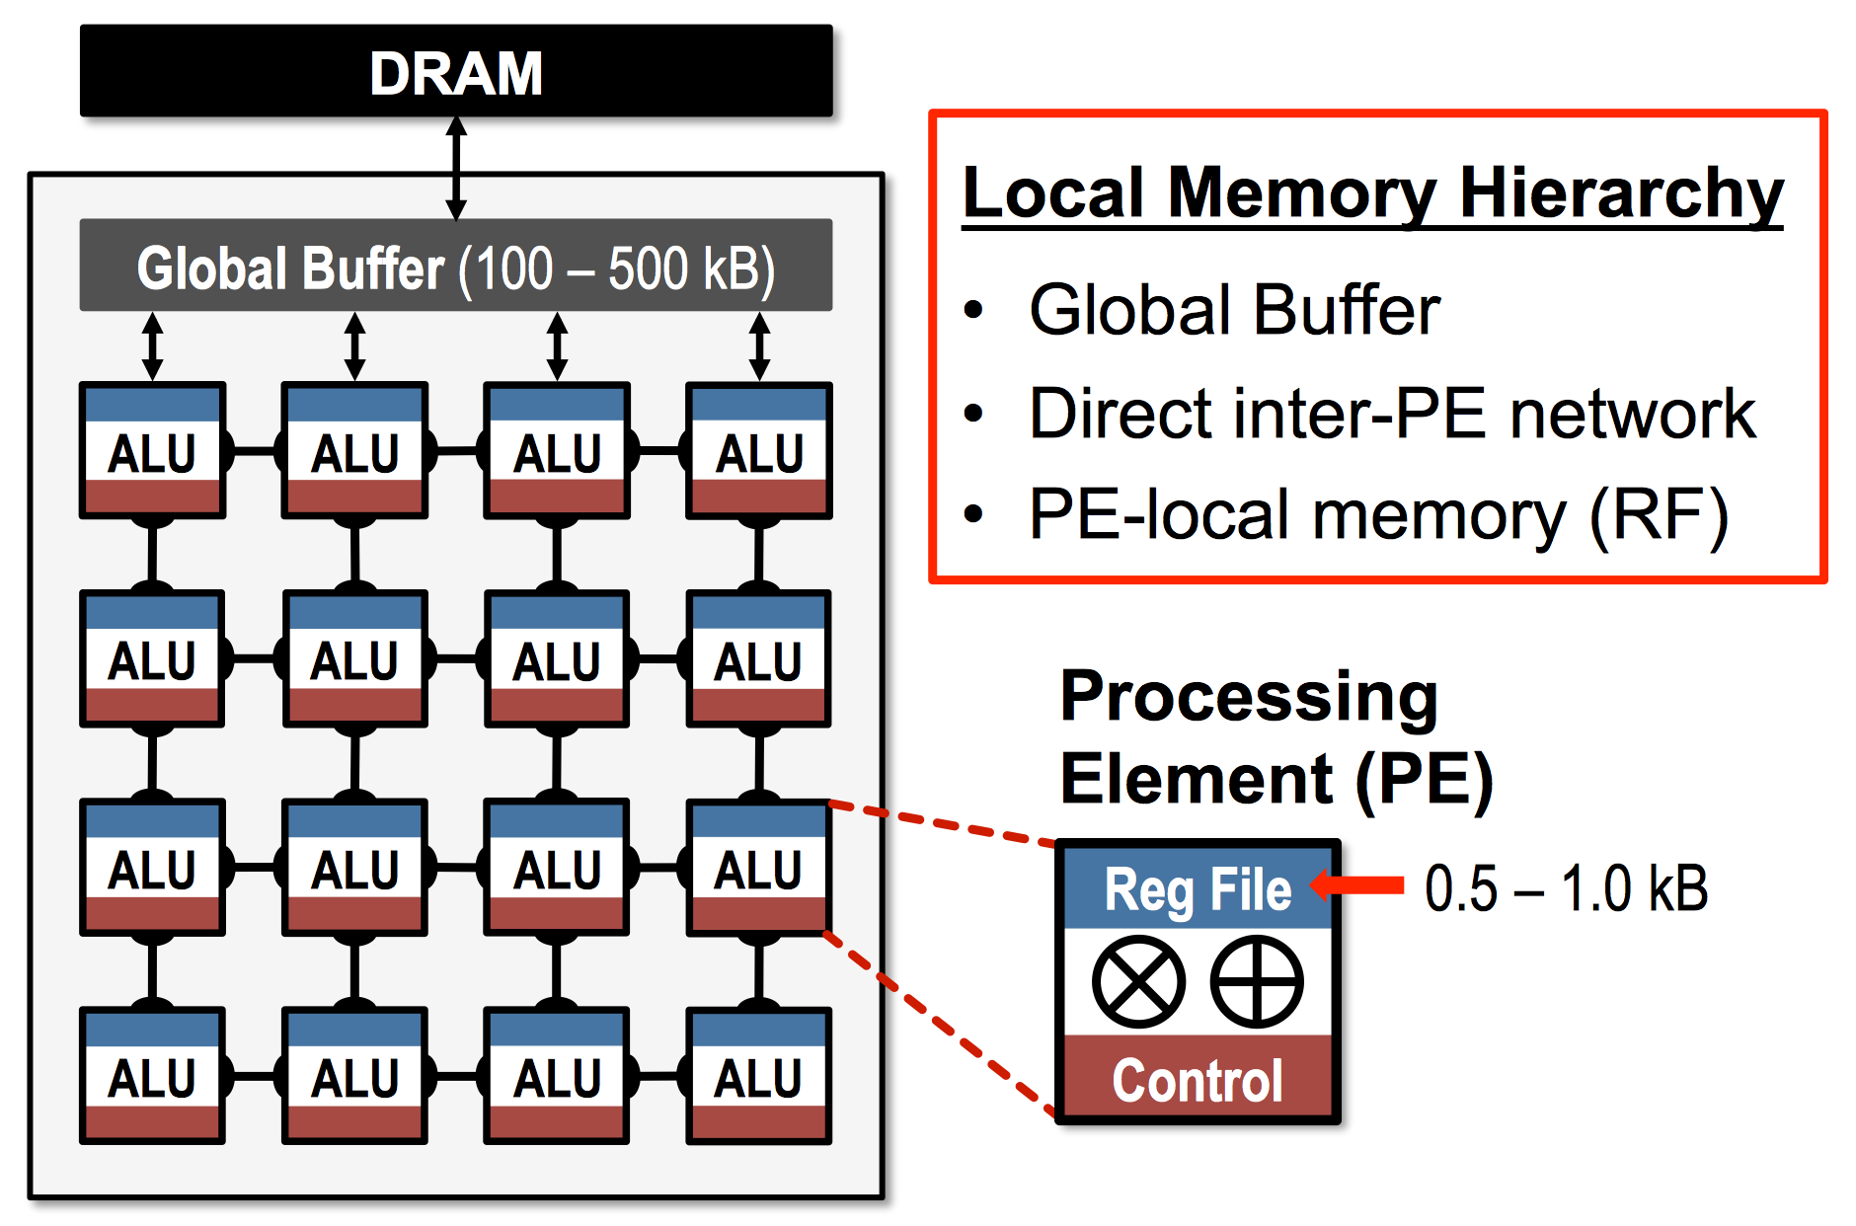
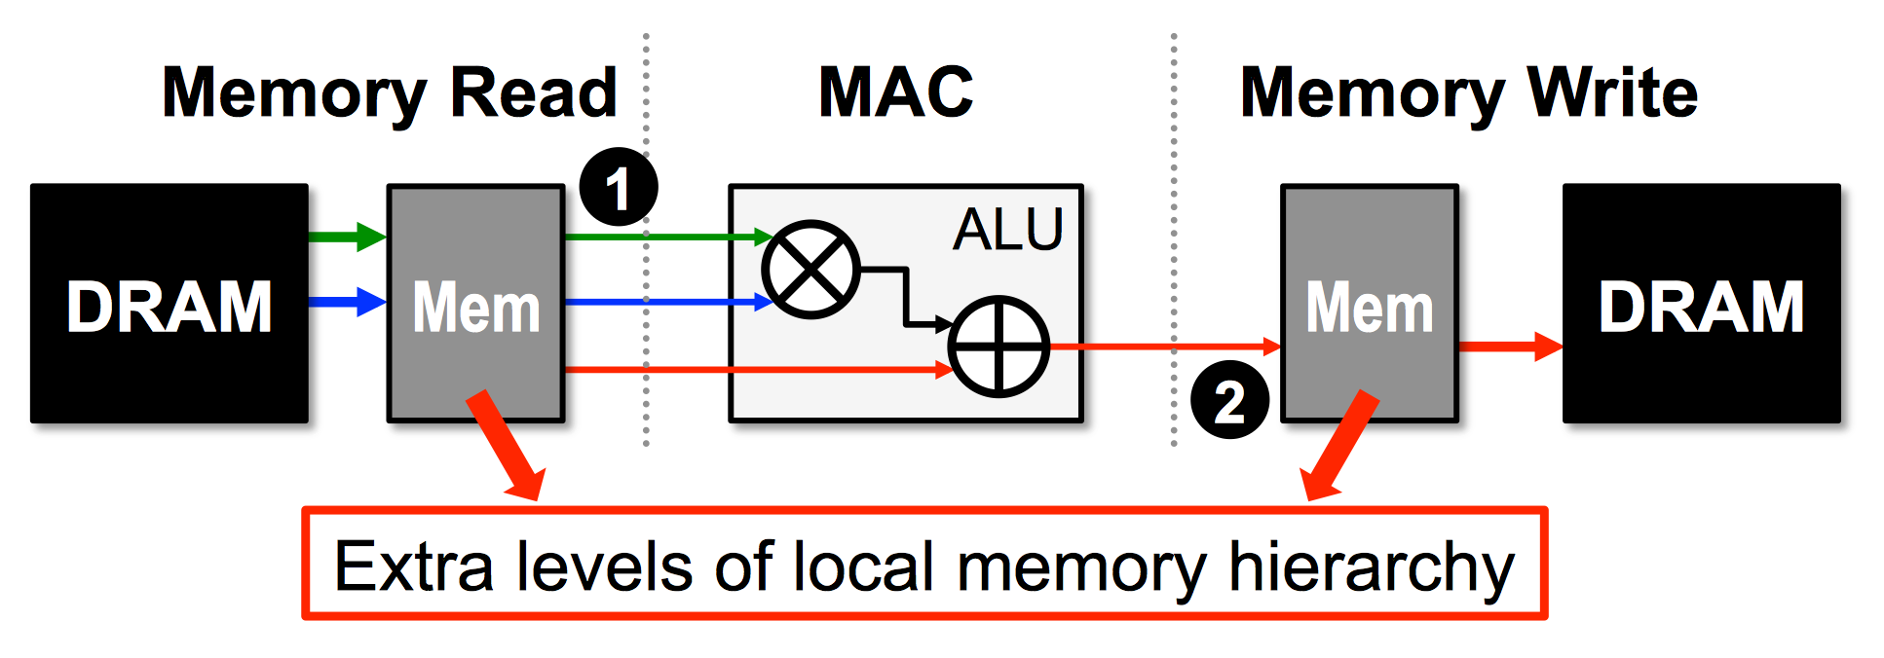


Why NCS Matters? Relationships to DNN Accelerators
Reuse Filter Weights
Reuse Feature Maps
Accelerators
(Dataflow Processing)
Data reuse reduces DRAM reads of filter/fmap by up to 500x
Partial sum accumulation does NOT have to access DRAM
Credit: Eyeriss [ISCA 2016]
Notes:
For DNN accelerators
The key is to reduce data movement in memory. Most accelerators have local memory hierarchy in the ALU compute unit.
This extra local memory can reduce the memory access like loading model weights and writing computation results
For example, these local memory can cache and reuse CNN filters and feature maps, which means there is no need to repeatedly perform memory reads
Due to extra local memory in, saving the intermediate computation results does not have to access energy-intensive DRAMs.
As a result, a sample DNN accelerator looks like this one: for each processing element, the ALU has a local memory hierarchy, that reduce the accesses the external memory, which is faster and more energy efficient.

Slide 13
DNN Accelerators Should Run Faster and Be More Energy-Efficient
Device | Maximum On-Chip GOPs/s | Ext. Memory (kB) | Maximum BW (GB/s) | Power (W)
CPU | 17.6/core | 1536 | 27.8 | 5
GPU | 519 | 1024
DSP | 128 | 512
NCS1 | 1000 | 2048 | 7 | 1
NCS2 | 4000 | 2560 | 11.9 | 1
Notes:
DNN accelerators like NCS devices should run faster since they have stronger computational power,
for example, this table shows that NCS accelerators have 4G op/s
And power around 1W. In comparison, CPU/GPU/DSP power on a qualcomm snapdragon Soc is 5W.

Slide 14
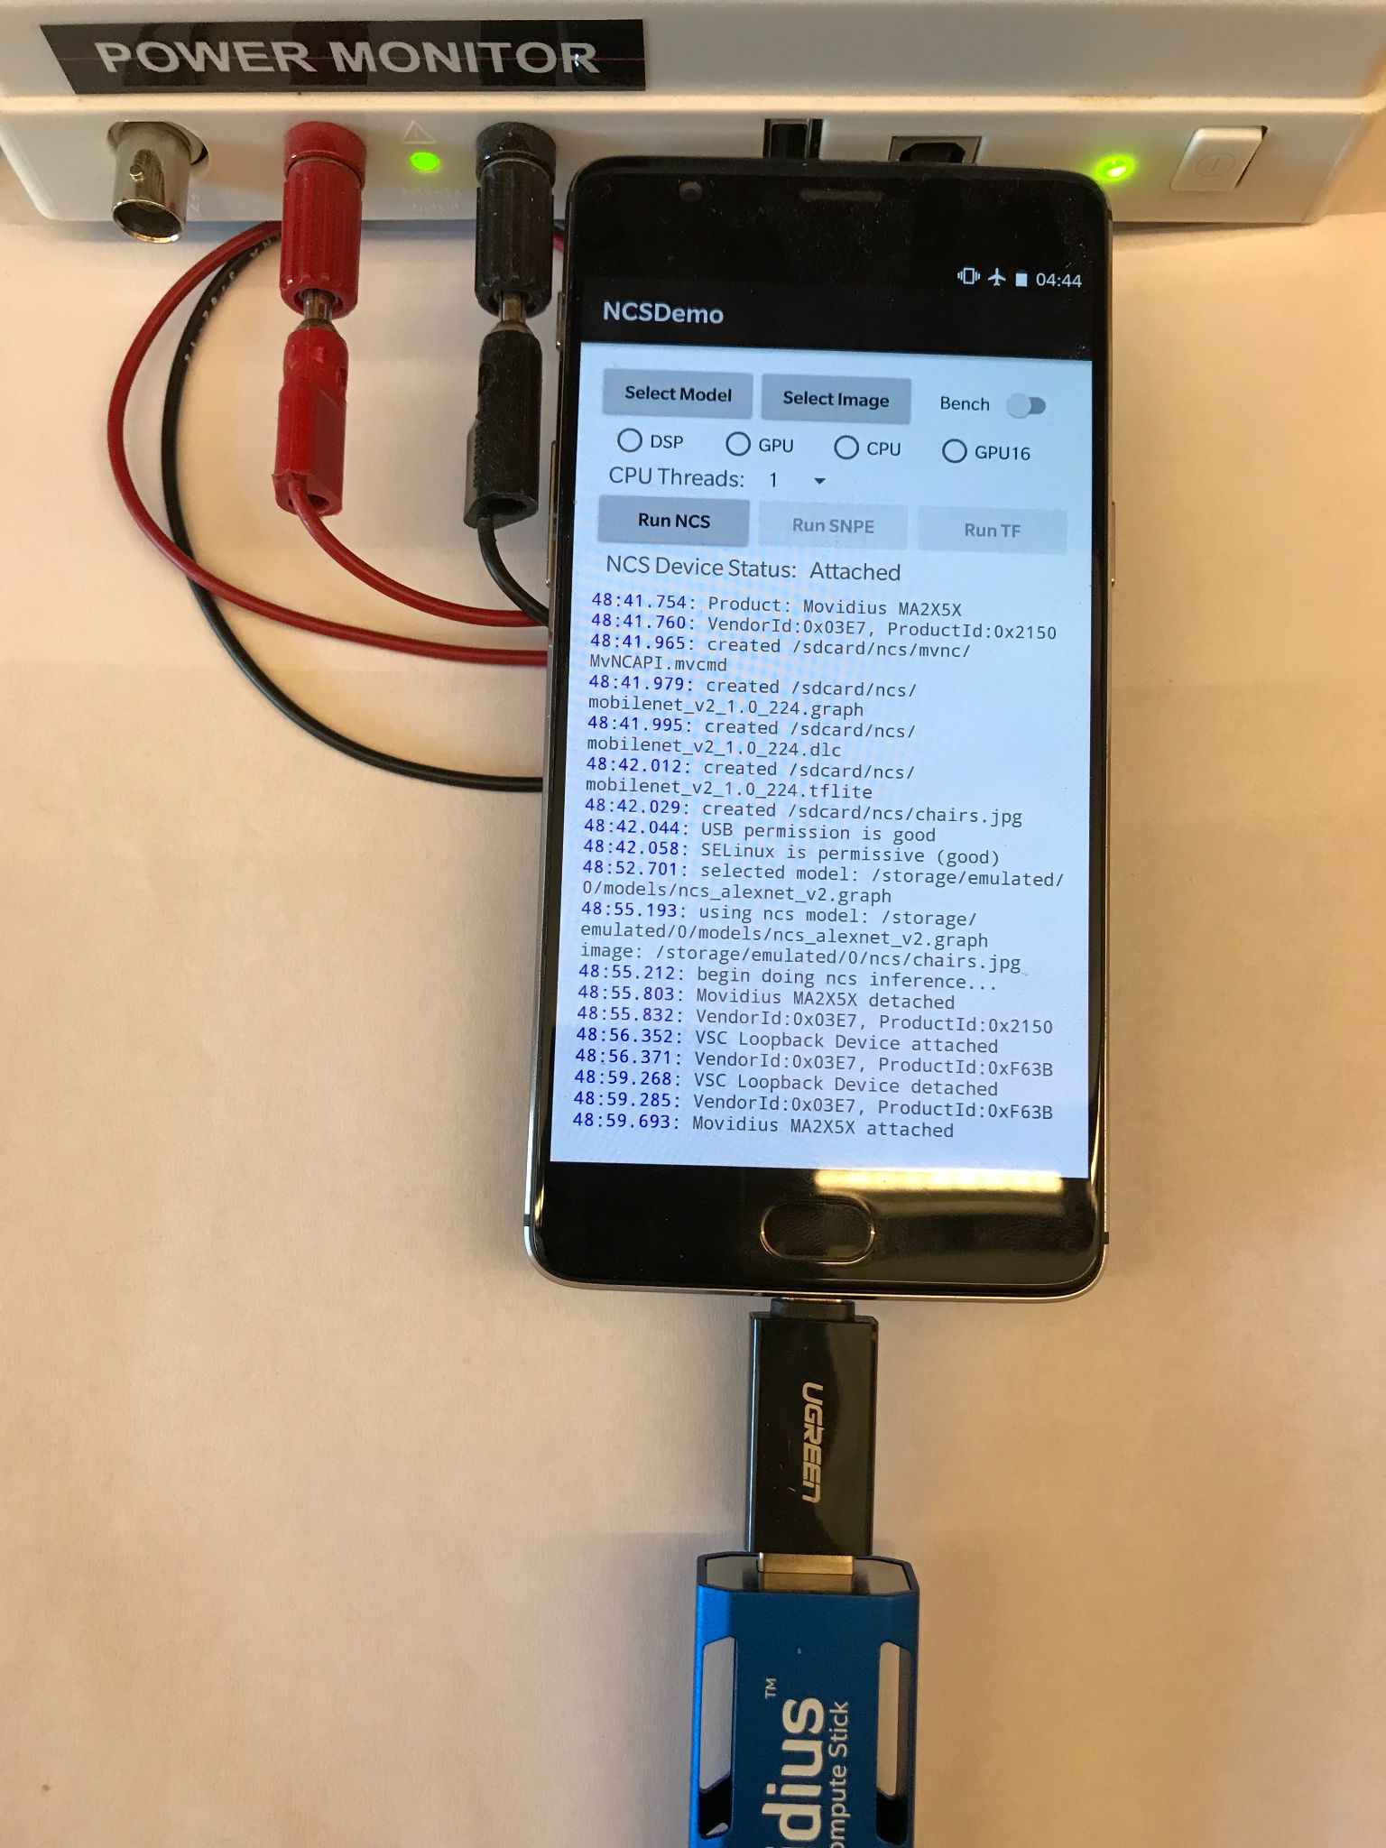
Study Setup
Hardware:
Android Smartphone (OnePlus 3),
NCS1 and NCS2,
Jetson TX2 board (w/ CUDA GPU)
Software:
OpenVINO SDK for NCS
TensorFlow Lite for CPU
Snapdragon Neural Processing Engine(SNPE) for GPU and DSP
Power measurements:
Monsoon power monitor for OnePlus 3
MakerHawk UM34C for NCS on PC
On-board power module for TX2
Notes:
To quantify the performance and power of DNNs, we benchmark
three set of hardware devices

Slide 15
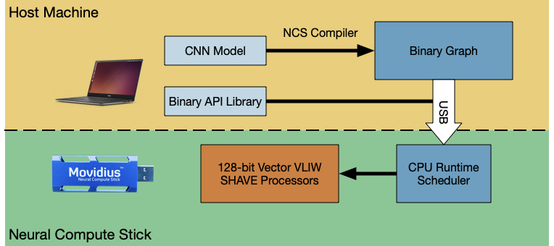
NCS DNN Accelerator Workflow

Slide 16
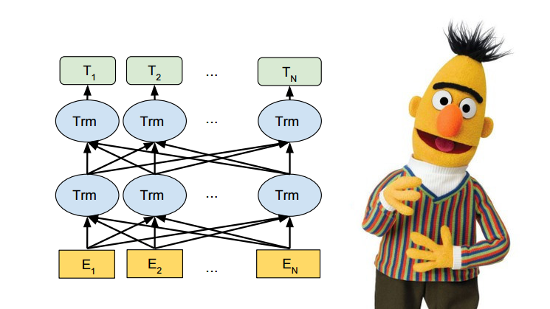
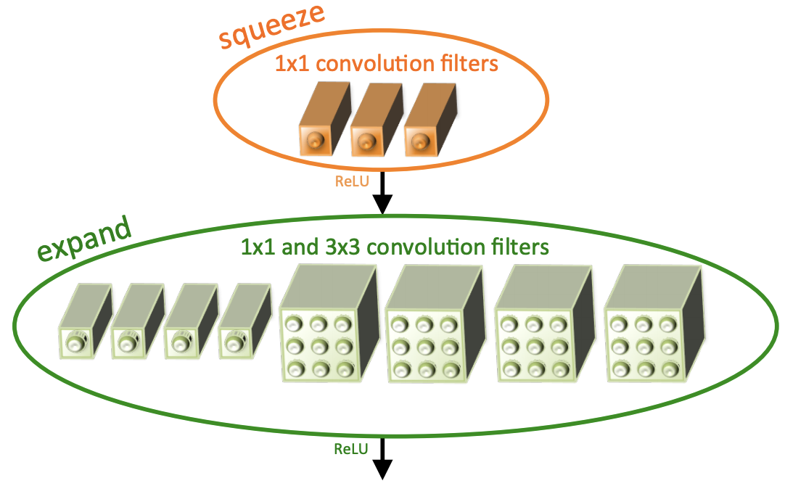

Study Methodology
DNN Workloads
4 Popular CNNs: SqueezeNet, MobileNetV2, ResNet50, InceptionV3
4 NLP Transformer (BERT) models: BERT-tiny, BERT-mini, BERT-small, BERT-medium
Measurement Setup
Measure inference latency and energy and average across 10 runs
Scale the voltage and current measurements to make them comparable

Slide 17
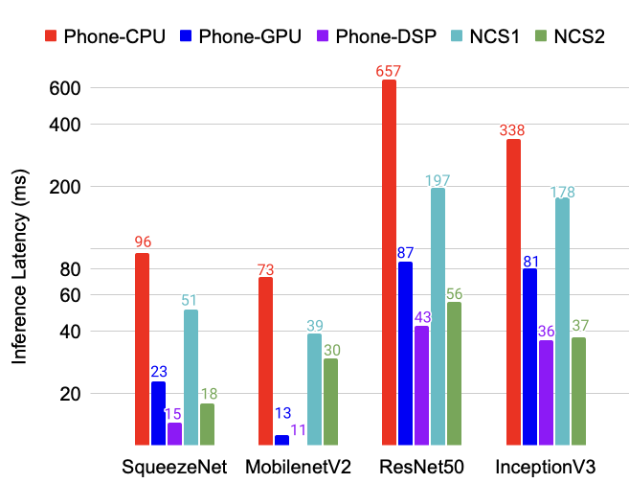
GPU and DSP Are Faster than NCS1 for CNN Workloads
NCS1 is slower than GPU and DSP, likely because the SHAVE cores are not optimized for CNNs.
Due to dedicated neural compute engine, NCS2 consistently beats NCS1 as expected, and is often faster than GPUs.
DSP is still the fastest accelerator for all studied CNN workloads.
Notes:
NCS1 armed with the vision-oriented SHAVE cores turns out to be slower than conventional mobile GPU and DSP.
This is likely the reason that the NCS2 abandoned the SHAVE cores for CNN acceleration,and instead opted to add a dedicated neural compute engine (NCE)specifically for DNNs.
This is reflected in our latency measurements: NCS2 consistently beats NCS1 as expected, and is often faster than GPUs as well.
DSPs, however, are still the fastest accelerator for CNNs over all of our workloads.

Slide 18
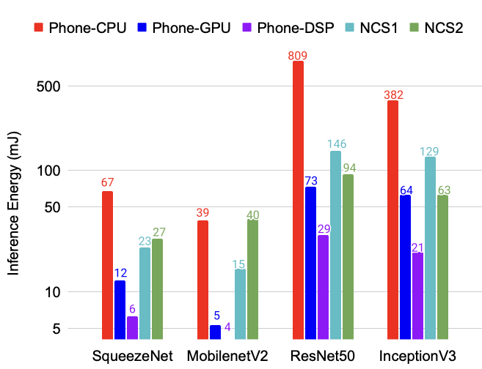
CNN: GPU and DSP Are More Energy-Efficient than NCS
The NCS1/2 consume more energy than the GPU, but much less than the CPU in all cases.
DSP consumes least energy for all studied CNN workloads.
Notes:
Fig. 1b shows the network energy consumption of over the five platforms.
The NCS1/2 consume more energy than the GPU, but much less than the CPU in all cases. This is surprising because mobile accelerators like NCS1 and NCS2 are designed to run the CNNs in a more energy-efficient way due to specialized chip design.
Conventional mobile processors like GPU and DSP are the winners compared to NCS accelerators in both latency and energy efficiency.

Slide 19
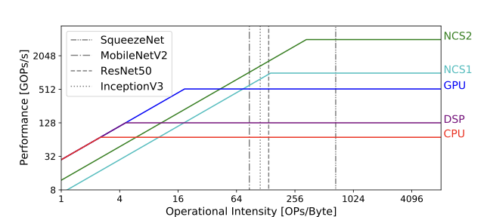
Roofline Analysis of CNNs
memory bound
compute bound
NCS devices are memory bound (except SqueezeNet)
Existing models cannot fit in memory (even with better memory architecture)
Parallelization does not help because the workload is memory bound
Notes:
We study why these CNNs are slower on the NCS than the GPU and DSP via a roofline analysis.
Roofline plots visualize and compare the performance of different kinds of processors, we can easily analyze processor bottlenecks for given workloads (either compute- or memory- bound)
On the x-axis shows operational intensity, while the y-axis displays peak performance.
A workload that intersects the roofline in the first (slanted) portion is hitting memory bandwidth limitations (memory-bound), and a workload that intersects the horizontal portion is compute bound.
NCS accelerators are memory-bound due to limited available memory
(e.g. NCS1 has 2MB on-chip memory).
This means for all studied CNNs except SqueezeNet, they cannot fit into NCS memory even the accelerator has better local memory architecture.
In that case, more parallelization does not help because the workload is memory bound.

Slide 20
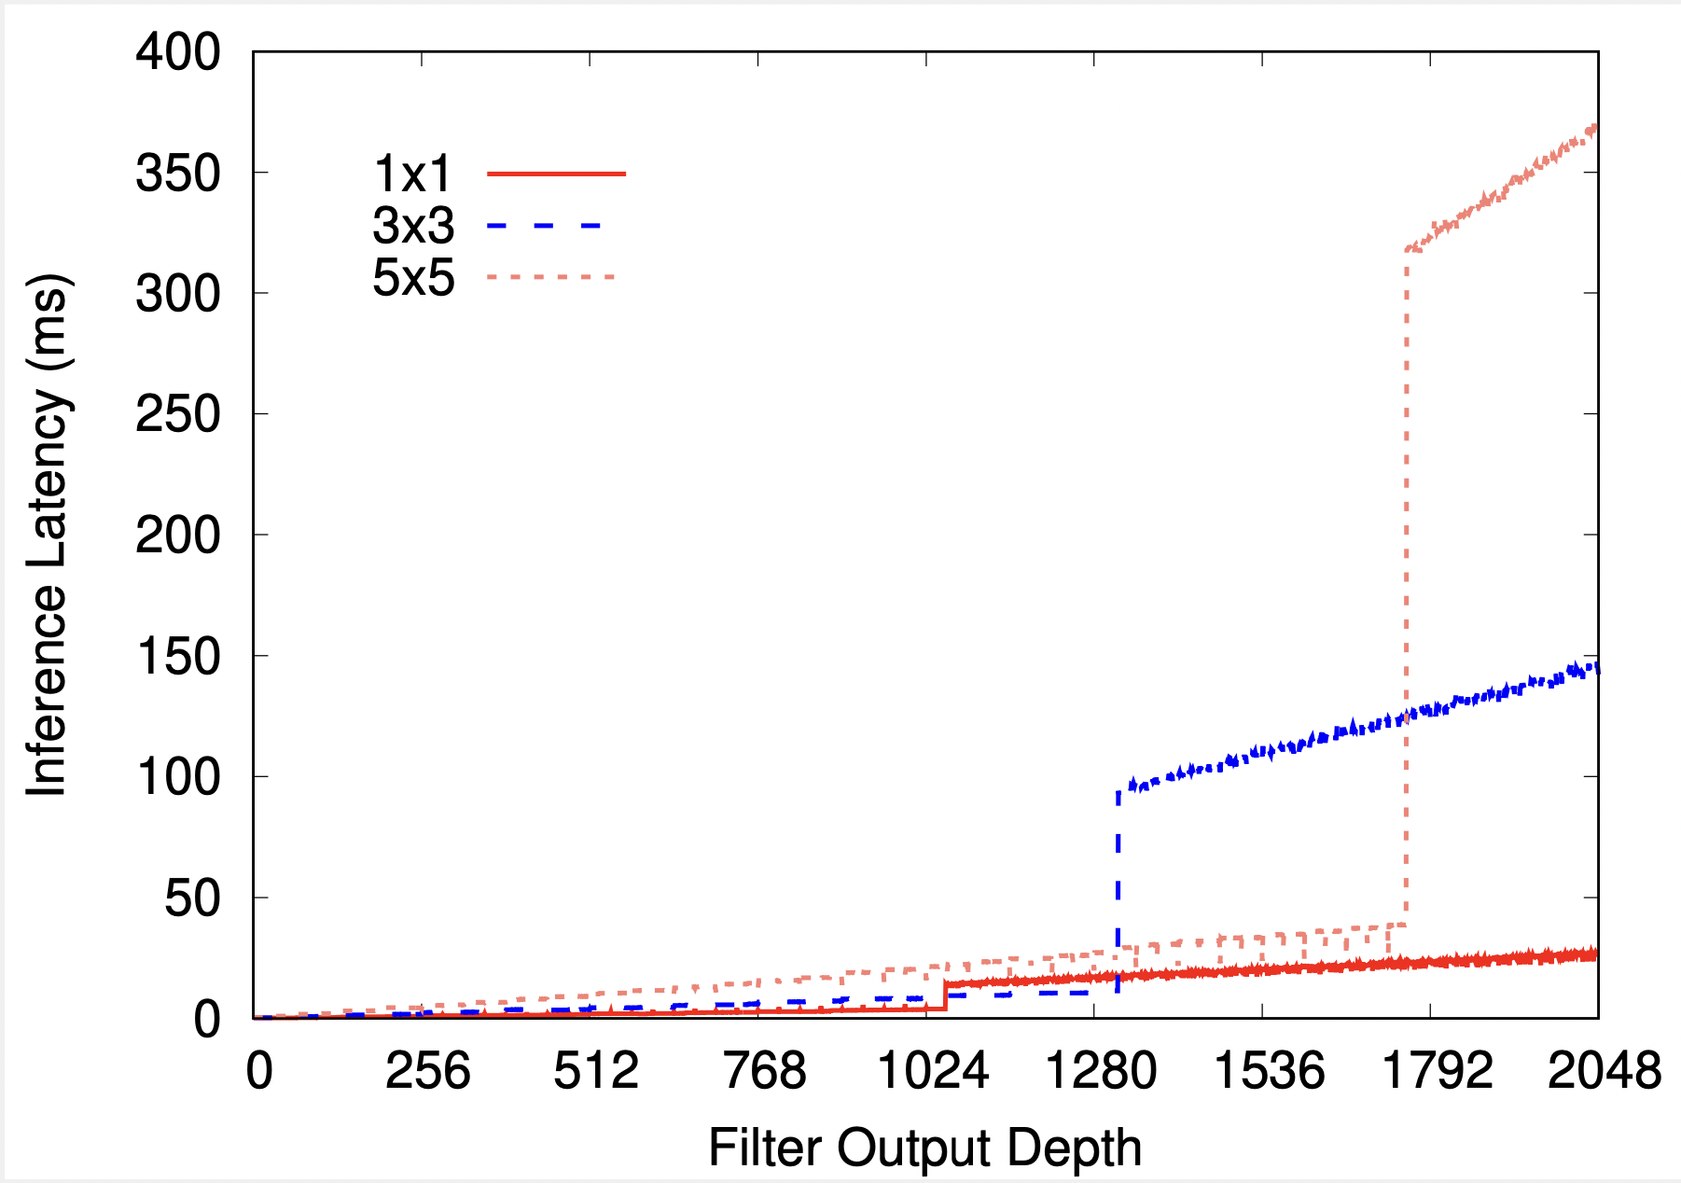
NCS “Memory Wall” Effects
A much larger jump (“memory wall") for different filter window sizes
Occurs when the filters no longer fit in on-chip memory, causing the filter reads to access slower external memory
Culprit could be software limitation, or
different filter window sizes could be laid out differently in on-chip memory
Notes:
We continue to increase the filter depths to study macro-scaling effects at larger filter sizes. We consistently observe a much larger jump (which we call the “memory wall") for different filter window sizes as shown on the plot. This dramatic increase in latency is likely due to each individual filter exceeding the sizeof the filter on-chip memory capacity on the NCS2, causing the filter reads to occur through external memory (which is often an order of magnitude slower). Curiously, the memory wall occurs at smaller filter depths for smaller filter window sizes.
For 1×1 filters, it occurs at 1053, for3×3at 1316 and for5×5at 1755.
This raises the question of whether OpenVINO software limitation could also be a contributing culprit to these memory walls.
Another possible reason could be that different filter window sizes are laid out differently in on-chip memory causing larger window sizes to more efficiently use the on-chip memory resources.
In any case, it is important to identify these memory walls for non-flexible dedicated DNN accelerators such as the NCE on NCS2 as they can impact performance by a large margin.

Slide 21
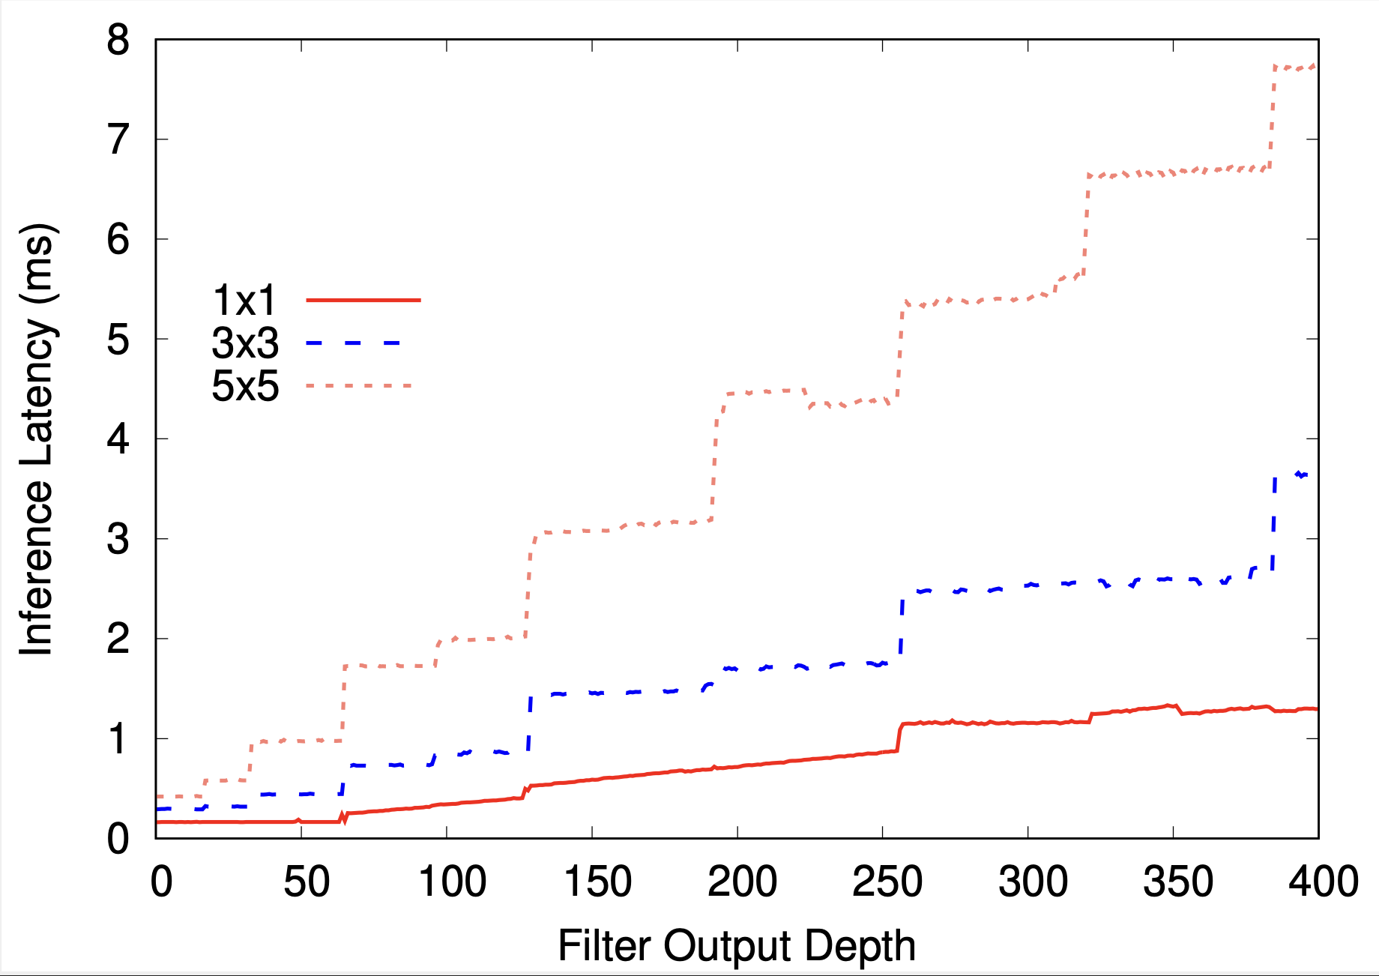
Can changing models help: NCS2 “Vectorization” Effects
Abrupt increases in latency at specific depths
Reason: CNN filter size exceeds the vector instruction parallelism in the NCS2
The effects happen much less on other devices such as CPU/GPU
(hence our focus on NCS2)
Notes:
So, if we can’t change the hardware easily, can we vary the model parameters?
We can change some parameters to see when NCS can help. We changed the CNN filter size, #of filters (network width) and #of layers (network depth). I am going to show the effect of changing filter size vs network depth.
we vary the filter depths of common1×1,3×3 and 5×5 filters to investigate the impact on latency on the NCS2 accelerator.
As we increase the filter depths, we observe abrupt increases in latency at specific depths. We call these vectorization effects as they are due to the filter size exceeds the vector instruction parallelism in the NCS2.
thereby issuing a new (underutilized) vector instruction to complete the computation.
For example, if vector width is 16 for multiply-accumulate instructions (MACs), and we have 17 MACs in our filter, then two vector instructions will need to be issued to compute the 17 MACs – the first will be fully utilized(16/16 MACs) while the second will be underutilized (1/16 MACs).
Other devices such as CPU/GPU have much finer-grained parallelism. Even NCS1 uses SHAVE cores for DNN acceleration, which has a finer-grained and more complex computation paradigm. In these cases, we expect that if 17 MACs need to be computed, a CPU (for example) can issue one vector instruction for 16 of the MACs, and one normal non-vector instruction for the remaining MAC, thereby displaying a smoother execution profile. However,the NCS2 is important to study in this detail as it is indicative of future dedicated accelerators for DNNs. We therefore recommend the careful design of DNNs to align to take advantage of such vectorization effects in DNN accelerators.

Slide 22
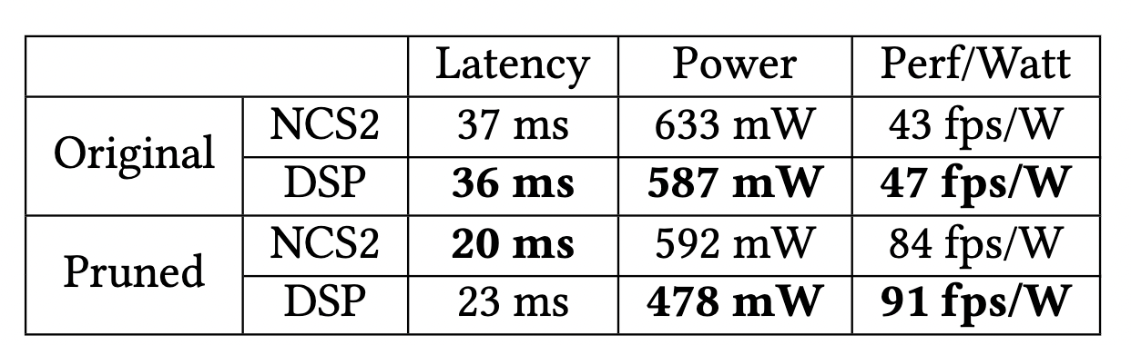
NCS-Aware CNN Optimizations
We decreased the output filter depths in InceptionV3 to the closest power of two and then retrained the model
NCS2 becomes 15% faster than DSP after pruning, even though it was 3% before pruning.
Notes:
NCS2 becomes 15% faster than DSP after pruning, even though it was 3% before pruning. However, the DSP still winsin overall efficiency as it consumes less power.

Slide 23
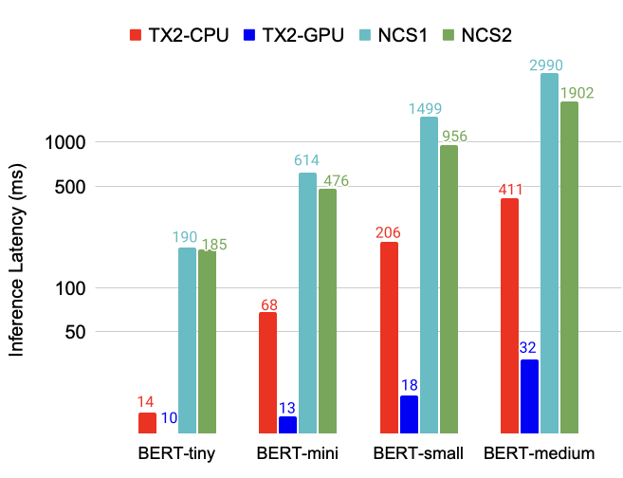
NCS Devices Are Slower than CPU/GPU for NLP Models
NCS1 and NCS2 are 5 ~ 10x slower than the CPU and are 20 ~ 60 slower than the GPU
Hypothesis: NCS accelerators are not optimized for NLP models like BERT;
BERT models use attention mechanism which has different properties compared to CNNs
Notes:
We also benchmarked NLP models on NCS1 and NCS2 devices, due to smartphone software limitations running NLP models, we use the Nvidia TX2 jetson board for CPU and GPU testing.
For all 4 studied NLP models,
NCS1 and NCS2 are 5 ~ 10x slower than the CPU and are 20 ~ 60 slower than the GPU
Hypothesis: NCS accelerators are not optimized for NLP models like BERT;
BERT models use attention mechanism which has different properties compared to CNNs
For example, CNN models often have filters that are easily paralizeable and can be cached into device memory, but attention-based NLP models often need to look at all input data at once and cannot easily fit into memory
Energy numbers are similar,
(NCS devices consume (3∼12)x more energy than the CPU and GPU)
These are preliminary experiments showing the NCS devices latency and energy behaviors, to understand why NCS are not good alternatives to conventional mobile processors like GPUs/DSPs, we need further investigation.

Slide 24
NCS Devices Are Not Energy-Efficient for NLP Models
hypothesis
Notes:
We hypothesize this is likely because neural accelerators designed for vision tasks are optimized for CNNs not for other types of model architectures.

Slide 25
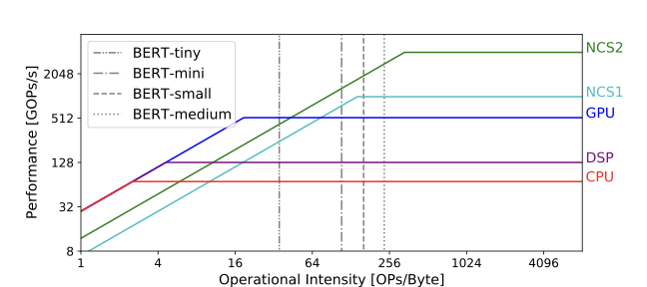
Roofline Analysis of BERT NLP Models
For CPU and GPU, all BERT models are compute-bound
For NCS2, all BERT models are memory-bound
For NCS1, smaller models like tiny and mini are memory-bound but larger models like small and medium are compute-bound.

Slide 26
Summary
Performance Characterization of DNNs on commodity mobile DNN accelerators -- NCS
Development of Preliminary Accelerator Specific Neural Network Inference Optimizations
Major Takeaway: Mobile DNN Accelerators are not ready yet to accelerator DNNs, and are just like conventional mobile processors, only as good as the software and algorithms that drive them.

