Slide 1
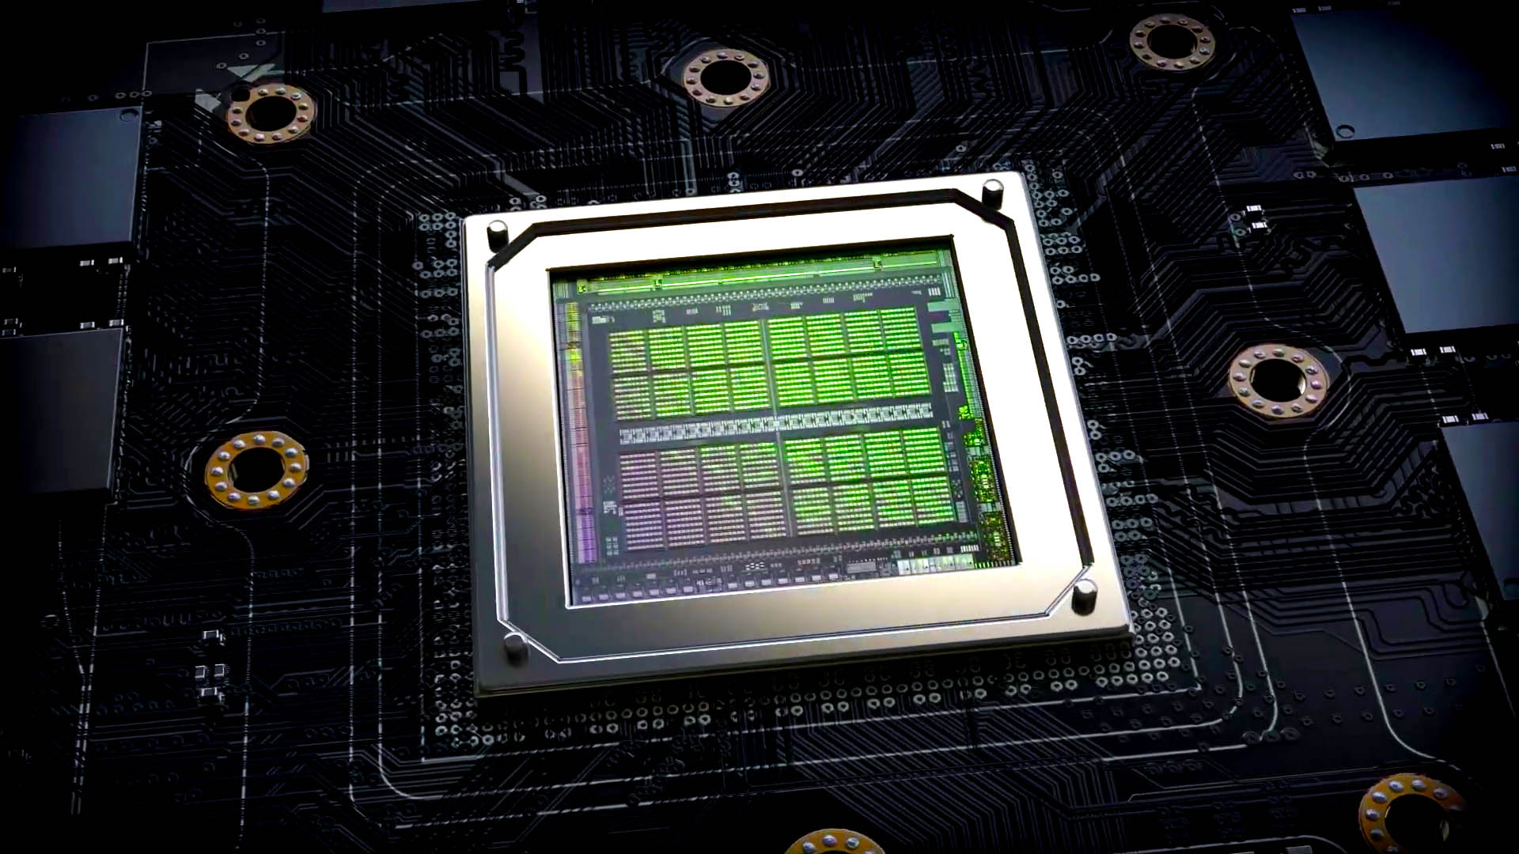
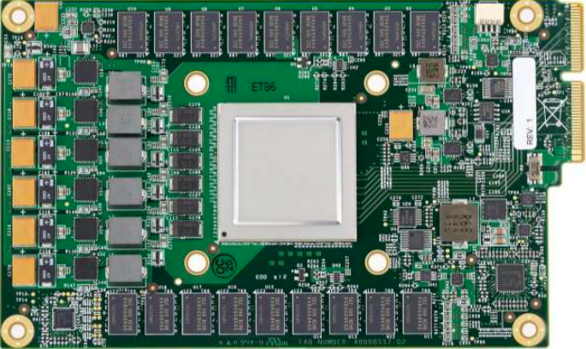
Lecture 09: GPU Architectures
Topics:
Nvidia Ampere: Architecture Overview
Google Coral TPU Overview
Graphic Processing Units
SIMD Processors and GPUs
Fused Multiply Add Operations

