Slide 1
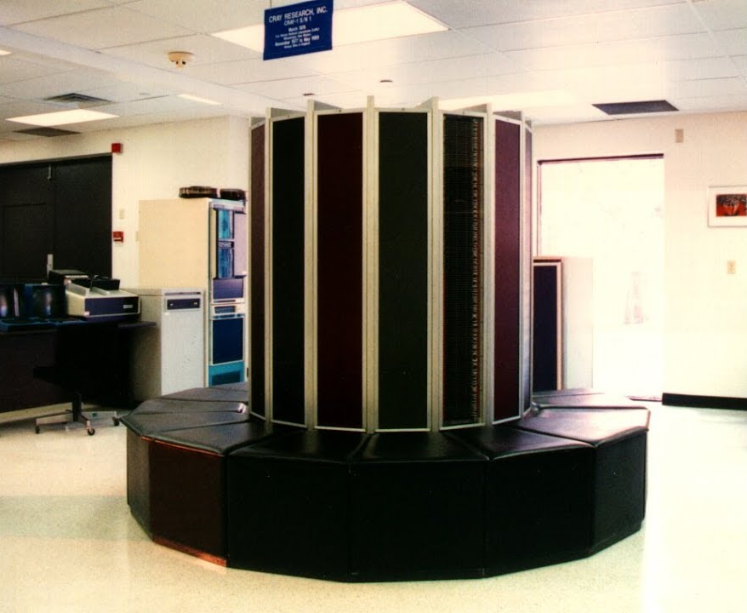
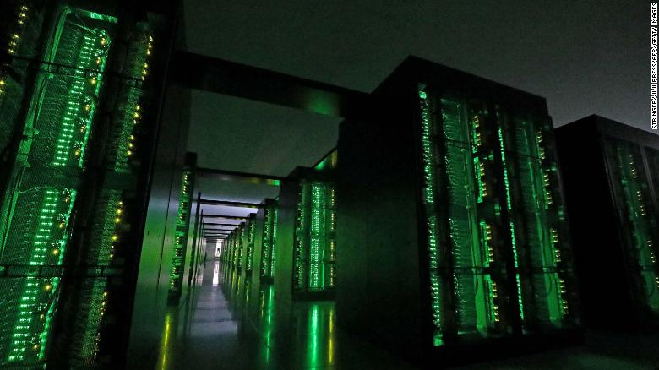
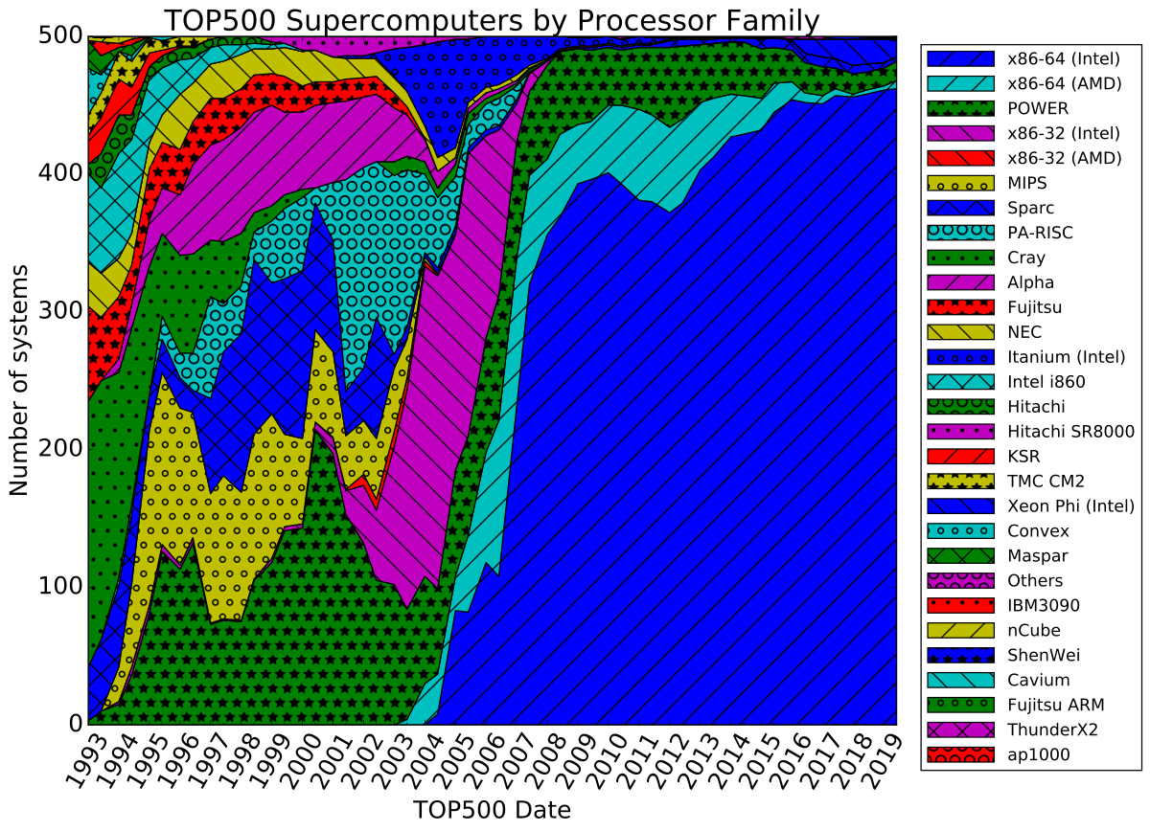
Lecture 01: Brief Introduction to Linux and Linux Clusters
Topics:
Course Syllabus
The Linux Operating System
Small Linux Clusters
The Neuronix Cluster
Command Line Programming
Programming Tools

Slide 2
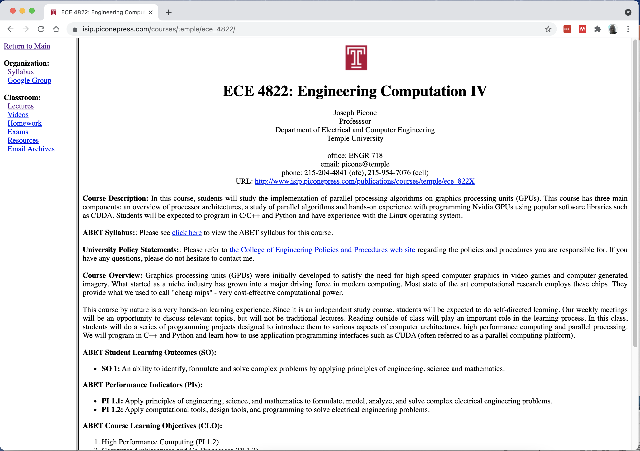
Course Syllabus and Web Site

Slide 3
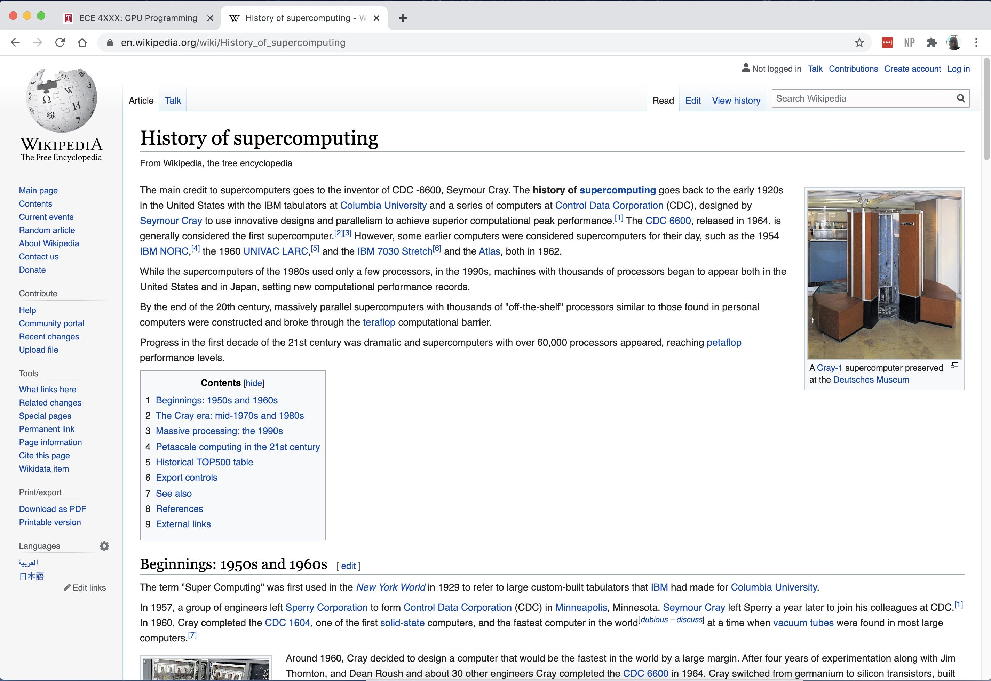
A Brief History of Supercomputing

Slide 4
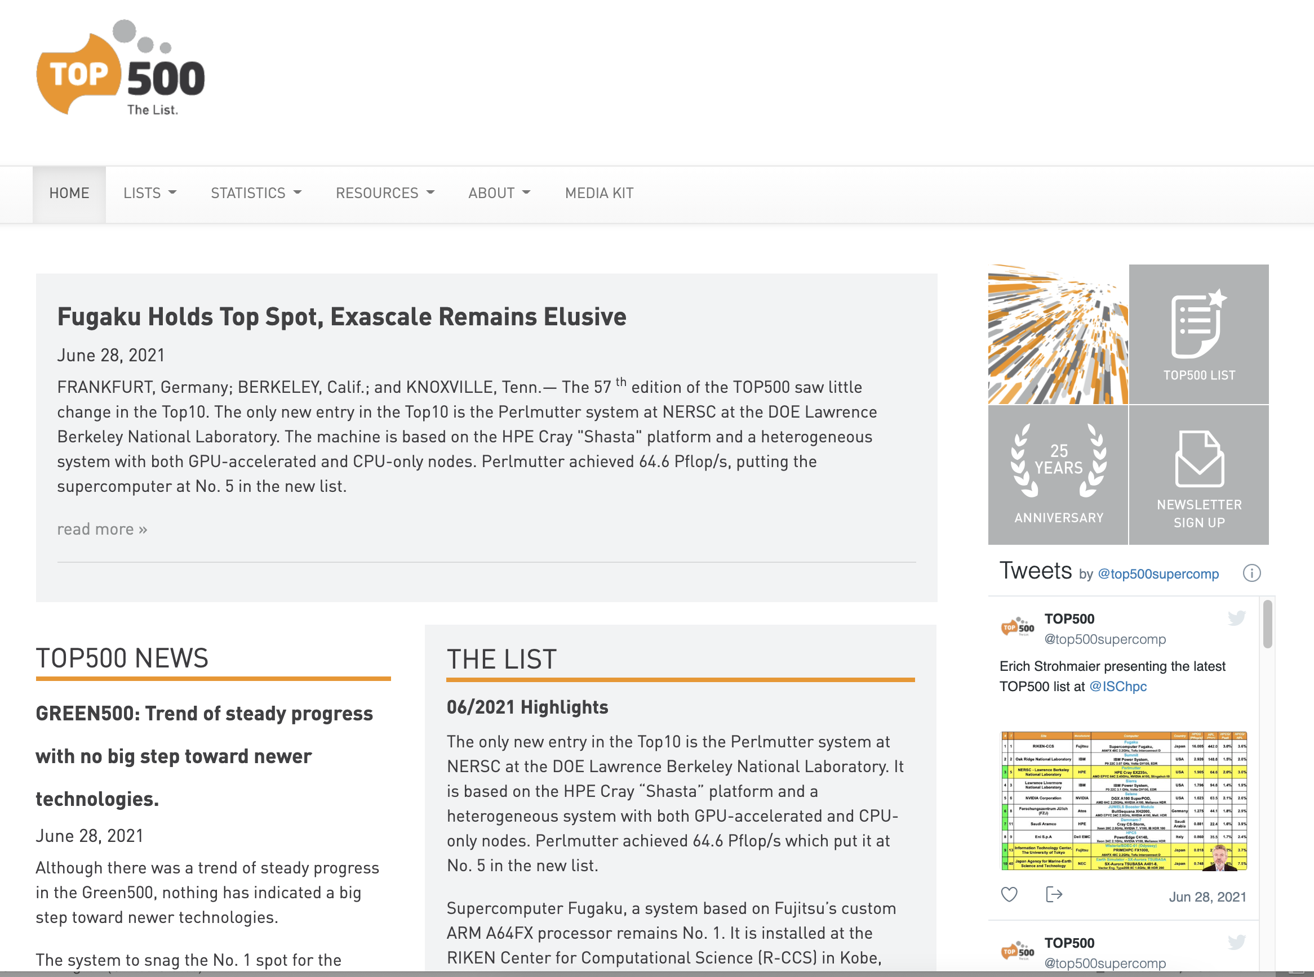
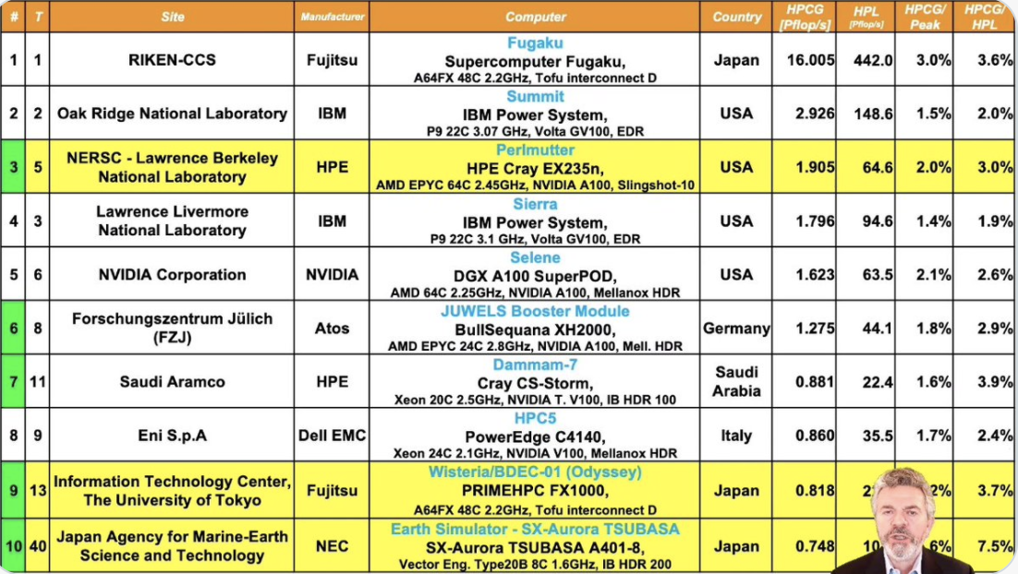
The Top 100 Supercomputers

Slide 5
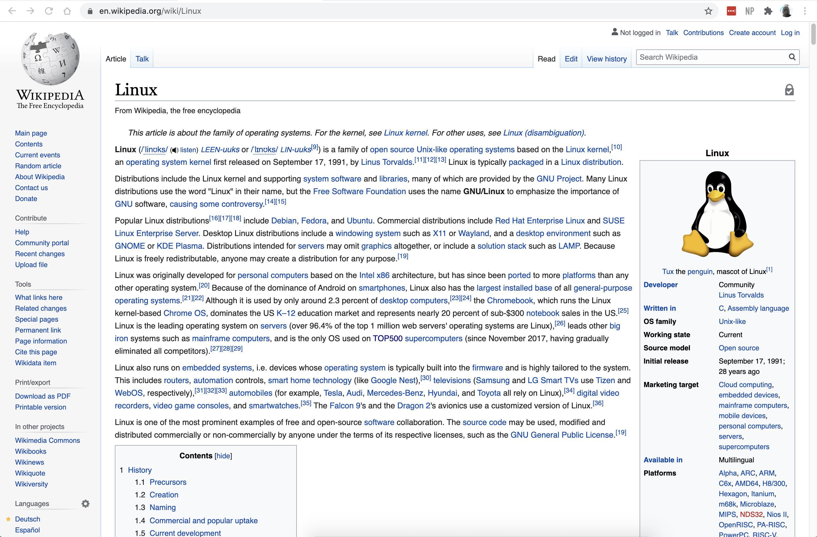
The Linux Operating System

Slide 6
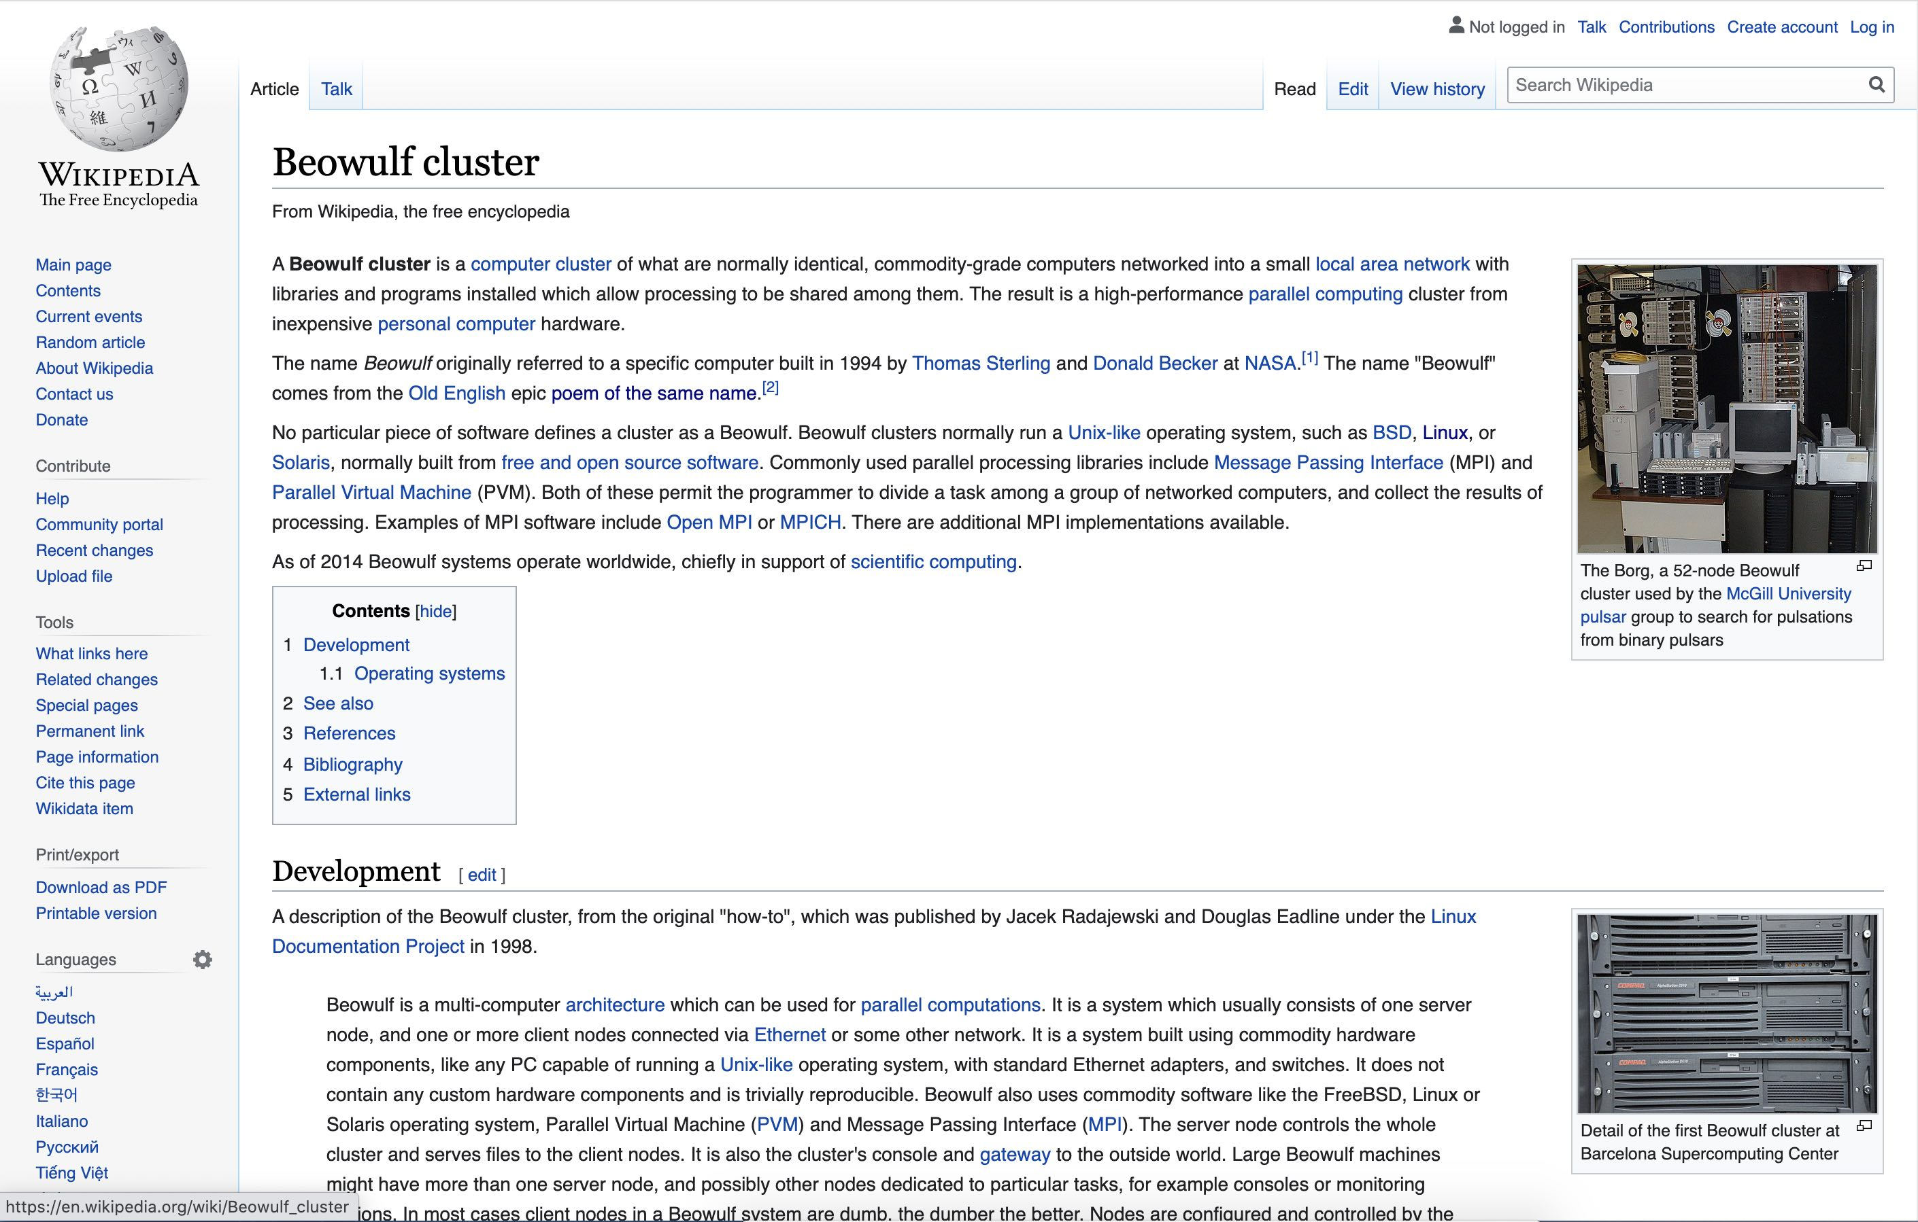
Small Linux Clusters

Slide 7
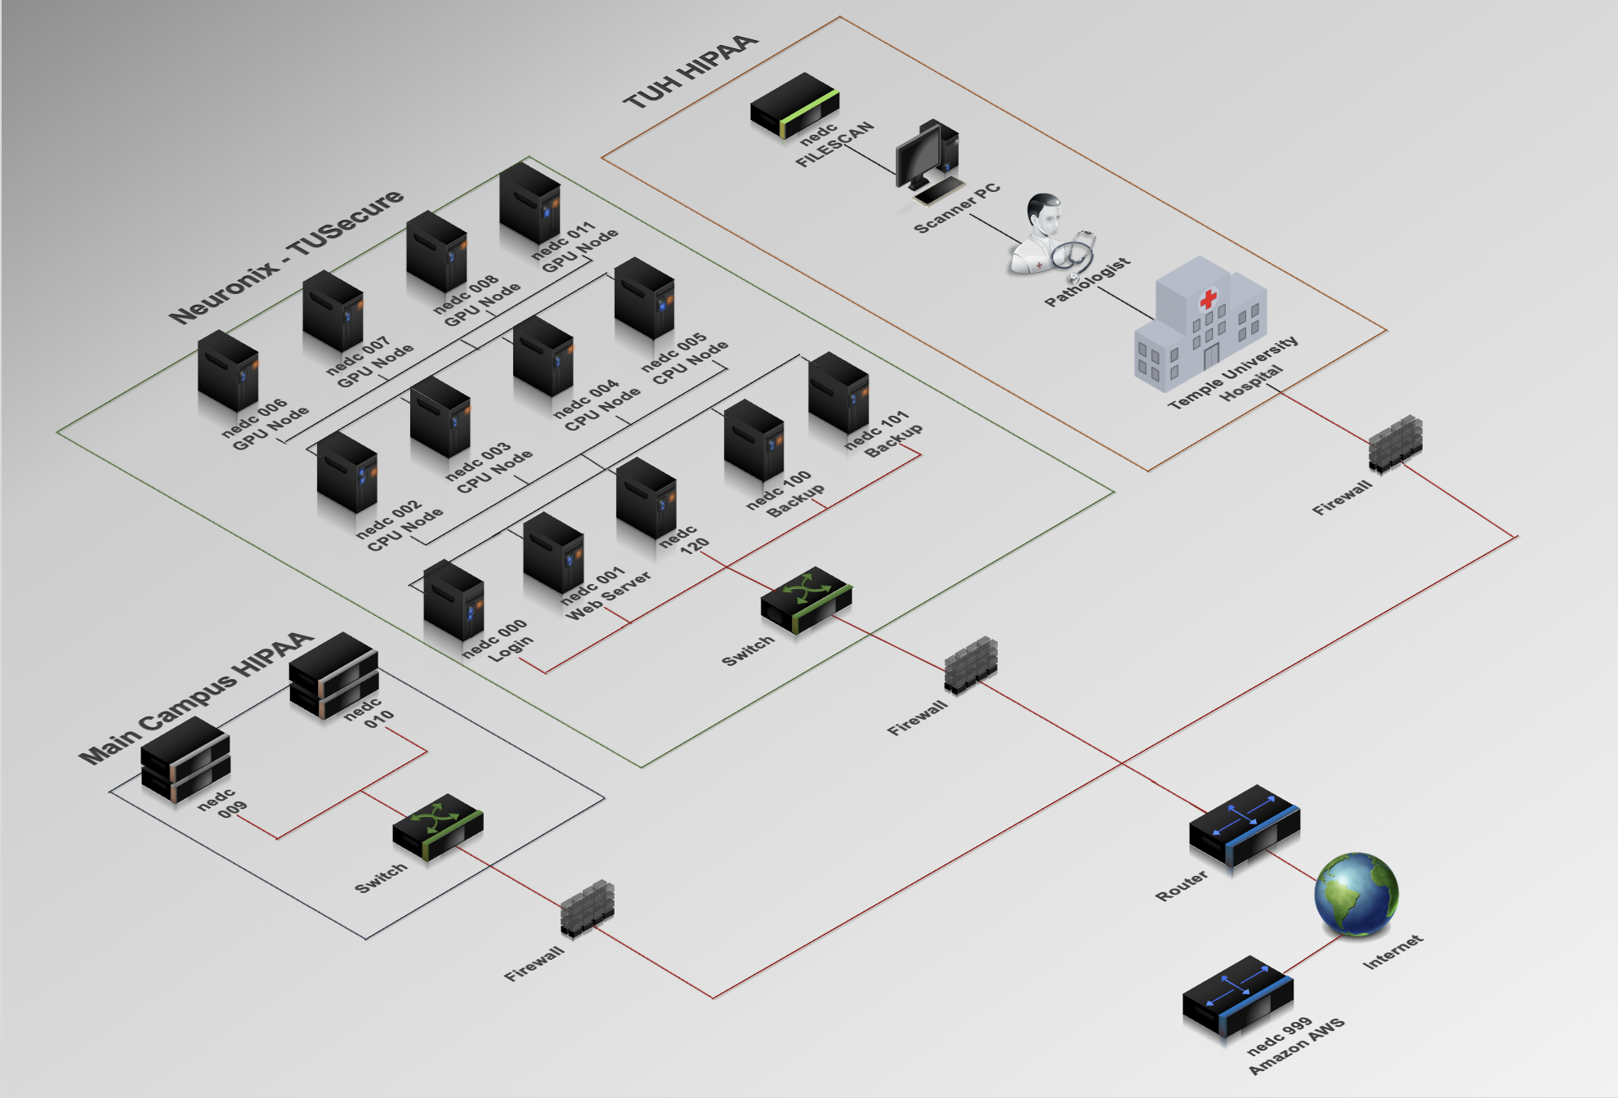
The Neuronix Cluster

Slide 8
Summary
Course Syllabus: course emphasizes hands-on learning using homework assignments and a final project.
Cluster Computing: the Neuronix cluster is an example of a small Linux cluster. It contains several machines that have different generations of Nvidia GPUs.
Operating Systems: familiarity with Linux is required. We will leverage shell programming, job submission using Slurm, and parallel processing.
Terminal Windows: demonstrated how to connect to the cluster using ssh.
Command Line: introduced the notion of a command line interface, changing directories, the location of your account, the courses directory, tab expansion.
Editors: introduced the reasons for using emacs (including code formatting and command line editing).
Shells: the shell (bash), the environment (printenv) and processes.
Login Environment: introduced the .bash_profile and the .bashrc files.

