Slide 1
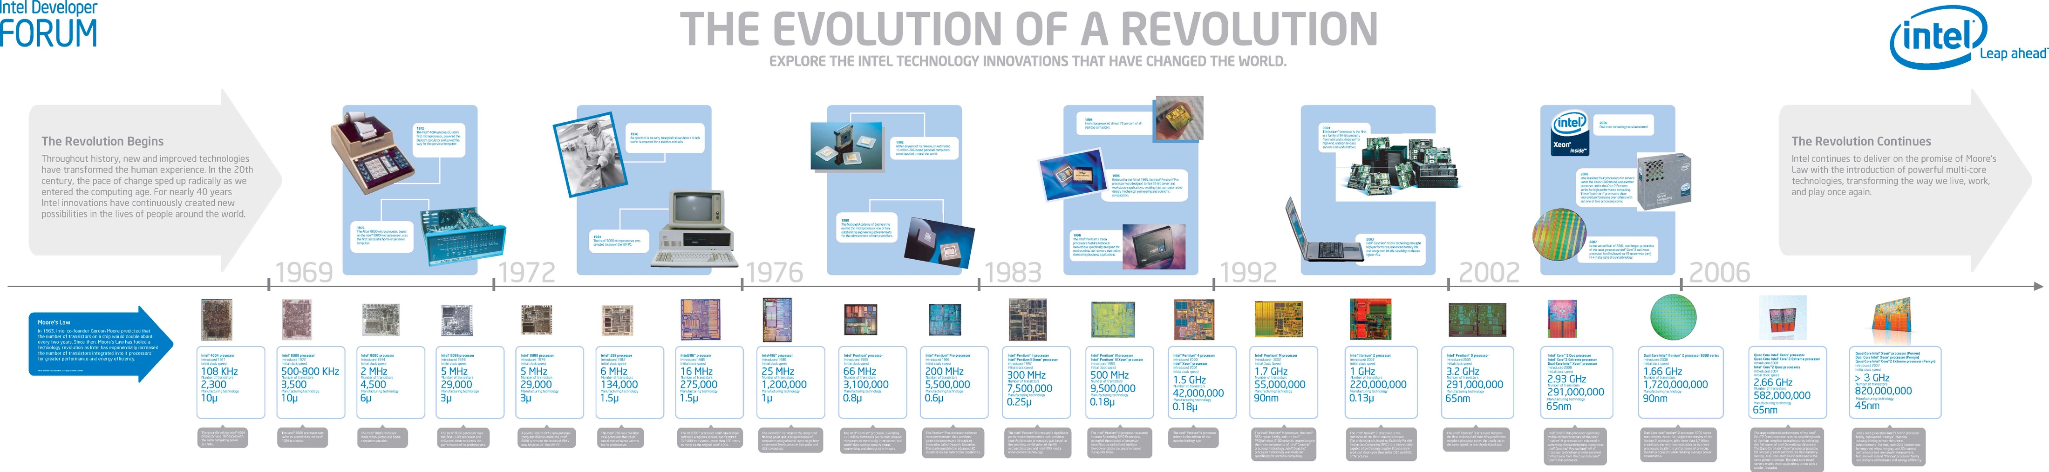
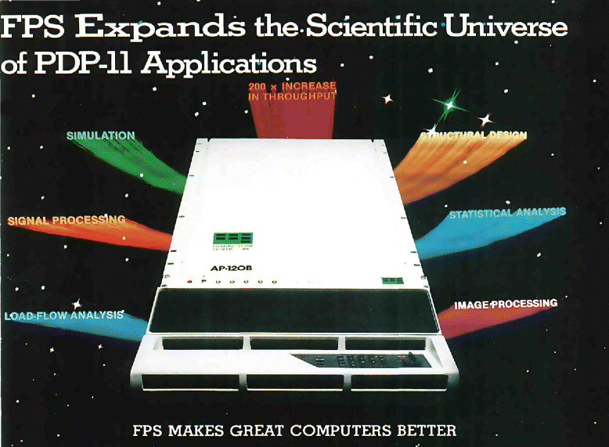
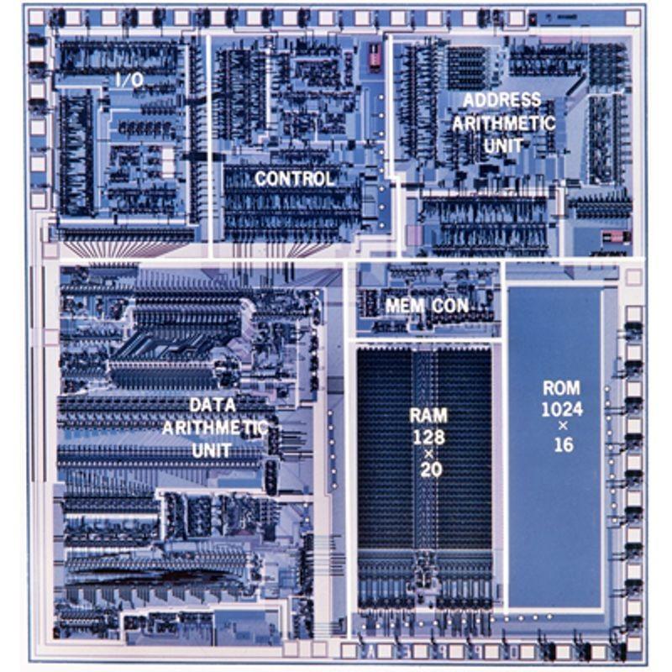
Lecture 04: A Brief History of Coprocessors
Topics:
Array Processors (Vector, FPS AP-120B)
Digital Signal Processors (Wiki, TI, C25)
SIMD Processors (Mutlu, Wiki)
CISC vs. RISC (El Kady, Lawlor, Soco)
SPARC, MIPS, PowerPC, ARM and VLIW
Comparisons (Nerlekar, Pratt)
FPGAs, ASICs, and DSP Cores (XILINX, TI)

