Slide 1
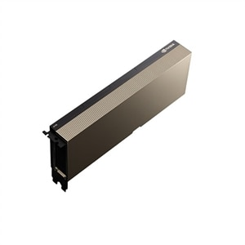
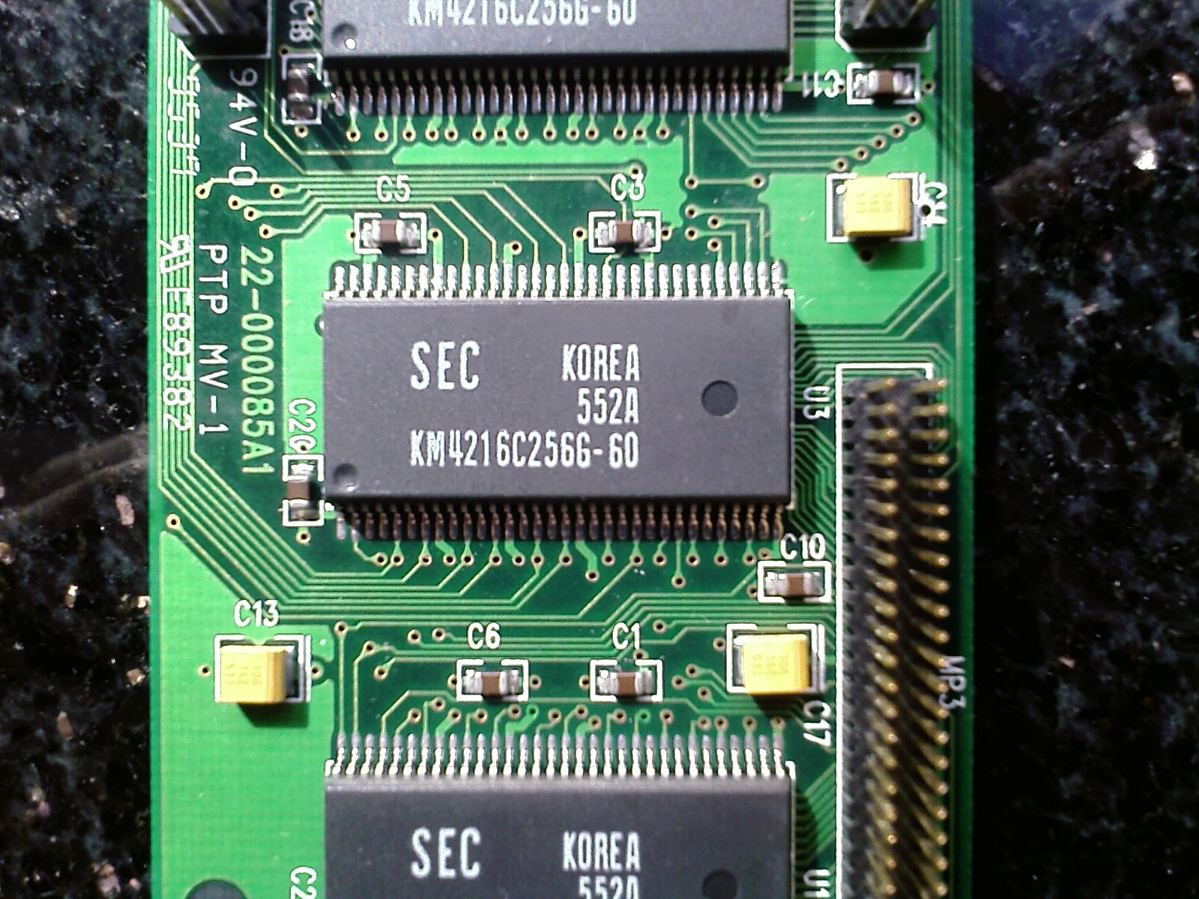
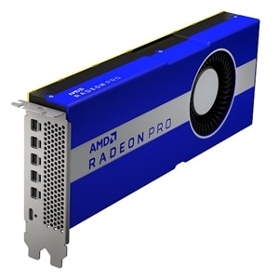
Lecture 13: Computer Memory
Books:
Processors and Main Memory
Computer Organization and Design
Computer Organization and Design (ARM)
Lectures:
History of Memory
Registers and RAM
How Memory Works
What is VRAM? (Basic)
Topics:
GPU Memory Architecture
Cache Memory
Computer Memory
Inside Cache Memory

