Slide 1
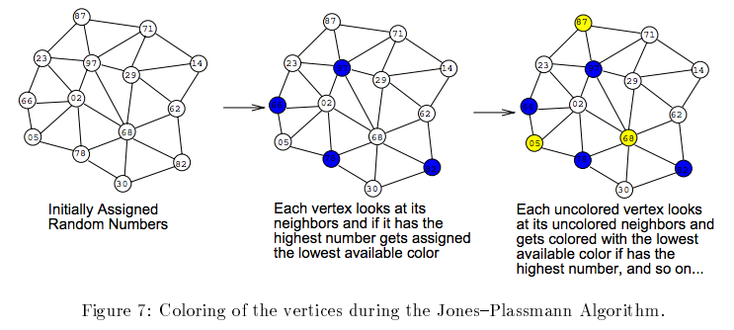
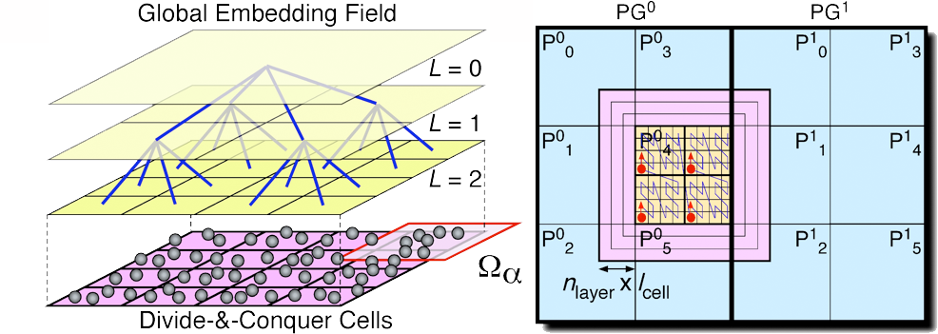
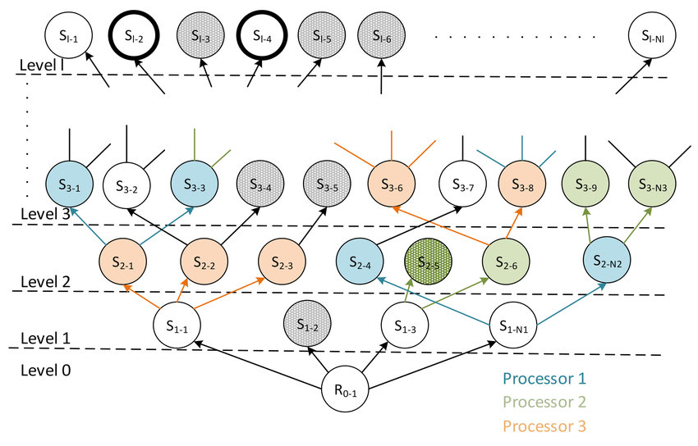
Lecture 12: Parallel Search Algorithms
Books:
Algorithms
Parallel Algorithms
Parallel Fourier Transforms
Parallel Computing
Lectures:
Hash Tables and Function
Hash Tables
Parallel Algorithm Design
Topics:
Hash Table
Parallel Search Algorithms
Modeling Parallel Algorithms
Depth-First Search
Parallel Algorithms
Discrete Optimization

