Slide 1
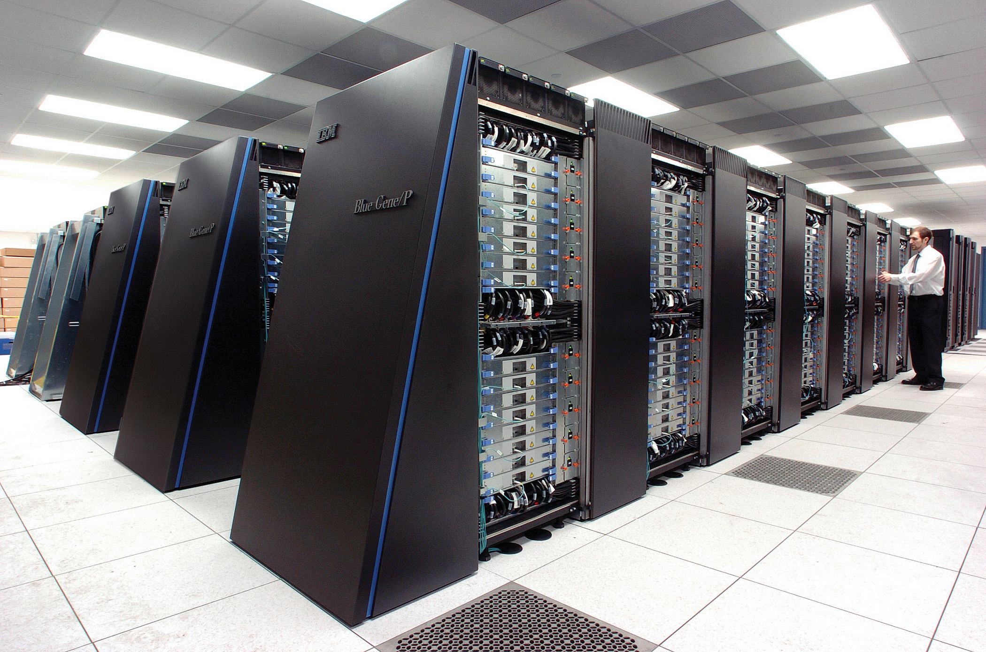
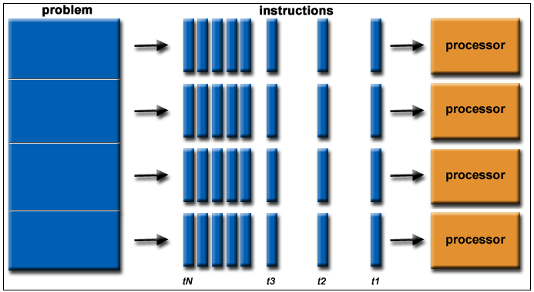
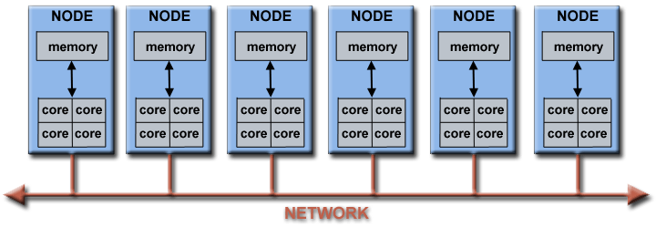
Lecture 11: Pipelining
Books:
Piplining in the MIPS Architecture
Programming Massively Parallel Architectures
Lectures:
Piplining in the MIPS Architecture
Intel Pipelining
Topics:
Instruction Pipelining
Pipelining
Pipelining Part II
Graphics Pipelining

