Slide 1
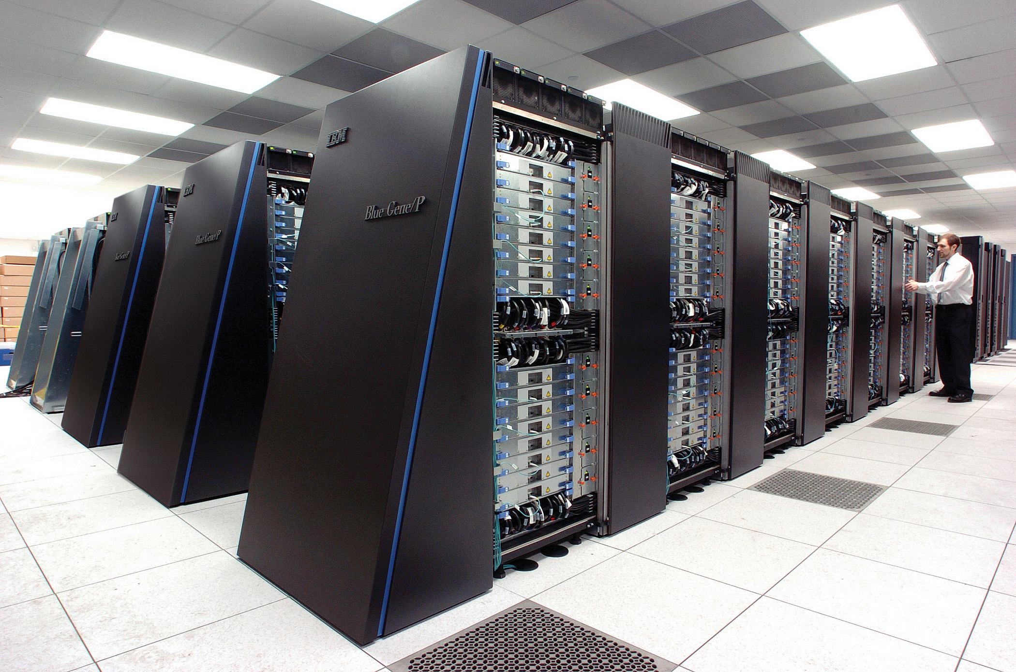
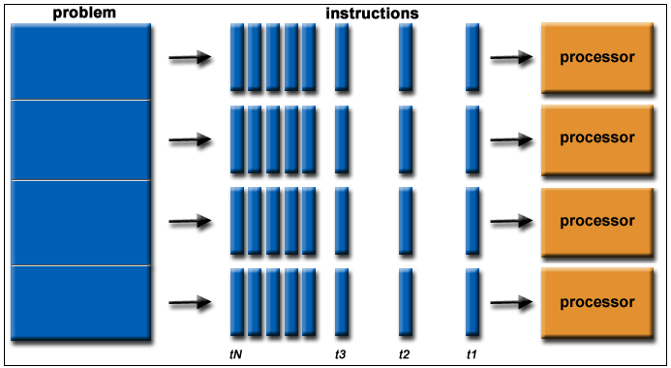
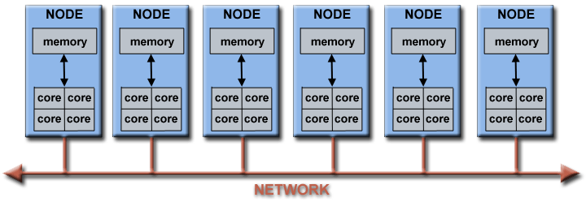
Lecture 10: Parallel Computing Revisited
Books:
Programming Massively Parallel Architectures
Lectures:
SIMD and GPUs
Topics:
Parallel Computing
Architectures

