Slide 1
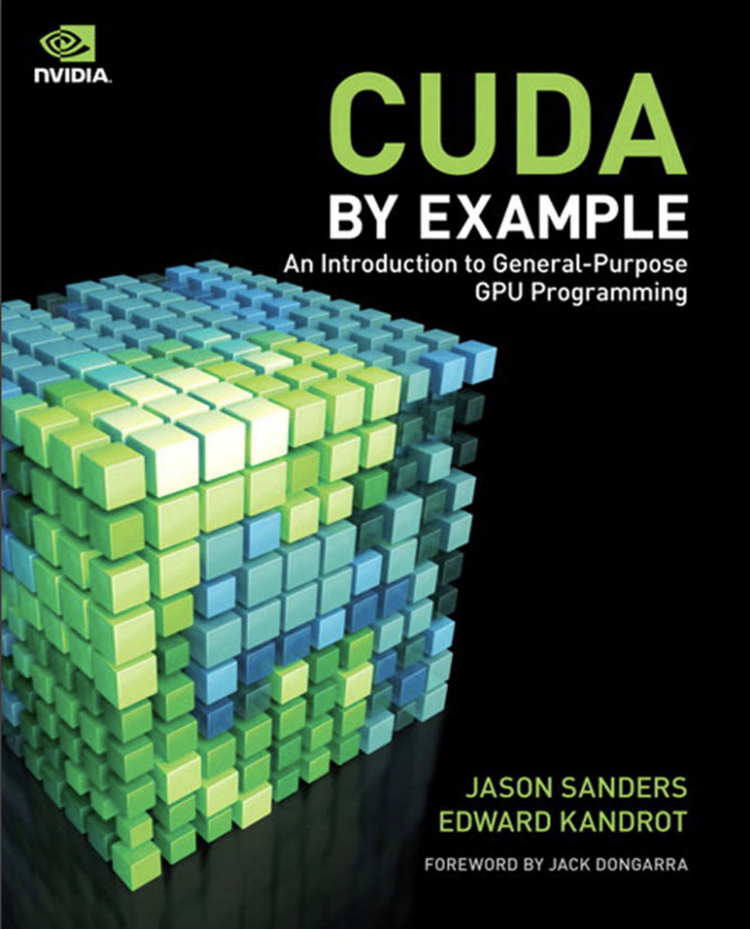
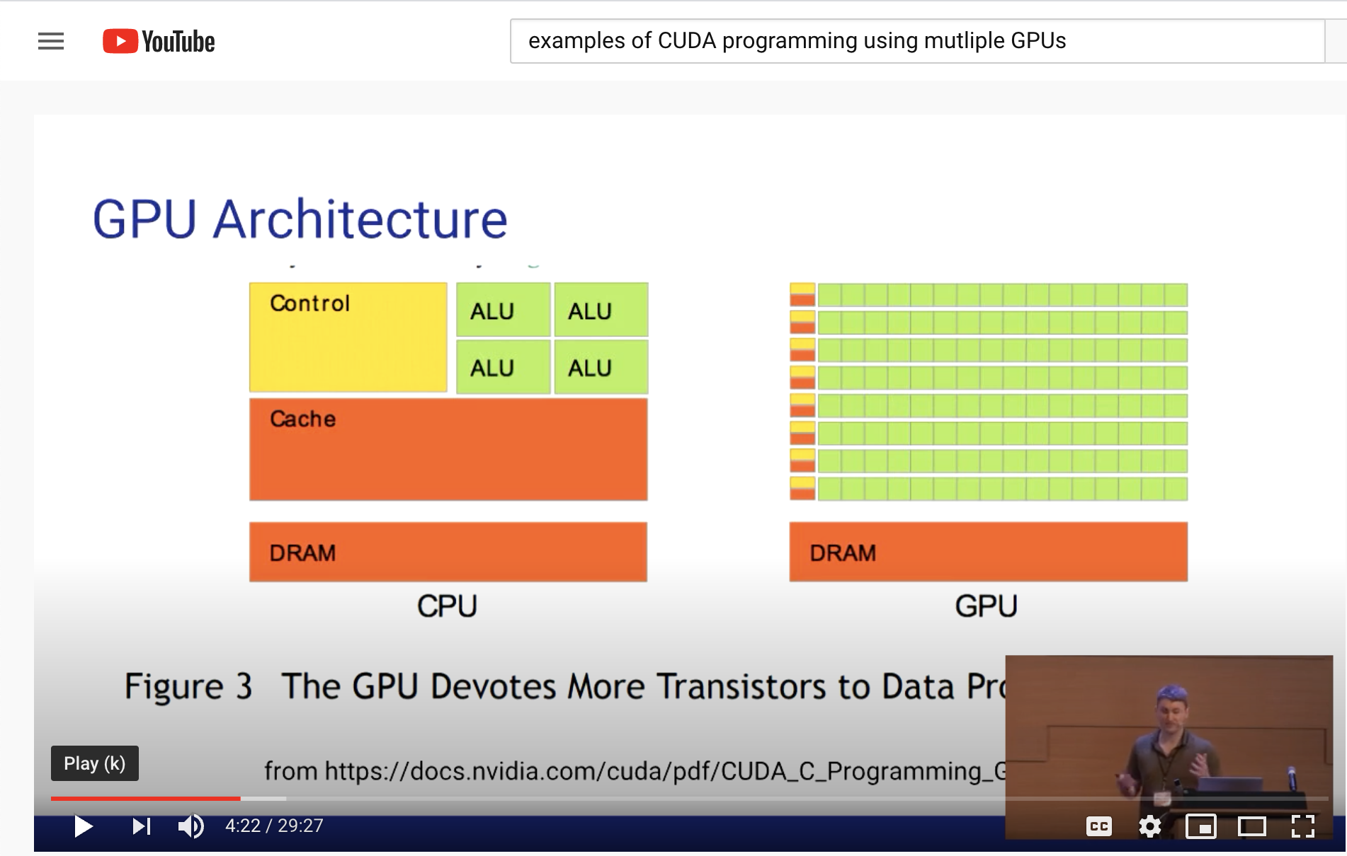
Lecture 09: Multiple GPU Tasks
Books:
CUDA By Example
Lectures:
Introduction to CUDA C
CUDA in Your Python
Topics:
Streams
Grids
Multi-GPU Example
Dot Product Example
Neural Network Implementation

