Slide 1
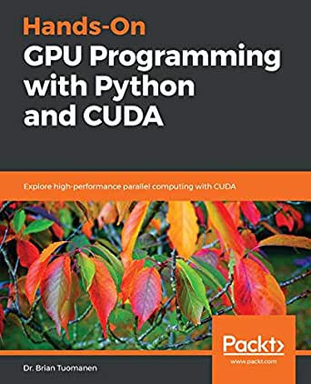
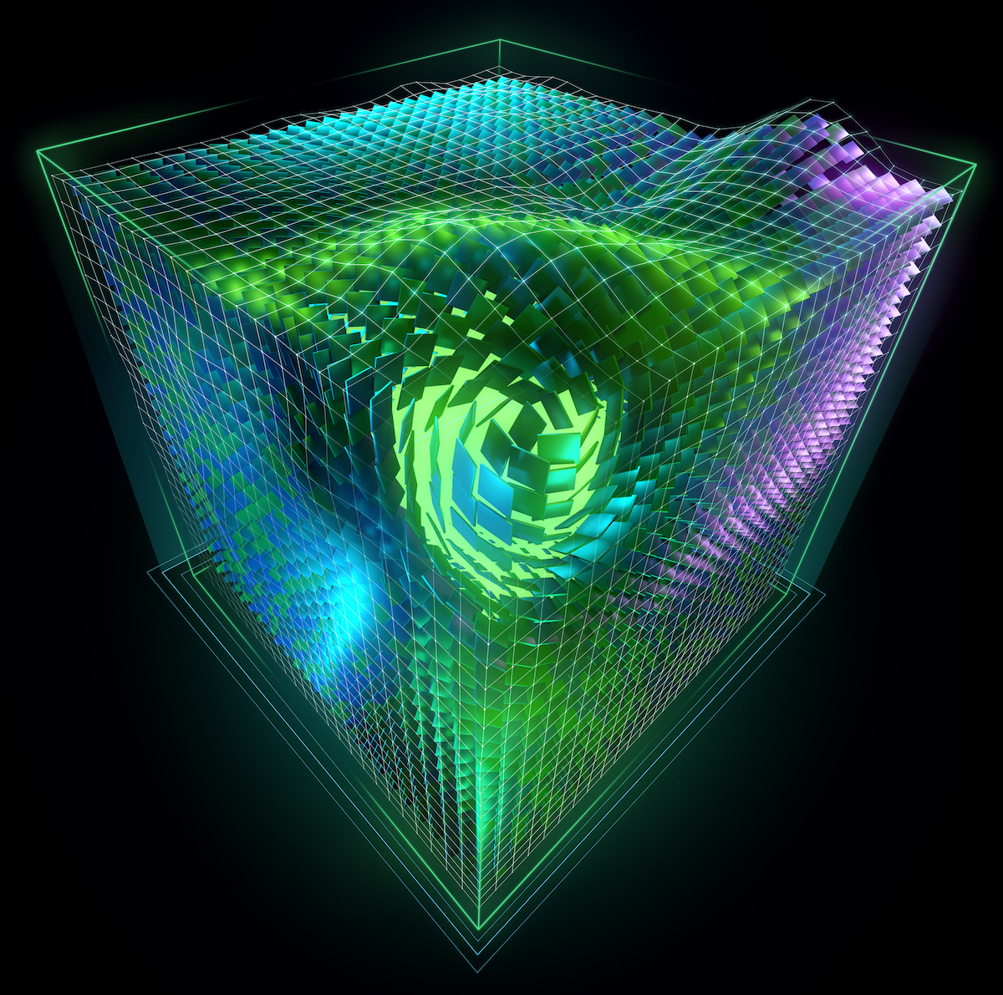
Lecture 06: Python Interfaces to CUDA
Books:
Hands-On GPU Programming with Python and CUDA
Getting Started with GPU Computing in Anaconda
Lectures:
Numba Makes Python Code Run Fast
Speed Up Your Algorithms
CUDA Python
PyCUDA: Even Simpler GPU Programming
Introduction to CUDA Programming
Topics:
CUDA C Basics
A ~5 minute guide to Numba
Numba: High-Performance Python with CUDA
Your First CUDA Python Program
CUDA Programming
Programming GPUs with Python

