Slide 1
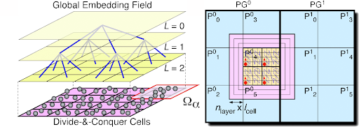
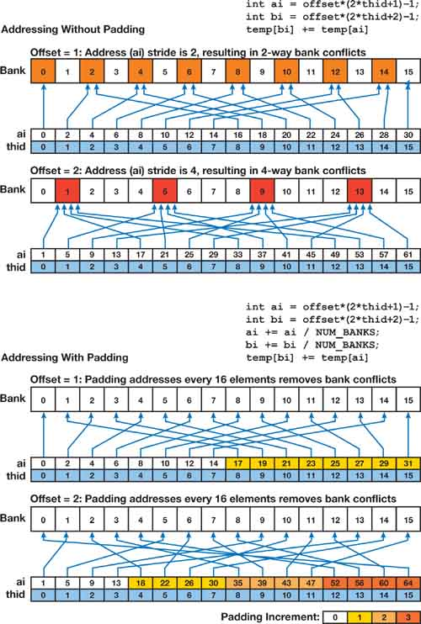
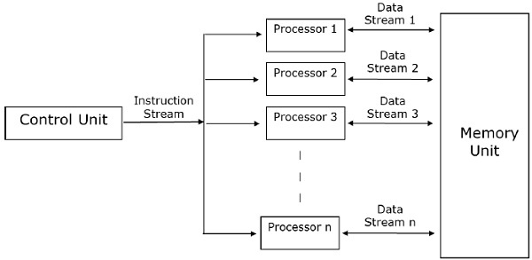
Lecture 04: Parallel Algorithms
Books:
An Introduction to Parallel Computing
Programming Massively Parallel Processors
An Introduction to Parallel Programming
Programming on Parallel Machines
Lectures:
Multicore Programming Primer
Parallel Computing
Topics:
Coarse-Grained vs. Fine-Grained Multiprocessing
Unix Pipes, Make and Easy Parallelism
Principles of Parallel Algorithm Design
Message Passing Interface (MPI)
Concurrent Programming

