Slide 1
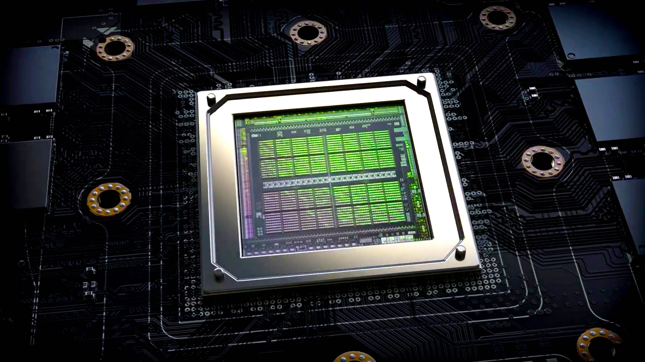
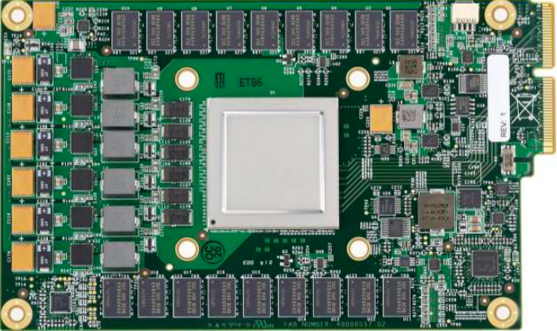
Lecture 03: GPU Architectures
Topics:
Typical Market Forecast, Nvidia Stock
Market by Vendor
Nvidia, AMD, Intel, Google, Ranking
Ampere, Radeon, Gen9
Nvidia Ampere: Architecture Overview
Google Coral TPU Overview
Comparisons: Medium, IEEE, WCCFTech
Blogs: Dettmers, Giles, Arora

