Slide 1
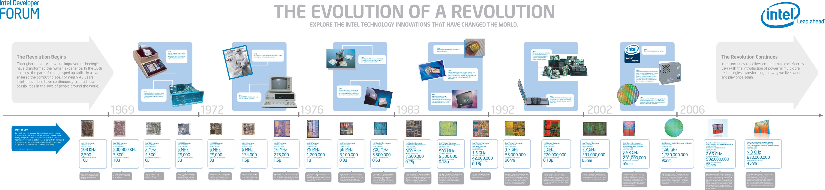
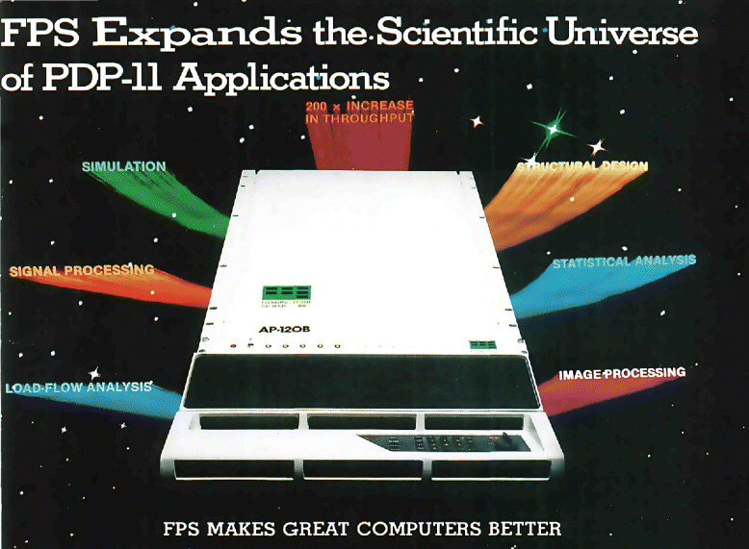
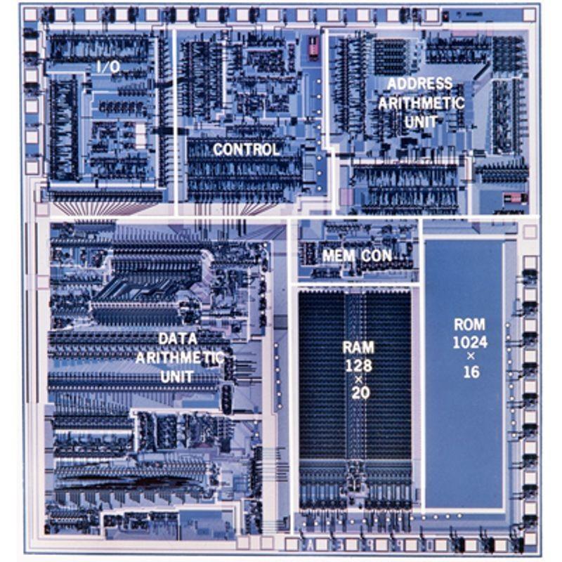
Lecture 02: History of Co-Processors
Topics:
Array Processors (Vector, FPS AP-120B)
Digital Signal Processors (Wiki, TI, C25)
SIMD Processors (Mutlu, Wiki)
CISC vs. RISC (El Kady, Lawlor, Soco)
SPARC, MIPS, PowerPC, ARM and VLIW
Comparisons (Nerlekar, Pratt)
FPGAs, ASICs, and DSP Cores (XILINX, TI)

