Slide 1
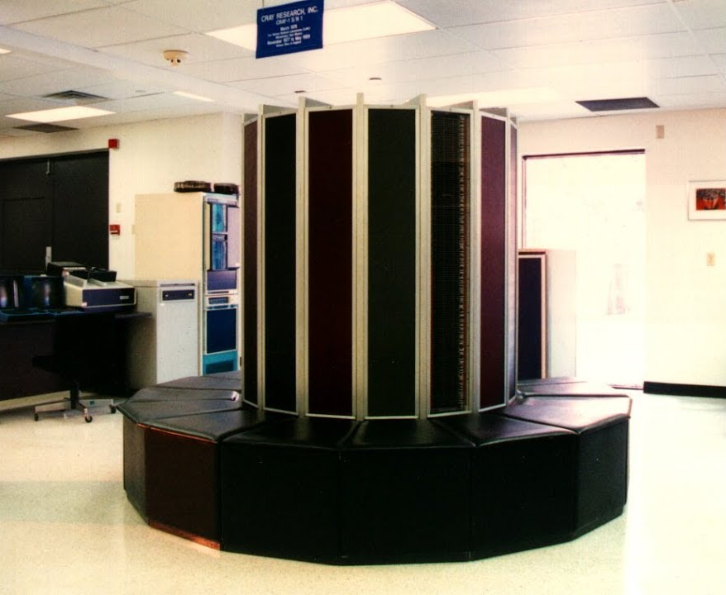
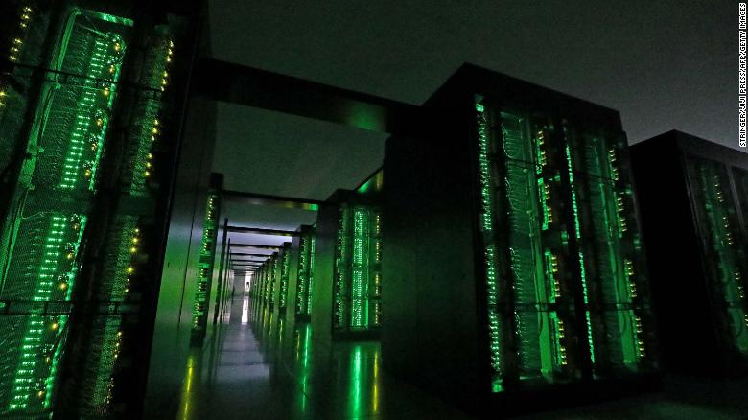
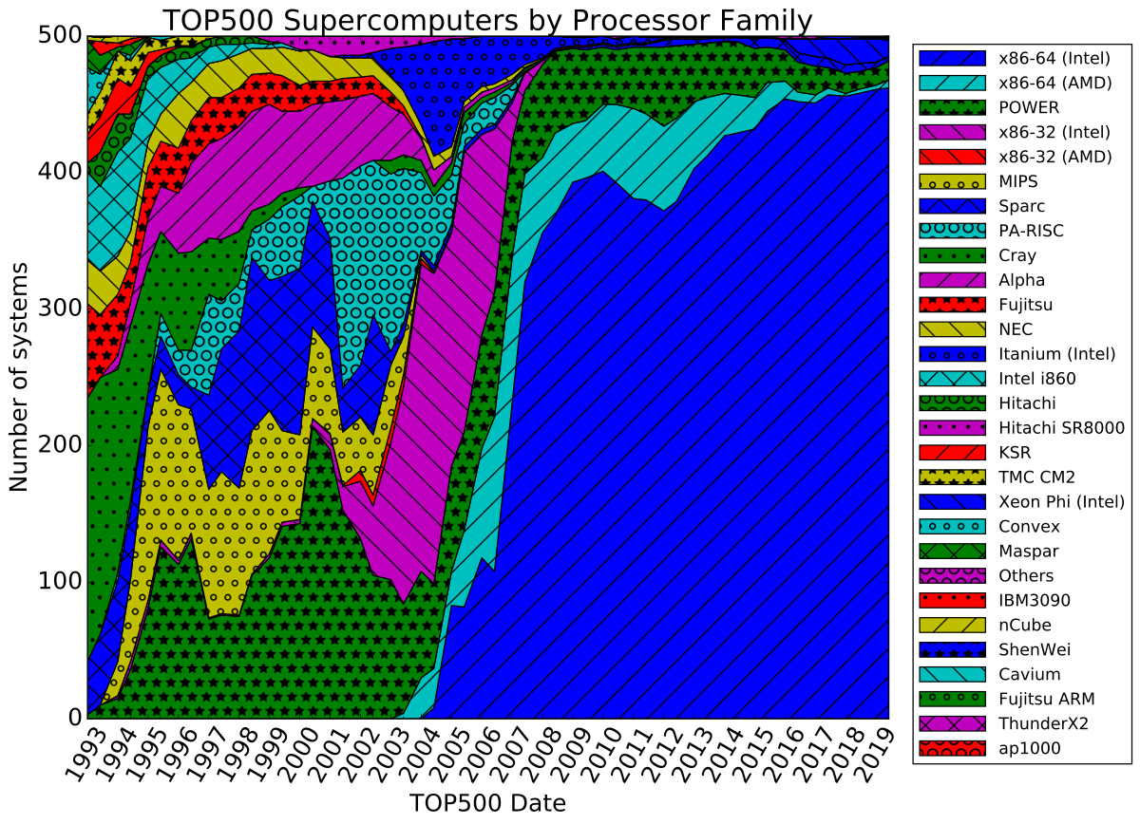
Lecture 01: History of High Performance Computing
Topics:
Course Syllabus
The Linux Operating System
Small Linux Clusters
Parallel Computing
The Neuronix Cluster
Supercomputing

Slide 2
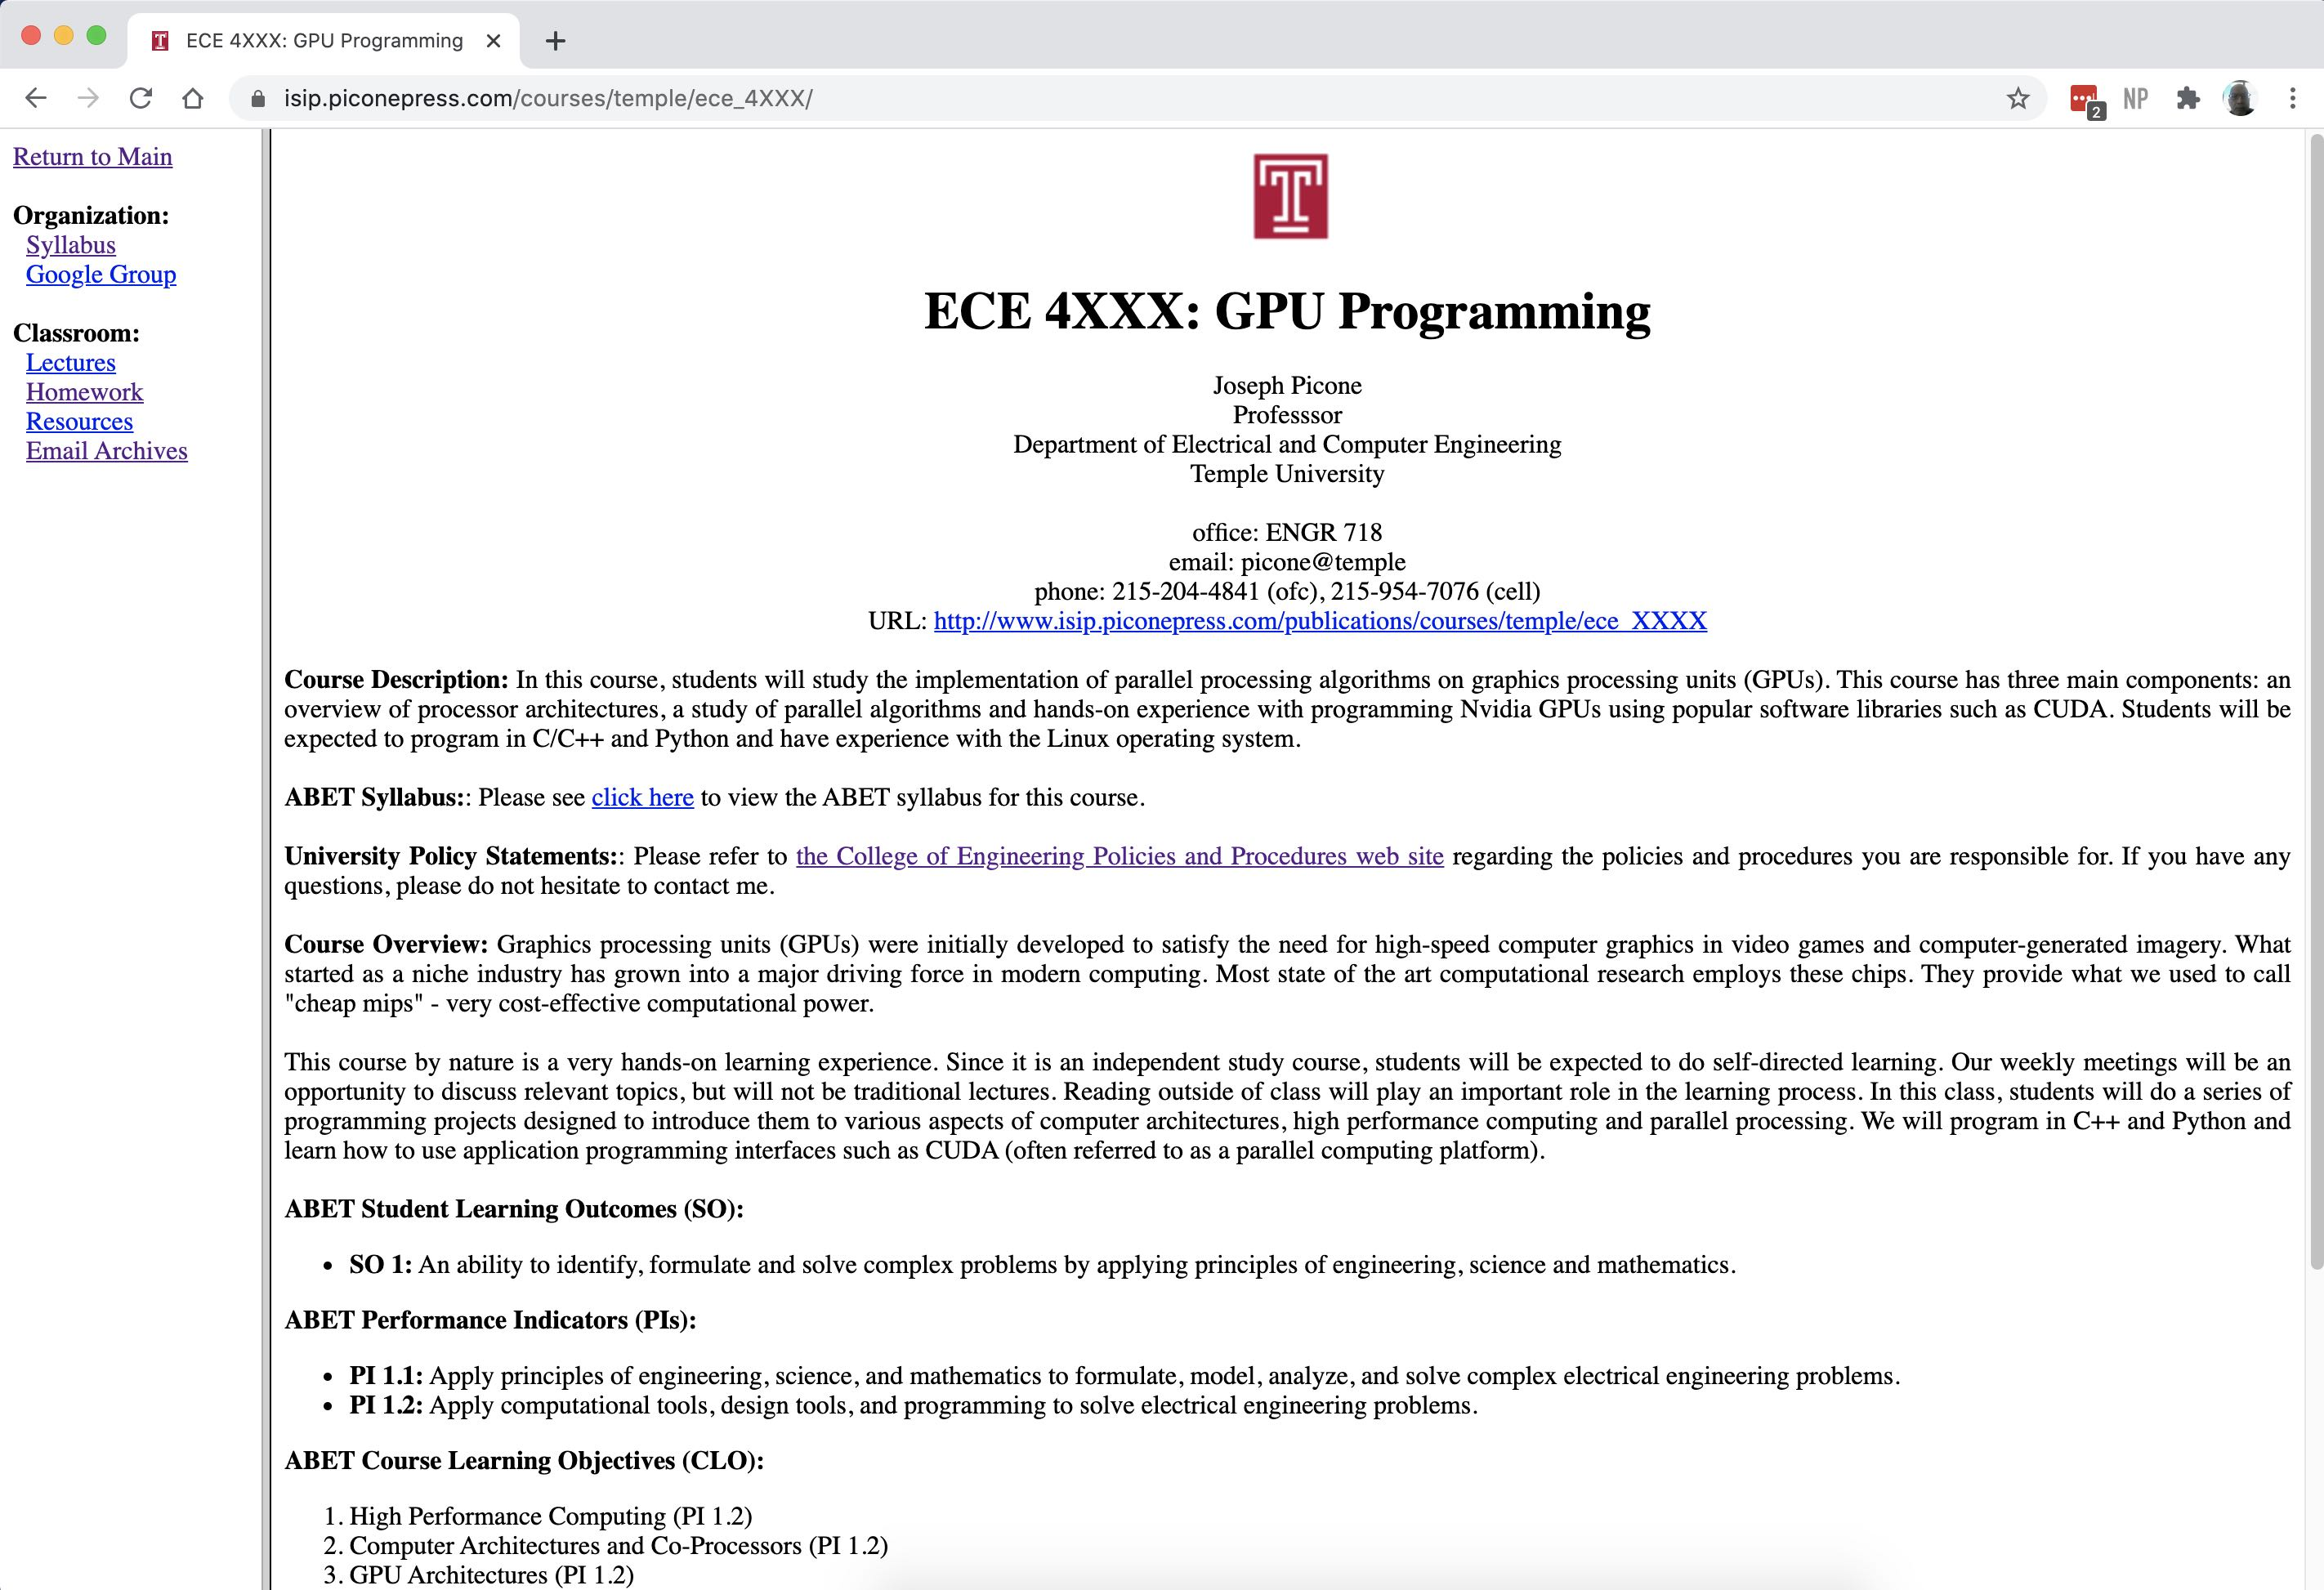
Course Syllabus and Web Site

Slide 3
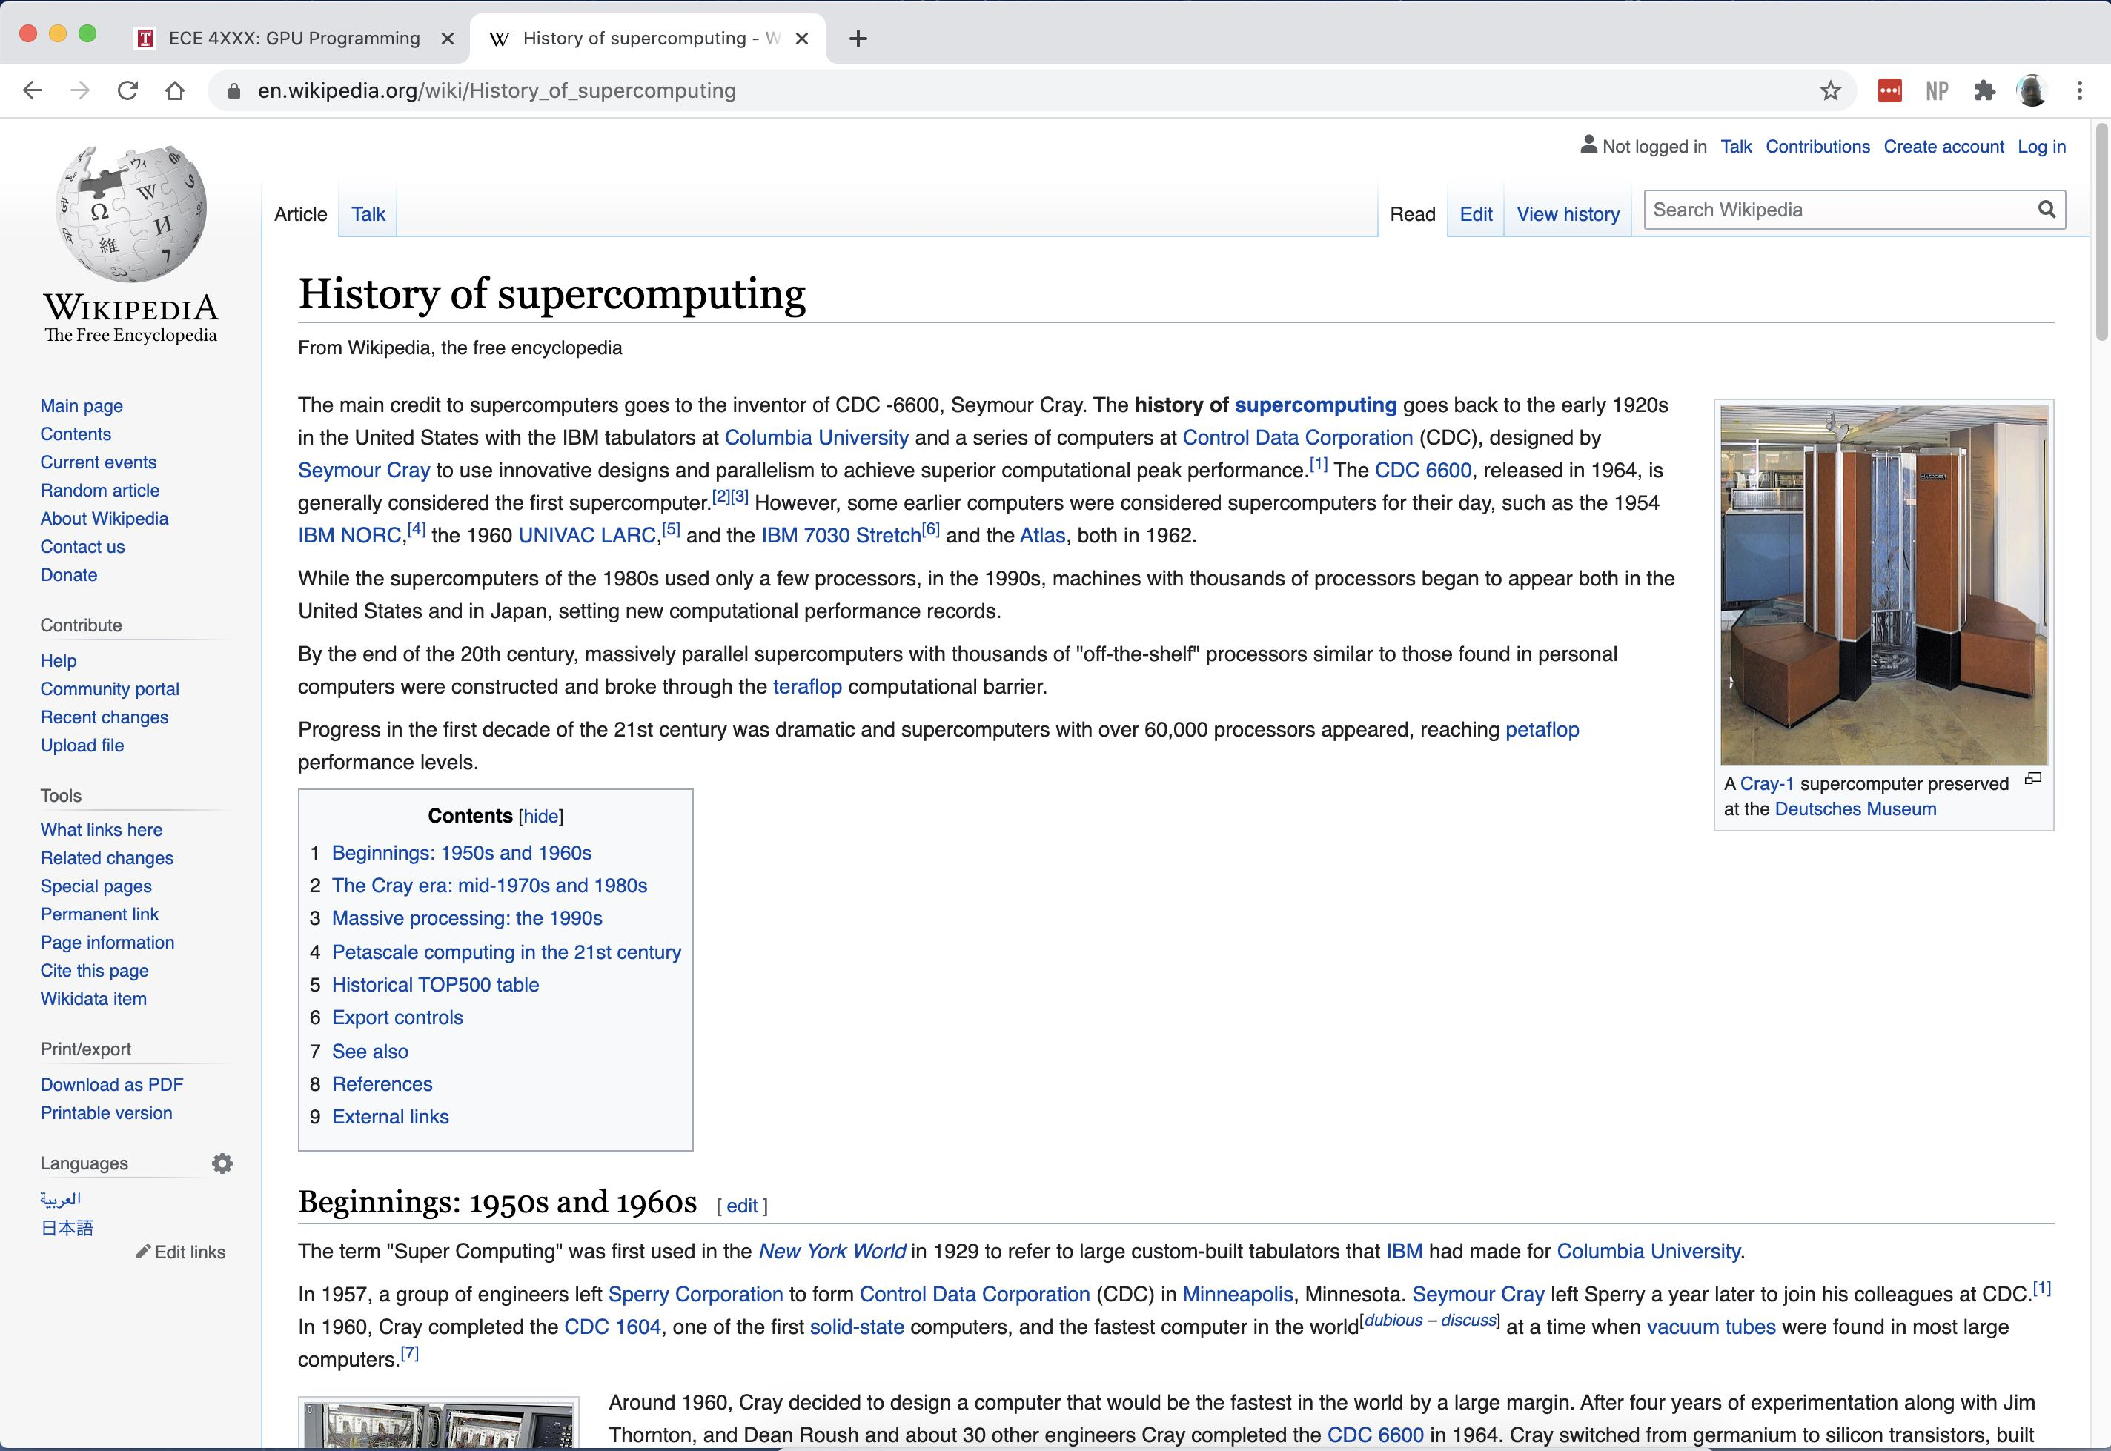
A Brief History of Supercomputing

Slide 4
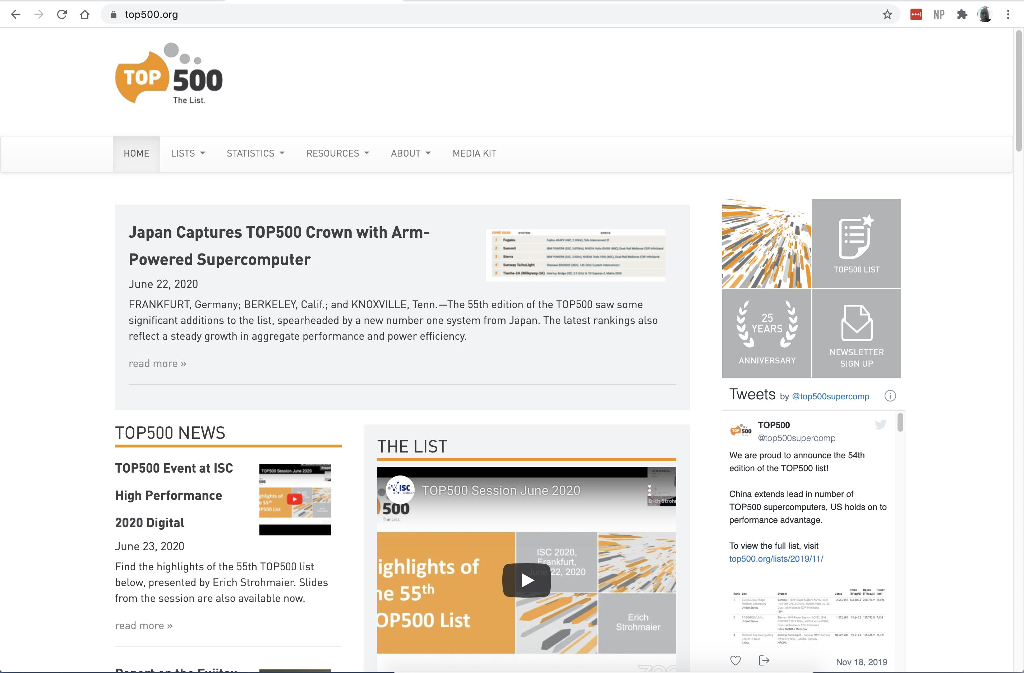
The Top 100 Supercomputers

Slide 5
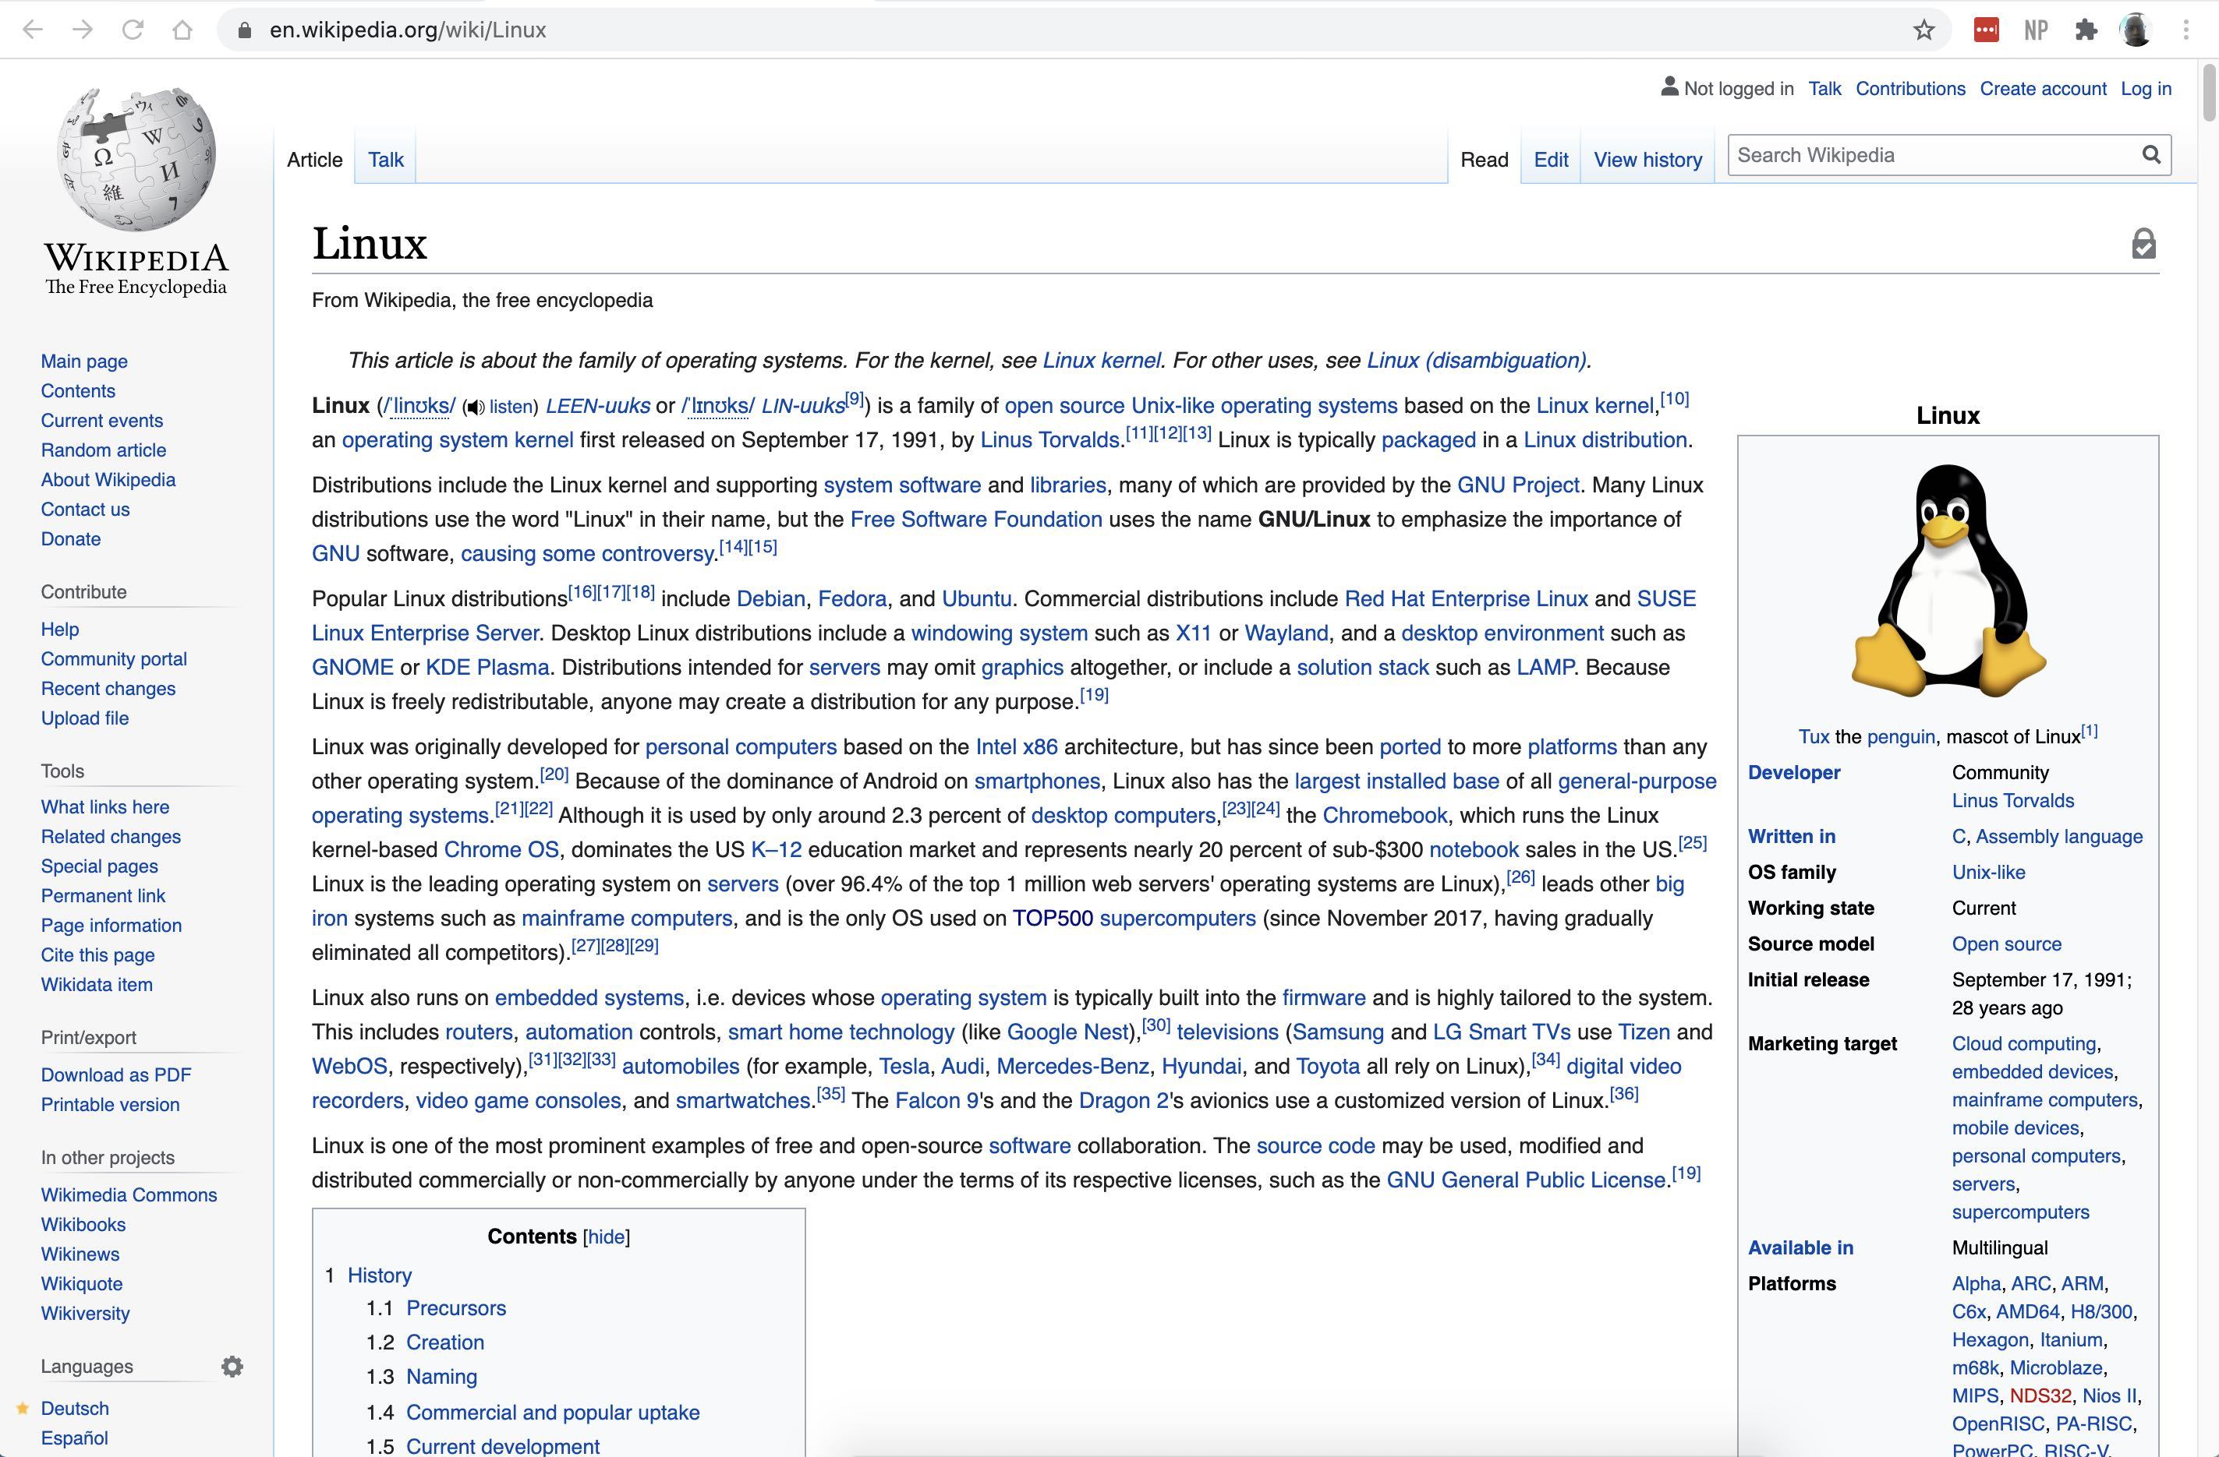
The Linux Operating System

Slide 6
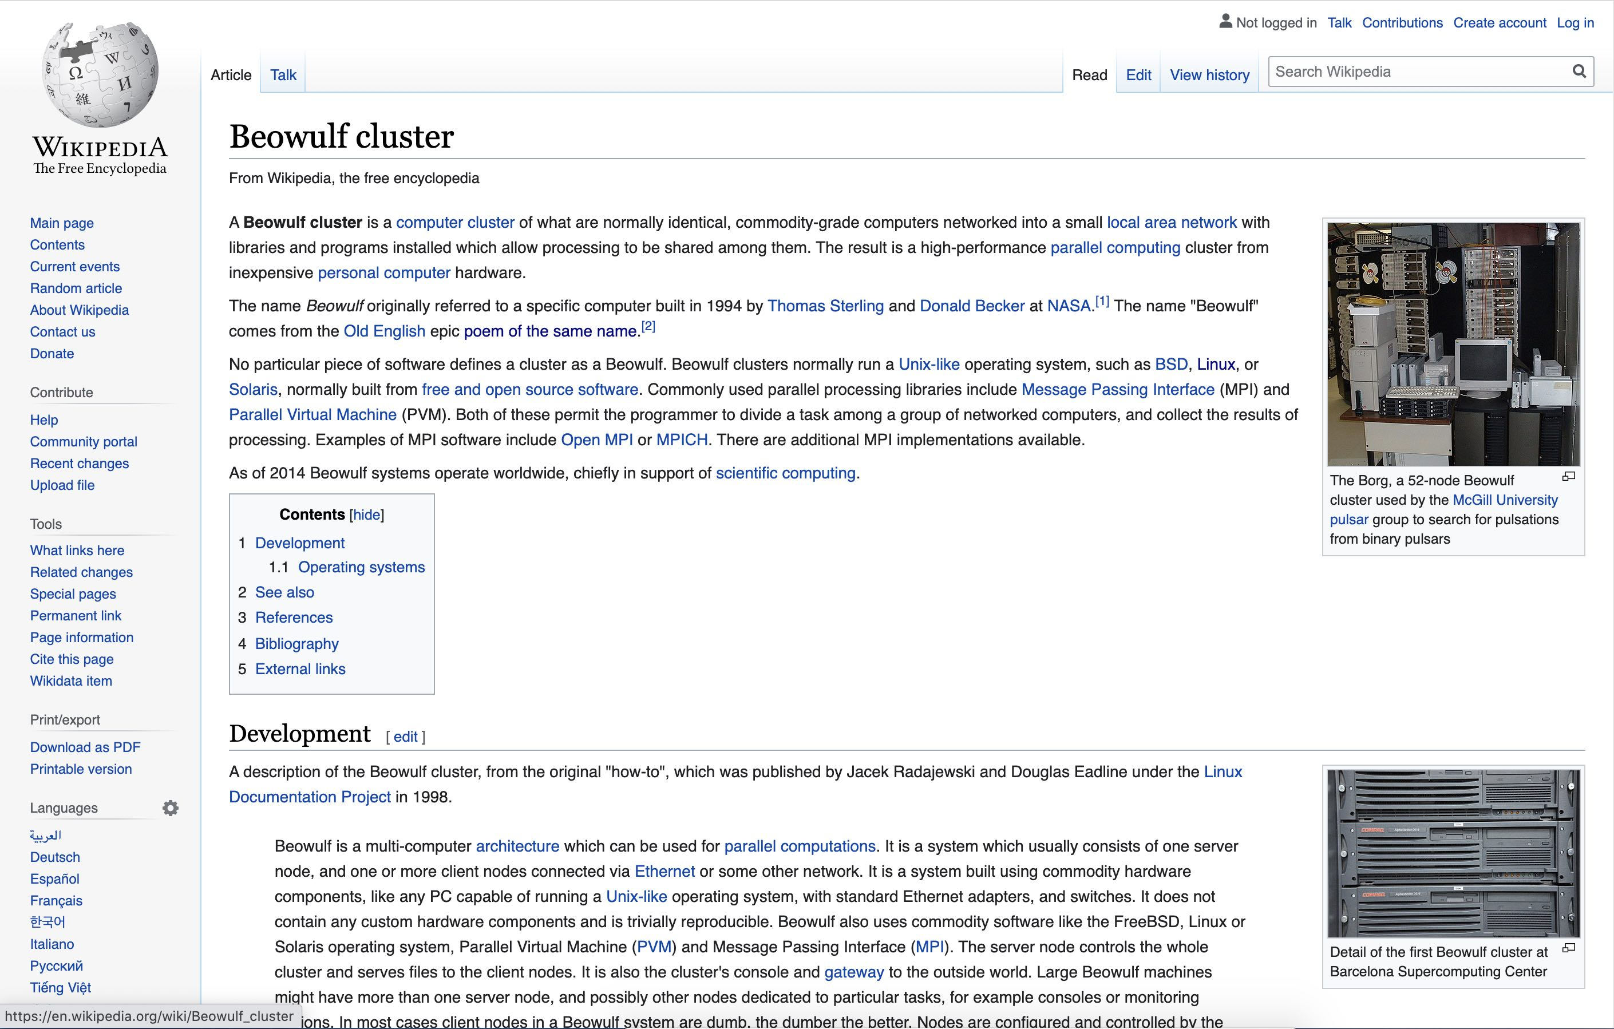
Small Linux Clusters

Slide 7
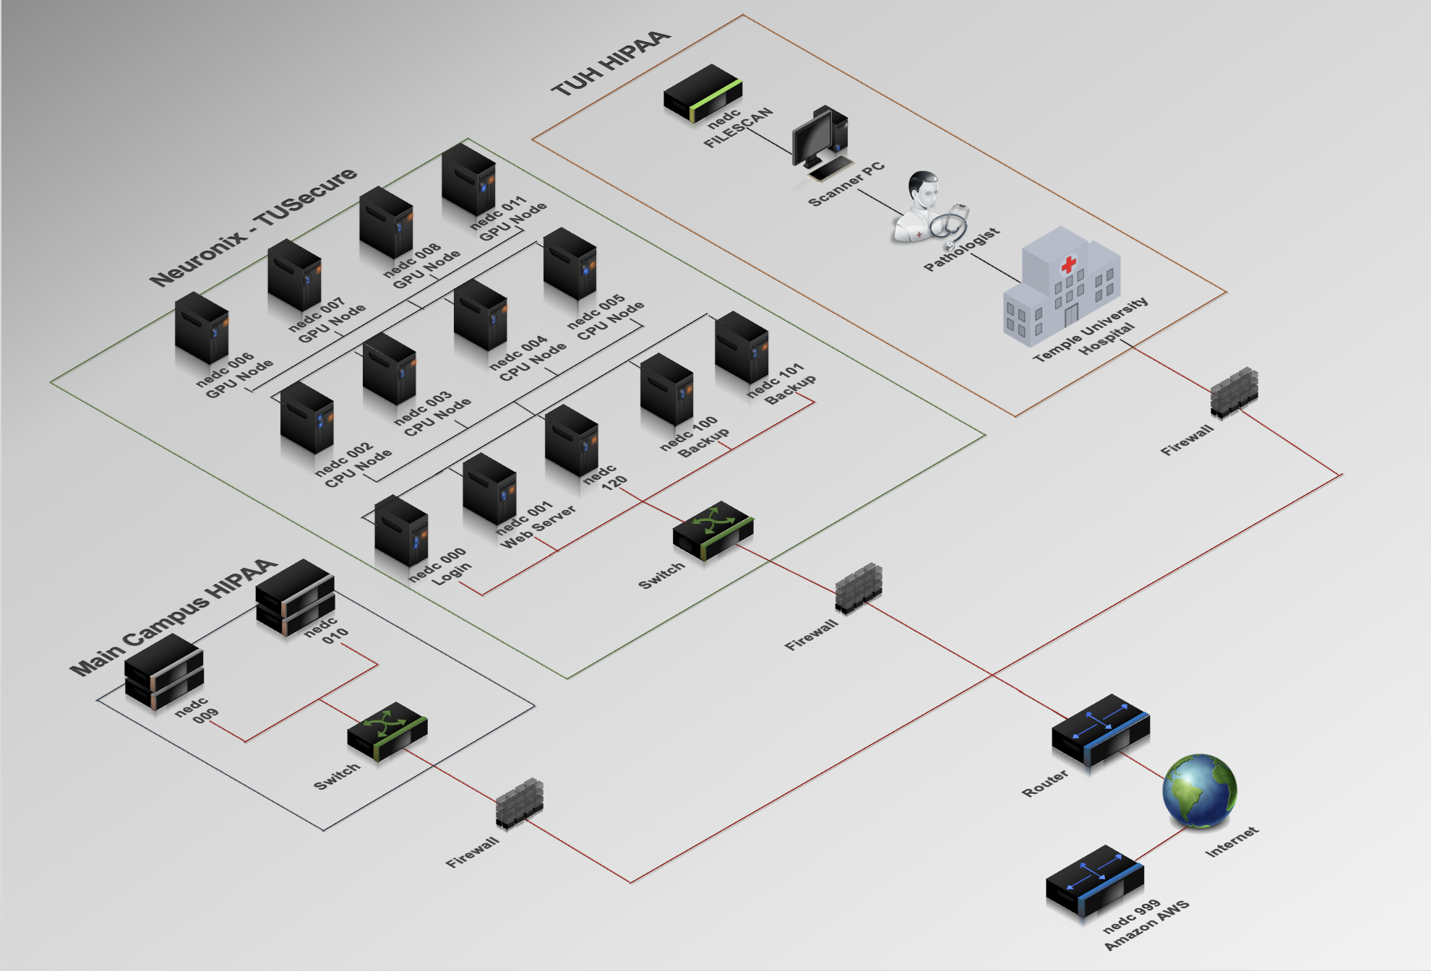
The Neuronix Cluster

Slide 8
A History of Supercomputing
Burton Smith
Microsoft

Slide 9
Outline
Definitions
Early days: Colossus and Eniac
Mainframes: Univac LARC to CDC 7600
SIMD systems
  Processor arrays: Illiac IV, PEPE, and BSP
  One-bit arrays: Staran, DAP, and the Goodyear MPP
  Vector pipelining: TI-ASC, CDC Star-100, and Cray-1
  Wide instructions: FPS, Multiflow, and Cydrome
MIMD systems
  Shared memory: Cray X-MP to SGI Altix
  Distributed memory: Cosmic Cube to Blue Gene
Japan-US competition
What next?

Slide 10
Definitions
Supercomputer: the world’s fastest computer at the time
SIMD: Single Instruction Stream, Multiple Data Stream
  One instruction at a time, each operating on an array of data
MIMD: Multiple Instruction Stream, Multiple Data Stream
  Multiple processors asynchronously issuing instructions
Shared Memory: MIMD computer in which a common memory is accessible by all processors
  UMA: Uniform memory access by all processors
  NUMA: Non-uniform memory access, based on placement
Distributed Memory: MIMD computer in which the memory is partitioned into processor-private regions
RISC: Reduced Instruction Set Computer
  Uses fast and simple instructions to do complex things
Pipelining: Processing in assembly-line style

Slide 11
Names and Places
BMD/ATC: Ballistic Missile Defense Advanced Technology Center, Huntsville, AL
BRL: Ballistics (now Army} Research Laboratory, Aberdeen, MD
DARPA: Defense Advanced Research Projects Agency, VA
NASA-Ames: Ames Research Center, Mountain View, CA
NASA-Goddard: Goddard Space Flight Center, Greenbelt, MD
Livermore: Lawrence Livermore National Laboratory, Livermore, CA
Los Alamos: Los Alamos National Laboratory, Los Alamos, NM
NSA: National Security Agency, Fort Meade, MD
Sandia: Sandia National Laboratories, Albuquerque, NM

Slide 12
Early days: Colossus
Used at Bletchley Park, England during WW II
  for cryptanalysis of Lorenz SZ40/42 rotor systems (“Fish”)
  Only recently declassified by Her Majesty’s Government
Concepts by Max Newman et al.
Designed and built by Tommy Flowers
  at the Post Office Research Station, Dollis Hill
Features:
  Paper tape loop data input at 30 mph = 5000 characters/sec
  1500 vacuum tubes (“valves”) in the Mark I, 2400 in Mark II
  Programmed by switches
  Not a general-purpose computer

Slide 13
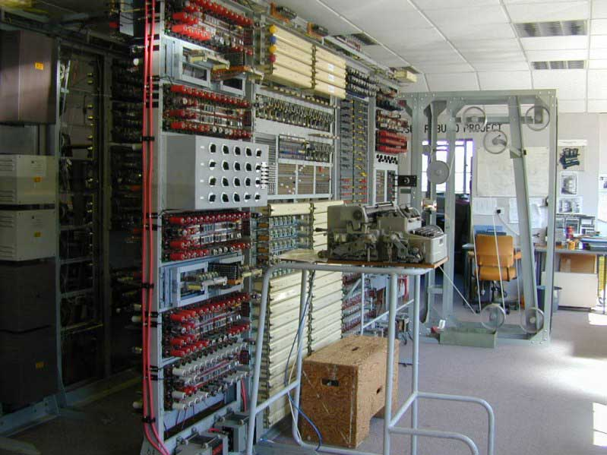
Colossus

Slide 14
Early days: Eniac
Built at Penn’s Moore School for BRL, Aberdeen, MD
  The motivating application was artillery firing tables
  Its first use was evaluating H-bomb feasibility
Designed and built by J. Presper Eckert and John Mauchly
Unveiled at the Moore School on February 15, 1946
It had 17,468 vacuum tubes and consumed 174 KW
  Reliability was a concern, so it was left on continuously
It was 80 feet long and weighed 30 tons
Programming was via switches and patch cables
Not a general-purpose computer

Slide 15

Eniac

Slide 16
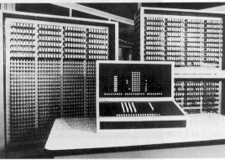
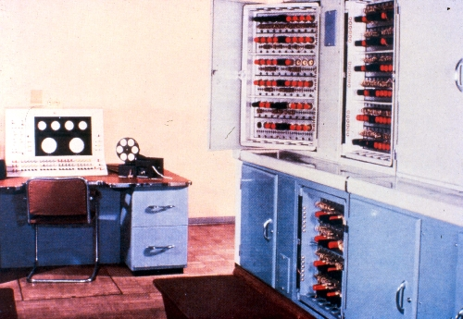
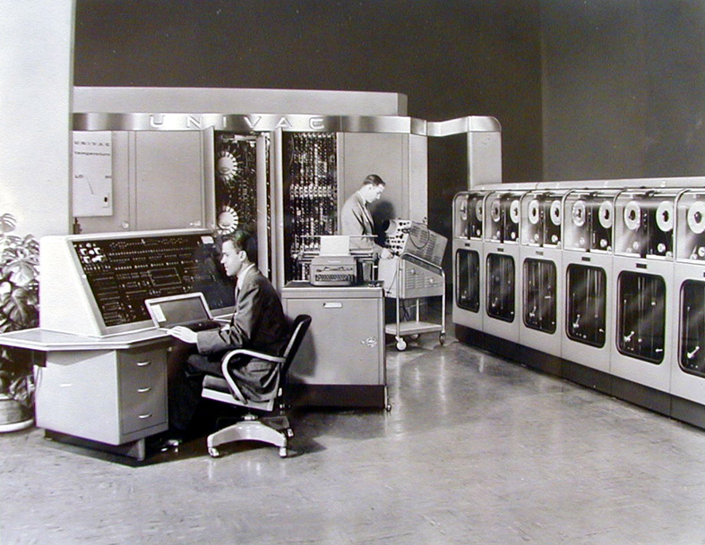
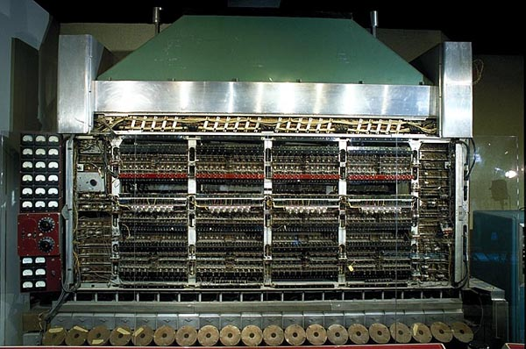
Other early supercomputers
Zuse Z3 (1941)
Manchester/Ferranti Mark I (1951)
Univac 1 (1951)
The IAS machines (1952)

Slide 17
Mainframes
The 50’s and 60’s saw fast progress in computer technology
Most of it was first used in “mainframe” supercomputers
  These systems were used for both business and science
  Later, supercomputers became much more science-oriented
Examples of new technology included:
  Magnetic core memory
  Transistor logic circuits
  Floating point hardware
  Pipelining
  High level languages and compilers

Slide 18
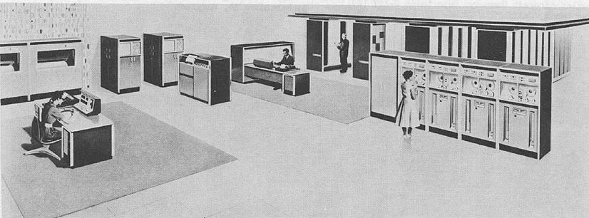
Mainframes: LARC
Begun in 1955 for Livermore and delivered in 1960
Had dual processors and decimal arithmetic
Employed surface-barrier transistors and core memory

Slide 19
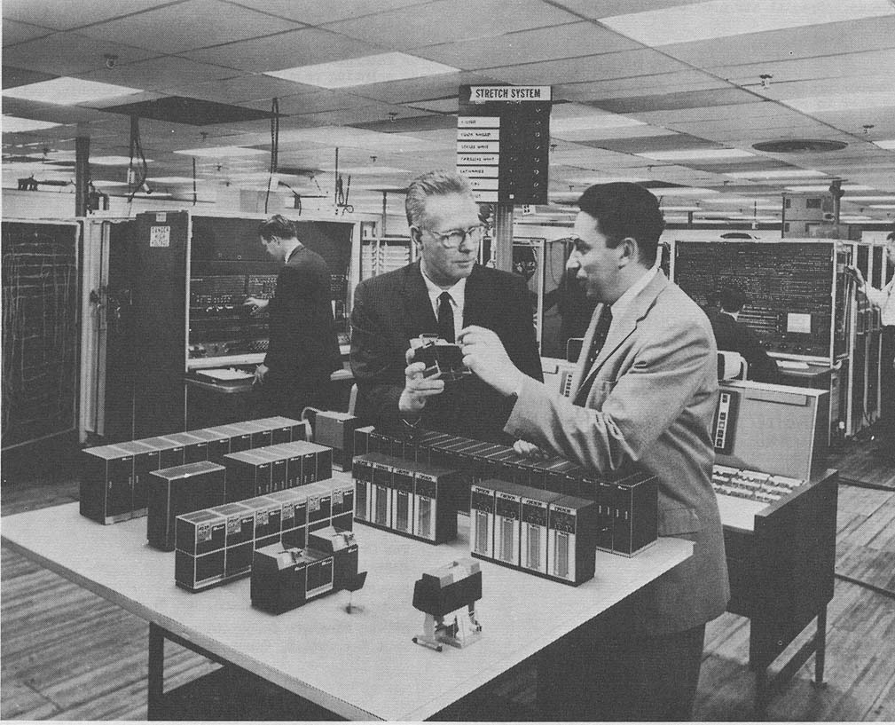
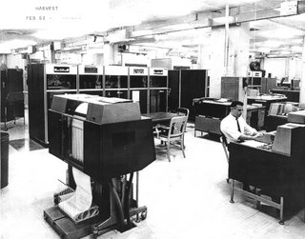
Mainframes: Stretch and Harvest
IBM 7950 (HARVEST)
Delivered to NSA 2/62
Was STRETCH + 4 boxes
  IBM 7951 Stream unit
  IBM 7952 Core storage
  IBM 7955 Tape unit
  IBM 7959 I/O Exchange
IBM 7030 (STRETCH)
Delivered to Los Alamos 4/61
Pioneered in both architecture
and implementation at IBM

Slide 20
Mainframes: CDC 6600
Seymour Cray and Bill Norris left Univac to start CDC
Cray’s CDC 1604 was the first successful transistor system
He wanted to build a scientific supercomputer
The 6600, built with silicon transistors, shipped Sept. 1964
  The chief architects were Seymour Cray and Jim Thornton
The 6600 had several notable features
  A very simple instruction set, lending itself to more speed
    No decimal arithmetic needed or wanted
  10 arithmetic function units able to process in parallel
    This overlapped execution style is now called superscalar
    It was coordinated by a famous circuit called the scoreboard
  Parallel I/O processors using a new idea called multithreading
    Some say RISC means “Really Invented by Seymour Cray”
  A futuristic operator’s console was provided at no extra charge

Slide 21
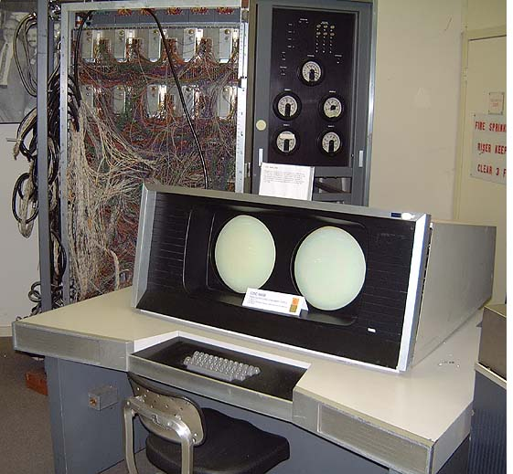
CDC 6600 Console

Slide 22
Mainframes: IBM 360/91
IBM’s Tom Watson was angry:
"Last week, Control Data ...announced the 6600 system. I understand that in the laboratory...there are only 34 people including the janitor. Of these, 14 are engineers and 4 are programmers. Contrasting this modest effort with our vast development activities, I fail to understand why we have lost our industry leadership position by letting someone else offer the world's most powerful computer."
The 360/91 (AKA 370/195) was IBM’s answer
It was delivered to NASA-Goddard in October 1967
Killer App: Passenger Airline Reservation Systems (1964)
  Jointly developed by IBM, American, and United Airlines
  Originally written in IBM assembly (i.e. machine) language
It was very close to the CDC 7600 in performance
The 360/91 also had a pretty impressive console…

Slide 23
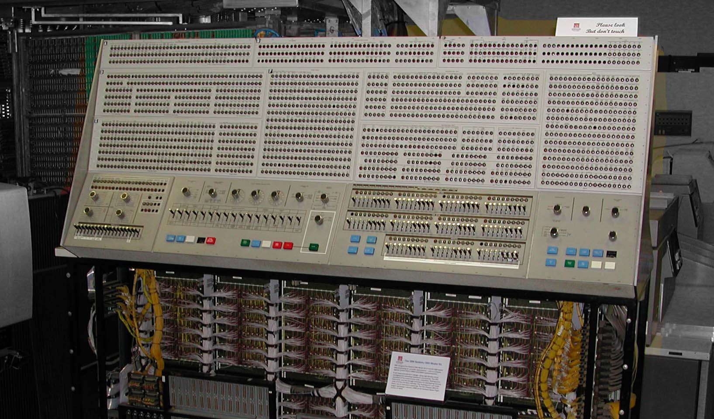
IBM 360/91 Console

Slide 24
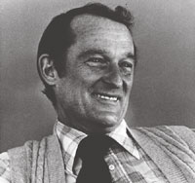
Mainframes: CDC 7600
The 7600 was delivered to Livermore in early 1969
It was highly compatible with the 6600
Besides being faster, its arithmetic was pipelined
  This meant the arithmetic units were never busy
It was so compact it had to be cooled with freon
It was also one of the worlds most beautiful computers
Seymour Cray

Slide 25
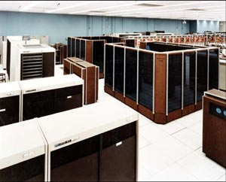
Two CDC 7600s

Slide 26
SIMD arrays: Illiac IV
By the late 60’s, it was clear mainframes weren’t enough
To improve performance, SIMD array machines were built or proposed with many arithmetic processing units
  Solomon was an early Westinghouse SIMD array prototype
The Illiac IV was a University of Illinois/Burroughs project
  Funded by DARPA from 1964 onward, it was usable in 1975
  The chief architect, Dan Slotnick, came from Westinghouse
It was to have 256 arithmetic units, later cut back to 64
The thin-film memory system was a major headache
After student demonstrations at Illinois in May 1970, the project was moved to NASA-Ames
Languages like IVtran (not pronounced four-tran) aimed to use parallel loops to express the necessary parallelism
  Much compiler expertise was developed working on Illiac IV

Slide 27
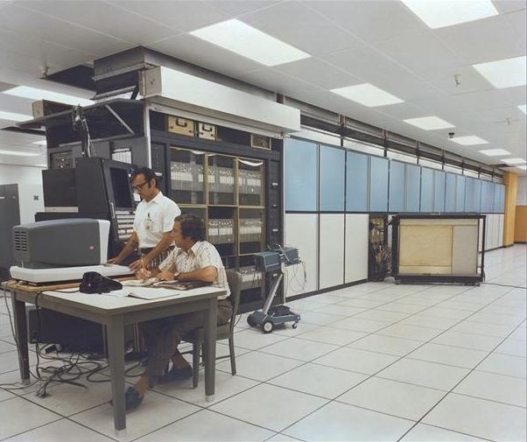
ILLIAC IV

Slide 28
SIMD Arrays: PEPE and BSP
Both were Burroughs designs derived from Illiac IV
PEPE had 288 processing elements and was designed to track ballistic missiles
  It was delivered to BMD/ATC in Huntsville in 1976
BSP had 16 processing elements and was aimed at commercial use
  Richard Stokes was chief architect
  The first customer was Marathon Oil Co. in Denver, CO
  The project was cancelled in 1980, before its first delivery

Slide 29
One-bit Arrays: STARAN, DAP, MPP
These were arrays of processors that were only one bit wide
  They were inexpensive to implement, especially on one chip
  Arithmetic was serial (like grade-school, only binary)
    It could use whatever precision made sense for the problem
Goodyear Aerospace developed STARAN in 1972
  It was a 256 by 256 array with lots of data permuting power
  Ken Batcher, an Illinois graduate, was chief architect
  It was great at image processing, though not intended for it
  The ASPRO version was used on Navy AWACS aircraft
The Goodyear MPP was a single-chip STARAN successor
  The array size was reduced to 128 by 128
  Delivered to NASA-Goddard in 1984
ICL (UK) developed the Distributed Array Processor
  Stuart Reddaway was the architect

Slide 30
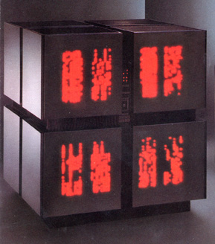
One-bit Arrays: Connection Machine
Danny Hillis and his colleagues initially based the design on a “connectionist” approach to artificial intelligence
  The design came out of Danny’s PhD thesis at MIT
The CM-1 was a hypercube-connected one-bit array
  High-level language support was excellent
  The machine proved useful for scientific computation
The CM-2/CM-200 added some
32-bit floating point hardware
  Many HPC users like NSA and
  Los Alamos bought them
The CM-2 had an array of light-
emitting diodes (right)
  Not one per processor, sadly
The CM-5 was MIMD, not SIMD
CM-2

Slide 31
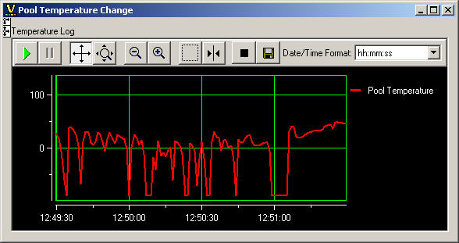
Vector pipelining: TI ASC
The ASC was designed to exploit Fortran loops
  This motivated the vector pipelining decision
  The ASC’s Fortran compiler was state-of-the-art
Several systems shipped, beginning in 1974
  Geophysical Fluid Dynamics Laboratory, Princeton, NJ
  Ballistic Missile Defense, Huntsville
  Naval Research Laboratory, Anacostia, MD
The GFDL machine had an interesting performance tool: a strip-chart recorder perched on top that plotted vector length
  The recording was returned to the user with the job output

Slide 32
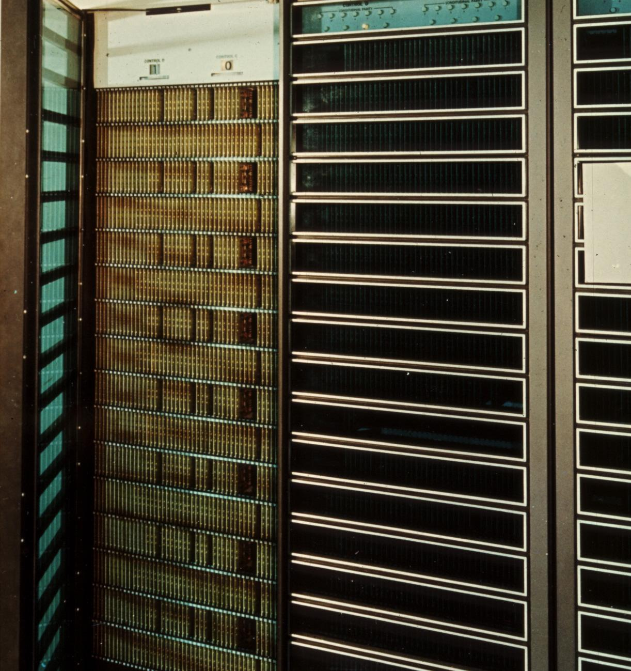
Vector Pipelining: CDC Star 100
CDC used APL rather than Fortran loops as a vector model
  APL is a language invented by Ken Iverson of IBM Research
  Neil Lincoln and Jim Thornton were the architects
  Sidney Fernbach at Livermore was the target customer
The Star-100 had poor scalar (non-vector) performance
  The result was highly limited applicability
  This effect is called Amdahl’s law
Both Livermore and Los Alamos
were scheduled to get one
  Los Alamos backed out
  in favor of the Cray-1
  Livermore got both Star-100
  systems as a result
Star-100

Slide 33
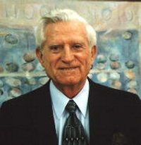
Amdahl’s law
If w₁ work is done at speed s₁ and w₂ at speed s₂,
the average speed s is (w₁+w₂)/(w₁/s₁ + w₂/s₂)
  This is just the total work divided by the total time
For example, if w₁= 9, w₂= 1, s₁= 100, and s₂= 1
then s = 10/1.09 ≅ 9
  This is obviously not the average of s₁ and s₂
Amdahl, Gene M, “Validity of the single
processor approach to achieving large
scale computing capabilities”,
Proc. SJCC, AFIPS Press, 1967

Slide 34
Vector Pipelining: Cray-1
Unlike the CDC Star-100, there was no development contract for the Cray-1
  Mr. Cray disliked government’s looking over his shoulder
Instead, Cray gave Los Alamos a one-year free trial
Almost no software was provided by Cray Research
  Los Alamos developed or adapted existing software
After the year was up, Los Alamos leased the system
  The lease was financed by a New Mexico petroleum person
The Cray-1 definitely did not suffer from Amdahl’s law
  Its scalar performance was twice that of the 7600
  Once vector software matured, 2x became 8x or more
When people say “supercomputer”, they think Cray-1

Slide 35
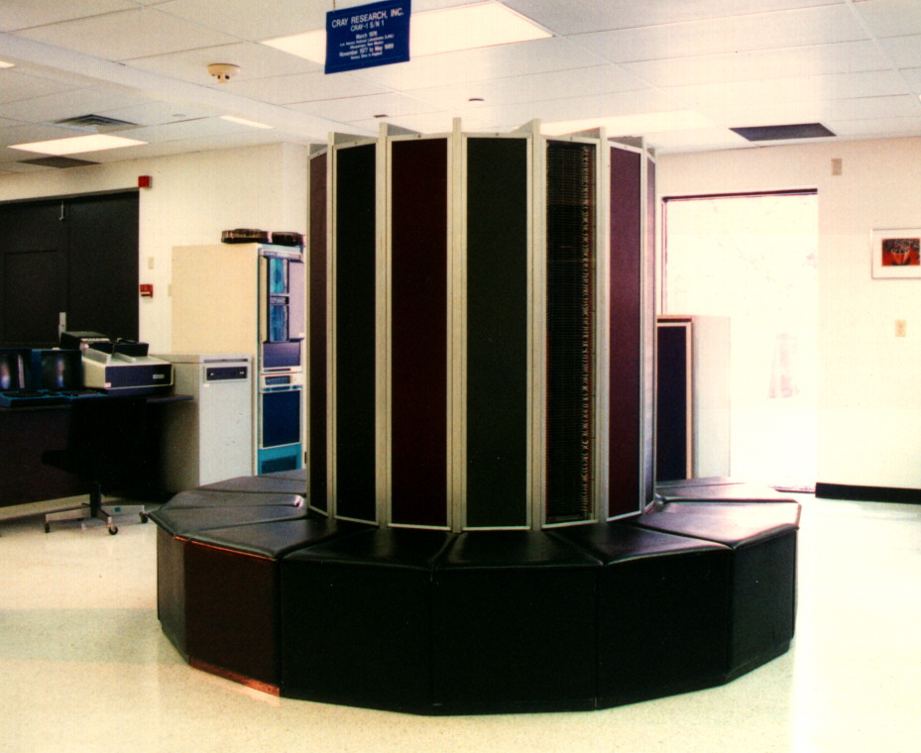
Cray-1

Slide 36
VLIW: FPS, Multiflow, and Cydrome
VLIW stands for Very Long Instruction Word
  It is a kind of SIMD system in which each arithmetic unit can be doing something different (thus the need for width)
Floating Point Systems led in 1976 with the AP-120B
  Glenn Culler was the chief architect
  These systems were embedded in GE CAT scanners
  They were also used widely for seismic data processing
Multiflow was founded in 1984 by Josh Fisher to exploit some compiler technology he had been pursuing at Yale
  The first shipments of the Trace 7/200 were in 1987
Bob Rau’s company, Cydrome, was also founded in 1984 and demonstrated the Cydra-5 machine in 1987
Both systems had instructions with seven fields and 256 bits
Technically, none of these machines was a supercomputer

Slide 37
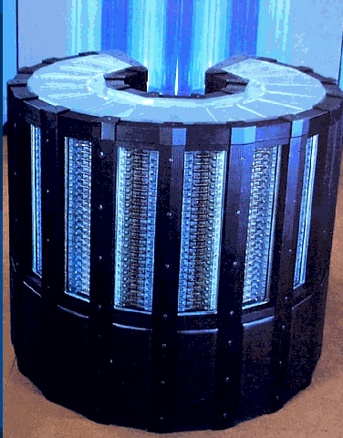
Shared Memory: Cray Vector Systems
Cray Research, by Seymour Cray
  Cray-1 (1976): 1 processor
  Cray-2 (1985): up to 4 processors*
Cray Research, not by Seymour Cray
  Cray X-MP (1982): up to 4 procs
  Cray Y-MP (1988): up to 8 procs
  Cray C90: (1991?): up to 16 procs
  Cray T90: (1994): up to 32 procs
  Cray X1: (2003): up to 8192 procs
Cray Computer, by Seymour Cray
  Cray-3 (1993): up to 16 procs
  Cray-4 (unfinished): up to 64 procs
All are UMA systems except the X1, which is NUMA
  *One 8-processor Cray-2 was built
Cray-2

Slide 38
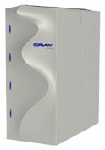
Shared Memory: Multithreading
These systems pipeline MIMD architecture in the same way vector systems pipeline SIMD architecture
  Like vector multiprocessors, they can be UMA or NUMA
Examples include
  Denelcor HEP (1980): up to 16 procs
  Tera MTA-1 (1998): up to 16 procs
  Cray MTA-2 (2002): up to 256 procs
A variant form of multithreading is
Simultaneous Multithreading (SMT)
  Intel® calls SMT “Hyper-Threading”
Cray MTA-2

Slide 39
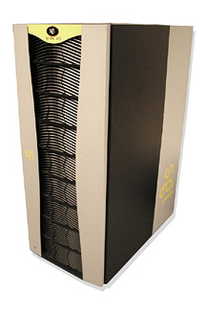
Shared Memory: CC-NUMA
Cache-coherent NUMA systems were researched at Stanford and developed as products by Silicon Graphics
  Kendall Square Research used a variant called COMA, which stands for Cache-Only Memory Architecture
These systems automatically move data among caches at each processor to minimize processor data access times
SGI CC-NUMA systems:
  Origin 2000 (1997): up to 128 procs
  Origin 3000 (2003): up to 512 procs
  Altix (2003): up to 512 procs*
Kendall Square COMA systems:
  KSR1: (1991): up to 1088 procs
  KSR2: (1994): up to 5000 procs
  * “Columbia” at NASA-Ames clusters 20 of these
SGI Altix

Slide 40
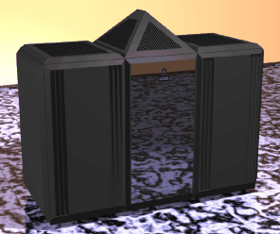
Distributed Memory: Cosmic Cube
Chuck Seitz and Geoffrey Fox pioneered the idea at Caltech
  The first system (1982) was called the Cosmic Cube
  It had 64 Intel® 8086 processors, each with an 8087 attached
  The processors were connected in a 6-dimensional hypercube
  They communicated by sending messages to each other
  This system architecture now dominates supercomputing
Early commercial systems included:
  Ametek/S14 (1986): 68020, over 1000 procs
  Intel® IPSC/1 (1985): 80286, up to 64 procs
  nCUBE/10 (1985): custom, up to 1024 procs
Variations since then are legion
nCUBE/10

Slide 41
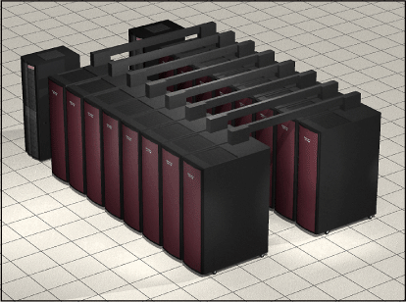
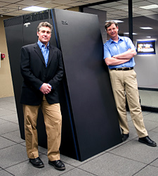
Distributed Memory: Classic MPPs
A classic MPP is a distributed memory system whose processing elements are individual (micro)processors
Examples include:
  Cray T3D (1994), T3E (1996), XT3
  Intel Touchstone series, Paragon (1992)
  IBM SP-1 (1992), SP-2, Deep Blue, Blue Gene
  And many others
Cray XT3
IBM Blue Gene/L

Slide 42
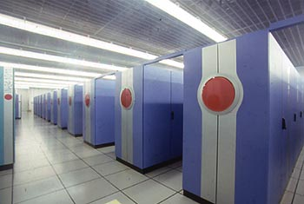
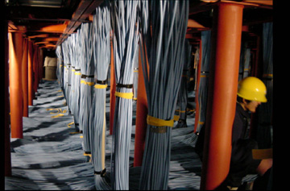
Distributed Memory: Clusters
A cluster MPP is a distributed memory system whose processing elements are shared memory multiprocessors
Examples include:
  IBM eServer p575
  NEC Earth Simulator (2002), SX-8
  A vast multitude of home-made “Beowulf” clusters
    Usually based on Intel or AMD processors
    Even Government Labs have done this
Earth Simulator (above)
Earth Simulator (below)

Slide 43
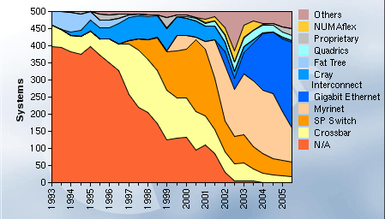
The Top 500 List
This is a list of the fastest computers in the world
  www.top500.org
  By definition, it’s a great place for supercomputer spotting
Be very careful about the term “fastest”, though
  Speed is measured by one benchmark program, LINPACK
  LINPACK doesn’t care how well the system is connected
  Shared memory isn’t useful for good LINPACK results
With that caveat, it’s well worth a look

Slide 44
Japanese Systems: Fujitsu, NEC, Hitachi
Japanese supercomputers mostly use vector processors with shared or (most recently) distributed memory architecture
Fujitsu shipped its first vector system (Facom 230) in 1976:
  This was followed by the VP200 (1982), VP400 (1985),
  VP2000 (1989), VP2600(1990), and distributed memory VPP500(1992), VPP700(1996), and VPP5000(1999)
  Recently, Fujitsu has been selling scalar NUMA systems
NEC got a late start on vectors, but caught up very quickly:
  SX-1 (1983), SX-2 (1985), SX-3 (1990), SX-4 (1994),
  SX-5 (2000), and distributed memory SX-6 and SX-7 (2002), Earth Simulator (2002), and SX-8 (2006)
  Tadashi Watanabe is the chief architect of these systems
Hitachi has sold few supercomputers outside Japan
  An exception is the distributed memory SR8000 (2000)

Slide 45
Japanese National Projects
The National Superspeed Computer Project (1981)
  About ¥23 billion over 9 years
  Intended to produce a supercomputer
  Two projects: architecture and technology
  Companies: Fujitsu, NEC, Hitachi, Mitsubishi, Oki, Toshiba
The Fifth Generation Project (1982)
  About ¥55 billion over 10 years
  Centered at a new laboratory: ICOT
  Focused on artificial intelligence: inference, vision, speech
  MCC in Austin, TX was a US industrial response

Slide 46
DARPA Strategic Computing Program
This program was intended to accelerate the development and application of parallel computing
It funded several industrial development projects over the period 1983-1993:
  Thinking Machines: Connection Machine (1-bit SIMD array)
  Bolt, Beranek, and Newman: Butterfly (shared memory)
  Intel: Touchstone series (distributed memory)
  Tera: MTA (shared memory)
  Cray: T3D (distributed memory)
Government agencies were encouraged to try these systems

Slide 47
The DOE ASCI Program
The Department of Energy was directed to use computer simulation to replace nuclear weapons testing
It has procured a series of distributed memory systems:
  System Name Laboratory Manufacturer Date
  Red Sandia Intel 1995
  Blue Pacific Livermore IBM 1996
  Blue Mountain Los Alamos SGI 1998
  White Livermore IBM 2000
  Q Los Alamos Compaq 2002
  Red Storm Sandia Cray 2004
  Purple Livermore IBM 2006
The performance range is about 100-fold

Slide 48
What Next?
Parallelism is becoming mainstream
  Intel and AMD are putting multiple processors on a chip
  It’s only a few now, but just wait!
This will change the supercomputer playing field, again
  Parallel application software will emerge
  Parallel languages and compilers will enable it
  Parallel architecture will evolve to match
The world’s computers become one giant cluster
  The cloud links them
  We must make them safe
What an exciting field it is with such challenges!

Slide 49
Apologies: Companies Not Mentioned
Alliant
Convex
HP
MasPar
Matsushita
Meiko
Parsys
Parsytec
Quadrics
Siemens-Nixdorf
Sun

