Slide 1
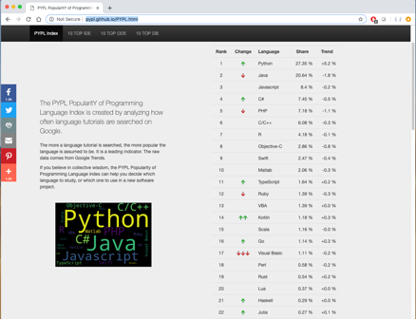
LECTURE 42: The Job Market
Topics:
Programming Languages
Jobs
Skills
Resources:
PYPL: Popular Languages
BI: Ten Most Popular Languages
GfG: Most Popular Languages
TIOBE: Index for 2019
TR: Job Market

Slide 2
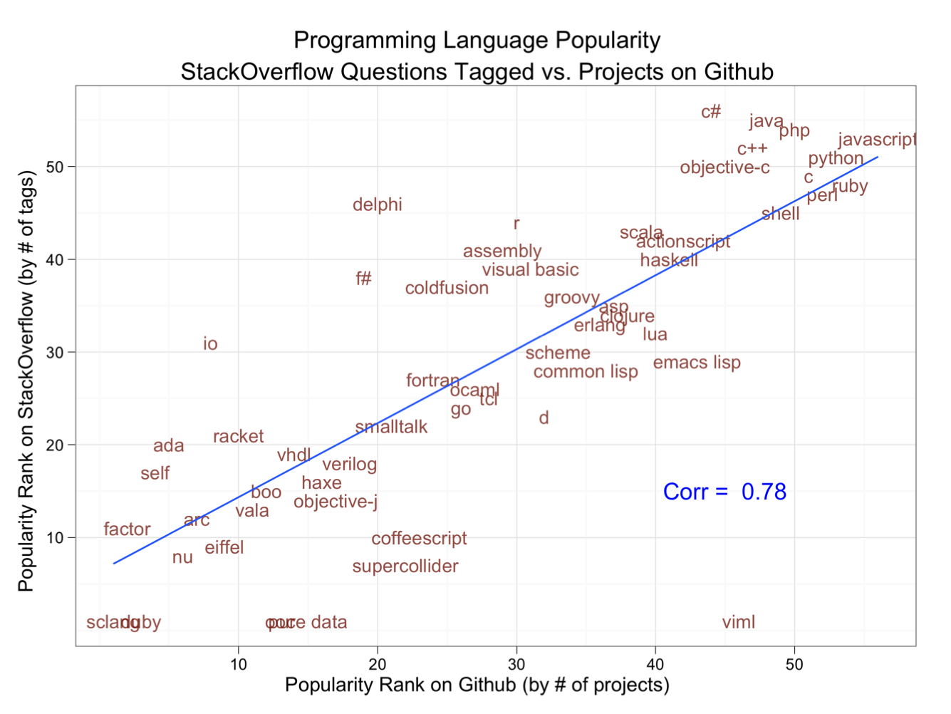
Popularity of Languages

Slide 3
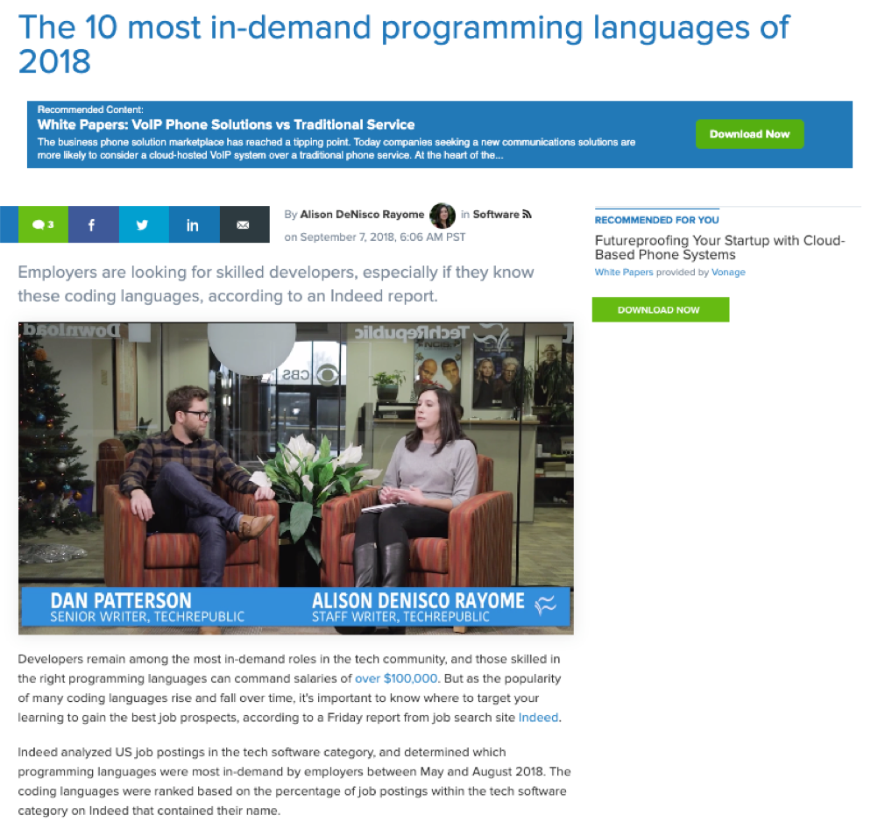
Job Market

Slide 4
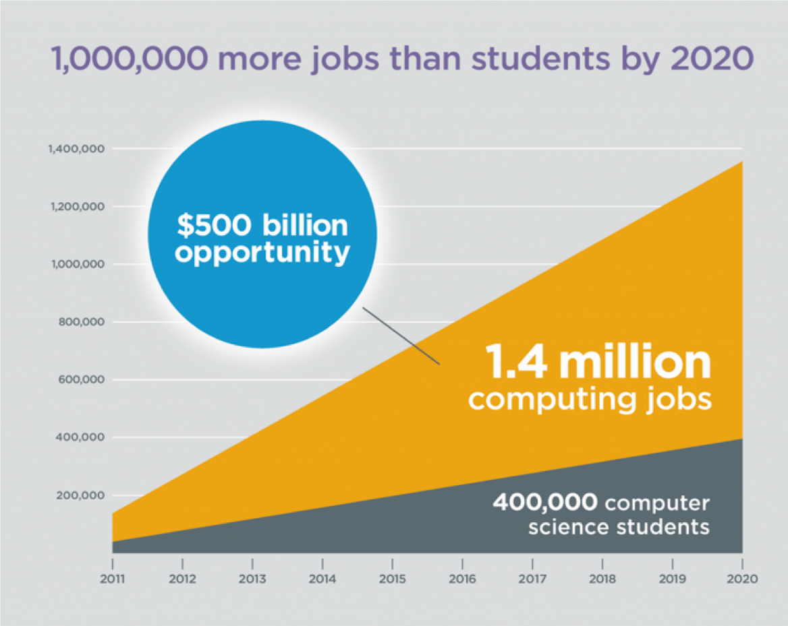
Job Market

Slide 5
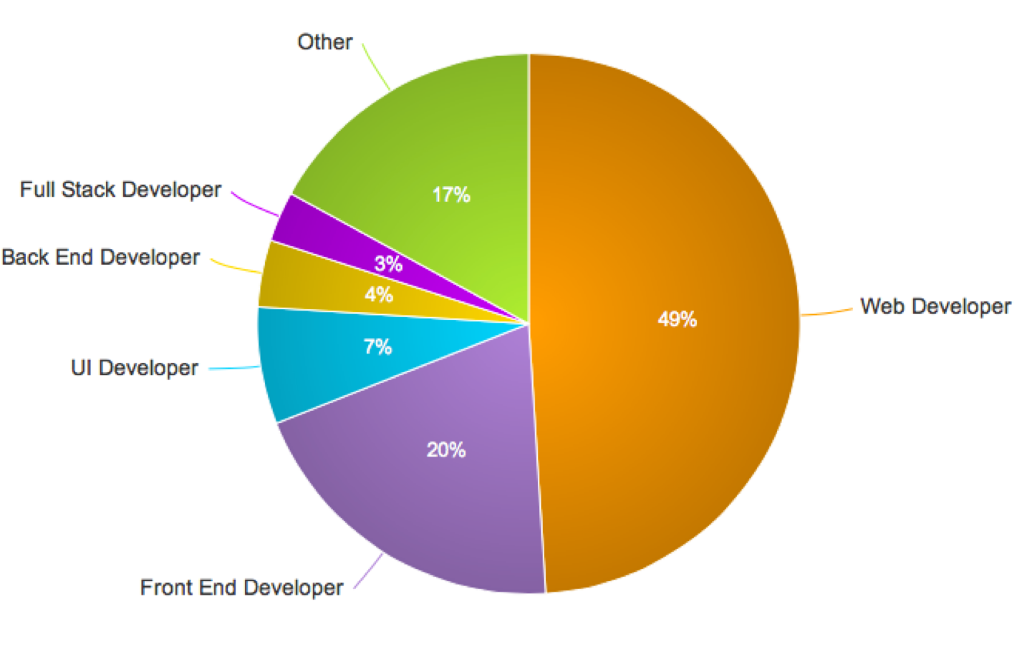
Web Development

