Slide 1
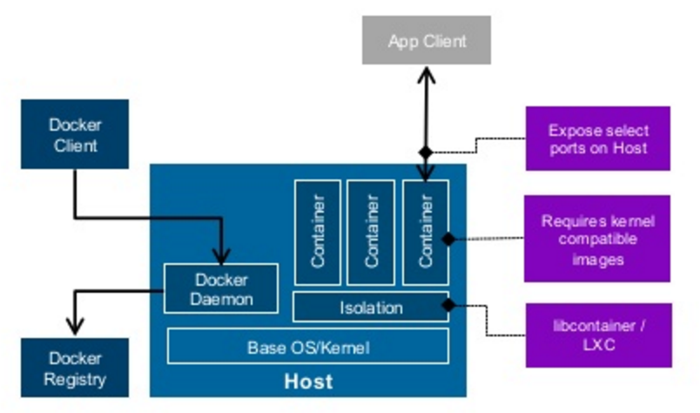
LECTURE 40: Software Distribution
Topics:
Make/Configure
Package Builders
Dockers and Containers
Resources:
GB: Make and Configure
Ubuntu: AptGet
Wiki: Homebrew
Lynda: Dockers and Containers
Docker: What is Docker?
Docker: Introduction

