Slide 1
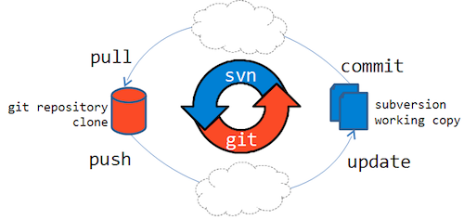
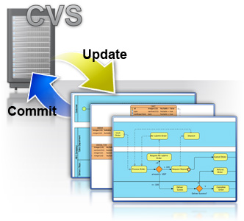
LECTURE 35: Git – Part I: Introduction
Topics:
Understanding Version Control
What is Git?
The History of Git
Installation
Resources:
RD: Simple Git Commands
Git: Basic Branches and Merges
Lynda: What is Git?
Lynda: Git Essential Training
Lynda: Software Version Control
Lynda: Up and Running
GitHub: Web Site
GitLab: Web Site

