Slide 1
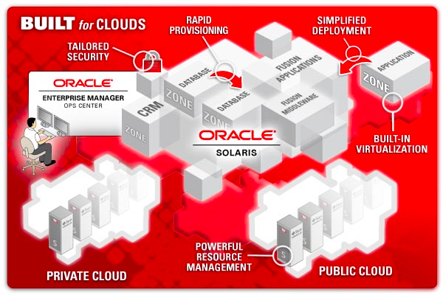
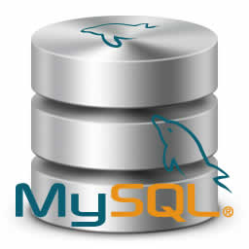
LECTURE 34: Database Introduction
Topics:
Definitions and Terminology
Abstraction
Schema
Tables
Types of Databases
Resources:
YouTube: Introduction
LM: Database Concepts
Dsoergel: Fundamentals

Slide 2
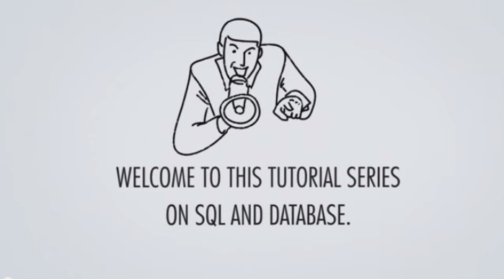
Introduction to Databases

Slide 3
What Is A Database?
The word database is commonly used to refer to any of the following:
your personal address book in a Word document
a collection of Word documents
a collection of Excel Spreadsheets
a very large flat file on which you run some statistical analysis functions
data collected, maintained, and used in airline reservation
data used to support the launch of a space shuttle
your personal address book in a Word document

Slide 4
Models of Reality
DML
DATABASE SYSTEM
REALITY
structures
processes
DATABASE
DDL
A database is a model of structures of reality
The use of a database reflect processes of reality
A database system is a software system which supports the definition and use of a database
DDL: Data Definition Language
DML: Data Manipulation Language

Slide 5
Use a DBMS when this is important:
When To Use A Database?
Do not use a DBMS when:
persistent storage of data
centralized control of data
control of redundancy
control of consistency and integrity
multiple user support
sharing of data
data documentation
data independence
control of access and security
backup and recovery
the initial investment in hardware, software, and training is too high
the generality a DBMS provides is not needed
the overhead for security, concurrency control, and recovery is too high
data and applications are simple and stable
real-time requirements cannot be met by it
multiple user access is not needed

Slide 6
Abstraction
It is very important that the language used for data representation supports abstraction.
Three kinds of abstraction:
Classification
Aggregation
Generalization

Slide 7
Classification
In a classification we form a concept in a way which allows us to decide whether or not a given phenomena is a member of the extension of the concept.
CUSTOMER
Tom Ed Nick ... Liz Joe Louise

Slide 8
Aggregation
In an aggregation we form a concept from existing concepts. The phenomena that are members of the new concept’s extension are composed of phenomena from the extensions of the existing concepts
AIRPLANE
WING
COCKPIT
ENGINE

Slide 9
Generalization
In a generalization we form a new concept by emphasizing common aspects of existing concepts, leaving out special aspects
CUSTOMER
1ST CLASS
BUSINESS CLASS
ECONOMY
CLASS

Slide 10
Subclasses May Overlap
Subclasses may overlap:
CUSTOMER
1STCLASS
BUSINESS
CLASS
Subclasses may have multiple superclasses:
MOTORIZED VEHICLES
AIRBORNE VEHICLES
TRUCKS
HELICOPTERS
GLIDERS

Slide 11
Database Schema
Schema Owner
Tables
Indexes
Procedures
Views
Constraints
schema objects

Slide 12
Tables
A table is the primary unit of physical storage for data in a database.
Usually a database contains more than one table.
A database can have multiple tables:
Publishers
Books
Customers
Authors
Inventory
Orders

Slide 13
Tables
Customers

Slide 14
Field (Column)
Tables
Customers
a field

Slide 15
Record (Row)
Database Schema
Customers
a record

Slide 16
Primary Key
Tables
Customers
primary key field
Primary key is a unique identifier of records in a table.
Primary key values may be generated manually or automatically.

Slide 17
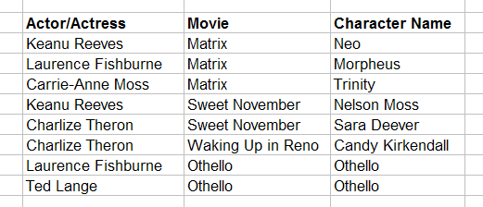
Primary Key
Tables
Roles (Performances)
primary key fields
A primary key can consist of more than one field.

Slide 18
Foreign Key
Tables
primary key field
parent table
Directors
relationship
child table
Movies
foreign key field

Slide 19
More Terminology
Types of Relationships: one-to-one, one-to-many, many-to-many
Data Types: Alphanumeric (Text, Memo), Numeric (Number, Currency, etc.), Date/Time, Boolean (Yes/No)
Entity: An entity is a business object that represents a group, or category of data.
Instance: A single, specific occurrence of an entity is an instance. Other terms for an instance are record and tuple.
Attribute: An attribute is a sub-group of information within an entity.
Relationship: A relationship is a link that relates two entities that share one or more attributes.

Slide 20
OO Design vs. Database Design
Object-Oriented Design: Database Design:
Class → Entity (Table)
Object → Record
Attribute → Attribute (Field)
Association → Relationship
…

Slide 21
Database Environments and Types
Database Environments:
Mainframe
Client/Server
Internet-based
Database Types:
Flat-file
Hierarchical
Network
Relational
Object-oriented
Object-relational

Slide 22
Summary
Flat-file
Hierarchical
Network
Relational
Object-oriented
Object-relational

