Slide 1
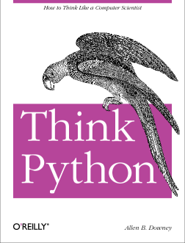
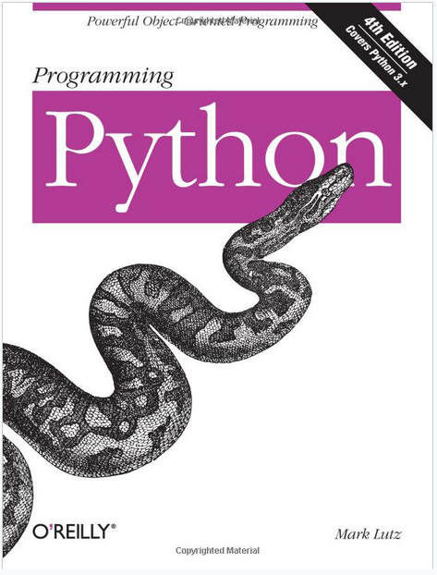
LECTURE 30: Graphs Using PyQT
Topics:
PyQT
Reading Data
PyQTGraph
Simple Plots
GUIs
Resources:
Riverbank: What is PyQT?
PyQTGraph: What is PyQTGraph?
PyQTGraph: About PyQTGraph

