Slide 1
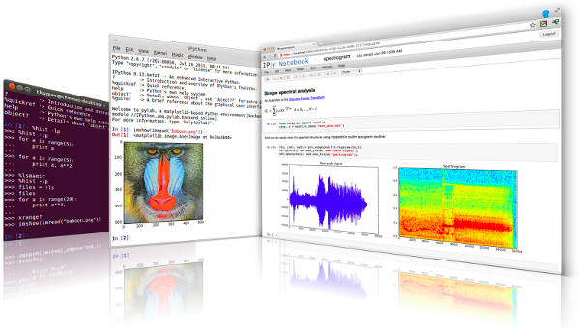
LECTURE 29: Multithreading and Parsing
Topics:
Multithreading
Excel Spreadsheets
General Parsing
XML Parsing
Resources:
GfG: Multithreading
TP: Multithreading
DC: Spreadsheets in Python
DCT: Lex and Yacc
IBM: Lex and Yacc
TP: XML Parsing
SE: XML Parsing

