Slide 1
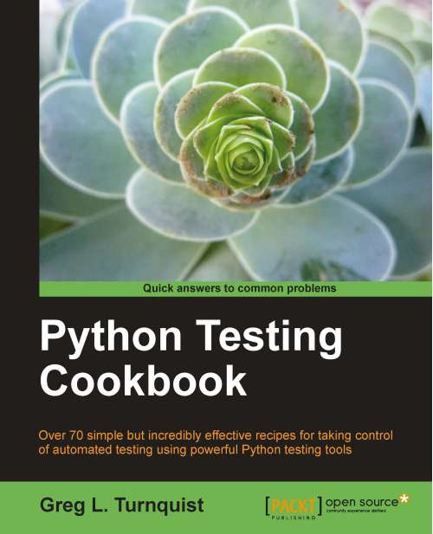
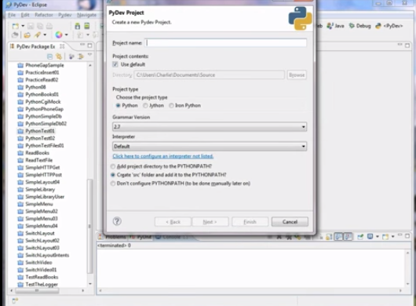
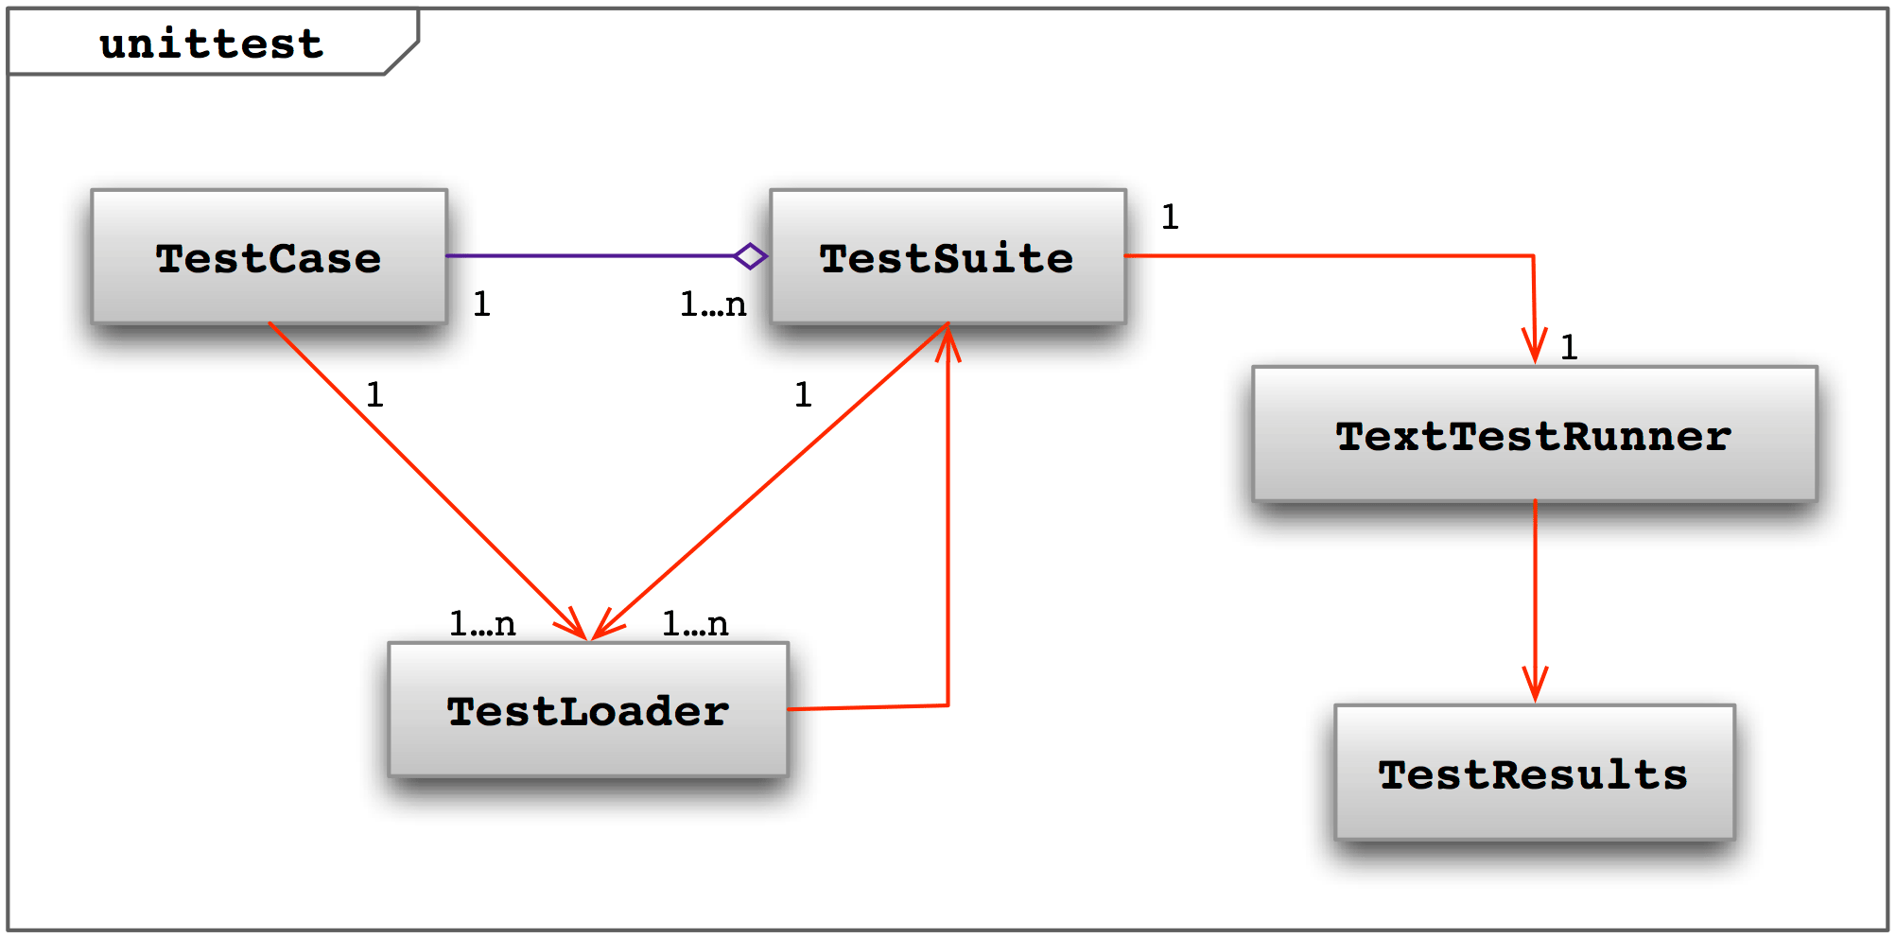
LECTURE 25: Unit Testing
Topics:
Testing As You Code
Class Syntax For Testing
Examples
Resources:
Python: PyUnit
Python: Unittest
Dr. Dobbs: Testing
PG: Writing Tests
YouTube: Eclipse and PyUnit
JK: C++ Unit Testing

