Slide 1
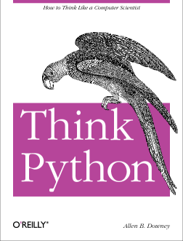
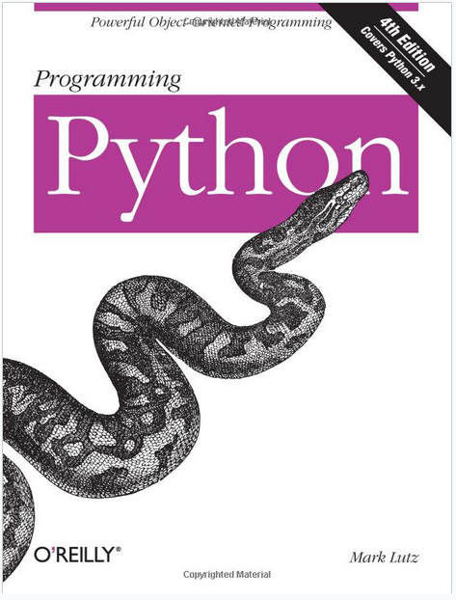
LECTURE 22: Data Types and Control Structures
Topics:
Variables
Arrays
Lists
Loops
Conditionals
Resources:
Python: Loops and Conditionals
Python: Dictionaries Python: Data Structures Lynda: Up and Running
YouTube: Google Python
YouTube: O'Reilly Python
Python: Getting Started
Python: Tutorial

