Slide 1
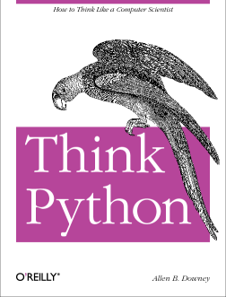
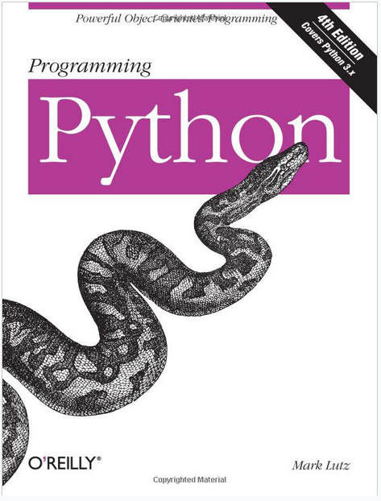
LECTURE 21: Python: Program Structure and Libraries
Topics:
Good Books
Python Distributions
The Path Revisited
The Interpreter
Importing Libraries
The Main Program
Command Line Arguments
Resources:
Lynda: Up and Running
YouTube: Google Python
YouTube: MIT Python
YouTube: O'Reilly Python
Python: Getting Started
Python: Tutorial

