Slide 1
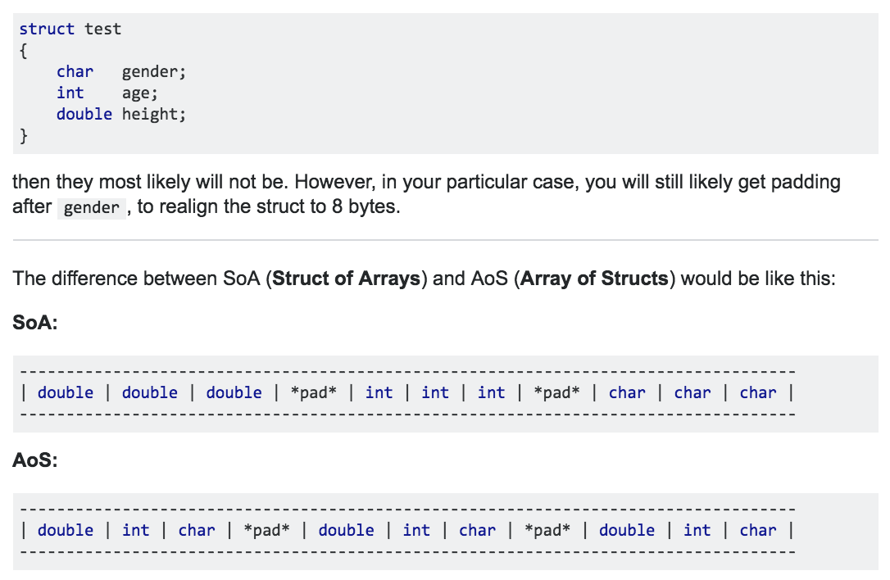
LECTURE 20: Memory Maps in C/C++
Topics:
Basic Data Types
Arrays
Structures
Arrays of Structures
Classes
Array of Classes
Resources:
StkOv: Structs in C/C++
StkOv: C++ Classes vs. Structs
Catb: Lost Art of Packing
StkOv: Padding and Packing

Slide 2
LECTURE 20: Review of Pointers
Topics:
Pointers Parsing Command Line Arguments
Arrays of Pointers
Dynamic Memory Allocation
Resources:
TP: Pointers
GNU: Getopt and Argp
CPP: Arrays of Pointers

