Slide 1
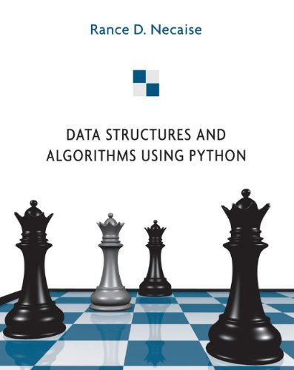
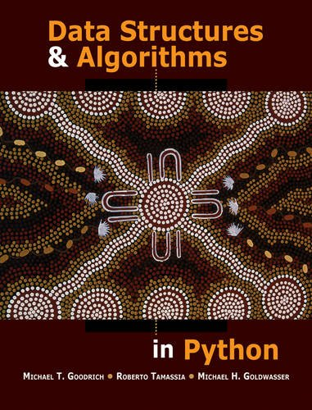
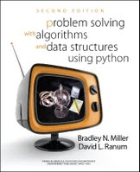
LECTURE 19: More Data Structures
Topics:
Types of Data Structures Ordered Lists
Hash Tables
Dictionary
Sets
Queues and Stacks
Resources:
Wiki: Data Structures
TP: Structures in C++
YouTube: Hash Tables
AO: Hash Table Implementation
ANM: Hash Table in C++

