Slide 1
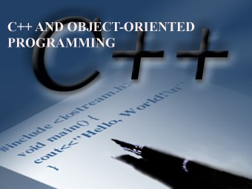
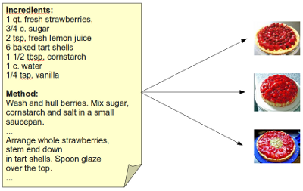
LECTURE 17: More About C++
Topics:
Implementations
Initialization
Memory Management
Example
Resources:
C++: Class Definitions
Java: Class Definitions
Python: Class Definitions
Wiki: Python Example

