Slide 1
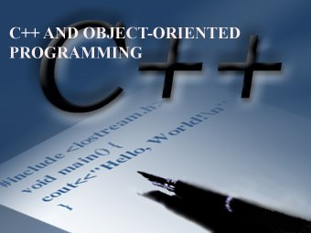
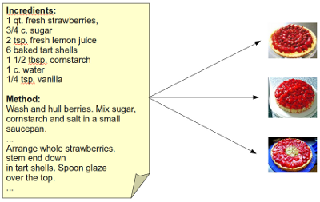
LECTURE 16: C++ Classes
Topics:
Classes in C++
Constructor/Destructor
Data
Functions
Resources:
C++: Class Definitions
Java: Class Definitions
Python: Class Definitions
Wiki: Python Example

