Slide 1
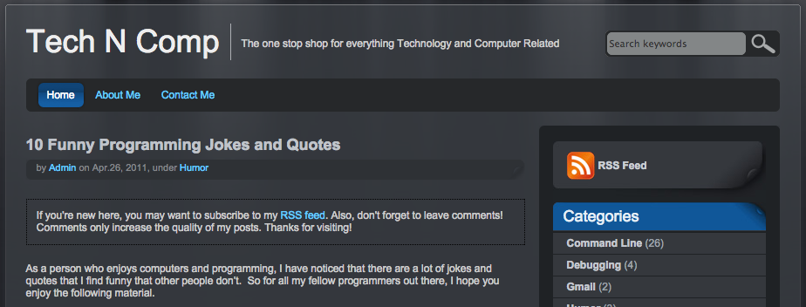
LECTURE 10: Program Development and Compilation
Topics:
Gcc and gdb (LLVM/LLDB)
Compilation and Linking
Assembly Code
Make Files
Emacs Revisited
Man Pages
Resources:
Lynda: Understanding LLVM
Lynda: Essential C
YouTube: Using Gcc on Linux
YouTube: GNU Make
Deloire: Generating Assembly Code

