Slide 1
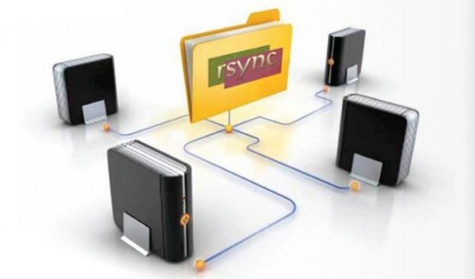
LECTURE 09: Archiving, Backups and Rsync
Topics:
Diff
Backup Strategies
Dropbox
Compression
Tar
Rsync
Resources:
Lynda: Dropbox
YouTube: Rsync
YouTube: Tar Compression
Computerworld: Backup Strategies
JDMZ: Rsync and Cron
TGS: Tar Examples

