Slide 1
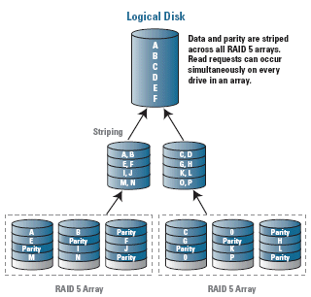
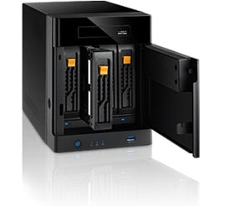
LECTURE 08: Disks, File Systems and I/O
Topics:
The Unix File System Revisited
Redundant Storage
Disk Management Commands
Symbolic Links and Virtual Mounts
Security Issues
Resources:
Lynda: Unix for Mac Users
YouTube: Unix File System
YouTube: RAID Basics
YouTube: du and df

