Slide 1
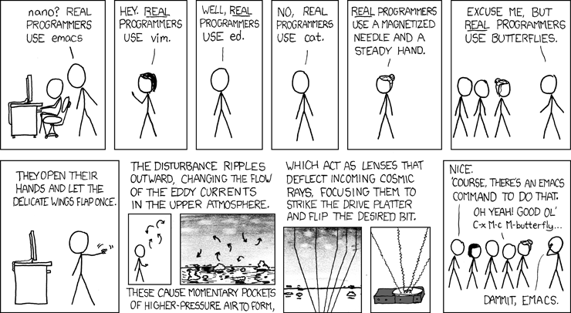
LECTURE 07: EMACS… The title says it all…
Topics:
Text Editors (e.g., ed, sed, vi)
Buffers, Screens and Shells
LISP Programming
Macros
Demonstration
Fun Stuff
Resources:
Lynda: Unix Text Editors
GNU IRC: The Emacs Channel
YouTube: VIM Basics
Wiki: The History of Emacs
Batsov: Emacs Resources
Wiki: Nifty Emacs Tricks

