Slide 1
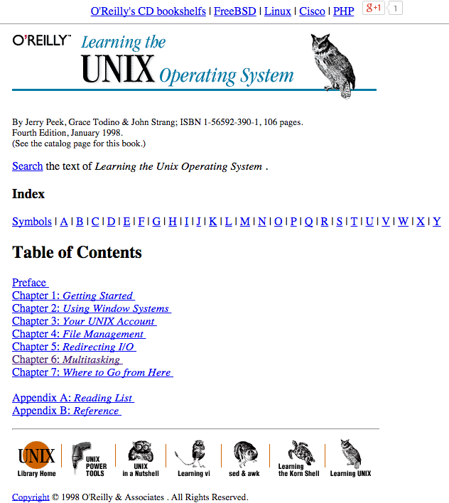
LECTURE 06: Processes, Tasks and Batch Computing
Topics:
Foreground and Background
Persistence
Multiprocessing
Load Balancing
Resources:
YouTube: Managing Processes
YouTube: fg & bg
YouTube: Starting Processes

