Slide 1
LECTURE 03: The Bash Command Line
Topics:
Command Line Editing History and Reusing Commands
Pipes and Semicolons Combining Commands
Regular Expressions Variables and Shell Programming
Resources:
Lynda.com: YouTube:
Bash Scripting Bash Basics
Popular Linux Commands Shell Command Pipes
Regular Expressions Regular Expressions

Slide 2
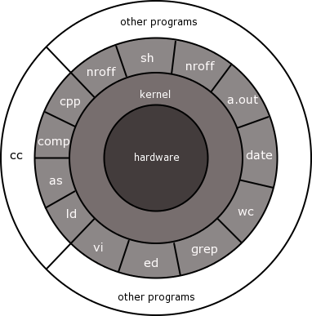
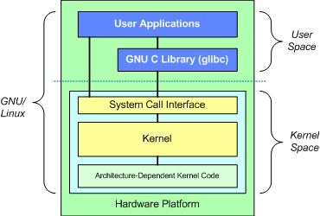
LECTURE 03: The Command Line Revisited
Topics:
Man Pages
Commands vs. Functions
Command Line Tools
Pipes and Redirection (Stderr)
Portability
Resources:
Lynda: Unix Manual Pages
YouTube: Linux Info Pages
YouTube: Pipes and Filters
YouTube: System Calls

