Slide 1
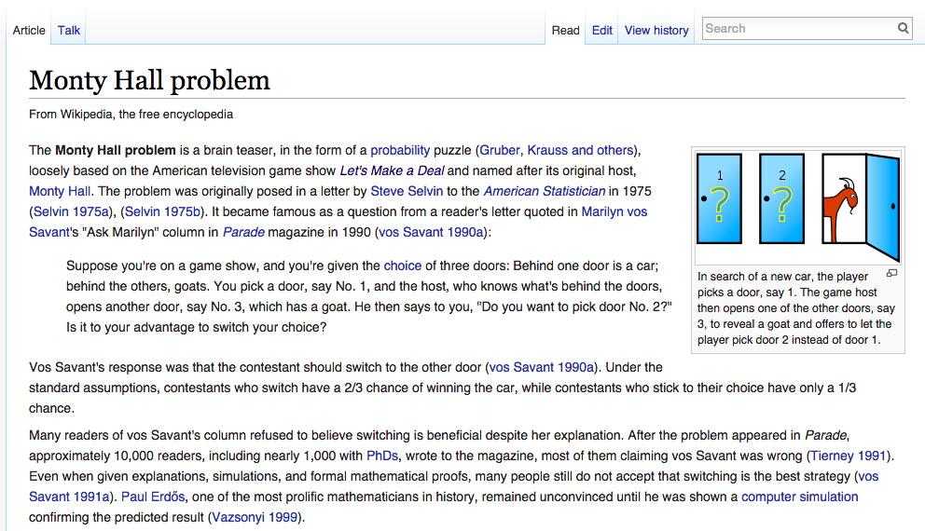

Slide 2
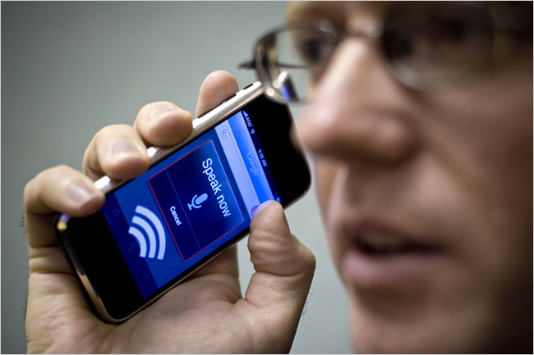

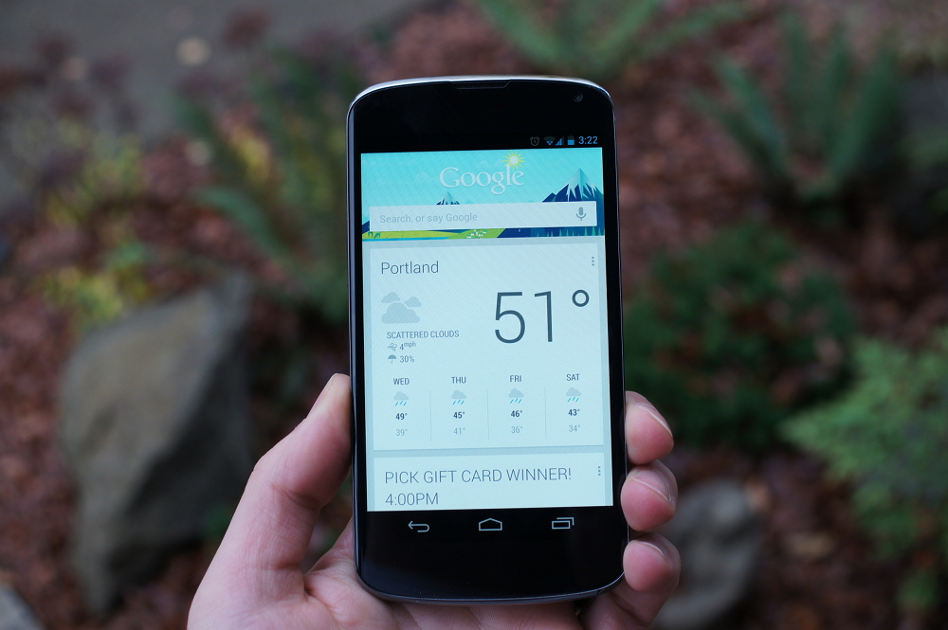


Emerging Directions in
Statistical Modeling in Speech Recognition
Joseph Picone and Amir Harati
Institute for Signal and Information Processing
Temple University
Philadelphia, Pennsylvania, USA

Slide 3
Abstract
Balancing unique acoustic or linguistic characteristics, such as a speaker's identity and accent, with general behaviors that describe aggregate behavior, is one of the great challenges in acoustic modeling in speech recognition.
  The goal of Bayesian analysis is to reduce the uncertainty about unobserved variables by combining prior knowledge with observations.
  A fundamental limitation of any statistical model, including Bayesian approaches, is the inability to adapt to new modalities in the data.
Nonparametric Bayesian methods are one popular alternative because the complexity of the model is not fixed a priori. Instead a prior is placed over the complexity that biases the system towards sparse or low complexity solutions.
  Neural networks based on deep learning have recently emerged as a popular alternative to traditional acoustic models based on hidden Markov models and Gaussian mixture models due to their ability to automatically self-organize and discover knowledge.
In this talk, we will review emerging directions in statistical modeling in speech recognition and briefly discuss the application of these techniques to a range of problems in signal processing and bioengineering.

Slide 4
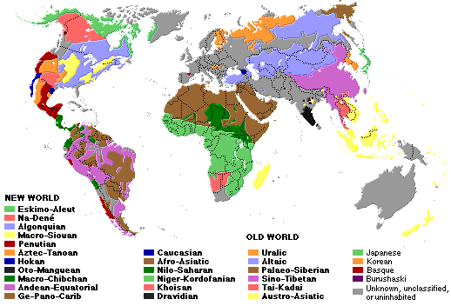
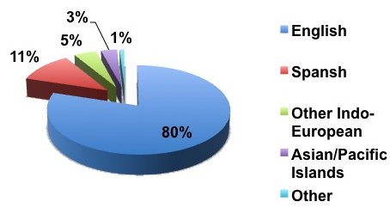
The World’s Languages
There are over 6,000 known languages in the world.
A number of these languages are vanishing spurring interest in new ways to use digital media and the Internet to preserve these languages and the cultures that speak them.
The dominance of English is being challenged by growth in Asian and Arabic languages.
In Mississippi, approximately 3.6% of the population speak a language other than English, and 12 languages cover 99.9% of the population.
Common languages are used to facilitate communication; native languages are often used for covert communications.
Philadelphia (2010)

Slide 5


Finding the Needle in the Haystack… In Real Time!
There are 6.7 billion people in the world representing over 6,000 languages.
300 million are Americans. Who worries
about the other 6.4 billion?
Ilocano ( ) Tagalog ( )
Over 170 languages are spoken in the
Philippines, most from the Austronesian
family. Ilocano is the third most-spoken.
This particular passage can be roughly translated as:
Ilocano¹: Suratannak iti lizardfish3@yahoo.com maipanggep iti amin nga imbagada iti taripnnong. Awagakto isuna tatta.
English: Send everything they said at the meeting to lizardfish@yahoo.com and I'll call him immediately.
Human language technology (HLT) can be used to automatically extract such content from text and voice messages. Other relevant technologies are speech to text and machine translation.
Language identification and social networking are two examples of core technologies that can be integrated to understand human behavior.
1. The audio clip was provided by Carl Rubino, a world-renowned expert in Filippino languages.

Slide 6
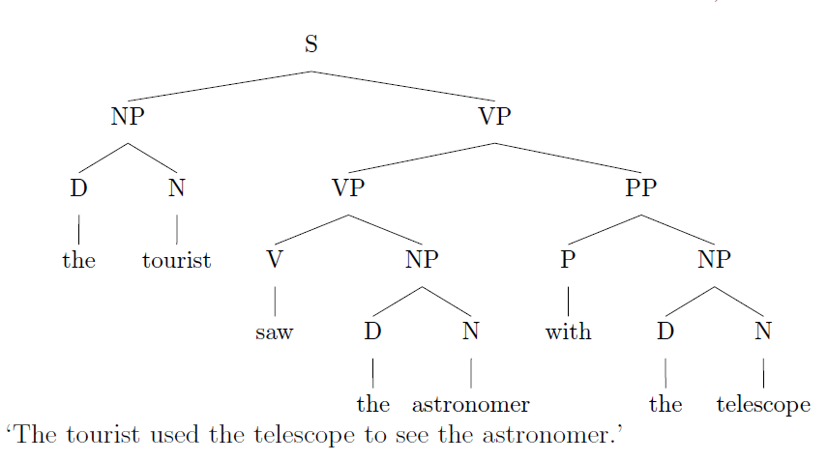
Language Defies Conventional Mathematical Descriptions
According to the Oxford English Dictionary, the 500 words used most in the English language each have an average of 23 different meanings. The word “round,” for instance, has 70 distinctly different meanings.
(J. Gray, http://www.gray-area.org/Research/Ambig/#SILLY )
Are you smarter than a 5th grader?
“The tourist saw the astronomer on the hill with a telescope.”
Hundreds of linguistic phenomena we must take into account to understand written language.
Each can not always be perfectly identified (e.g., Microsoft Word)
95% x 95% x … = a small number
D. Radev, Ambiguity of Language
Is SMS messaging even a language? “y do tngrs luv 2 txt msg?”

Slide 7
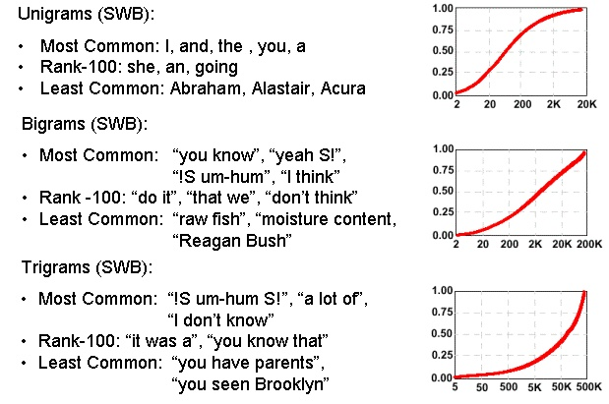
Communication Depends on Statistical Outliers
A small percentage of words constitute a large percentage of word tokens used in conversational speech:
Conventional statistical approaches are based on average behavior (means) and deviations from this average behavior (variance).
Consider the sentence:
“Show me all the web pages about Franklin Telephone in Oktoc County.”
Key words such as “Franklin” and “Oktoc” play a significant role in the meaning of the sentence.
What are the prior probabilities of these words?
Consequence: the prior probability of just about any meaningful sentence is close to zero. Why?

Slide 8
Human Performance is Impressive
Human performance exceeds machine performance by a factor ranging from 4x to 10x depending on the task.
On some tasks, such as credit card number recognition, machine performance exceeds humans due to human memory retrieval capacity.
The nature of the noise is as important as the SNR (e.g., cellular phones).
A primary failure mode for humans is inattention.
A second major failure mode is the lack of familiarity with the domain (i.e., business terms and corporation names).
Word Error Rate
20%
Wall Street Journal (Additive Noise)
15%
Machines
10%
5%
Human Listeners (Committee)
0%
10 dB
16 dB
22 dB
Quiet
Speech-To-Noise Ratio

Slide 9
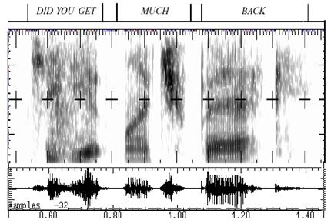
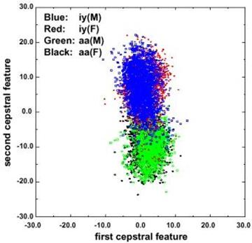
Fundamental Challenges in Spontaneous Speech
Common phrases experience significant reduction (e.g., “Did you get” becomes “jyuge”).
Approximately 12% of phonemes and 1% of syllables are deleted.
Robustness to missing data is a critical element of any system.
Linguistic phenomena such as coarticulation produce significant overlap in the feature space.
Decreasing classification error rate requires increasing the amount of linguistic context.
Modern systems condition acoustic probabilities using units ranging from phones to multiword phrases.

Slide 10
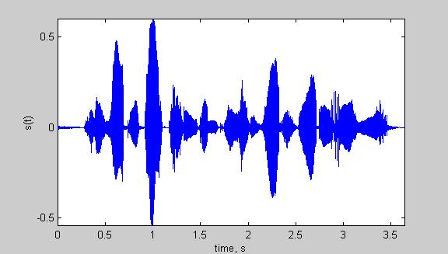
Speech Recognition Overview
Based on a noisy communication channel
model in which the intended message is
corrupted by a sequence of noisy models
Bayesian approach is most common:
Objective: minimize word error rate by
maximizing P(W|A)
P(A|W): Acoustic Model
P(W): Language Model
P(A): Evidence (ignored)
Acoustic models use hidden Markov
models with Gaussian mixtures.
P(W) is estimated using probabilistic
N-gram models.
Parameters can be trained using generative (ML)
or discriminative (e.g., MMIE, MCE, or MPE) approaches.
Input
Speech
Feature
Extraction
Acoustic
Front-end
Acoustic Models
P(A/W)
Language Model
P(W)
Search
Recognized Utterance

Slide 11
Deep Learning and Big Data
A hierarchy of networks is used to automatically
learn the underlying structure and hidden states.
Restricted Boltzmann machines (RBM) are used to
implement the hierarchy of networks (Hinton, 2002).
An RBM consists of a layer of stochastic binary
“visible” units that represent binary input data.
These are connected to a layer of stochastic binary
hidden units that learn to model significant
dependencies between the visible units.
For sequential data such as speech, RBMs are often combined with conventional HMMs using a “hybrid” architecture:
  Low-level feature extraction and signal modeling is performed using the RBM, and higher-level knowledge processing is performed using some form of a finite state machine or transducer (Sainath et al., 2012).
Such systems model posterior probabilities directly and incorporate principles of discriminative training.
Training is computationally expensive and large amounts of data are needed.

