Slide 1
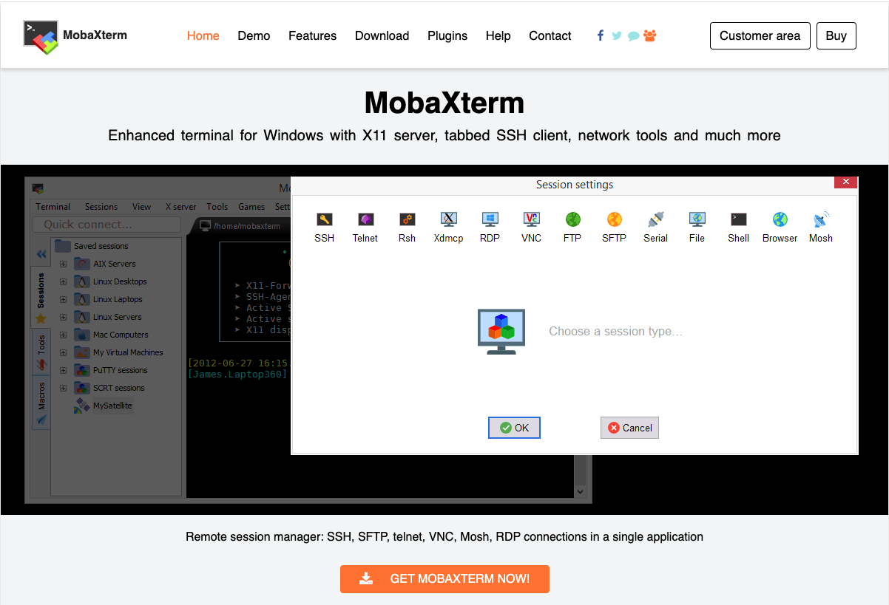
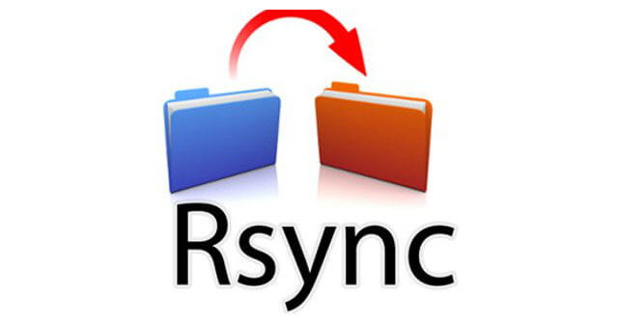
File Transfer With Rsync For Windows Users: Using MobaXterm’s Terminal Tool

Slide 2
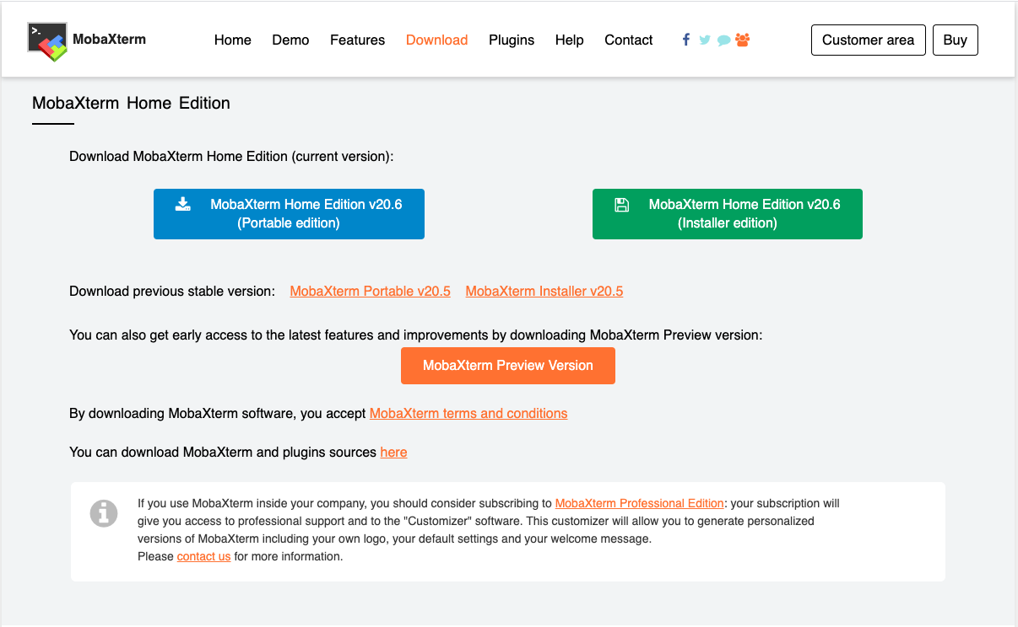
Step 1: Download and Install MobaXterm
This tutorial is only for Windows users.
There are many ways to transfer files to/from a Windows machine. However, our favorite approach for moving large amounts of data is rsync.
One of the easiest ways to use rsync under Windows is to install MobaXterm.
To download and install MobaXterm, use this link:
https://mobaxterm.mobatek.net/download-home-edition.html
Select the portable edition.
Download the zip file and unpack it on your Desktop.

Slide 3
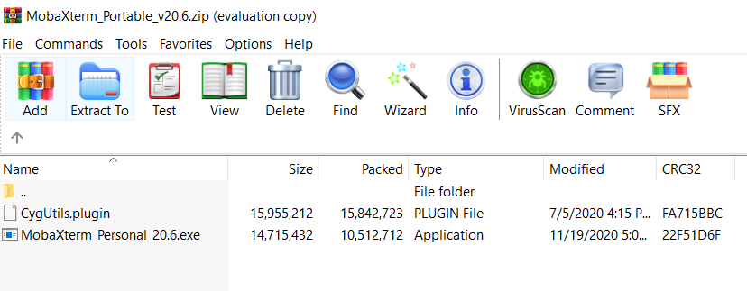
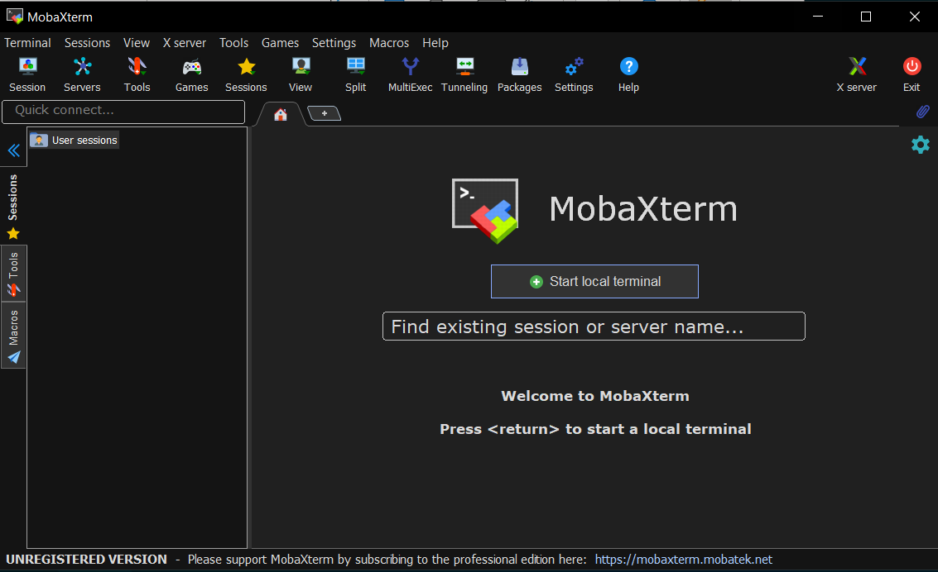
Step 2: Run MobaXterm
Click on the executable in this folder.
Once the application is open, click on “Start Local Terminal.”
For those familiar with a terminal window or the Linux command line, this will start a pseudo-bash session.
It does not have all the functionalities of a bash session, but it does include the basics that we need, such as rsync.

Slide 4
Step 3: Using Rsync
Many excellent tutorials are available on rsync. A simple Google search for “how do I use rsync” will return links to many excellent tutorials.
We will focus on the task of copying data from the NEDC data repository, as described here. The general form of the command is:
rsync [options] user@hostname:/source_path /destination_path
A specific example is:
rsync -auxvL nedc@www.isip.piconepress.com:data/nedc_pyprint_edf .
You will be prompted for a username and password, which you can acquire from here.
The options ”-auxvL” are the options we find most useful for transferring data. Consult the rsync man page or users guides for additional information.
The next argument, “user@hostname”, is the username you use to log into the remote host.
The final argument, “.”, is the location where the files are to be deposited. In this case, they will be deposited in the current working directory.
The beauty of rsync is that if your file transfer fails for some reason, you can simply rerun the command, and it will pick up where it left off.

