Slide 1

Incubator Add-Ons Tutorial

Slide 2
Contents
TMP36 Temperature Sensor
Fans and Motors
How to easily connect many devices to a single micro:bit
CHANZON Multicolor LED
External Audio Devices
External Switches/Pushbuttons
Servo Motors
Radio Messages
OLED Display Messages

Slide 3
TMP36 Temperature Sensor
A more accurate temperature sensor
Return to Contents

Slide 4
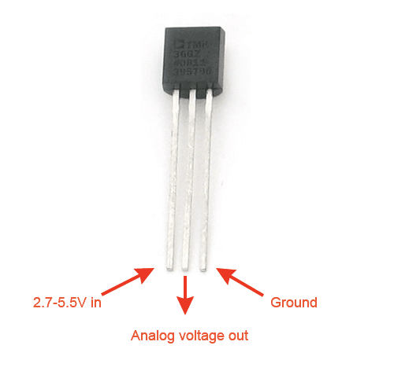
What is the TMP36?
Analog sensors produce a continuous output signal or voltage which is proportional to the quantity being measured. Digital sensors digitally convert data and then transmit.
TMP36 Temperature Sensors – these analog sensors use a solid-state technique to determine the temperature (not mercury, bimetalic strips, or thermistors). They rely on the fact that as temperature increases, the voltage across a diode increases at a known rate. (Diodes conduct current in primarily one direction only...high resistance in 1 direction; little to no resistance in other direction)

Slide 5
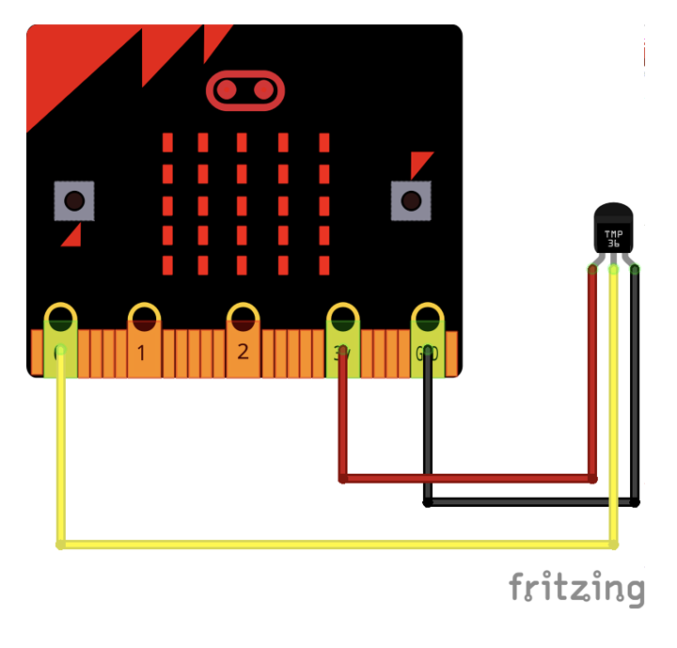
Hooking the TMP36 Directly to the Micro:bit
It’s imperative that the sensors be attached correctly or else they’ll be fried. See the following figure. Be careful the pins/clips don’t touch each other.

Slide 6
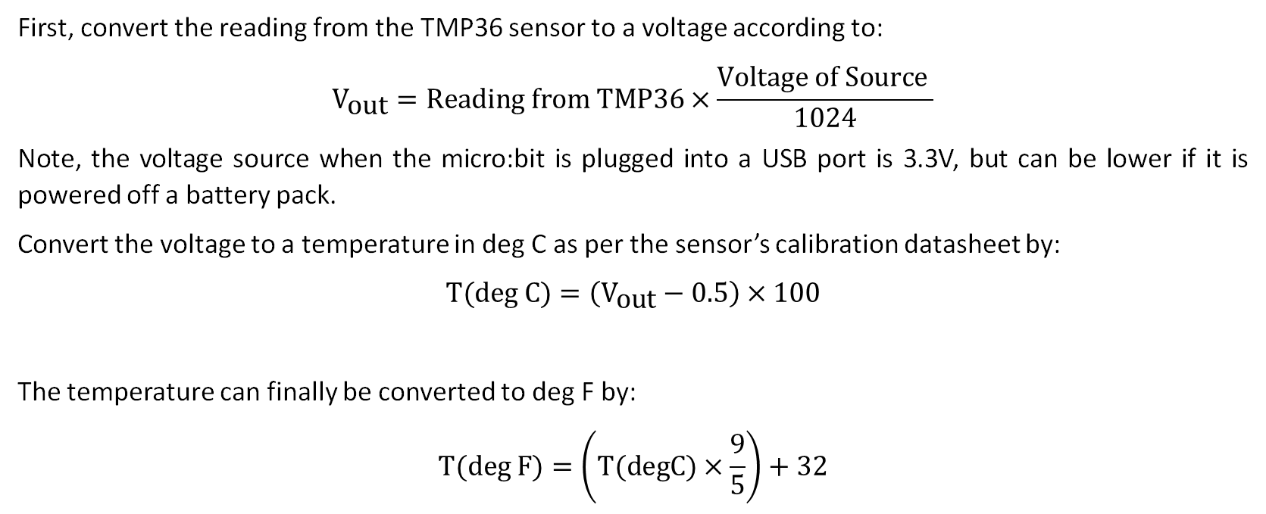
How do you code the TMP36?
First, convert the reading from the TMP36 sensor to a voltage according to:
$${\text{V}}_{\text{out}}=\text{Reading} \text{from} \text{TMP}\text{36}×\frac{\text{Voltage} \text{of} \text{Source} }{1024}$$
Note, the voltage source when the micro:bit is plugged into a USB port is 3.3V, but can be lower if it is powered off a battery pack.
Convert the voltage to a temperature in deg C as per the sensor’s calibration datasheet by:
$$\text{T}\text{(}\text{deg} \text{C}\text{)}=\left({\text{V}}_{\text{out}}−0.5\right)×100$$
The temperature can finally be converted to deg F by:
$$\text{T}\text{(}\text{deg} \text{F}\text{)}=\left(\text{T}\text{(}\text{degC}\text{)}×\frac{9}{5}\right)+32$$

Slide 7
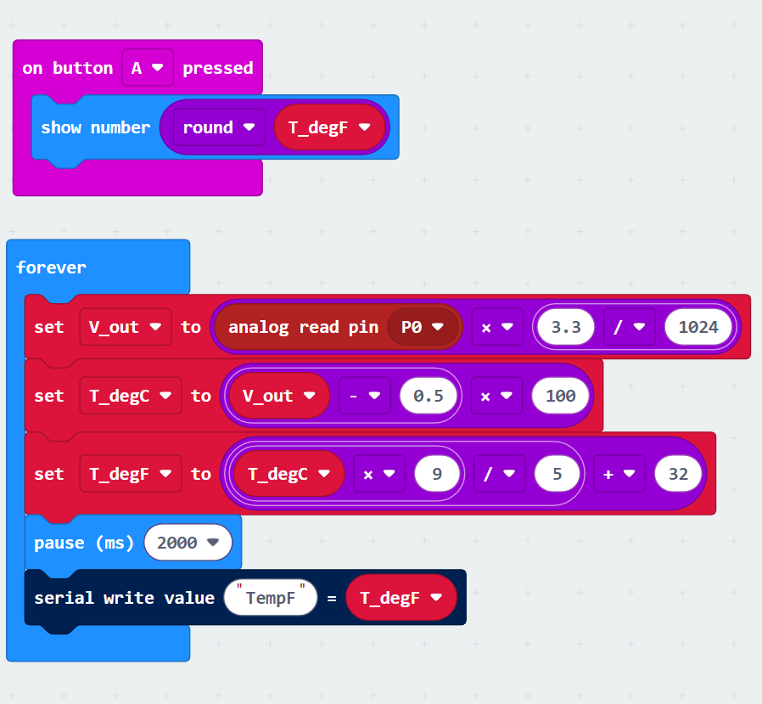
Micro:bit Sample Code – Link Below
https://makecode.microbit.org/S05916-95769-27594-17159

Slide 8
Fans and Motors
How do I hookup the Fans and the Motors?
Return to Contents

Slide 9
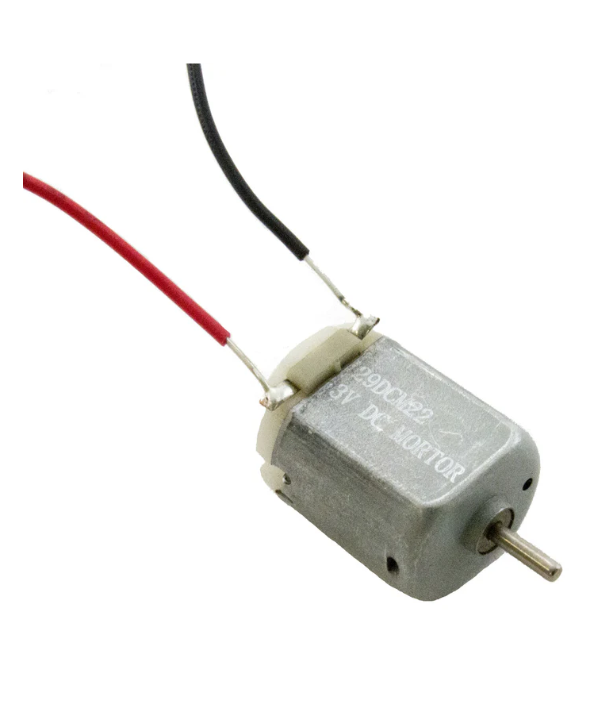
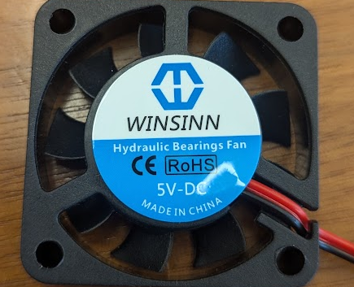
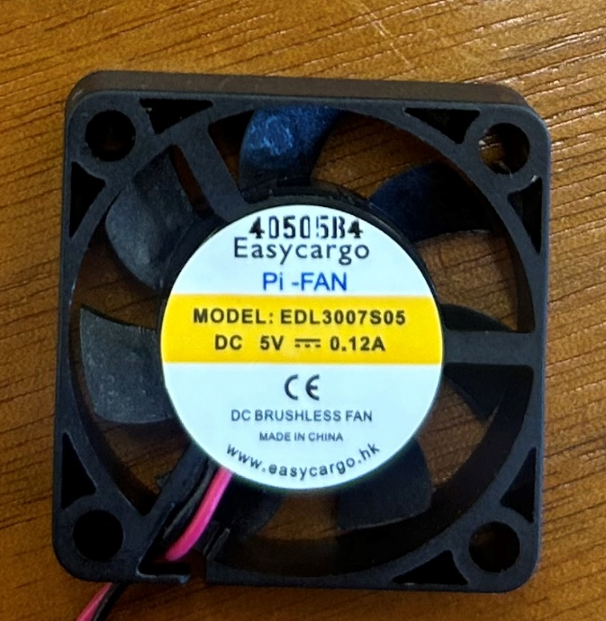
What are the Fan and Motor
Determine if you fan/motor is 3V or 5V – see images below
Apply 3V or 5V DC electricity to make them spin!
This label says 5V and can’t be powered with 3V
This label says 5V but can also be powered with 3V

Slide 10
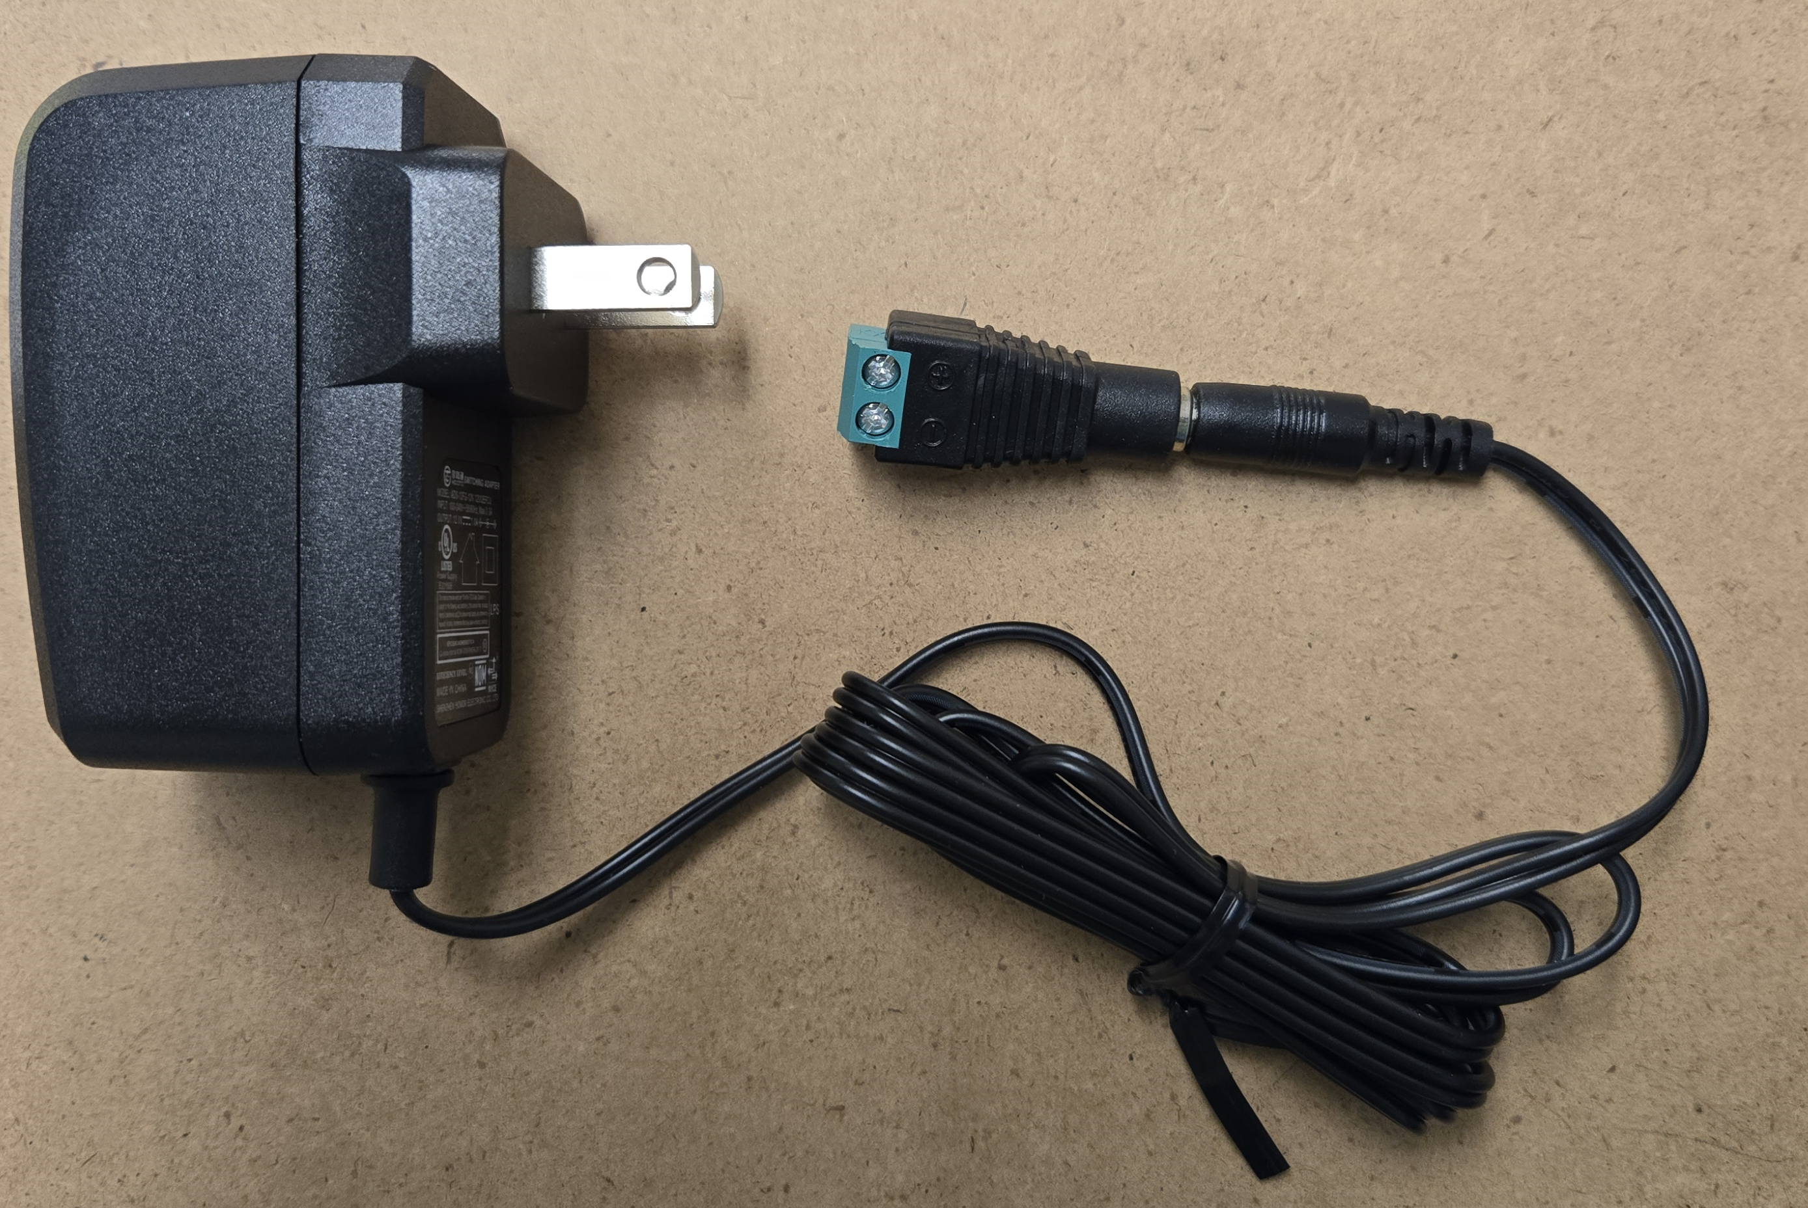
How do we hook them up to the Micro:bit?
Very similar to our heating wire with ONE VERY KEY DIFFERENCE. WE WILL NOT USE THE 12V SOURCE. WE WILL USE THE 3V FROM THE MICROBIT.

Slide 11
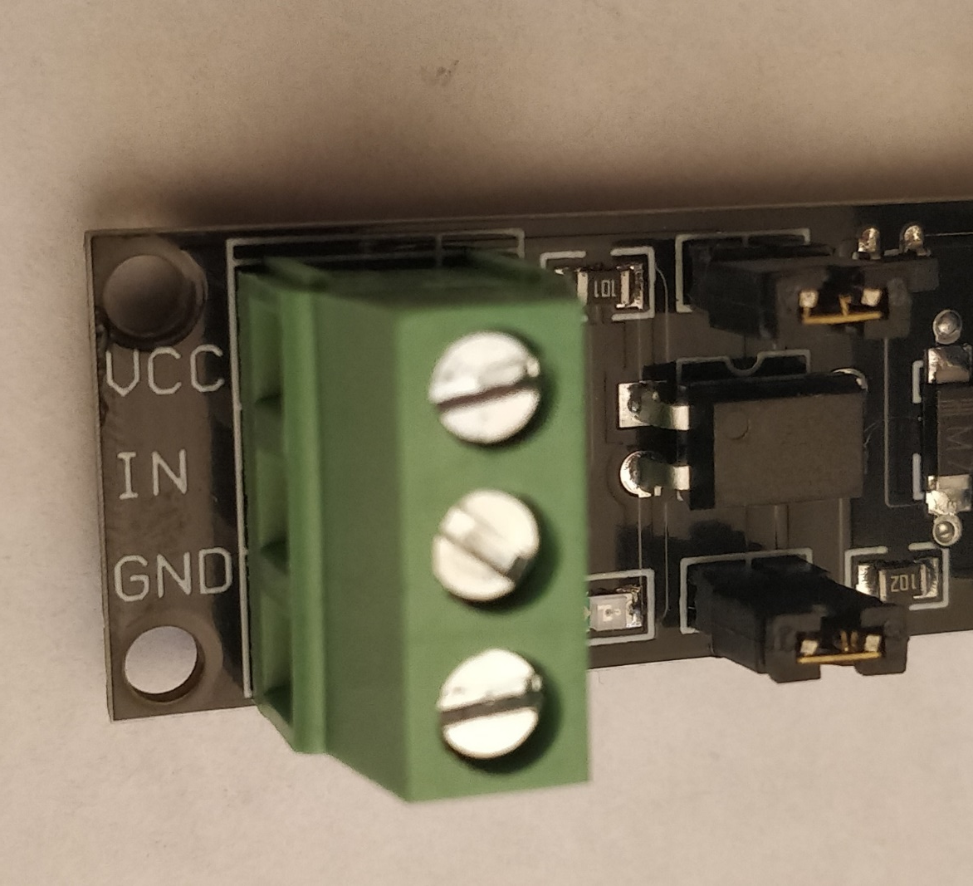
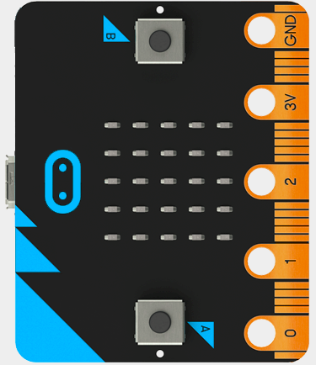
This step is the same

Slide 12
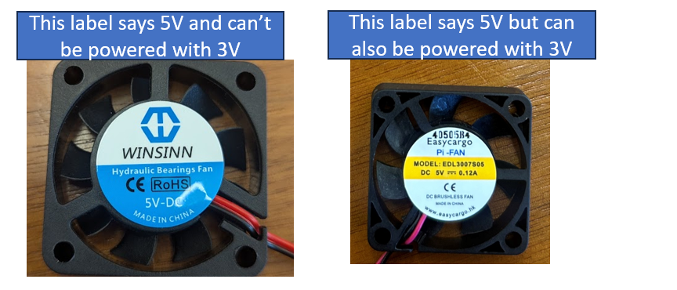
DETERMINE IF YOU HAVE 3V OR 5V
If you have 3V, you will use the micro:bit to power your fan/motor
If you have 5V, you will need two battery packs

Slide 13
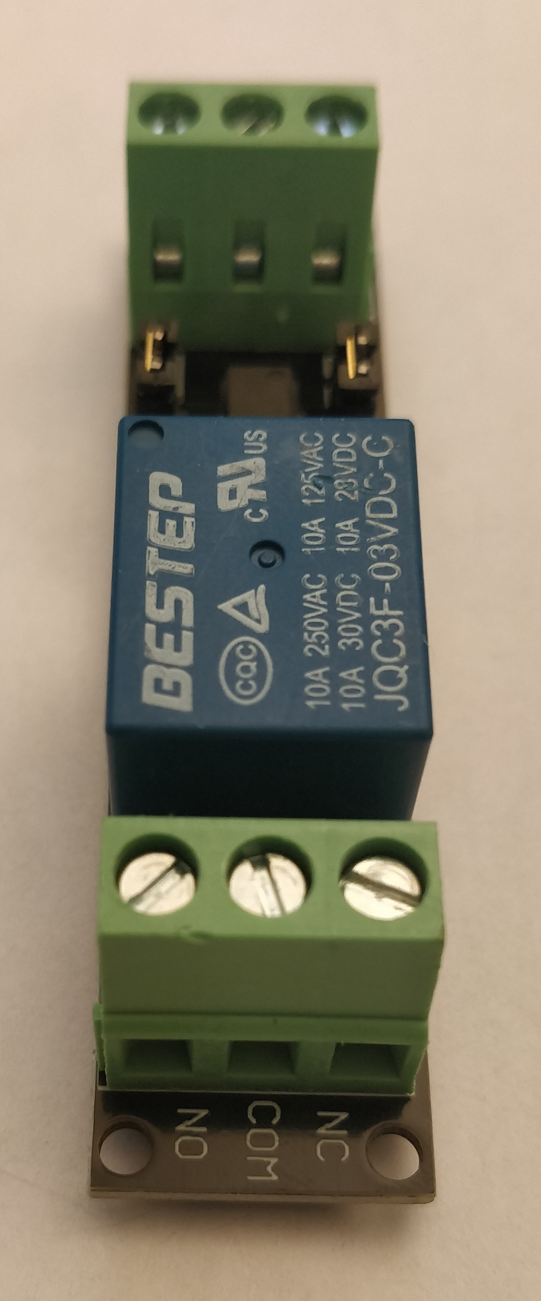
3V Assembly: (Relay to 3V on Microbit)
Locate the NO, COM, NC terminals on the relay
These terminal will connect the relay to the 3V of the microbit and the fan/motor
The NO and NC terminals provide switching ON/OFF of the fan/motor
The relay switches between these terminals based on the logical signal provided to IN
If a True/1 signal is provided the relay will switch to the NO terminal
Here, this completes the circuit allowing electrical current to flow from the charger to the heater, essentially turning it ON
Similarly, if a False/0 is given the relay switches to NC
Here, this opens the circuit turning OFF the heater

Slide 14
3V Assembly: (Relay to 3V on Microbit)
Motor or Fan
Note: This may get messy as you are already using the 3V and ground pin…you may want to use the dragontail as detailed in the next slides.

Slide 15
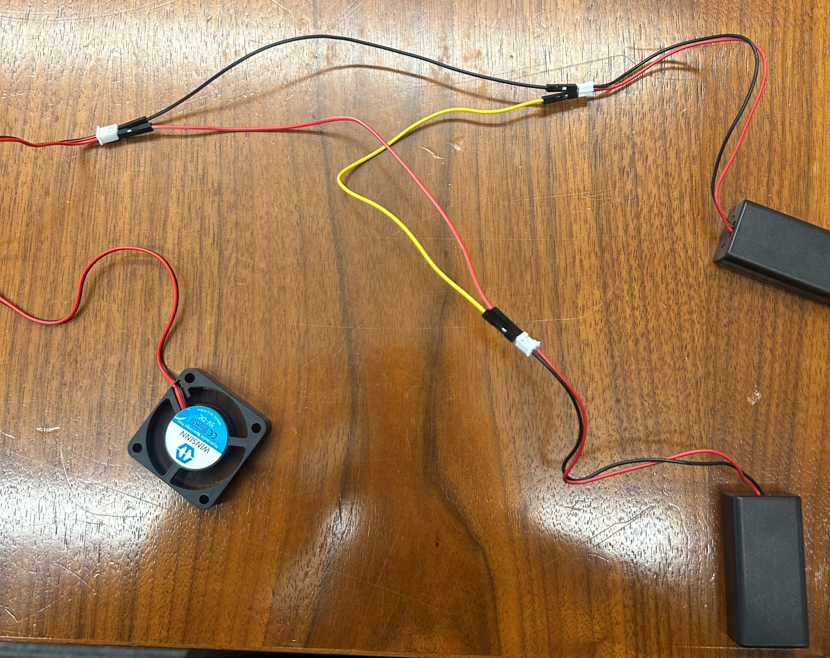
5V test the fan first
Hook the fan up as below and make sure it turns on. If it does, you have wired the battery packs correctly. Make sure you also have batteries in both of your battery packs.

Slide 16
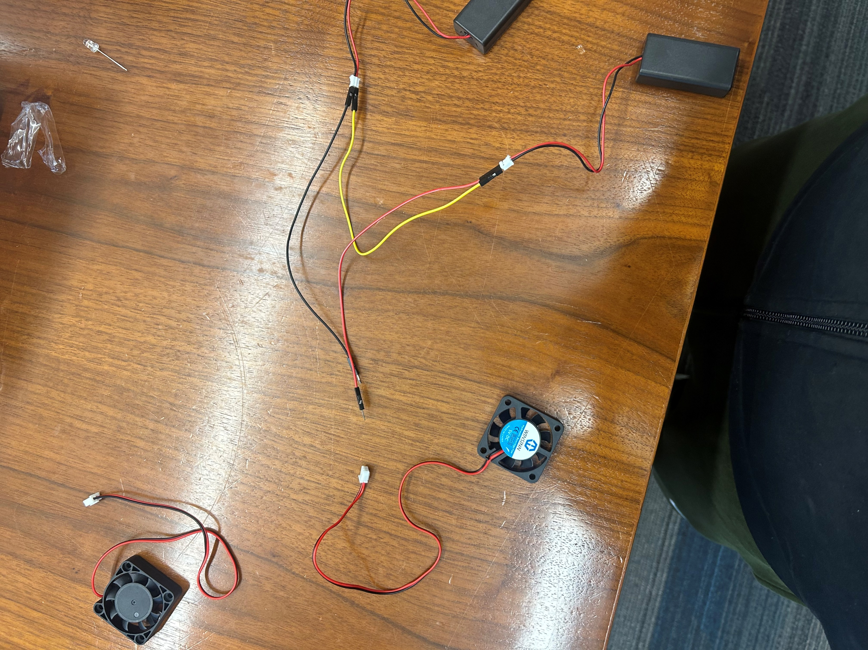
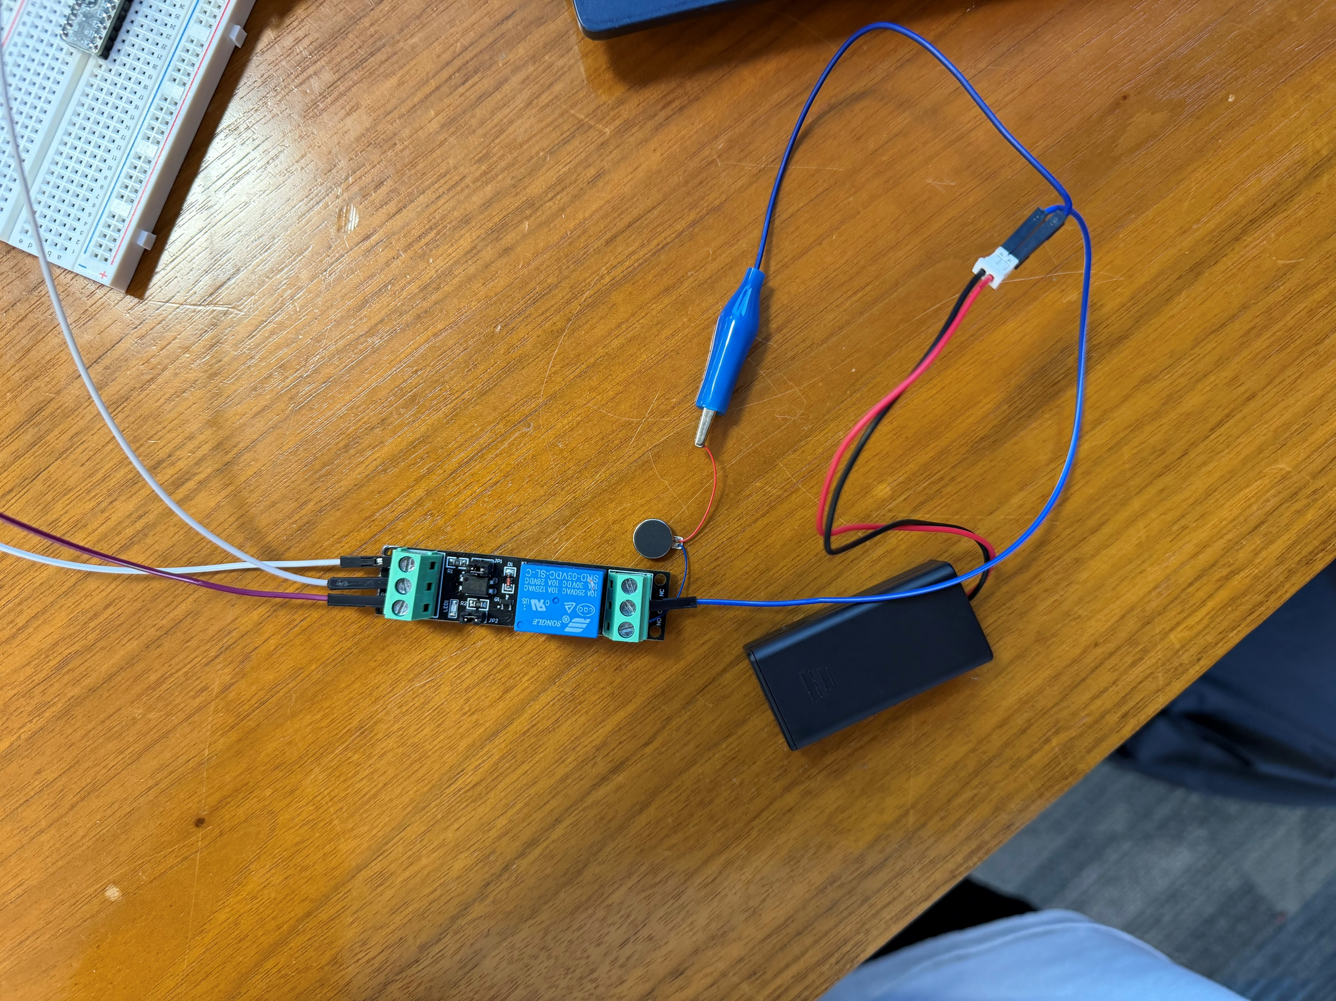
5V Assembly
Motor or Fan
Unplug the fan from the battery packs and then wire it up to the relay as shown.
The wiring and programming for a traditional motor and vibration motor will be identical. The only difference is the vibration motor will only need one battery pack to turn on and looks like this.

Slide 17
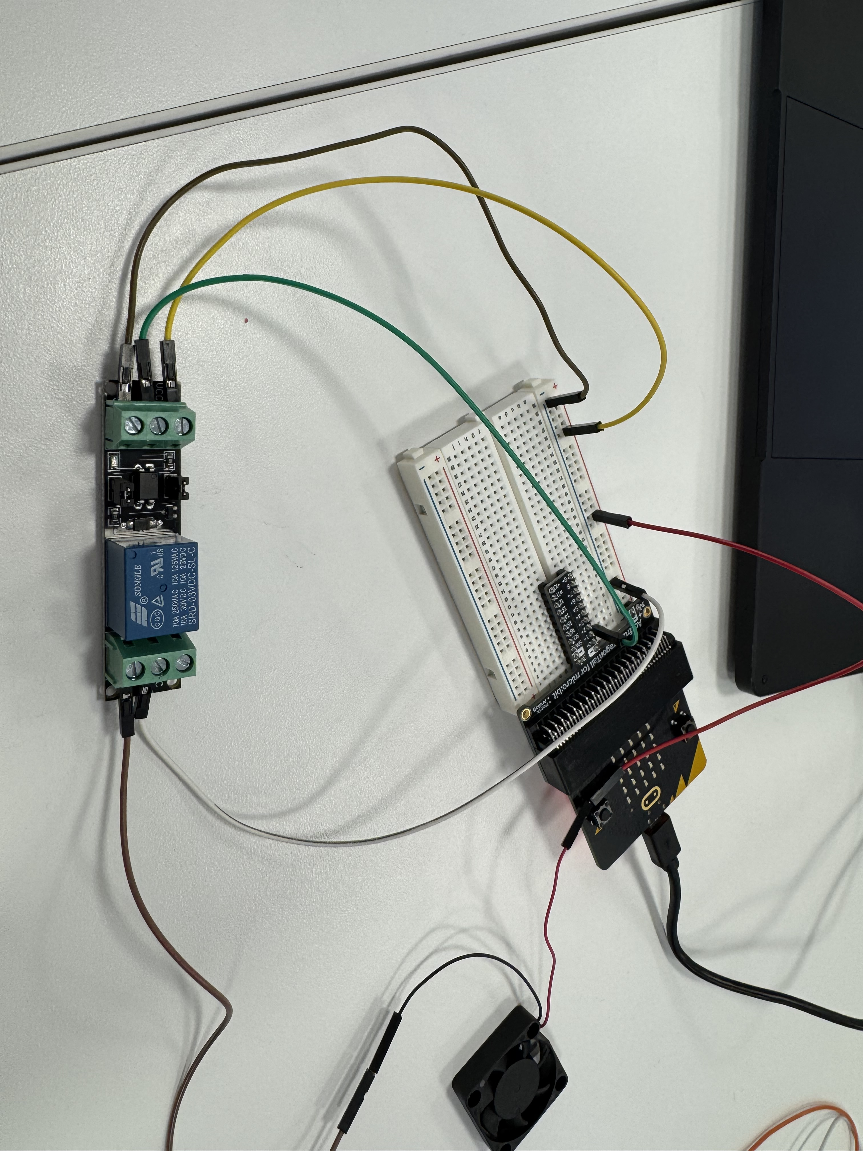
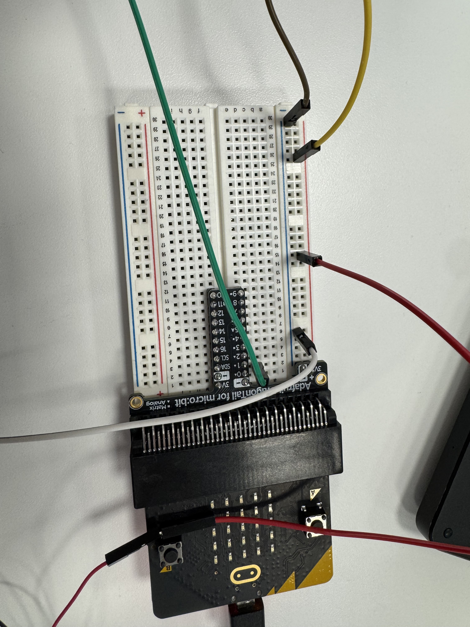
Fan with Dragon Tail
Here are pictures of how the fan should be connected with the dragon tail, make sure the positive (red) wire of the fan is connected to the 3V row of the breadboard.

Slide 18
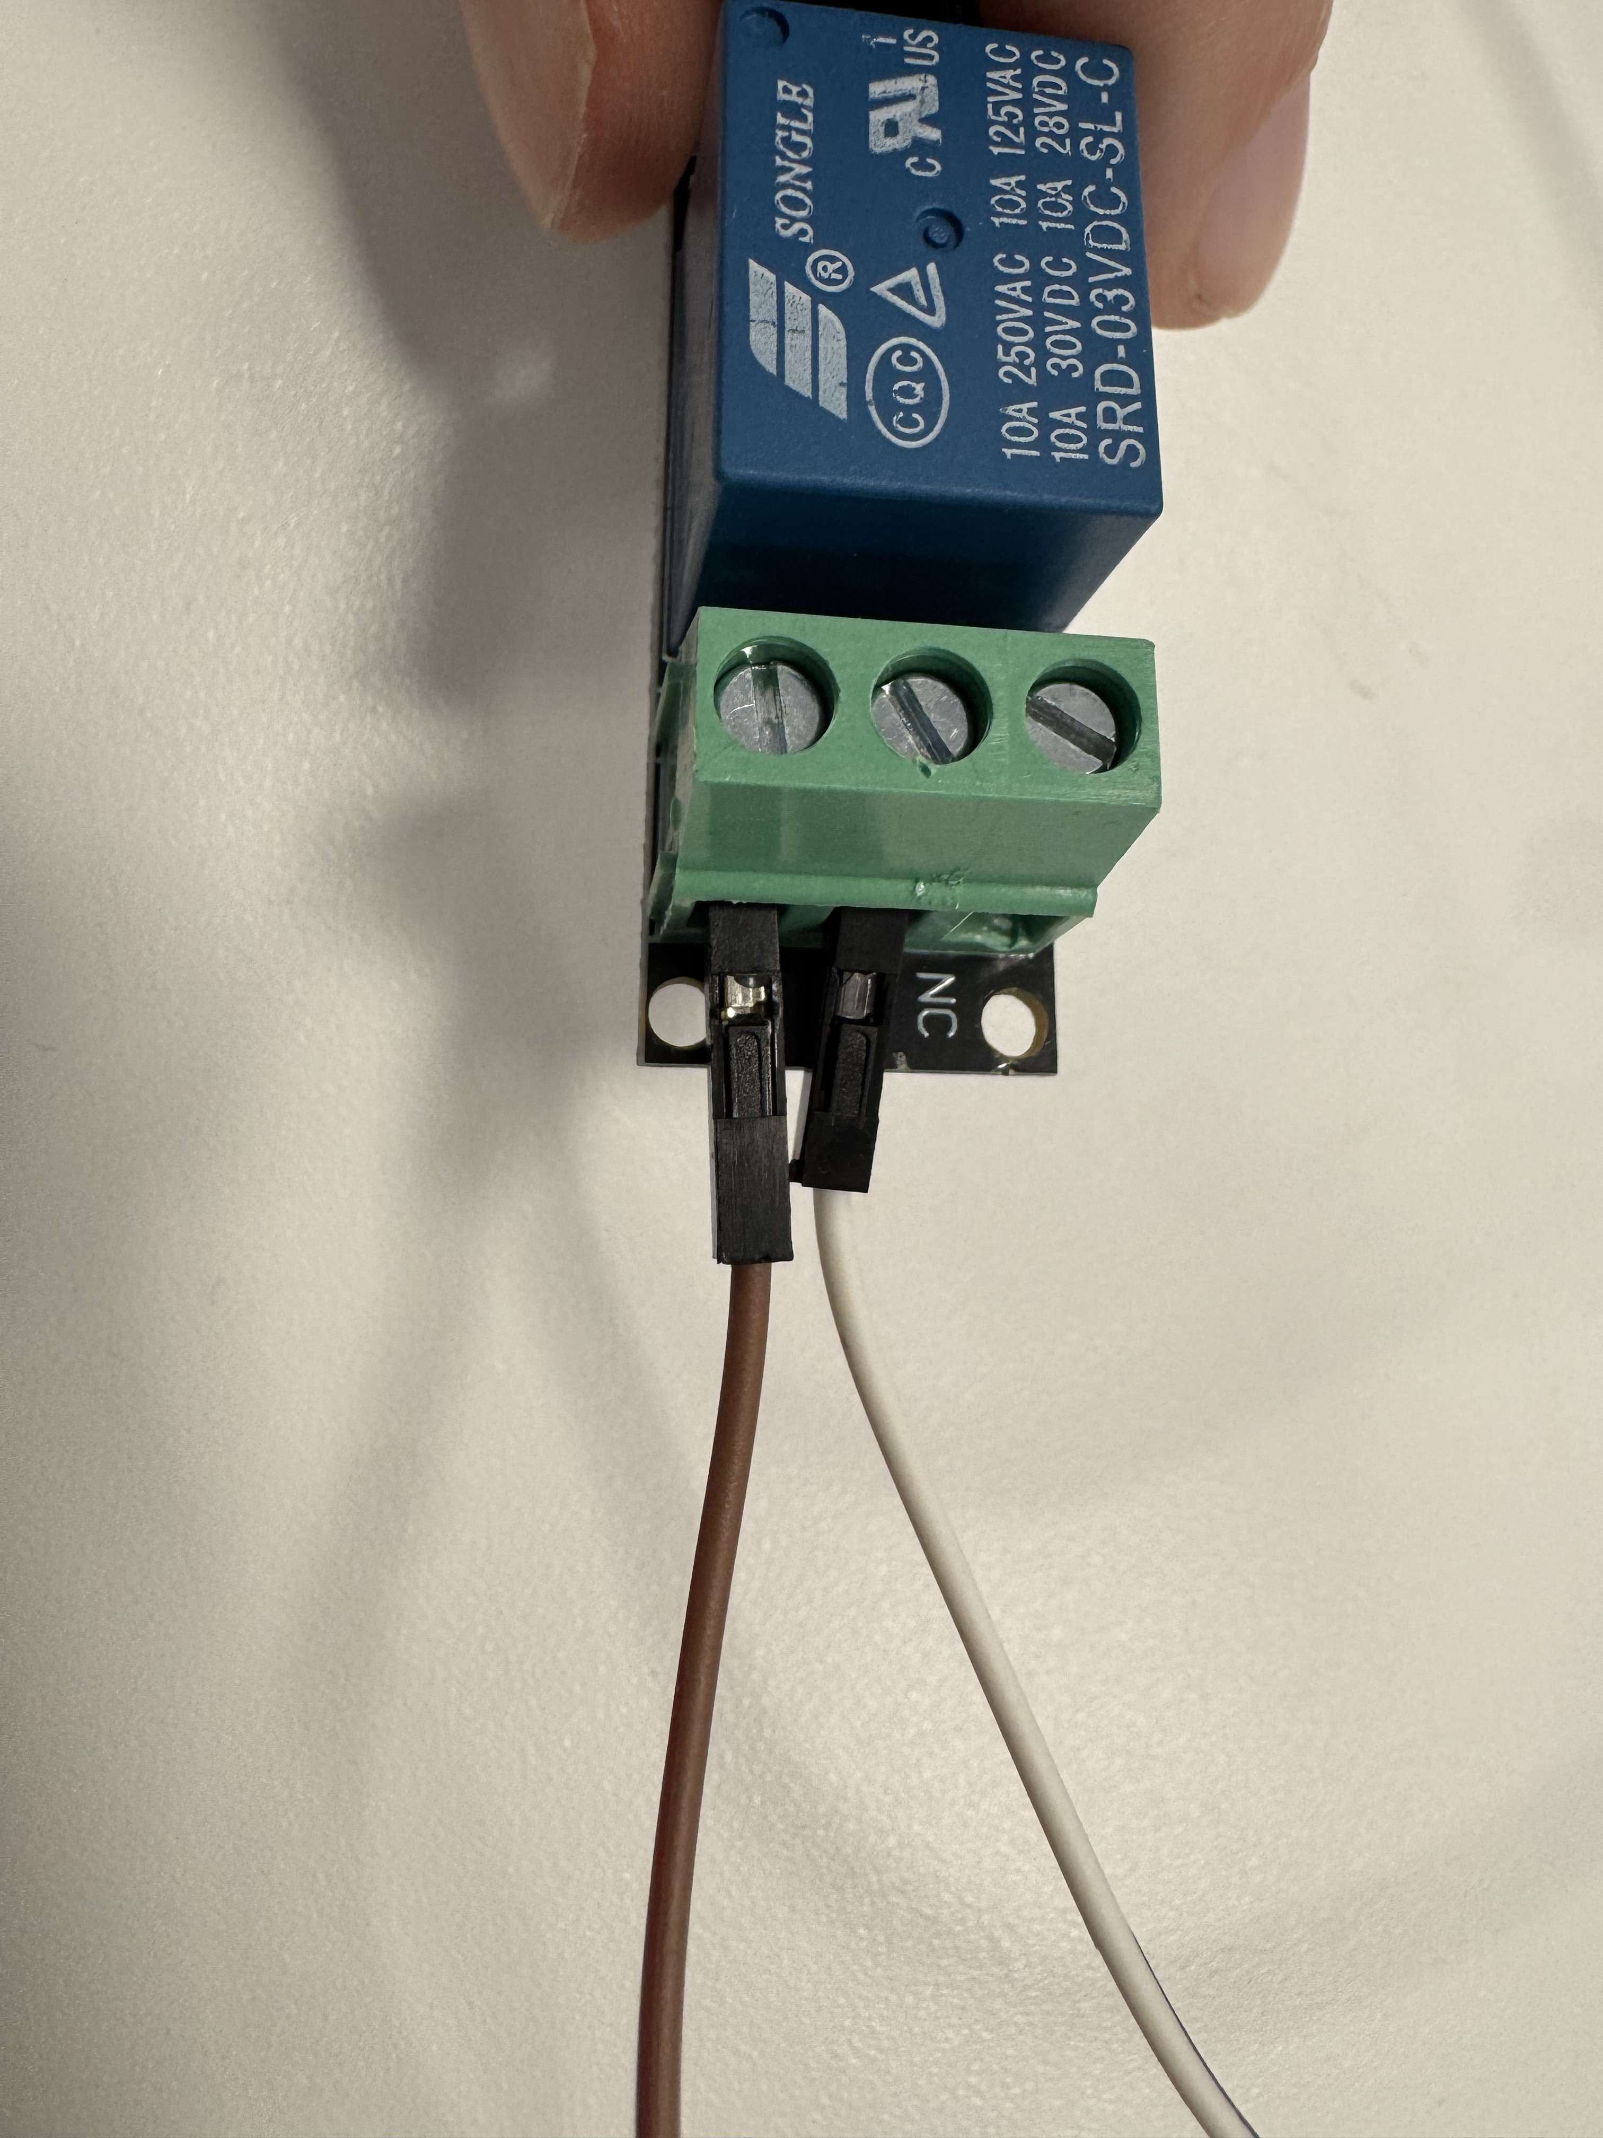
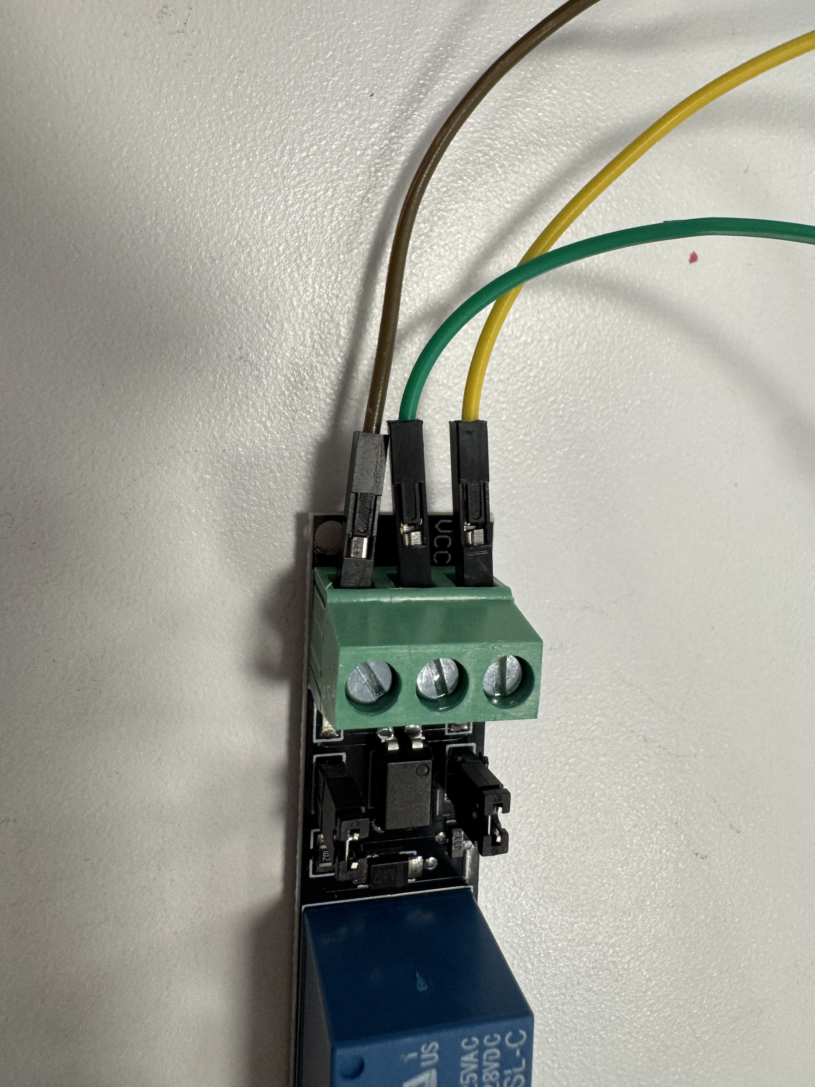
Fan with Dragon Tail
Here are close up pictures of the relays and how they should be connected

Slide 19
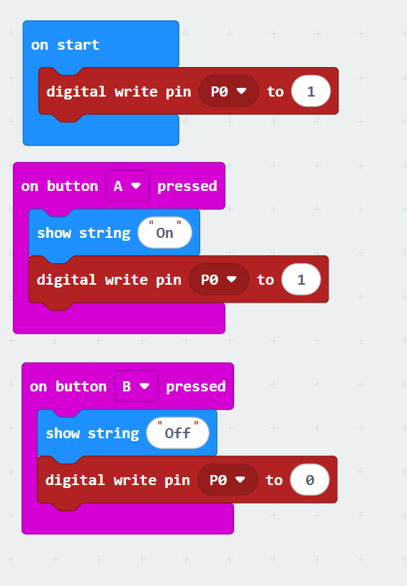
Test Code
https://makecode.microbit.org/S50988-10418-16415-21579

Slide 20
How to easily connect many devices to a single Micro:bit
Breadboards and Dragon Tails
Return to Contents

Slide 21
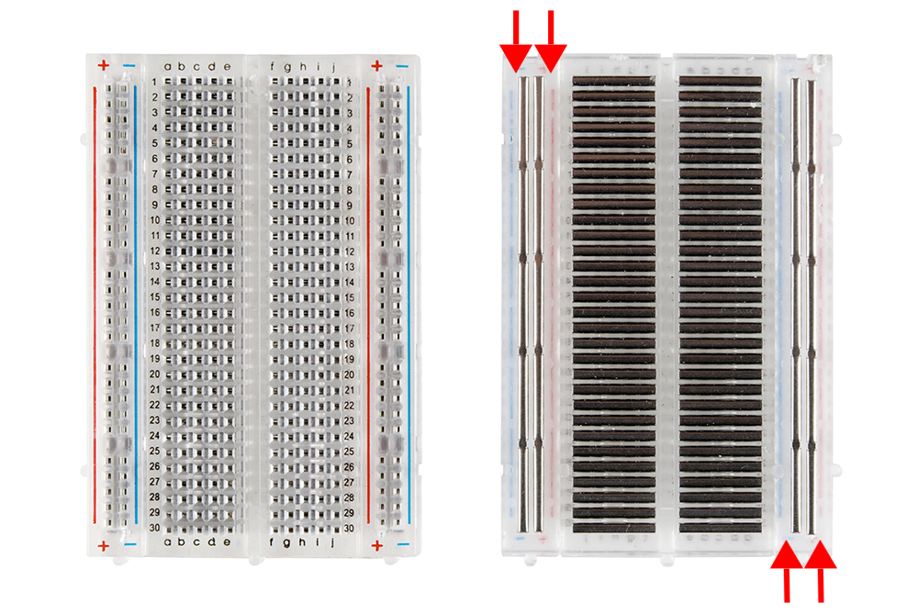
Breadboard
A breadboard allows you to easily wire up circuits more easily than the alligator clips we have been using.
Look at the picture to the right that shows the front of the breadboard and the back (without a back cover). The horizontal metal pieces connect the rows in the middle together. The vertical pieces connect the two outer columns together i.e. + and -.
https://cdn.sparkfun.com/assets/3/d/f/a/9/518c0b34ce395fea62000002.jpg

Slide 22
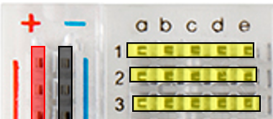
Breadboard Another Look
Here the red, black, and yellow rectangles show you which pins are connected together.
On the next slide, we will show you how a dragon tail uses these

Slide 23
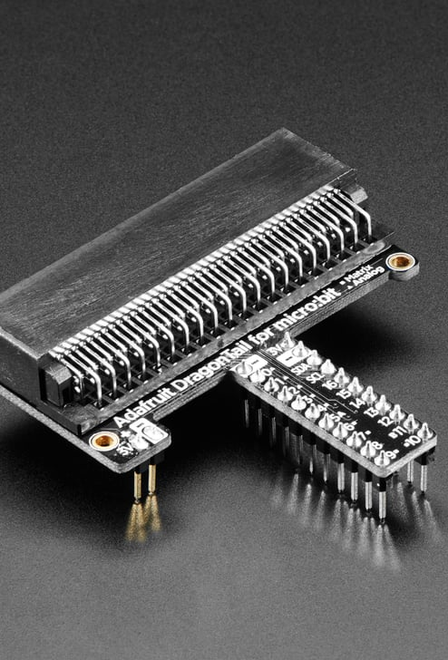
Dragon Tail
This allows for all the micro:bit pins to be accessed. It looks like this.
https://www.adafruit.com/product/3695?gad_source=1&gclid=CjwKCAiAxea5BhBeEiwAh4t5K3EZhW_CHisOPp2REVTQLm44mEs4-xoO_lDbqPCa760MqTU6hUY81BoCr6oQAvD_BwE

Slide 24
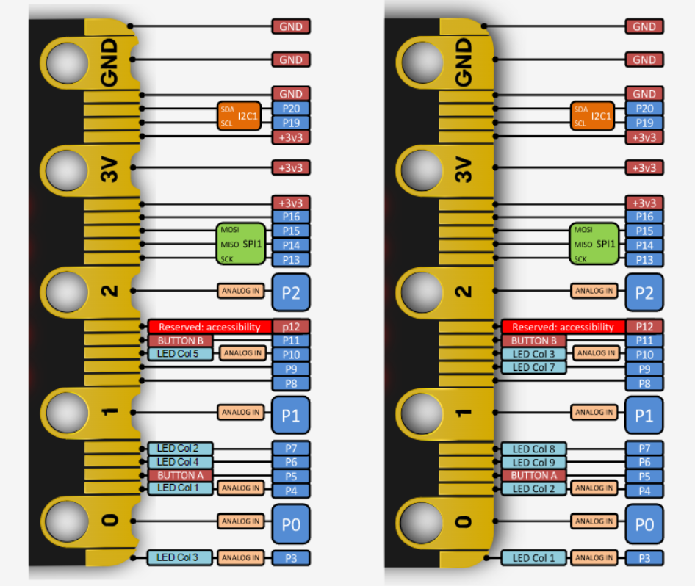
How the Dragon Tail allows for more inputs/outputs
This picture shows how the Micro:bit has more than 3 pins. They are incredibly hard to access without the Dragon Tail, which takes these small pins and allows them to be easily accessed by the breadboard.

Slide 25
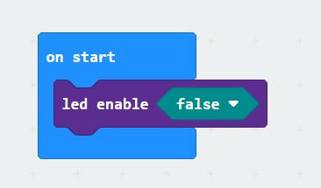
Using more than 3 pins on your Micro:bit
If you want to use more than 3 pins for your project, you must disable all LED pins and will not be able to use any display.
Use the following code to disable your LED pins

Slide 26
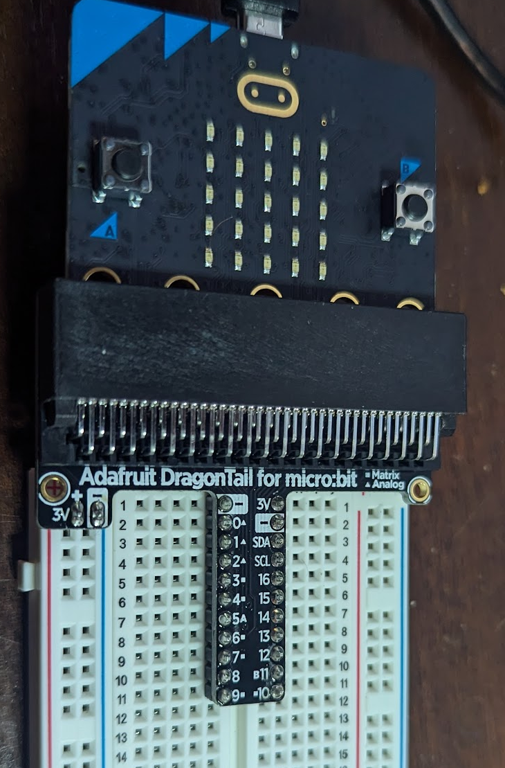
Here the red, black, and yellow rectangles show you which pins are connected together. With the dragon tail plugged in you can see connections for 3V (red), GND (black), and different pin numbers (yellow). The second yellow rectangle is how to hook into pin 0

Slide 27
IMPORTANT
If you plan to use more than the 3 default Micro:bit pins, please note that certain pins are reserved. Use the following table to see which pins can be used as general purpose inputs and outputs
Usable Pins | Analog/Digital
P0 | Analog/Digital
P1 | Analog/Digital
P2 | Analog/Digital
P3 | Analog/Digital
P4 | Analog/Digital
P6 | Digital
P7 | Digital
P8 | Digital
P9 | Digital
P10 | Analog/Digital
P16 | Digital

Slide 28
How do we do this with the dragontail?

Slide 29
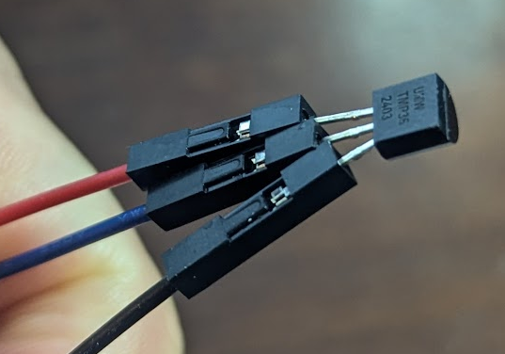
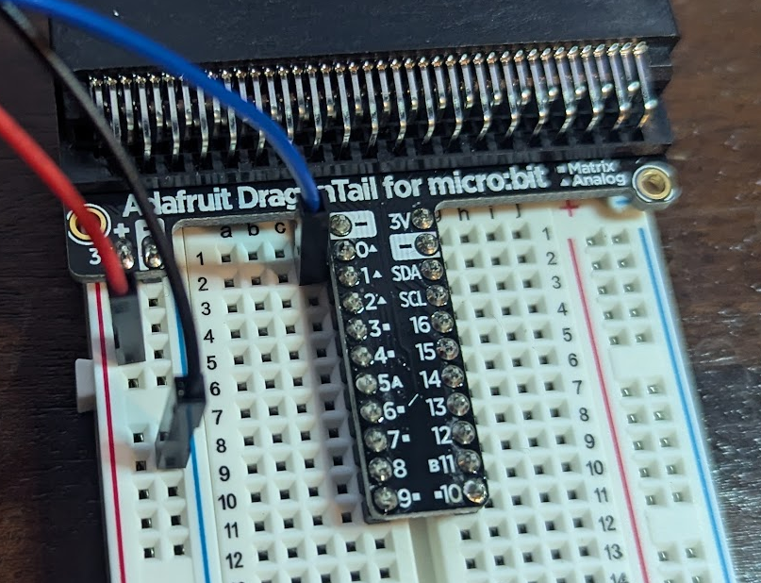
TMP36 to Breadboard
First connect the TMP36 to Female to Male Jumpers as shown below. Note: you can do it without the jumpers by bending the metal ends of the TMP36 as well
Then connect the male end of the jumps to the dragon tail breadboard as shown below – the blue wire is in row 2 – or pin 0 of the microbit

Slide 30
CHANZON Multicolor LED
A guide on connecting your LED to the Micro:bit
Return to Contents

Slide 31
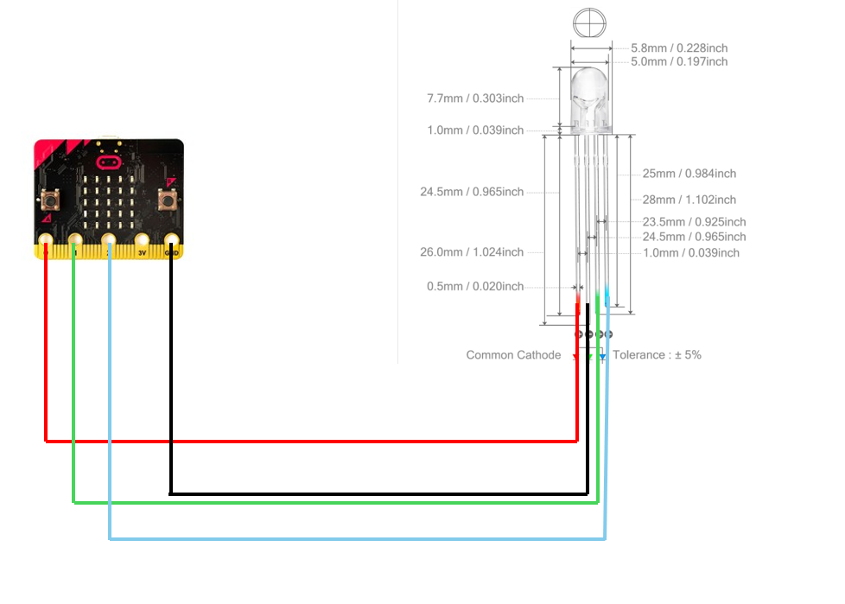
Hooking the LED to the Micro:bit
The long pin on the LED connects to the Micro:bit ground pin
The LED Colors are the short pins, which we turn on and off with the pins of the Micro:bit

Slide 32
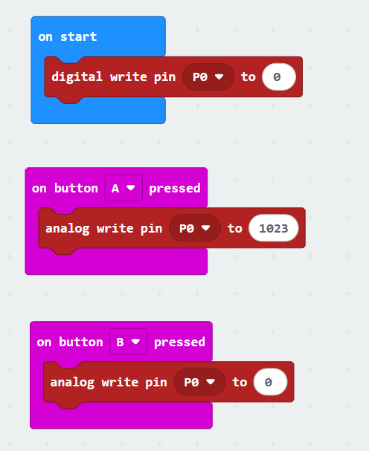
Test Code
Full On
When we send the 1023 signal, we fully turn on the LED.
When we send the 0 signal, we fully turn off the LED.
To control the brightness, change the write value between 0-1023.
This code only turns on one pin but just repeat the process with the other LED pins.
Here is a link to the code.
Full Off

Slide 33
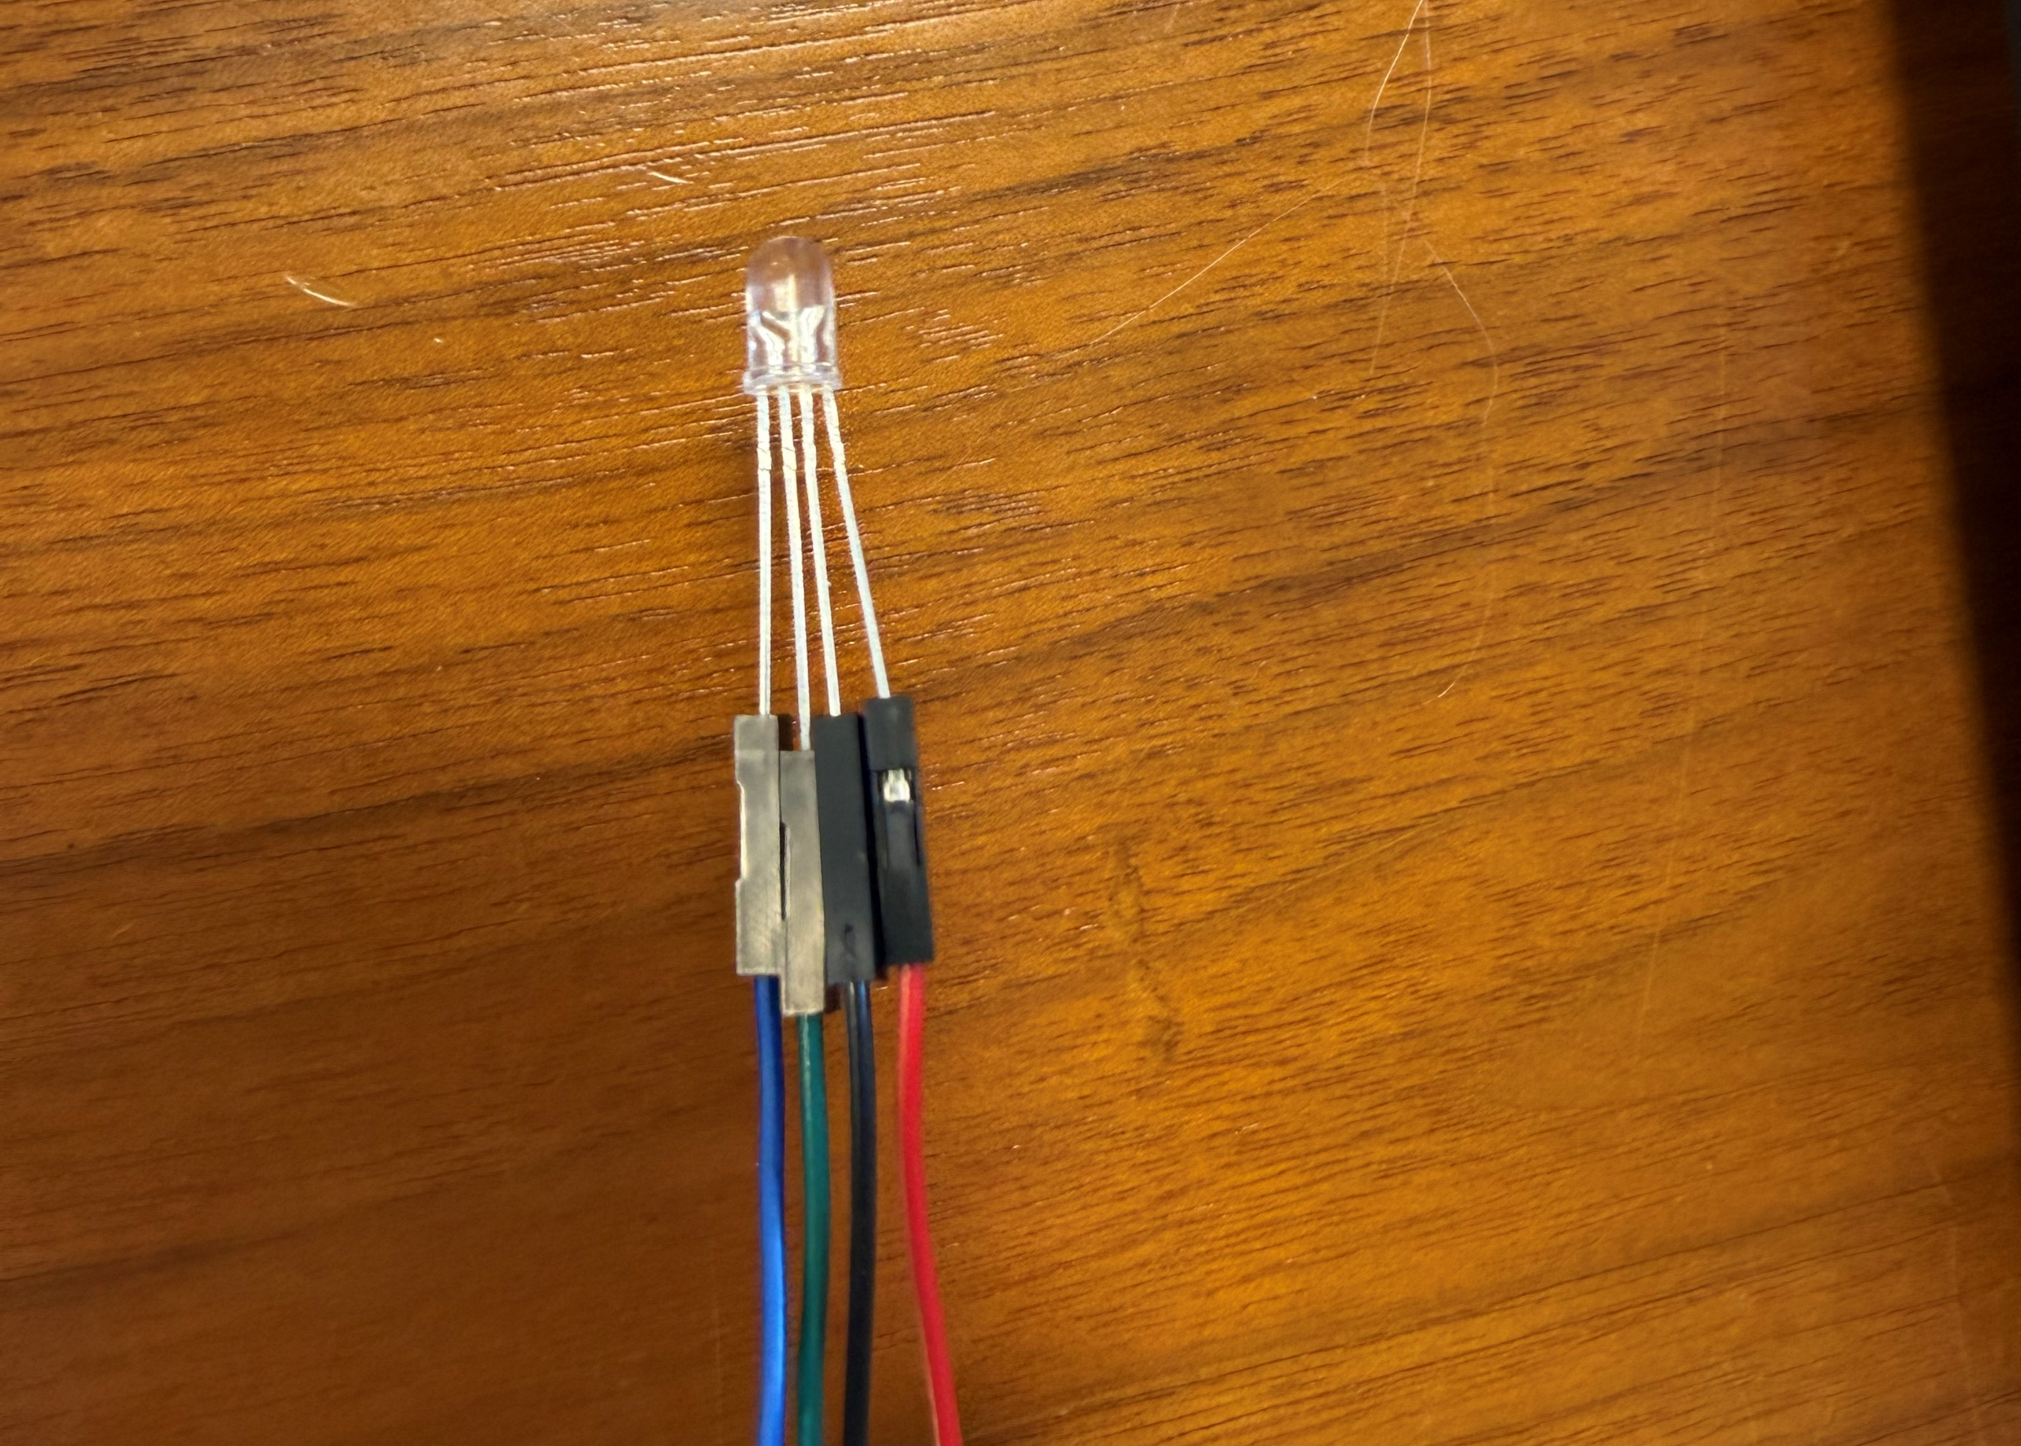
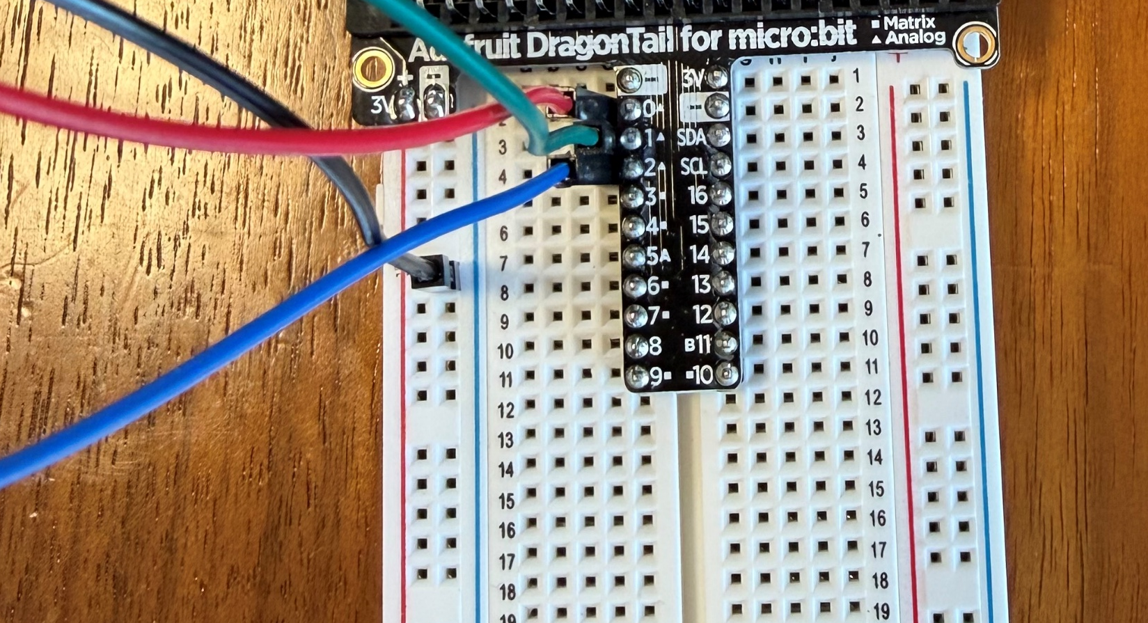
Using the Dragon Tail
First connect the CHANZON multicolor LED to Female to Male Jumpers as shown below. Note: you can do it without the jumpers by bending the metal ends of the LED as well
Then connect the male end of the jumps to the dragon tail breadboard as shown below:
The red wire controlling the red LED connects to row 2 of the breadboard, pin 0 of the Micro:bit
The green wire controlling the green LED connects to row 3 of the breadboard, pin 1 of the Micro:bit
The blue wire controlling the blue LED connects to row 4 of the breadboard, pin 2 of the Micro:bit
The black wire is the ground, connecting to the blue(negative) rail on the breadboard, ground pin on the Micro:bit

Slide 34
External Audio Devices
A guide on letting the world hear your feedback
Return to Contents

Slide 35
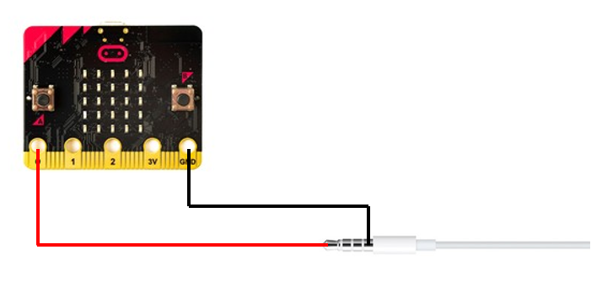
How to Connect an Audio Jack to Micro:bit
When we want to create an audio output using the Micro:bit, we connect the outermost ring of the audio jack to pin 0, and the innermost ring to the ground pin

Slide 36
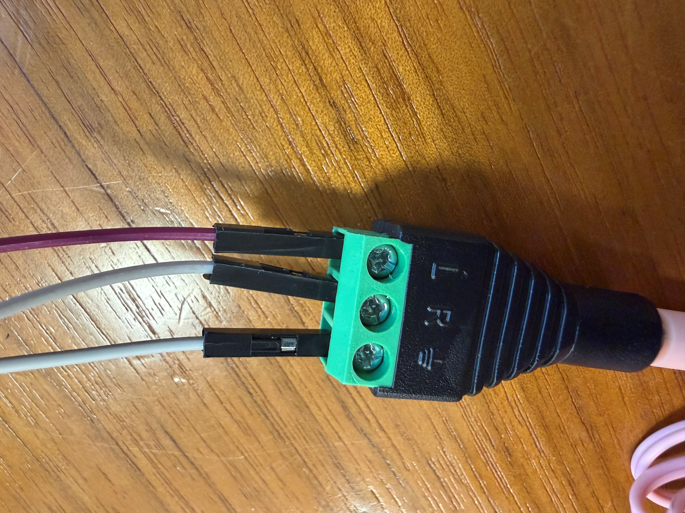
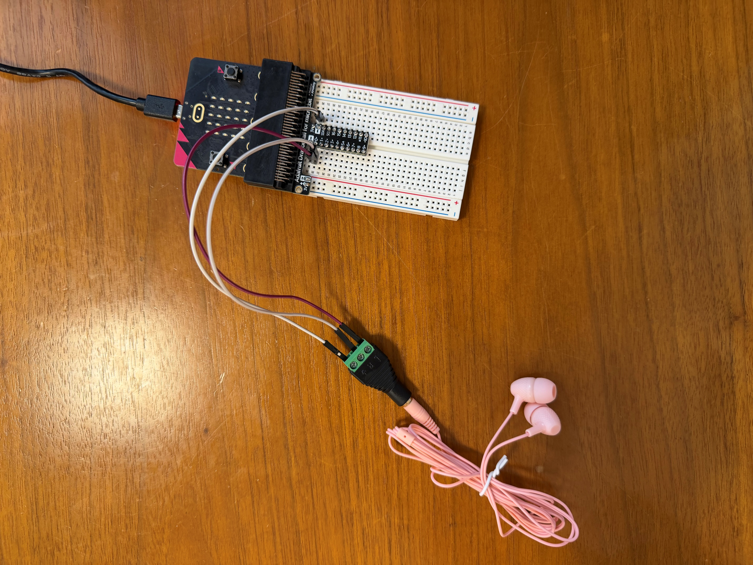
Using an adapter for audio connections
Connect the left and right pins of the adapter to pin 0 on your Micro:bit and connect the ground pin to the – pin on your Micro:bit
To make it easier to use headphones or speakers that have an audio jack for the Micro:bit, use the provided adapter

Slide 37
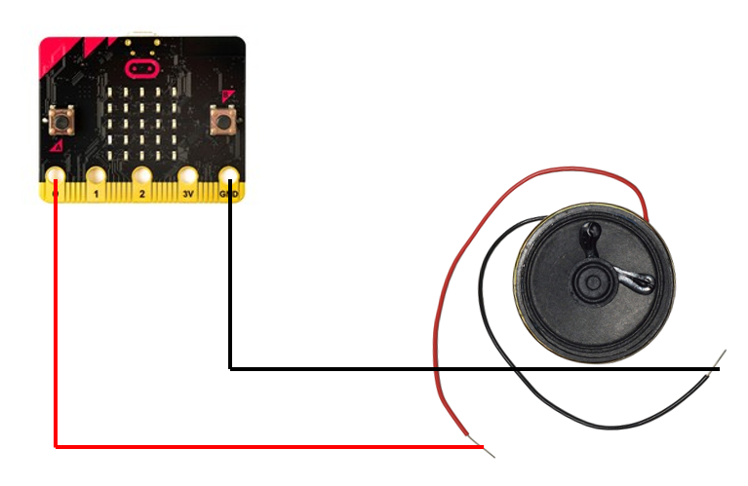
How to Connect a Speaker to Micro:bit
When we want to create an audio output using the Micro:bit, we connect the red wire of the speaker to pin 0 and the black wire of the speaker to the ground pin

Slide 38
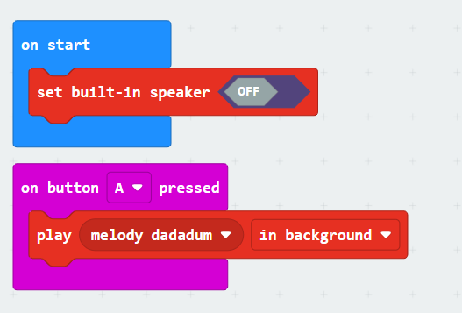
Test Code
To play audio out of the Micro:bit, we go into the music section of block code and scroll down to “Melody Advanced”. Click and drag play in background to play audio out of pin 0.
Then we scroll even further to the very bottom of the music section and use "set built-in speaker off" on start.
This code plays a melody out the speaker when button A is pressed.
Here is a link to the test code.

Slide 39
Further Information
Make sure that you only use pin 0 for audio outputs, as this is the only pin we can produce audio from.
If you would like to know more about using audio with the Micro:bit, here is the official link to audio control from Makecode.

Slide 40
External Switches/Pushbuttons
A guide on allowing external inputs dictate your Micro:bit logic
Return to Contents

Slide 41
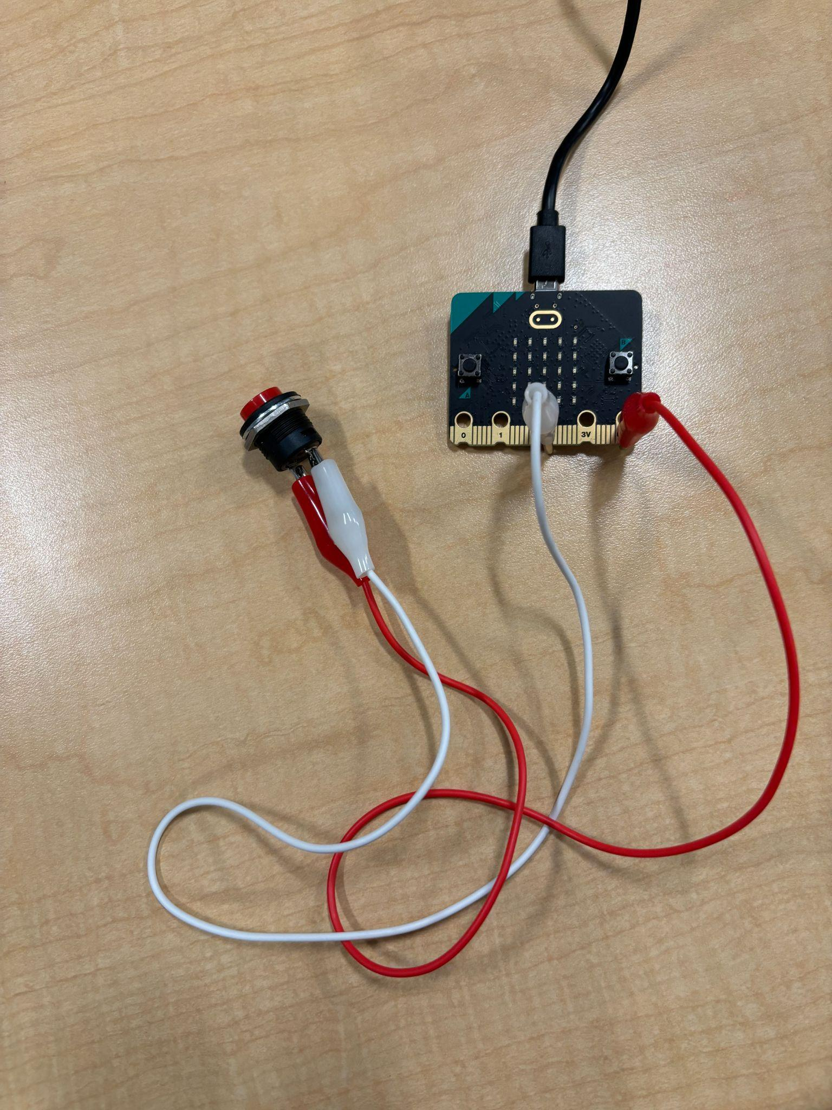
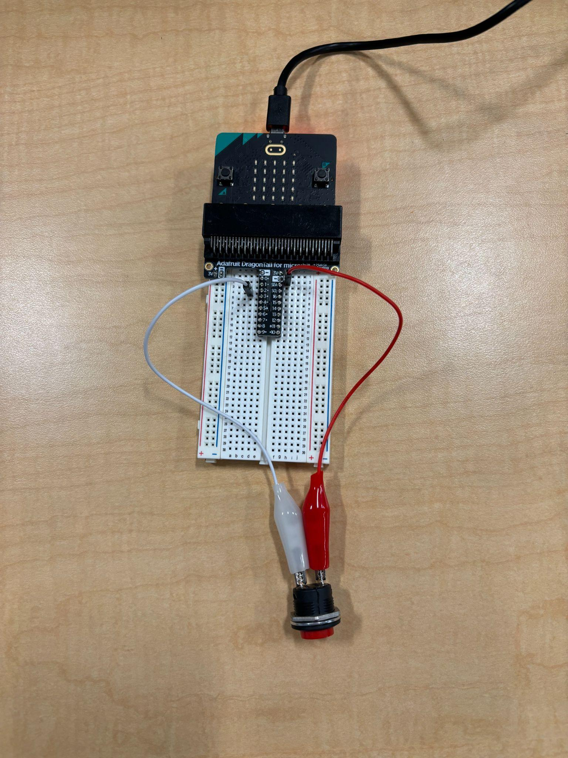
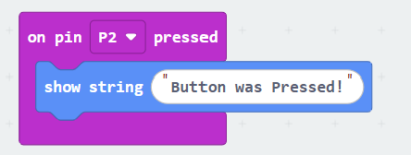
How to use a Push Button
Connect one side to P0, P1, or P2. No other pins will work using this method.
Connect the other side to ground (GND). Below examples use P2:
Connecting directly to the microbit
Connecting to a breadboard
Block code example

Slide 42
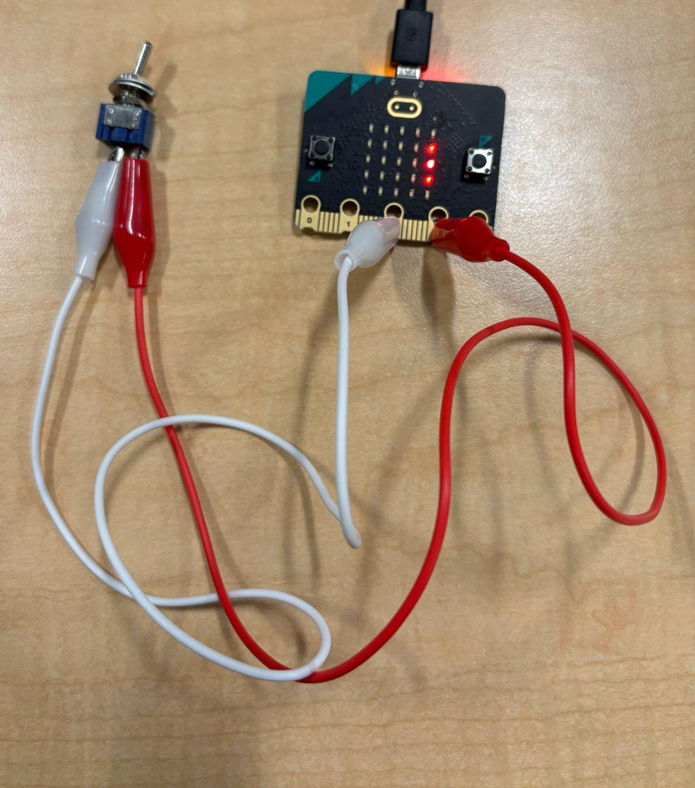
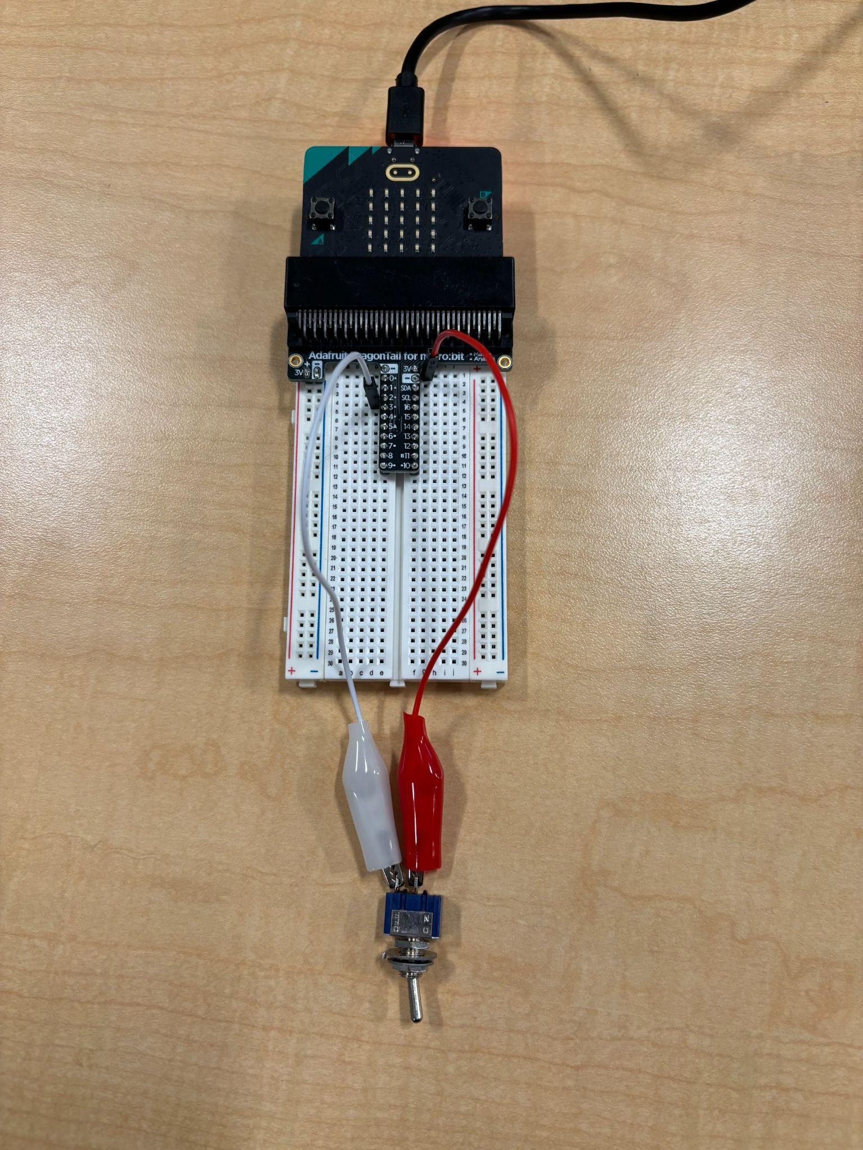
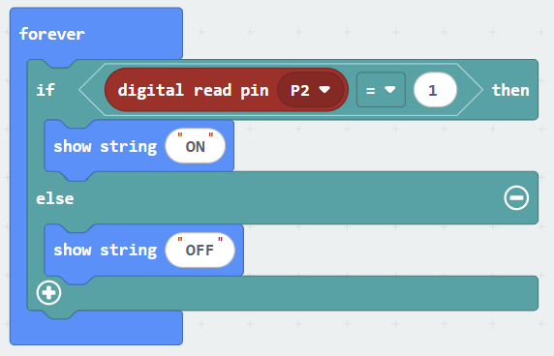
How to use a Toggle Switch
Connect one end to 3V, connect the other end to P0, P1, P2, P8, or P16. Other pins may or may not work but the ones listed have been confirmed to be working. Below examples use P2:
Connecting directly to the Micro:bit
Connecting to a breadboard
Block code example

Slide 43
Servo Motors
A controlled motor movement device
Return to Contents

Slide 44
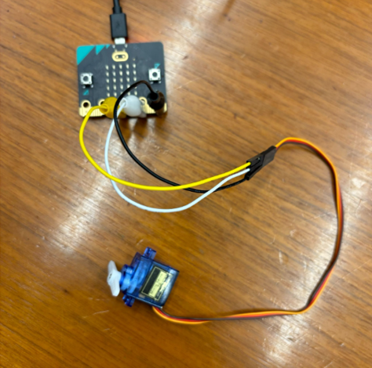
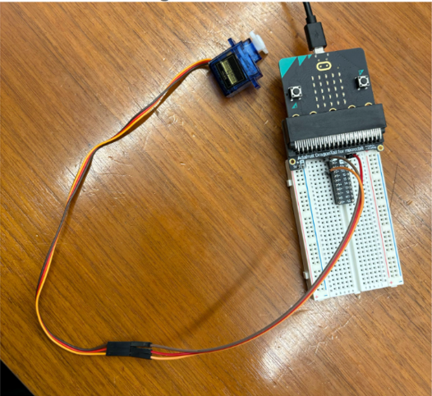
How to use a Servo
Connect the brown wire of the servo to Ground (GND). Connect the red wire to 3V.
Connect the orange wire to P0,P1,or P2. Below examples use P2:
Connecting directly to the Micro:bit
Connecting to a breadboard

Slide 45
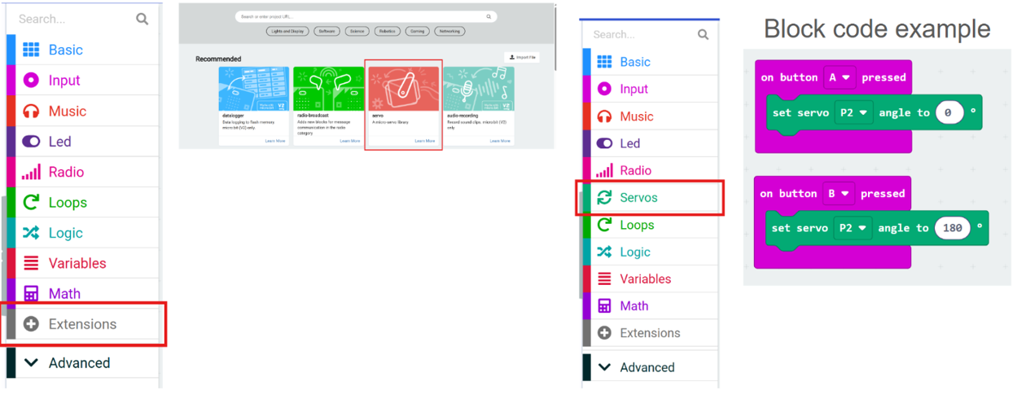
How to Program a Servo
Step 1) Press the extension button in MakeCode
Step 2) Click on the “servo” library image
Step 3) Click on the “servos” to use the servo blocks

Slide 46
Radio Messages
Sending messages between two Micro:bits
Return to Contents

Slide 47
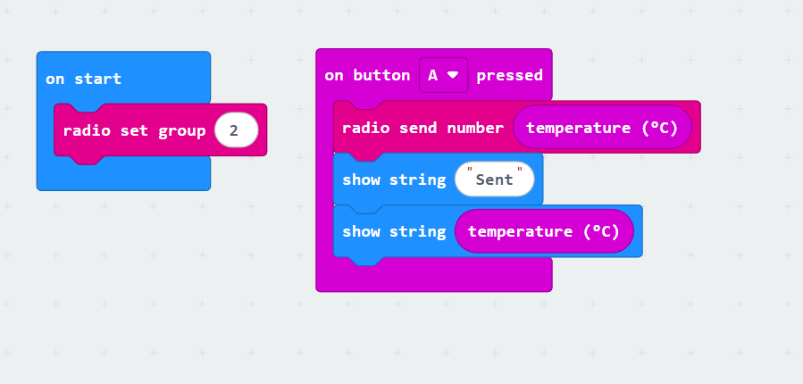
How to program the radio
Example Sender code below
On button A it will send through radio the temperature
What starts the send can be changed. It can be every second, or every few seconds.
It will show “Sent” as a confirmation that it runs
***MUST BE A RADIO SEND NUMBER BLOCK***

Slide 48
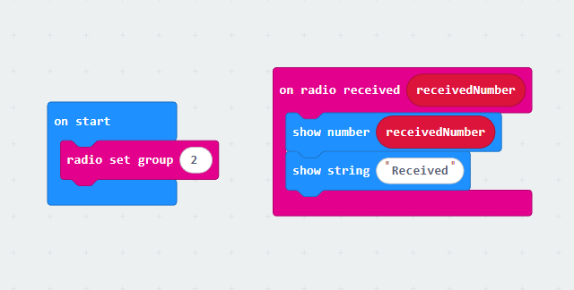
Example Receiver code
Example code for receiver below:
The radio group can be any number but the Micro:bit sending the information must have same number
Please also note that if you would like to receive a number, you must send a number. Whatever datatype I send I must also receive or radio will not work

Slide 49
OLED Display Messages
Displaying your data to the world
Return to Contents

Slide 50
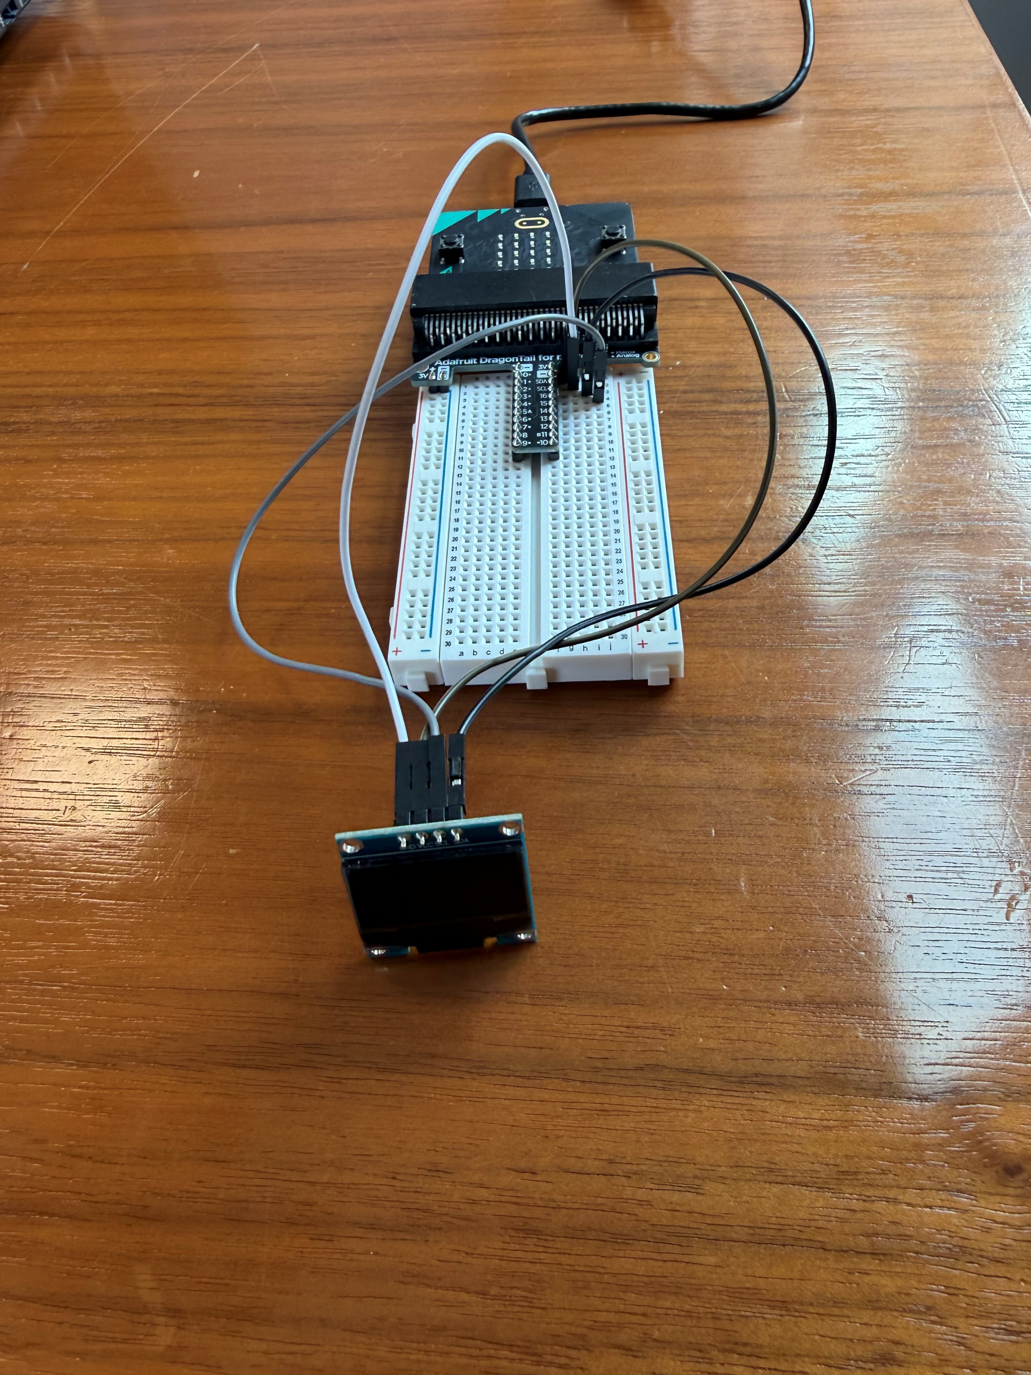
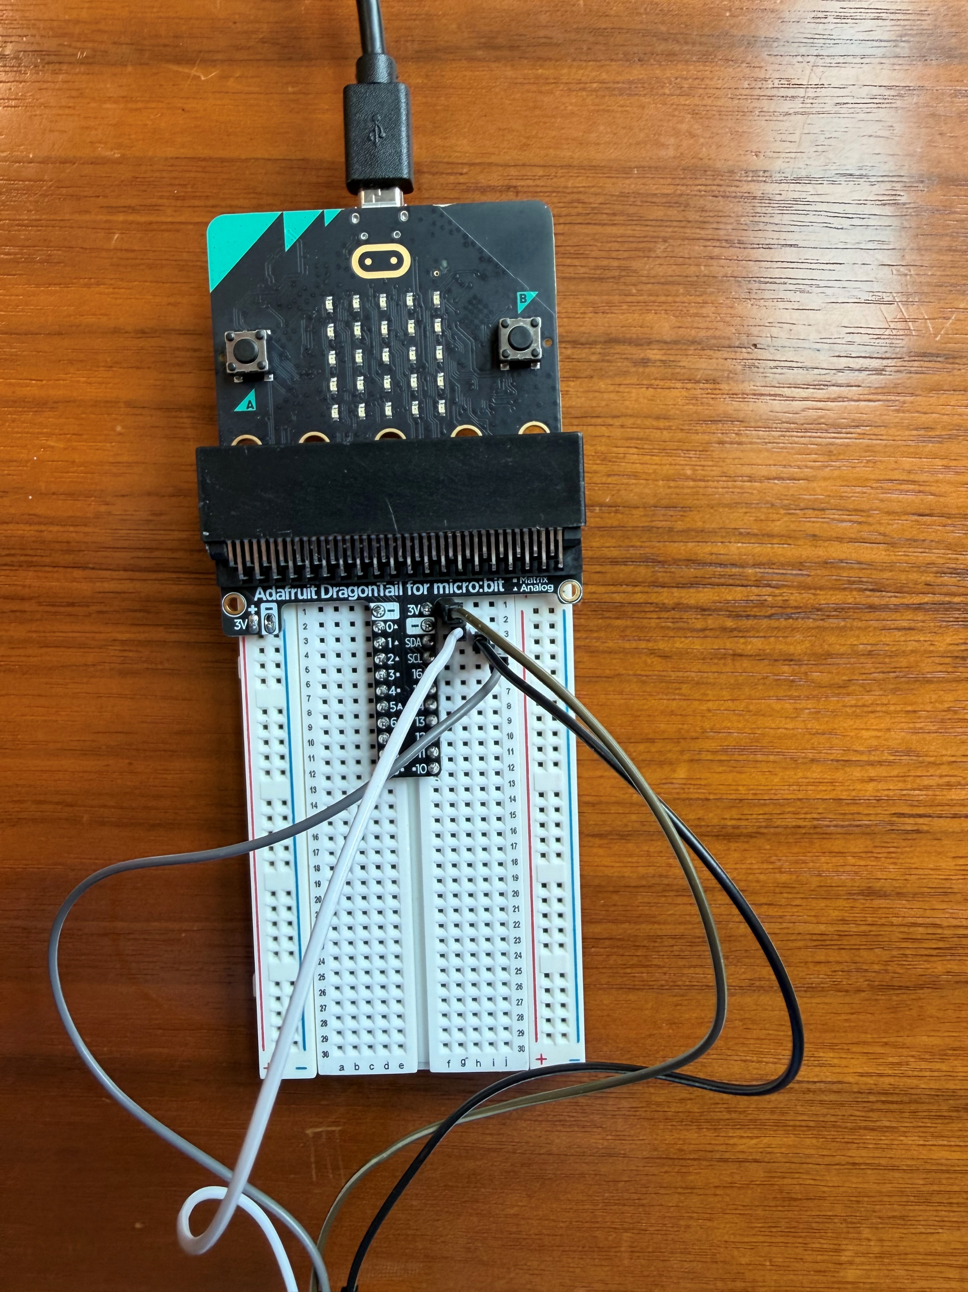
How to connect your OLED
The VCC pin on the display goes to the 3V pin on the breadboard
The GND pin on the display goes to the (–) pin on the breadboard
SDA and SCL pins from the display plug into the SDA and SCL pins on the breadboard
To use the OLED display, you must use a Dragon Tail

Slide 51


How to program your OLED
To begin programming, click on extensions and download the oled-ssd1306 extension
Block Code Example

