Slide 1
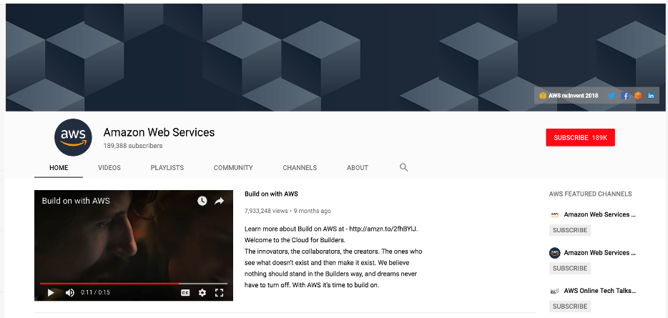
Getting Started: AWS Account Creation and Cloud9

Slide 2
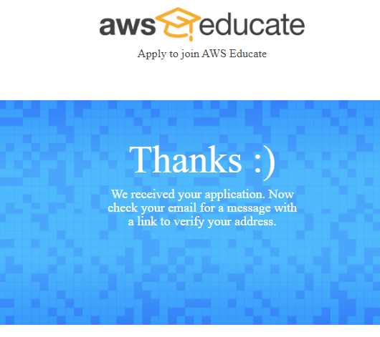
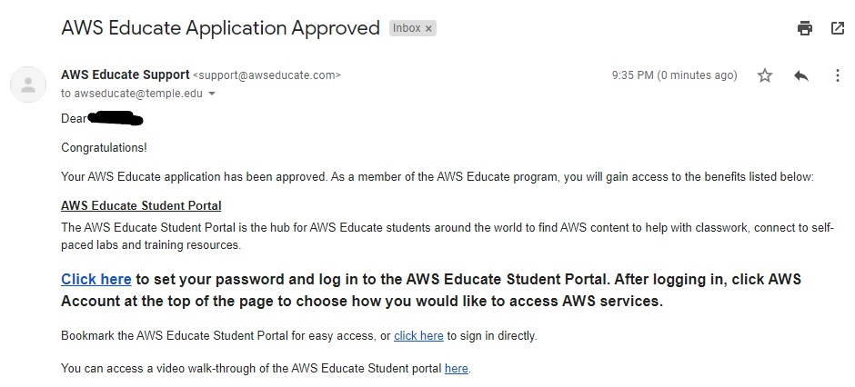
Step 1: Creating Your Amazon AWS Educate Account
You will be invited to AWS Educate to join a “Classroom”.
Complete the AWS Educate application process.
Fill in the prompted information, scroll down the terms and conditions, agree, then submit.
You should see this screen
An email confirmation will be sent. Click the link.
Wait for your application to be approved. Once you get the approval email, click the link to set your password.

Slide 3
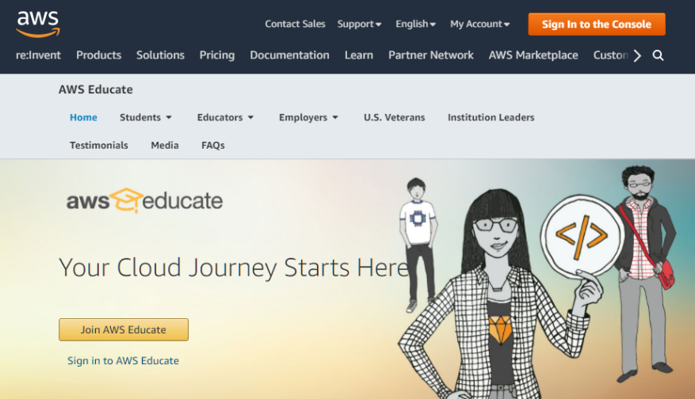
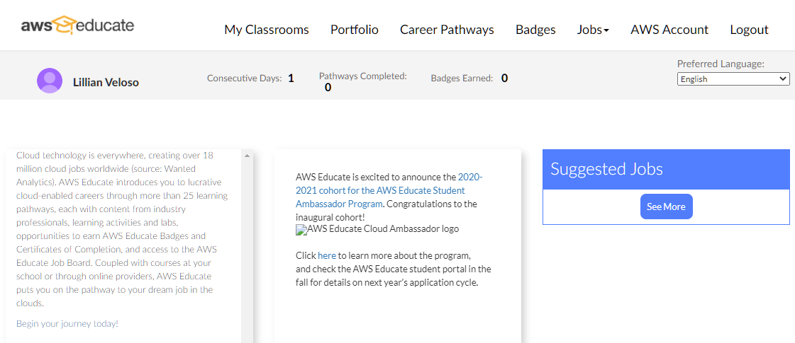
Step 2: Getting to your AWS Educate Classroom
Once you login to your AWS Educate Account (for future reference: https://aws.amazon.com/education/awseducate/), click on “My Classrooms”
Next, click on “Go to classroom” for Engineering Computation I
Click “Confirm” then “I Agree” on the next two pages.

Slide 4
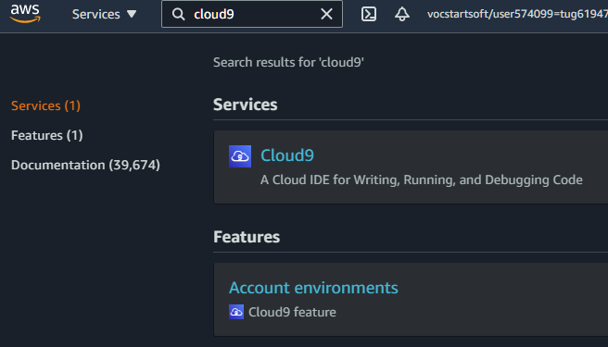
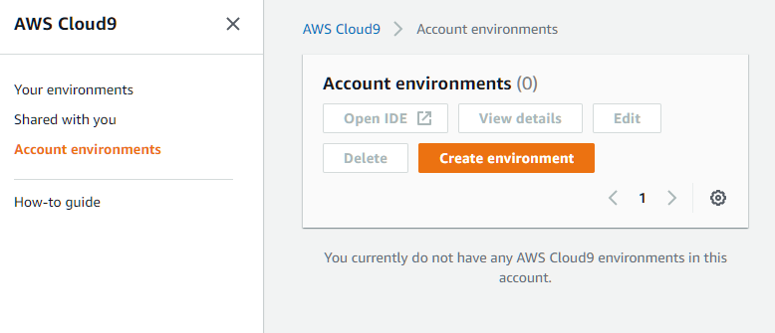
Step 3: Creating Your Amazon AWS Account
Click on “AWS Console”
You are now in the AWS Management Console.
Search for “Cloud9” in the search bar.
Under ‘Features’ click ‘Account environments.
After entering the Cloud9 service, click “Create Environment”

Slide 5
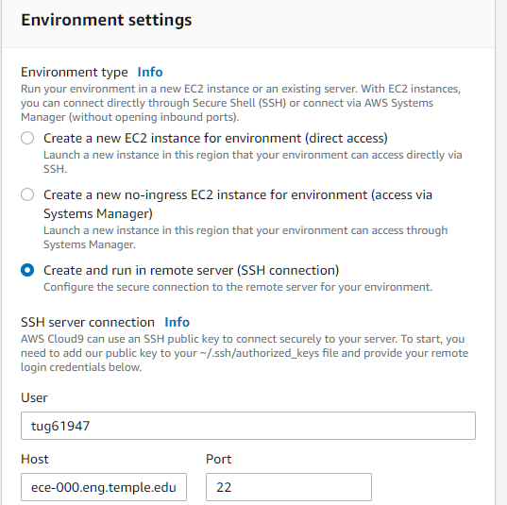
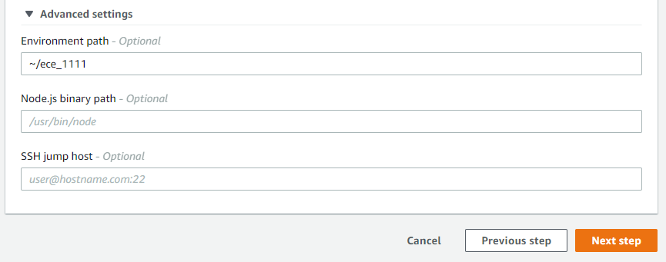
Step 4: Creating a Cloud9 Environment
Enter “ECE_1111” for the name of the environment. Then hit “Next step” on the lower right. This will bring you to the “Configure settings” page.
Select the SSH option for environment type.
Enter your login name (TUID) and the host that you use when accessing the VM (ECE 1111 will use ece-000.eng.temple.edu).
Open the “Advanced settings” dropdown menu and type “~/ece_1111” for the environment path.
DO NOT CLICK NEXT STEP YET
Open a terminal session and ssh to the ece-000 server

Slide 6
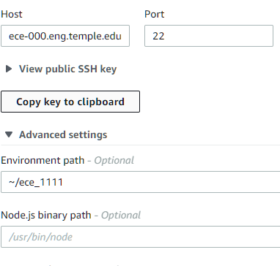
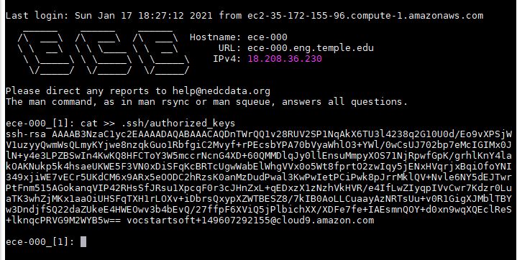
Step 5: Creating a Cloud9 Environment
Type this command into the terminal and press enter once: “cat >> .ssh/authorized_keys”
Next click “Copy key to clipboard” under the View public SSH key section
Go back to the terminal. Paste the key*. Hit enter twice. Then Press Ctrl + D
*you need to know how to paste into your respective terminal tool
(e.g. macOS: ⌘ + V MobaXterm: right-click → paste Gnome Terminal: Ctrl + Shift + V)

Slide 7
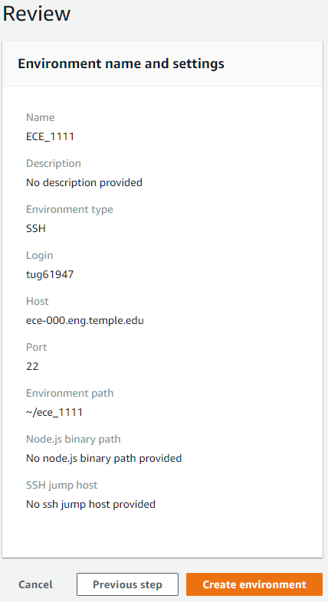
Step 6: Finish Creating The Environment
Return to the AWS “Configure settings” page in your web browser and select “Next Step”. This will take you to the “Review” page shown below.
On the “Review” page, double-check these fields:
name is “ECE_1111”
login name is your TUID
host is “ece-000.eng.temple.edu”
environment path is “~/ece_1111”
Click on “Create environment” tab at the bottom right.

Slide 8
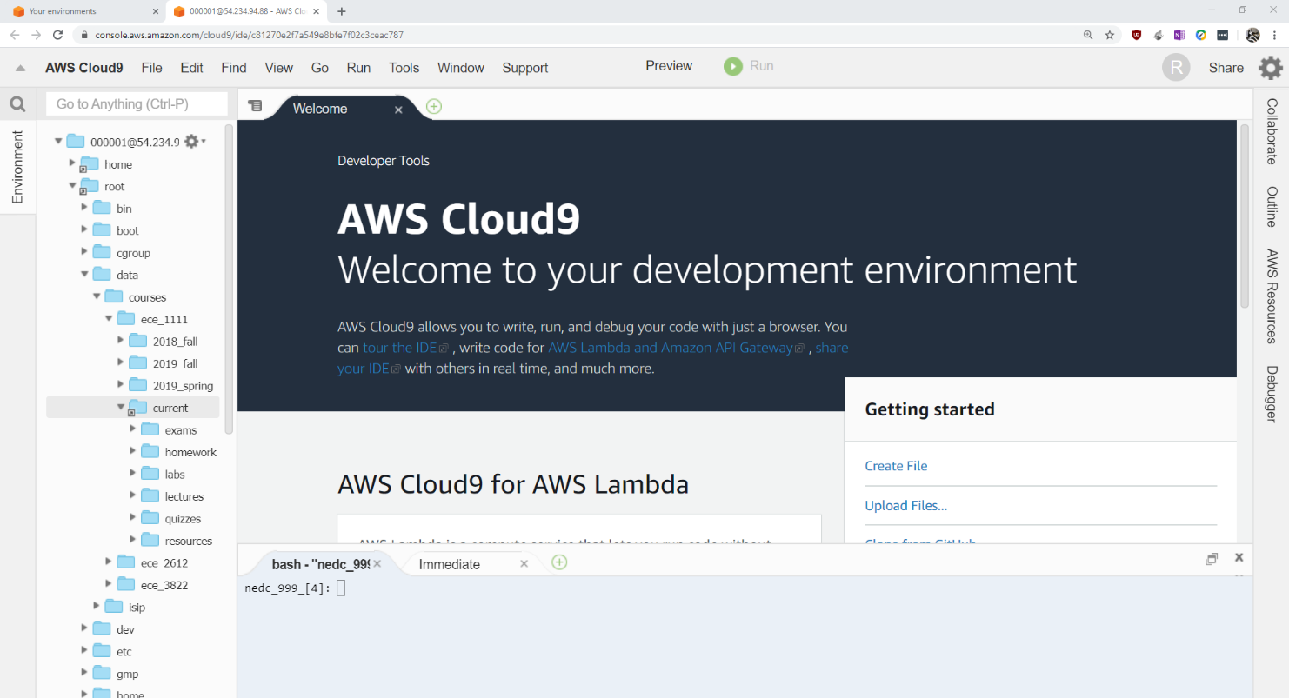
Step 7: Navigating the Cloud9 Environment
The IDE should look like the screenshot below.
Because the environment path was set to ~/ece_1111 only files inside this directory will show up in the environment. To access files on the rest of the server in Cloud9, use the home and root shortcuts.
NOTE: later in this course, when you use the debugger in Cloud9, it will only work on files under your ece_1111 directory (it will not work on files through the shortcuts). Suggestion: develop your homework and lab solutions inside the ece_1111 directory, then copy them into their corresponding submission directories when ready.
Files and Directories
Terminal

Slide 9
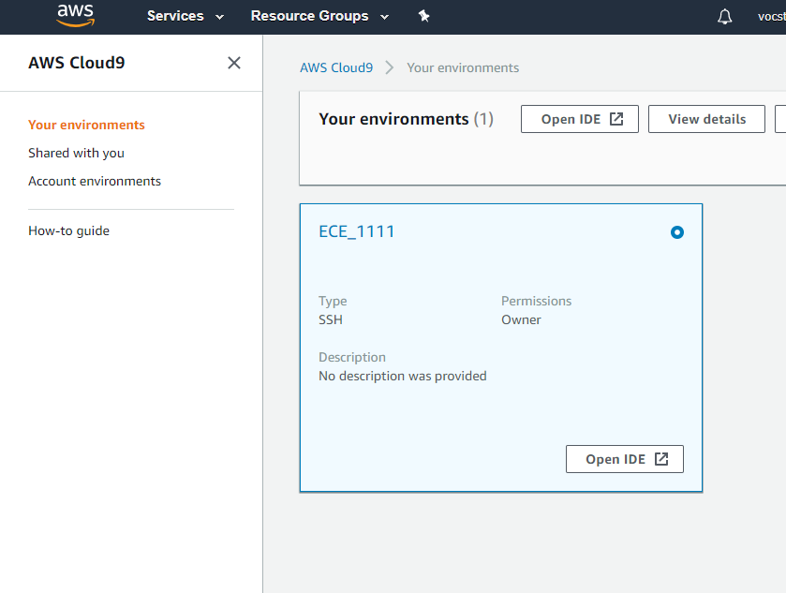
Step 8: Navigating to the Cloud9 Environment
To open a new session in the Cloud 9 environment:
Go to this URL: https://aws.amazon.com/education/awseducate/
Go to My Classrooms -> Go to classroom -> AWS Console -> Cloud9
Select “ECE_1111” (if you only have one environment installed, this will be done automatically).
The circle should have a white dot in it.
Select the “Open IDE” button to open up the environment.

