Slide 1
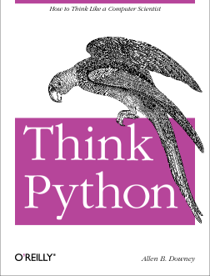
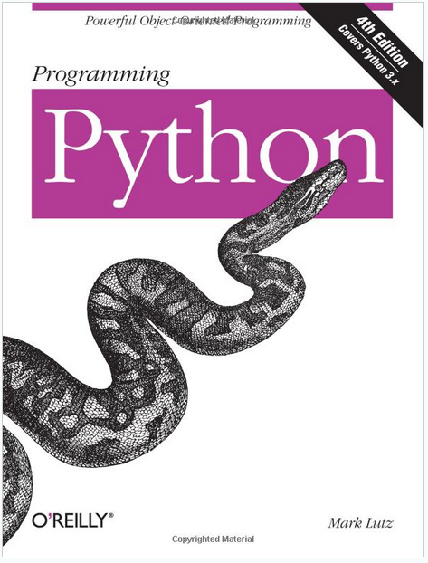
Lecture 30: Anatomy of a Class (C++ and Python)
Topics:
Why Object-Oriented Programming
C++:
The Class Declaration
Public/Private/Protected Data
Data Initialization
Member Functions
Scope
Python:
Comparisons to C++
Examples
Resources:
GeeksForGeeks: C++ Classes
TutorialsPoint: Classes and Objects
GeeksForGeeks: Python Classes
Python.org: Classes

Slide 2
Summary – C++
Why C++:
C++ provides a mechanism for binding together data structures and functions that operate on those data structures.
C++ allows explicit control the application programming interface (API).
C++ facilitates an object-oriented programming environment.
Many things introduced into the C++ language found their way back into the C programming language.
Significant New Reserved Words:
Class: defines the beginning and end of the definition of a class similar to the keyword “struct” in C.
Public/Private/Protected: allows you to control the visibility of data and functions in your API.
Significant New Functionality/Terminology:
Instantiate An Object: simply means creating an instance of a class.
Constructors/Destructors: functions that are used to control how an object is created and destroyed.
“.” and “->”: used to access functions and data in a class.

Slide 3
Summary - Python
Classes in Python are very similar to C++:
The reserved word “class” is used to denote the start of a class definition.
The reserved word “def” is used to denote the start of a member function.
The reserved word “self” is similar to “this” in C++.
Constructor syntax is a little tricky:
def __init__(self):
Syntax in the calling program is straightforward:
toaster = Toaster();
toaster.myprint();
Flexible argument referencing for function calls:
toaster1.myset(model = "bosch", width=float(99), length=float(35))
Two main differences:
Usually let the garbage collector handle destruction of objects.
Many programs do not protect class data (e.g., ’protected’ and ‘private’ are not commonly used).

