Slide 1
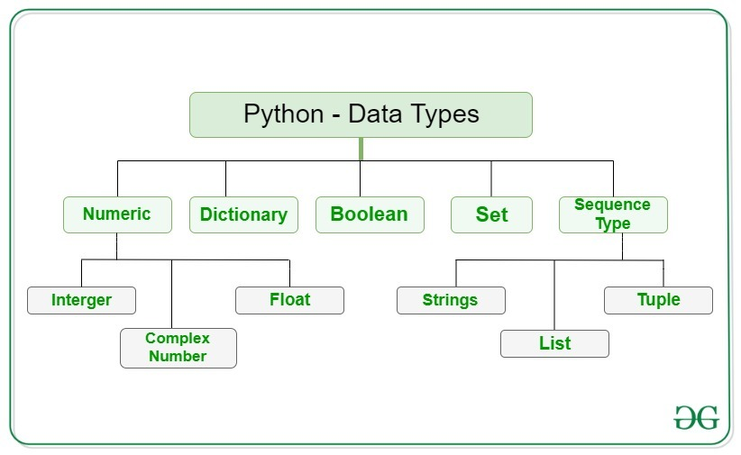
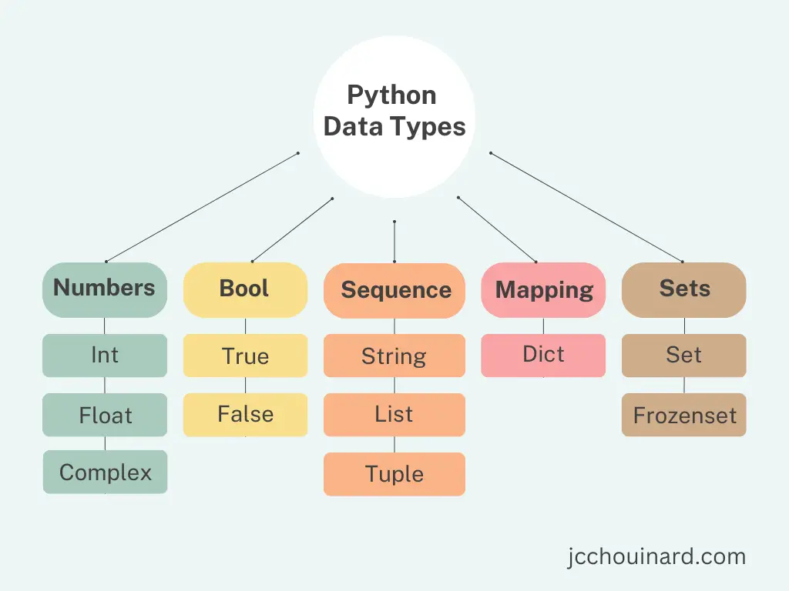
Lecture 05: Atomic Types and Built-In Data Structures
Topics:
Atomic Types
Numeric
Boolean
Sequence
Mapping
Sets
Resources:
Python: Data Types
Python: Dictionaries Python: Data Structures

Slide 2
Summary
Atomic Types: basic data types in a programming language that let us do simple mathematics (e.g., integers, floating-point numbers).
Data Structures: a specialized format for organizing, processing, retrieving and storing data (e.g., a list or dictionary).
Lists: one of several data types in Python that allow you to store a collection of things. Lists can be heterogenous (a collection of different things).
Arrays: using the numpy library, we can have compact arrays comparable to arrays in compiled languages like C/C++. These are used for high speed numeric computations.
Dictionaries: an associative array.
Data is indexed by a key.
Starting with Python 3.7, dictionaries are ordered (you can assume items can be indexed numerically in the same order they were inserted).
You can iterate over a dictionary by key or by index or both.
Loops: you can iterate over a data structure in Python without explicitly knowing its length (very convenient).

