Slide 1
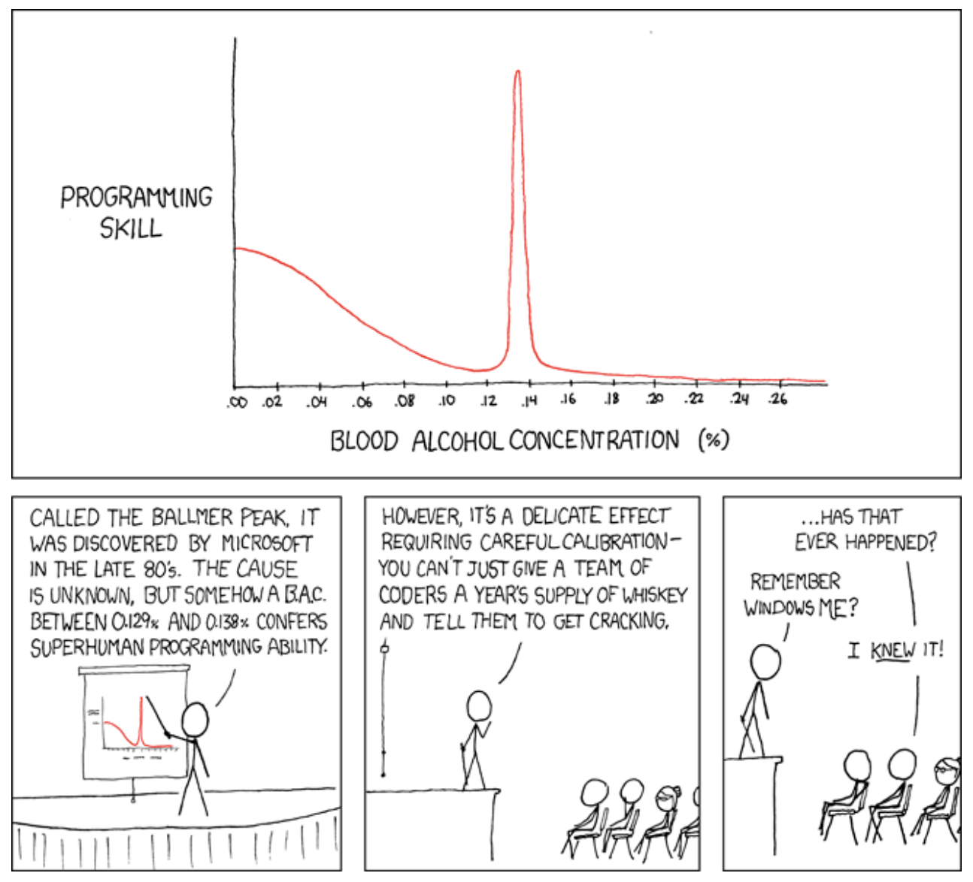
Lecture 04: The Bash Programming Language
Topics:
What is a Shell Program?
Environment Variables
The Environment
Redirection
Command Line Arguments
Syntax
Loops and Conditionals
Text File I/O
Functions
Job Control
Resources:
GNU: The Bash Reference Manual
Medium: Bash Scripting
MB: The Bash Guide
GHB: Awesome Bash

Slide 2
Summary
The Bash Programming Language: some tasks can be easily and efficiently solved using combinations of the highly-optimized tools that Linux provides. Linux supports the bash programming language, we can be used in scripts to solve problems.
The Environment: essentially a list of name value pairs that encode information about your session. Information can be passed from one application to another using environment variables.
Command Line Arguments: programs should be configured using command line arguments rather than hardcoding information.
Program Flow: bash supports common structure such as loops, conditionals and function calls.

