Slide 1
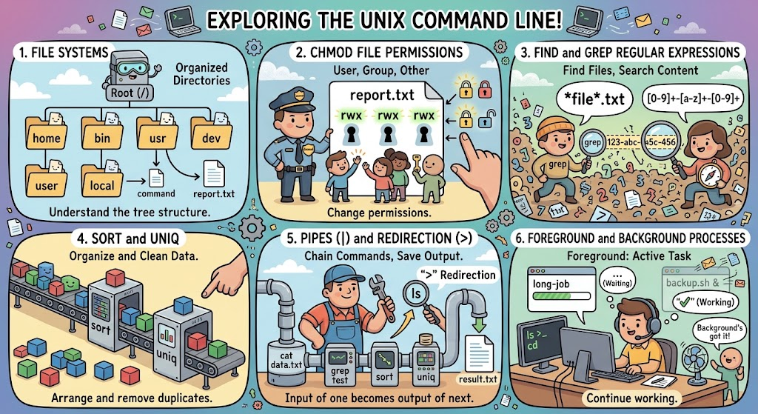
Lecture 02: Linux – Command Line Programming
Resources:
TutorialsPoint: Unix File Permissions
Temple: Unix for Poets
Cheat Sheets:
GNU: Bash Reference Manual
AF: Bash Scripting
JHU: UNIX Reference Card
SSC: Bash Reference Card
Topics:
File Systems “ls” and “d”
Directory Listings “chmod” and “chgrp”
File Permissions “find” and “grep”
Simple Regular Expressions “sort” and “uniq”
Foreground and Background Unix Pipes (“|”) and Redirection (“>”)

Slide 2
Summary
File Permissions: We can set permissions for the user, the group and other users using commands like “chmod”.
Pipes: Allow you to concatenate commands. You can send the output of one command as input to the next command.
Foreground/Background: We can run processes interactively (foreground) or in the background, which allows you to continue to work while the process is running.
Command Line Regular Expressions: The Bash shell supports simple regular expressions that can be used to identify files and directories.
Command Line Programming: Unix is built from a set of simple commands such as ‘cat’ and ‘grep’. Using pipes we can build complex commands from simple ones by combining these simple commands together.
Regular Expressions: The bash shell supports simple regular expressions that allow you to easily find files in large databases. We can also use these expressions with commands like ‘grep’.
Useful Commands: We will use ‘cat’, ’d’, ‘sd/td/pd’, ‘find’, ‘grep’, pipes, shell redirection and, of course, ‘isip_e’, extensively in this course.

