Slide 1
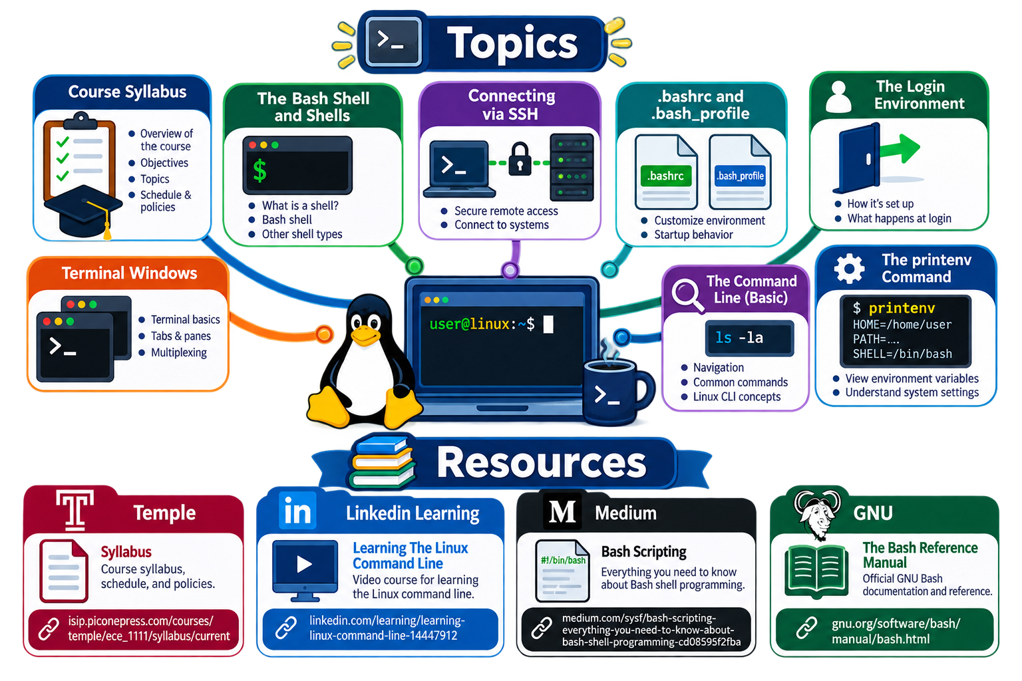
Lecture 01: Linux – Virtualization, Command Line, Shells
Topics:
Course Syllabus The Bash Shell and Shells .bashrc and .bash_profile
Connecting via SSH Terminal Windows The Command Line (Basic)
The Login Environment Basic Filesystem Navigation The printenv Command
Resources:
Temple: Syllabus
LinkedIn: Learning The Linux Command Line
Medium: Bash Scripting
GNU: The Bash Reference Manual

Slide 2
Summary
Course Syllabus: course web site, the structure of the course, the listserv, the listserv archive, the archive of exams and quizzes, online materials such as LinkedIn, textbooks, and StackOverflow
Cloud Computing: ece-000 is physically part of the Amazon cloud.
Operating Systems: explained the difference between a Windows and Mac machine with respect to Unix
Terminal Windows: demonstrated how to connect to ece-000 using a terminal window, ssh keys and the Remote Connection
Command Line: introduced the notion of a command line interface, changing directories, the location of your account, the courses directory, tab expansion
Shells: the shell (bash), the environment (printenv) and processes
Login Environment: introduced the .bash_profile and the .bashrc files

