Slide 1

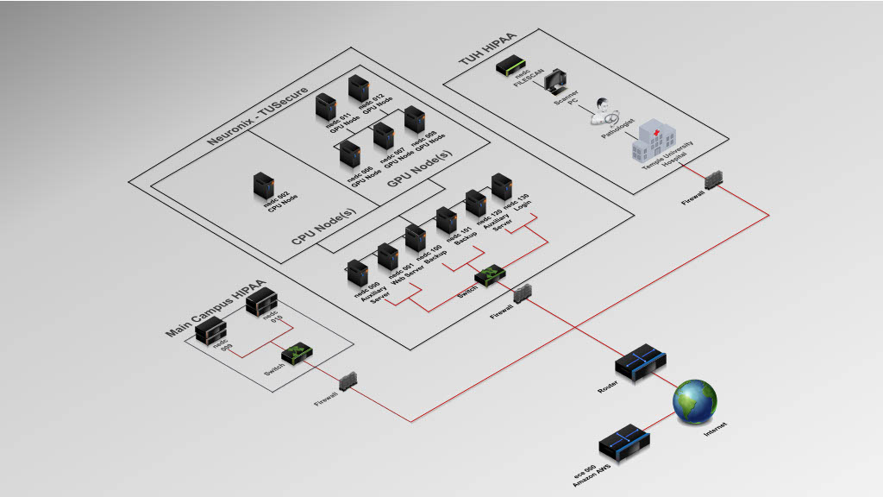
Lecture 08: Introduction to VSCode
Topics:
Popular Tools
Debuggers
Integrated Development Environments
Working Remotely Via SSH
VSCode Basics
Resources:
Temple: Tips For VSCode
MS: VSCode Documentation

Slide 2
Summary
Integrated Development Environments (IDE): there are many such environments (e.g., VSCode, PyCharm, Eclipse). These allow you to create and debug code. Helper tools can suggest function names, show arguments and help information, etc. Code can be written in a way that these tools can pick up comments and function descriptions.
Source Level Debugging: the ability to step through code, watch variables, examine output. This is done by setting breakpoints.
Remote Shell: we typically log into a remote host, such as ece-000, to debug. VSCode allows you to connect to a remote host using Open SSH, which is integrated into the tool.
Repository Integration: Most tools allow you to interact directly with configuration management software such as GitHub.
AI Integration: Most IDEs now support AI functions that will generate code.

