Slide 1
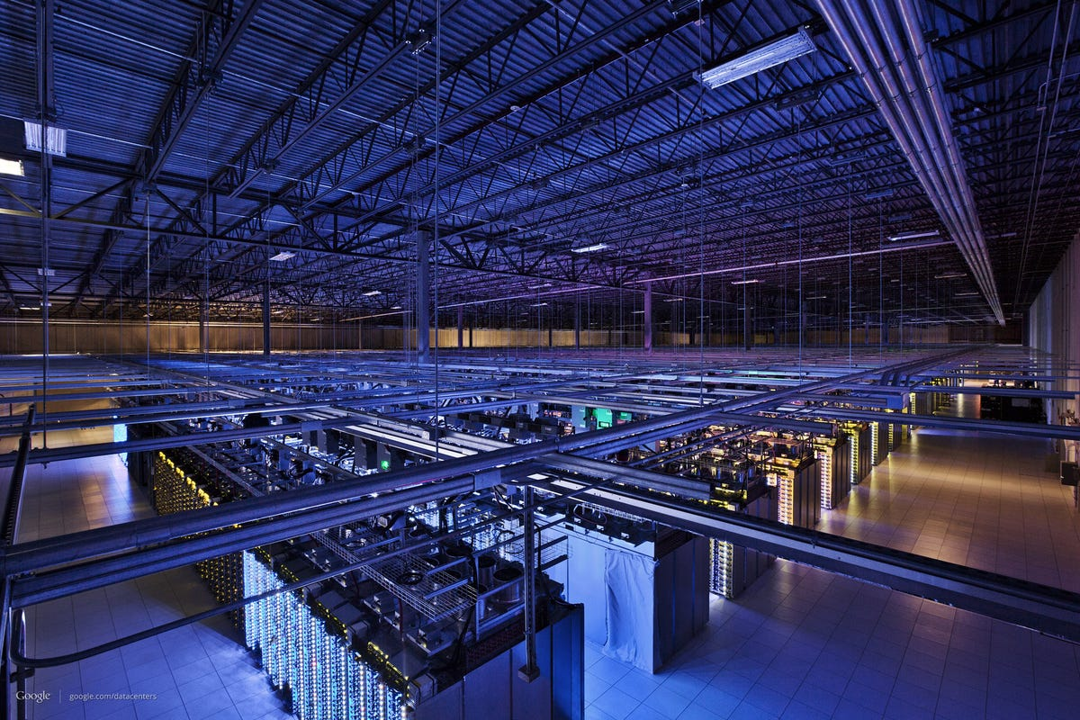
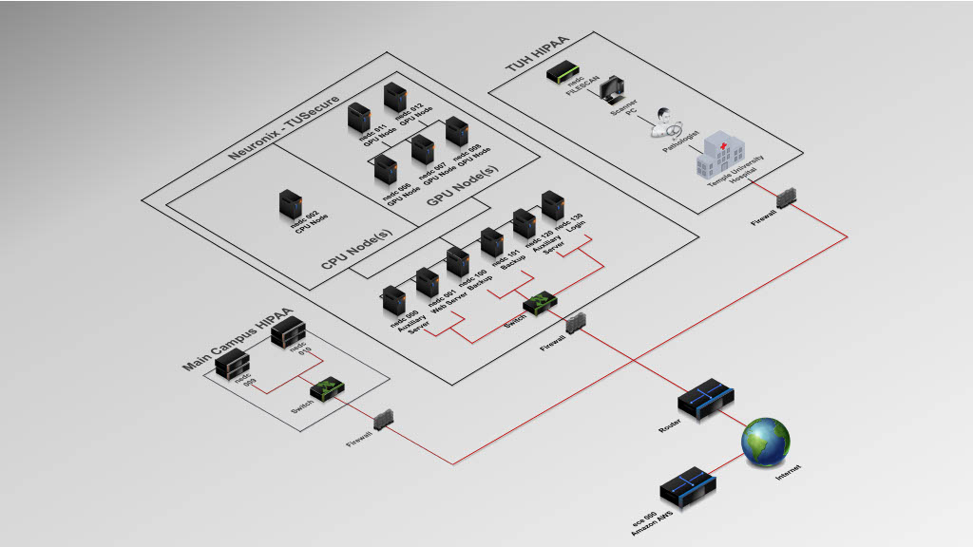
Lecture 07: How Do I Run
Large-Scale Computer Simulations?
Topics:
Data Centers
Clusters
Foreground/Background
Remote Job Submission
Job Management
I/O and Remote Filesystems
Resources:
Temple: The Neuronix Cluster
Wiki: Amazon AWS
Wiki: Slurm Workload Manager
Wiki: Network File System

Slide 2
Summary
Virtualization: most computing environments now use virtualized environments, which simply means any CPU in the cloud is capable of running any environment you configure. This makes it easy to expand and maintain hardware.
Cloud Computing: ece-000 is physically part of the Amazon cloud.
Small Clusters: these are still useful when there are unique computing needs such as big data or specialized hardware (GPUs).
Portability: most good software these days runs transparently on CPUs and GPUs (but often produces different results).
Job Management: since state of the art simulations can often use tens of thousands of processors, job management and load balancing software becomes crucial.
I/O and Memory: when data is stored on remote filesystems, I/O can become a huge bottleneck. Since GPUs have limited memory, writing software that efficiently moves data to/from a GPU to/from a remote filesystem becomes a huge programming (and algorithm) challenge.

