Slide 1
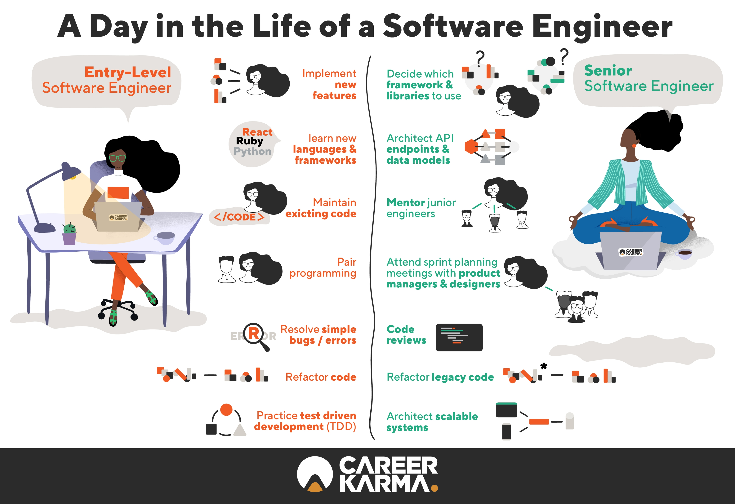

LECTURE 42: Jobs, Jobs, Jobs…
Topics:
Guest Speaker
Gaining Programming Experience
Job Interviews
Career Paths
Resources:
What is a software engineer?
Navigating your career path
Stack Overflow Survey

Slide 2
Summary
A software engineer applies mathematical analysis and the principles of computer science in order to design and develop computer software.
The software engineering market (2024) has definitely slowed due to the economy, but it is still as competitive as it has ever been because there is a shortage of experienced senior developers who can quickly bring applications to market.
Electrical and computer engineers often work on embedded systems.
Embedded Software Engineering is the process of controlling various devices and machines that are different from traditional computers, using software engineering. Integrating software engineering with non-computer devices leads to the formation of embedded systems. A typical embedded system requires a wide range of programming tools, microprocessors and operating systems. Embedded software engineering, performed by embedded software engineers, needs to be tailored to the needs of the hardware that it has to control and run on.
Updating your skills regularly is critical in a rapidly evolving field like software engineering. Look for jobs that provide training or allow you to develop code using leading-edge tools.
DevOps, Full-Stack Development and Real-time Operating Systems are just a few of the many opportunities that are in great demand.

