Slide 1
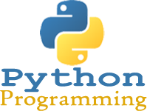
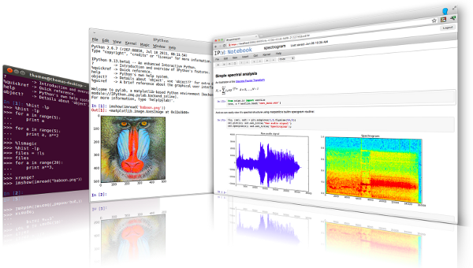
Lecture 36: Python – Data Structures and
Functional Programming
Topics:
Lists, Stacks, Queues
Tuples and Sequences
Sets and Dictionaries
Looping Revisited
List Comprehension
Functional Programming
Resources:
Python.org: Data Structures
TutorialsPoint: Data Structures
BogotoBogo: Map, Reduce, Filter
TutorialsPoint: Tutorial

Slide 2
Summary
Lists, Stacks, Queues, Tuples, Sets, Dictionaries: Python has a rich inventory of data structures that make programming much easier and faster.
Looping Revisited: We can loop over data structures in an abstract way, or explicitly by index or key.
List Comprehension: a functional programming tool that allows efficient implementation of iterative operations (e.g., iterating over a list and computing some function for each element)
Functional Programming: a programming paradigm where programs are constructed by applying and composing functions.

Slide 3
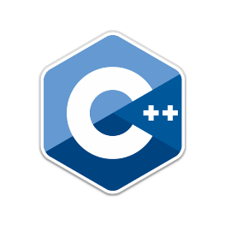
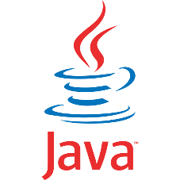












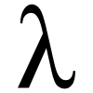


Programming Paradigms
Imperative
Object Oriented
Declarative
Functional
F#
Scheme

Slide 4
Why Should I Use Functional Programming?
Fewer Bugs
Code Simpler/More Maintainable Code
No Side Effects
Easy to Parallelize & Scale
Mathematically Provable
Its been around a while

Slide 5
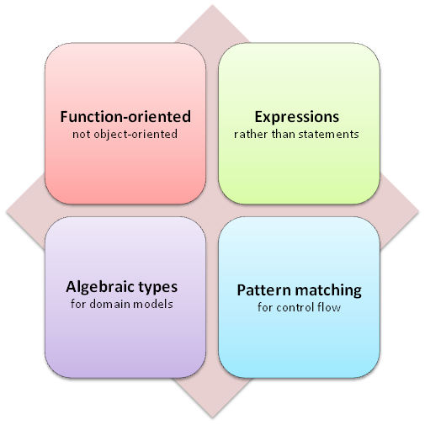
Functional Core Concepts

Slide 6
Terms to Know
Immutable Data
First Class Functions
Tail Call Optimization
Mapping
Reducing
Pipelining
Recursion
Currying
Higher Order Functions
Lazy Evaluation
Monad: “A Monad is just a monoid in the category of endofunctors, what’s the problem?

Slide 7
Functional Programming
a = 0
b = 2
sum = 0
def add():
global sum
sum = a + b
def add(a, b):
return a + b
No Side Effects
Side Effects
Notes:
Example of imperative programming having side effects

Slide 8
Higher Order Functions
What’s the difference between these?
x = np.random.rand(10,)
for i in range(len(x)):
y[i] = x[i] * 5
x = np.random.rand(10,)
y = map(lambda v : v * 5,
filter(lambda u : u % 2, x))
Imperative
Functional
Notes:
The map function takes as an input a functions,
The Lamda function is inlined called x

Slide 9
Higher Order Functions
x = np.random.rand(10,)
for i in range(len(x)):
if(x[i] % 2):
y[i] = x[i] * 5
else:
y[i] = x[i]
x = np.random.rand(10,)
y = map(lambda v : v * 5,
filter(lambda u : u % 2, x))
Functional
Imperative
Notes:
The map function takes as an input a functions,
The Lamda function is inlined called x

Slide 10
Higher Order Functions
x = np.random.rand(10,)
for i in range(len(x)):
if(x[i] % 2):
y[i] = x[i] * 5
else:
y[i] = x[i]
x = np.random.rand(10,)
y = map(lambda v : v * 5,
filter(lambda u : u % 2, x))
Functional
Imperative
Notes:
The map function takes as an input a functions,
The Lamda function is inlined called x

Slide 11
Higher Order Functions
import functools
x = [0, 1, 2, 3, 4]
ans = functools.reduce(lambda a, b: a + b, x)
x = [0, 1, 2, 3, 4]
sum(x)
Functional Python 3.5
Imperative
x = [0, 1, 2, 3, 4]
ans = reduce(lambda a, b: a + b, x)
Functional Python 2.5
Notes:
The map function takes as an input a functions,
The Lamda function is inlined called x

Slide 12
Tail Call Recursion
def factorial(n, r=1) :
if n <= 1 :
return r
else :
return factorial(n-1, n*r)
def factorial(n):
if n==0 :
return 1
else :
return n * factorial(n-1)
Optimized Tail Recursive
Tail Recursive
Notes:
Both implementations have an O(n) runtime
Tail Recursive will fail on factorial(999) because of RuntimeError: Maximum recursion depth exceeded
Optimized Tail recursive is essentially forced in Functional Languages like F#

Slide 13
Partial Functions
Consider a function f(a, b, c);
Maybe you want a function g(b, c) that’s equivalent to f(1, b, c);
This is called “partial function application”.
import functools
def log(message, subsystem):
"""Write the contents of 'message' to the specified subsystem."""
print('%s: %s' % (subsystem, message))
...
server_log = functools.partial(log, subsystem='server')
server_log('Unable to open socket')

Slide 14
What’s Next?

Slide 15
Functional Basics with F#

Slide 16
F# Syntax Cheat Sheets
http://dungpa.github.io/fsharp-cheatsheet/
http://www.samskivert.com/code/fsharp/fsharp-cheat-sheet.pdf
https://msdn.microsoft.com/en-us/library/dd233181.aspx
http://en.wikibooks.org/wiki/F_Sharp_Programming

Slide 17
History of F#
F#
OCaml
C#/.NET
Similar core language
Similar object model

Slide 18
Imperative vs. Functional
C#
F#
Imperative Functional

Slide 19
What does “functional” even mean?
Preferring immutability
  Avoid state changes, side effects, and mutable data as much as possible.
Using data in → data out transformations
  Try modeling your problem as a mapping of inputs to outputs.
  Everything is an expression! Too much |> ignore is often an anti-pattern
Treating functions as the unit of work, not objects
Looking at problems recursively
  Think of ways to model a problem as successively smaller chunks of the same problem
Notes:
Immutable by default.
Recursion is easier when you think about inputs and outputs.
Treating functions as the unit of work is easier without state.
These all work together.

Slide 20
Functional basics – Immutability
var x = 1;
let x = 1
let mutable x = 1
x<-2
x++
let y = x+1

Slide 21
Declarative Style
var vipCustomers = new List<Customer>();
foreach (var customer in customers)
{
if (customer.IsVip)
vipCustomers.Add(customer);
}
Imperative
Declarative
var vipCustomers = customers.Where(c => c.IsVip);

Slide 22
Functions
Add(x, y)
{
var z = x + y;
return z;
}
int Add(int x, int y)
{
var z = x + y;
return z;
}
int Add(int x, int y)
{
var z = x + y;
return z;
}
Add(x, y)
{
var z = x + y;
return z;
}
add(x, y)
{
var z = x + y;
return z;
}
add(x, y)
{
var z = x + y;
return z;
}
add x y
{
var z = x + y;
return z;
}
let add x y =
{
var z = x + y;
return z;
}
let add x y =
{
var z = x + y;
return z;
}
let add x y =
var z = x + y;
return z;
let add x y =
var z = x + y;
return z;
let add x y =
var z = x + y
return z
let add x y =
var z = x + y
return z
let add x y =
let z = x + y
return z
let add x y =
let z = x + y
return z
let add x y =
let z = x + y
z
let add x y =
let z = x + y
z
let add x y =
let z = x + y
z
let add x y =
x + y
int Add(int x, int y)
{
var z = x + y;
return z;
}
let add x y = x + y
int Add(int x, int y)
{
var z = x + y;
return z;
}
let and equals
int Add(int x, int y)
{
return x + y;
}
let instead of var
camel case
no parens and commas
no curly braces
no types
no return
no semi colons
Func<int,int,int>
int -> int -> int
In
Out
In
Out

Slide 23
Pipeline Operator
let filter (condition: int -> bool) (items: int list) = // …
let filteredNumbers = filter (fun n -> n > 1) numbers
let filteredNumbers = numbers |> filter (fun n -> n > 1)
let filteredNumbers = numbers
|> filter (fun n -> n > 1)
|> filter (fun n -> n < 3)

Slide 24
Currying
//normal version
let addTwoParameters x y =
x + y
//explicitly curried version
let addTwoParameters x = // only one parameter!
let subFunction y =
x + y // new function with one param
subFunction // return the subfunction
// now use it step by step
let x = 6
let y = 99
let intermediateFn = addTwoParameters x // return fn with
// x "baked in"
let result = intermediateFn y
// normal version
let result = addTwoParameters x y
val printTwoParameters : int -> (int -> unit)

Slide 25
Partial Application
let sum a b = a + b
let result = sum 1 2
Returns int = 3
let result = sum 1
Returns int -> int
let addOne = sum 1
Returns int -> int
let result = addOne 2
Returns int = 3
let result = addOne 3
Returns int = 4

Slide 26
Composition
let addOne a = a + 1
let addTwo a = a + 2
let addThree = addOne >> addTwo
let result = addThree 1
Returns int = 4

Slide 27

Functional basics: Higher-order functions
[1..10]
|> List.filter (fun x -> x % 2 = 0)
|> List.map (fun x -> x + 3)
|> List.sum
let sumEvensPlusThree =
Array.filter (fun x -> x % 2 = 0)
>> Array.map (fun x -> x + 3)
>> Array.sum
sumEvensPlusThree [|1..10|]
[|1.0;2.;3.;4.;5.;6.;7.;8.;9.;10.|]
|> Array.filter (fun x -> x % 2. = 0.)
|> Array.map (fun x -> x + 3.)
|> Array.sum
[|1..10|] |> sumEvensPlusThree
let plus_3 x = x + 3
let list_plus_3 = List.map plus_3
let filtered = List.filter (fun x -> x % 2 = 0)
[1..10]
|> filtered
|> list_plus_3
|> List.sum
Notes:
List & Array can use Seq. Pipelining & composition are similar.
Data in – data out transformations.
Think about inputs and outputs of functions → like our microservices.
Higher-order functions. These all are examples. Think about passing functions around instead of objects.
(SHOW CODE)
Add >> mult == mult(add(x)) ← create new slide.

Slide 28
Work with Higher Order Functions
What is the sum of the numbers 1 to 100, each squared?
What about the sum of just the even numbers?
Write a function that takes any list of floats and a function as an input.
  Add 10.25 to each element
  Divide each element by 4
  Finally act on the list with the function you sent in.
Notes:
Change last functions from (int -> int)
value
|> Int -> string
|> String -> bool

Slide 29
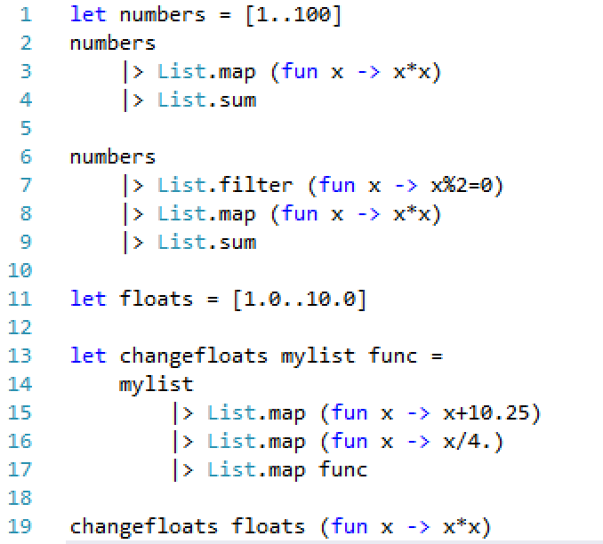
Higher-order functions: Answer

Slide 30
The Iterator and Disposable patterns in F#
F# provides the use keyword as an equivalent of C#’s using statement keyword (not to be confused with C#’s using directive keyword, whose F# equivalent is open)
In F#, seq is provided as a shorthand for IEnumerable
Your preference for collections should be (in descending order): list, array, seq

Slide 31
What is polymorphism?
Subtype polymorphism: when a data type is related to another by substitutability
Parametric polymorphism: when code is written without mention to any specific type (e.g., list of X type, array of X type)
Ad hoc polymorphism: when a function can be applied to arguments of different types
        Overloading (built-in and/or custom)
        Haskell: type classes
        F# specific feature: statically resolved type parameters

Slide 32
Continuation Passing Style (a.k.a. Callbacks)
“Hey, when you’re done doing that…”
Explicitly pass the next thing to do
Provides a method of composition of functions that can alter control flow
More common than you may realize (we’ll come back to this…)
Very common in Javascript as well

Slide 33
Blocking I/O and You – the reason for Async
The operating system schedules sequential operations to run in a thread
If code requires external I/O, the thread running that code will block until it is complete
This is bad

Slide 34
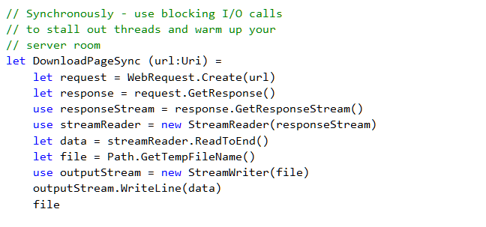
Example of a blocking operation

Slide 35

Your Web Server, Running Blocking I/O

Slide 36
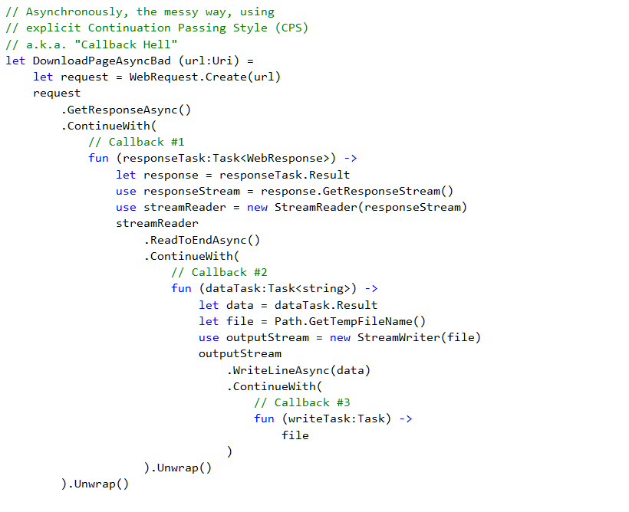
Continuation Passing Style (a.k.a. Callbacks)

Slide 37

Continuation Pas Style (a.k.a Callback Hell)

Slide 38
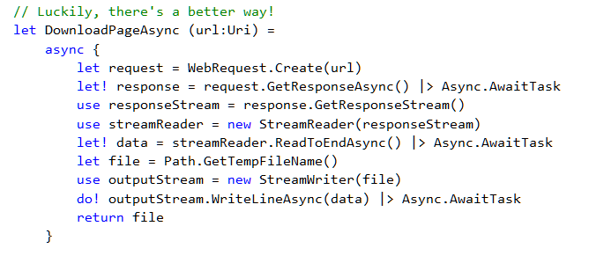
F# Async to the Rescue!

Slide 39


Slide 40
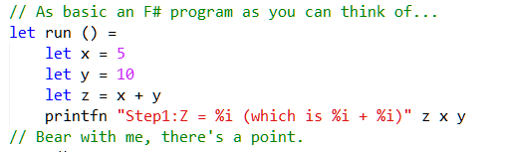
Let’s start from the beginning…

Slide 41
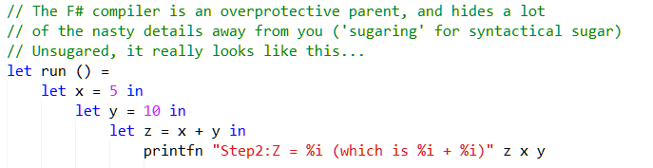
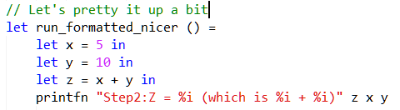
Let’s start from the beginning…

Slide 42
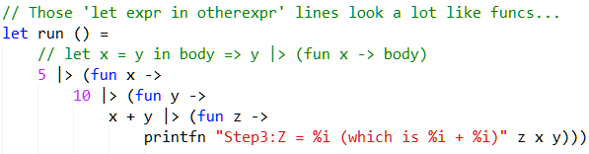
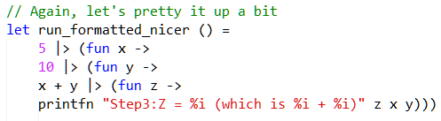
Let’s start from the beginning…

Slide 43
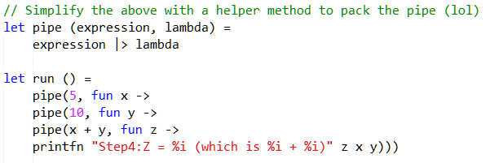
Let’s start from the beginning…
Hey, these look like callbacks!

Slide 44
Remember …

Slide 45
Additional libraries of interest
FsCheck: https://github.com/fsharp/FsCheck
Canopy: http://lefthandedgoat.github.io/canopy/
FAKE: http://fsharp.github.io/FAKE/
Paket: http://fsprojects.github.io/Paket/
Type Providers:
  Powershell: http://fsprojects.github.io/FSharp.Management/PowerShellProvider.html
  FSharp.Data: http://fsharp.github.io/FSharp.Data/
  FSharp.Configuration: http://fsprojects.github.io/FSharp.Configuration/

Slide 46
General resources
  Me!
  Team leads
  Slack - #fsharp channel
  F# chat on SO
  http://fsharp.org/
  Twitter: #fsharp
  F# channel on Functional Programming Slack
Additional reading
  F# for Fun and Profit
  F# Weekly
  Try F#
General Resources & Additional Readings

