Slide 1
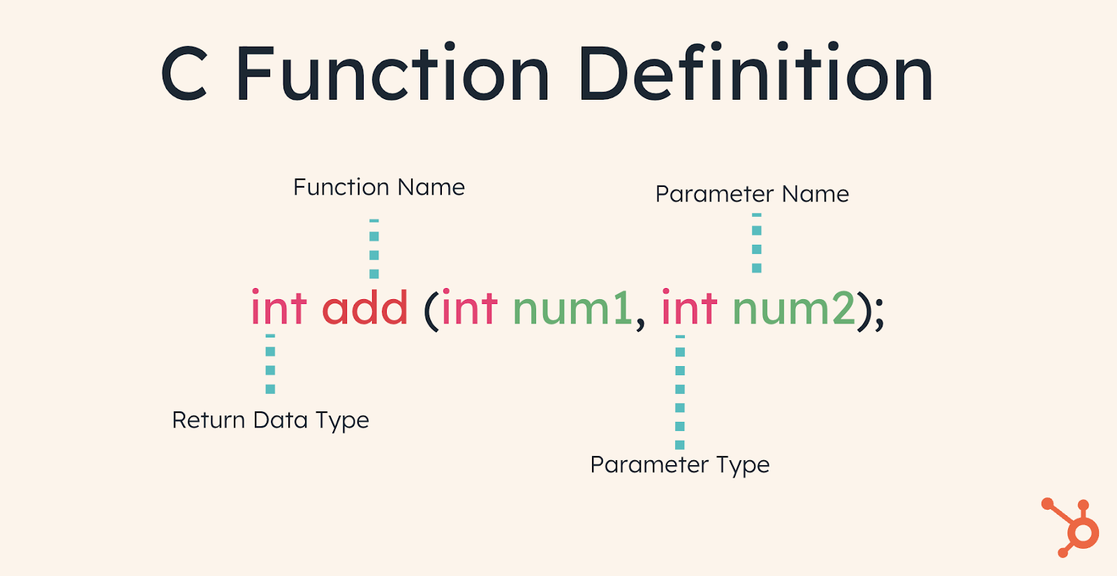
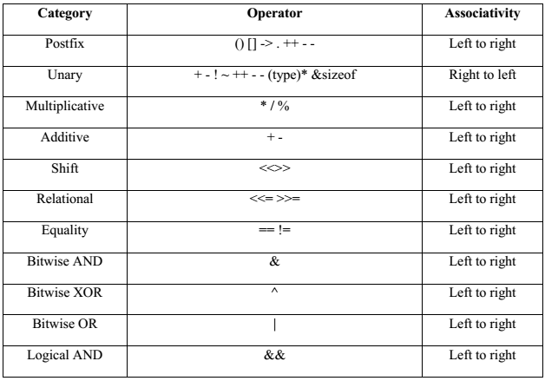
Lecture 16: C – Function Calls, Scope
and Operator Precedence
Topics:
Function Calls
Scope
C Operator Precedence
Logical Operators Revisited
Compound Expressions
Applications
Resources:
TutorialsPoint: C Functions
TutorialsPoint: Variable Scope in C
Wiki: Order of Operations
CPP: C Operator Precedence

Slide 2
Summary
Function Calls:
Prototype declaration in header file: float myfun(float, long);
Implementation in source code file: float myfun(float val1, long val2) {}
Key elements include a function name, arguments and a return value.
Functions can be overloaded (the same name, different arguments).
Scope:
Call By Value: value passed to function; argument in calling program doesn’t change value
Call By Reference: uses a pointer; the memory value pointed to by the argument in the main program can change value (to be discussed later).
C Operator Precedence: resolution of complex expressions requires a decision about which operators are to be interpreted first
(e.g., “a = b + c * d (e / f)”). This is part of the language definition and is referred to as operator precedence.
Logical Operators Revisited: logical operators are commonly used to test return values of functions and catch run-time errors.
Applications: open and read a file line by line with proper error checking.

