Slide 1

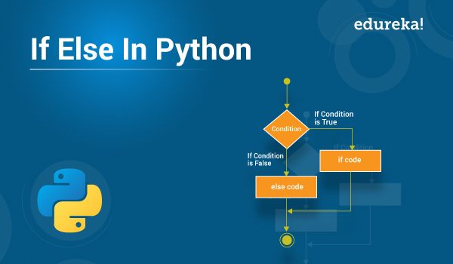
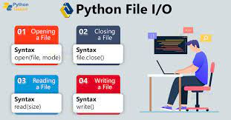
Lecture 06: Python – Loops, Conditionals and Text I/O
Topics:
String Manipulation
Loops
Conditionals
File I/O (Intro)
Command Line Arguments
Resources:
GeeksForGeeks: Strings
Python: Loops and Conditionals
TutorialsPoint: File I/O

Slide 2
Summary
String Operations: supports the usual types of string operations, such as split, join, strip, and index.
Remember to strip the newline character at the end of a line.
Conditionals: allows code to branch based on run-time behavior (e.g., exit if a file open fails).
Parentheses can be used to group expressions.
File I/O: supports ASCII, binary and an assortment of other file I/O modes. It emulates the way we access files in C/C++.
Reading files into a list is easily done with a one line piece of code, but such compactness can make code hard to debug and/or use lots of memory.
Be careful when reading files as text – Python inserts a lot of “intelligent” character processing that can fail if you don’t open a file with the proper character encoding system:
with open(filename, 'r', encoding='utf8') as f:
Command Line Arguments: are available in the list argv and can be manipulated as strings.
Sophisticated command line parsers do exist.
Completely analogous to argv[] in C/C++.

